Slide 1


INTRODUCTION
TO
DATA STRUCTURES
IN C++
A Quest Global Company

Slide 2
List of Topics to be covered
Data structures are the fundamental building blocks of computer programming. They define how data is organized, stored, and manipulated within a program.
An array is an example of a data structure, which allows multiple elements to be stored in a single variable.
Below are the topics:
Lists
Stacks
Queues

Slide 3

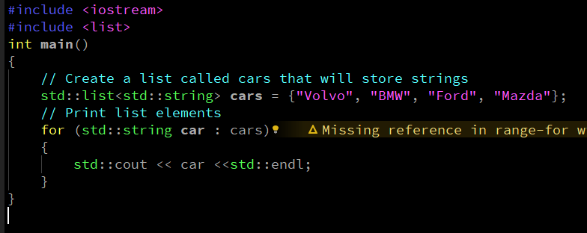
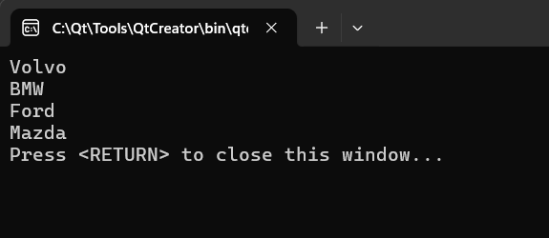
1. Lists
A list is a Data structure it can store multiple elements of the same type and dynamically grow.
we can add and remove elements from both the beginning and at the end of a list.
To create a list, use the list keyword, and specify the type of values it should store within angle brackets <> and
then the name of the list,
Syntax:
Example:-
output:-

Slide 4



2. Stacks
A Stack stores multiple elements in a specific order, called LIFO.
LIFO, which stands for Last In, First Out, is a data structure principle where elements are added and removed from the top.
To create a stack, use the stack keyword, and specify the type of values it should store within angle brackets <> and then the name of the stack.
Syntax:
Below are the operations performed in stacks:
Push(): The push() function is used to insert or ‘push’ an element at the top of stack container. This increases the size of stack container by 1.
Syntax:
Pop(): The pop() function to remove or ‘pop’ the element from the top of stack. As we are only inserting and removing from the top, the most recently inserted element will be removed first. This decreases the size of stack container by 1.
Syntax:

Slide 5



2. Stacks
empty(): The empty() method is used to check whether the stack is empty or not.
Syntax:
Returns true if the stack is empty.
Returns false if the stack is not empty.
size() : The size() method is used to find the number of elements in the stack container.
Syntax:
Returns the number of element present in the stack container.
If there are no elements in the stack, returns 0.
top(): This function is used to reference the top(or the newest) element of the stack.
Syntax:
Returns top of the element in the stack container.

Slide 6
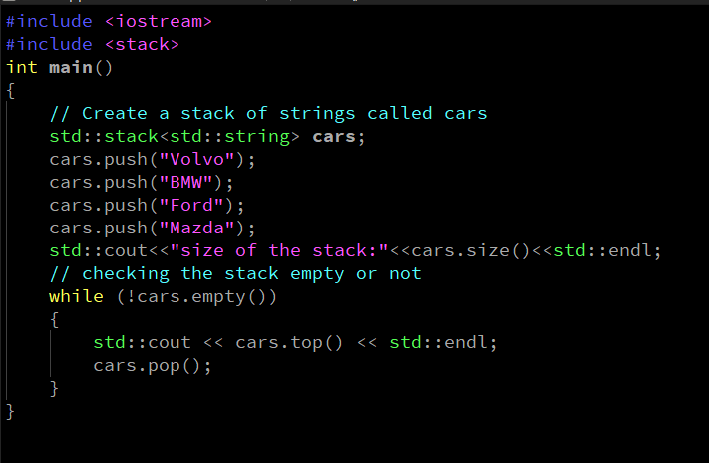
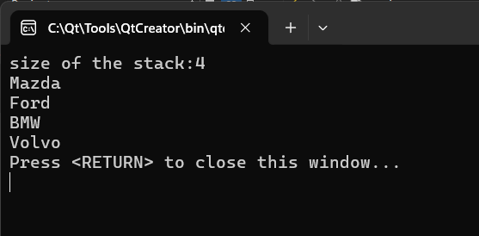
2. Stacks
Example:-
output:-

Slide 7



3. Queues
A Queue stores multiple elements in a specific order, called FIFO.
FIFO, which stands for First In, First Out, queue elements are added at the end and removed from the front, you can only access an element at the front or the back.
To create a queue, use the queue keyword, and specify the type of values it should store within angle brackets <> and then the name of the queue.
Syntax:
Below are the operations performed in stacks:
Push(): The push() function is used to insert an element at the back of the queue. This operation is called push operation hence the name push() method.
Syntax: Here val is parameter value to insert in queue.
Pop(): The pop() this function removes an element from the front of the queue.
It works according to the FIFO (First-In-First-Out) order of deletion. The element that was inserted first will be removed first.
Syntax:

Slide 8




3. Queues
empty(): The empty() function is used to check if the queue container is empty or not.
Syntax:
Returns true if the queue is empty.
Returns false if the queue is not empty.
size() : size() function is used to return the size of the list container which is the number of elements currently stored in the list container
Syntax:
Returns the number of element present in the container.
front(): This function can be used to fetch the first element of a queue.
Syntax:
Direct reference to the first element of the queue container.
back(): This function can be used to fetch the first element from the back of the queue.
Syntax:
Direct reference to the last element of the queue container

Slide 9
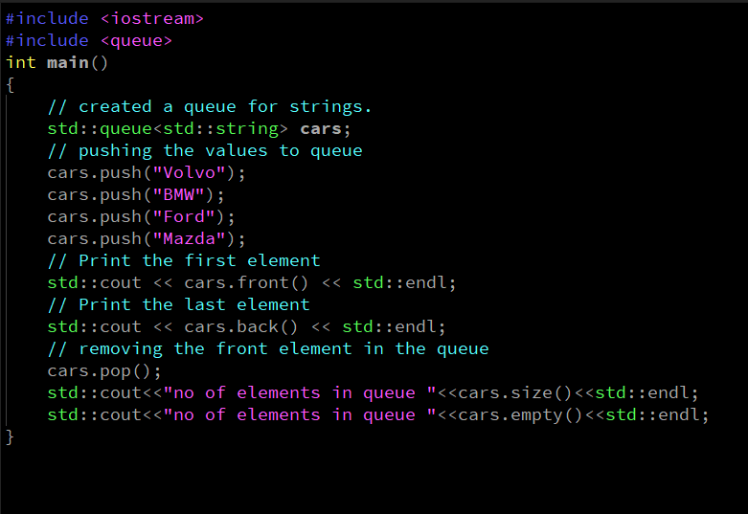
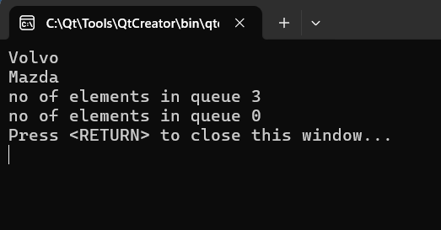
3. Queues
Example:-
output:-

Slide 10


Thank You

