Slide 1


T1910
Debugging techniques & Code testing
27/05/2025
A Quest Global Company

Slide 2
Agenda​
Key Learnings / Concepts Understand​​
Key Concepts with Definitions/ Code Snippet – Hands-on Practice​​
Challenges / Debugging Experience​​
Additional Learning Resources / Notes​​
Q&A​​
Plan for Tomorrow​​

Slide 3
Topics Covered Today
Unit test
Integration test
Code debugging

Slide 4
Key learnings/concepts understand
Unit tests check individual functions or classes in isolation.
Integration tests verify interactions between multiple components or systems.
Unit tests are fast and easy to maintain; integration tests are broader and slower.
Use frameworks like Google Test, Catch2 for writing C++ tests.
Debugging involves identifying and fixing bugs using tools like GDB or Visual Studio Debugger.
Breakpoints, step-by-step execution, and variable inspection are key debugging techniques.
Test-driven development (TDD) promotes writing tests before code for better design.

Slide 5
Unit Test
A unit test is a type of software test that focuses on verifying the correctness of a single unit of code, typically a function or method, in isolation from the rest of the system.
Characteristics of a Good Unit Test
Fast: Should run in milliseconds.
Isolated: Should not depend on external systems (like databases or file systems).
Repeatable: Always produces the same result under the same conditions.
Automatic: Should be easy to run repeatedly.
Advantages of Unit Testing
Catches issues in individual functions before they become bigger problems.
Forces developers to write cleaner, more modular, and testable code.
With tests in place, you can confidently change code without breaking functionality.
When a test fails, it's easier to locate the exact point of failure.
Fixing bugs during development is much cheaper than post-deployment.
Automated unit tests run on every change, ensuring stability.

Slide 6
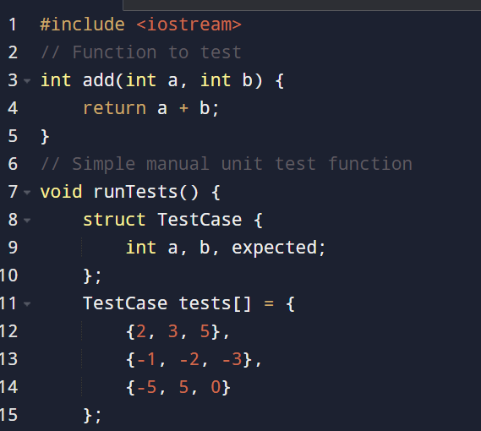
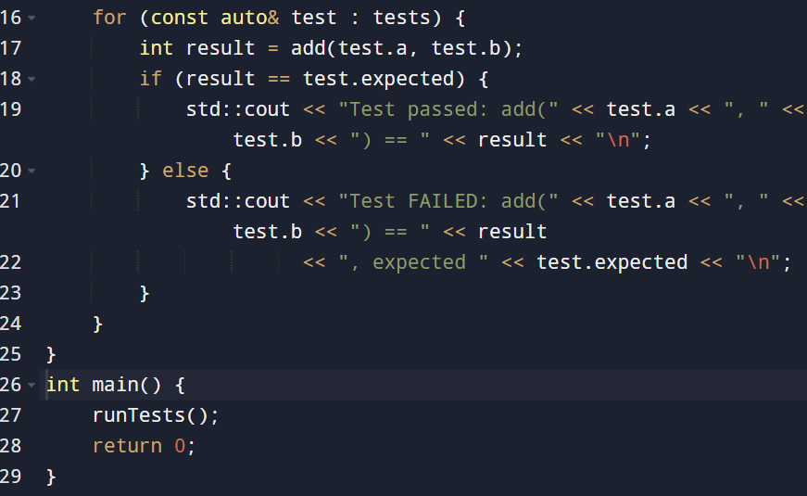
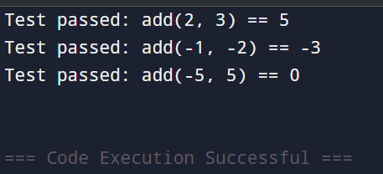
Unit Test
Part 1: part-2: output:

Slide 7
Integration Test
An integration test is a type of software test where multiple components or modules are combined and tested together to ensure they work correctly as a group.
It verifies data flow and interaction between units/modules that have already passed unit testing.
Characteristics
Tests multiple components together (e.g., function + database or API + UI).
Focuses on interface, communication, and data flow.
Detects incompatibility or miscommunication between modules.
Often uses real or simulated dependencies (e.g., mocks or stubs).
Slower than unit tests but more realistic.
Can be bottom-up, top-down, or big bang approach.
Advantages of Integration Testing
Ensures that connected parts of the system work together correctly.
Finds problems with APIs, data formats, and module assumptions.
Prevents bugs that only appear when components interact.
Test integration as new components are added.
Especially helpful in identifying logic or communication errors.

Slide 8
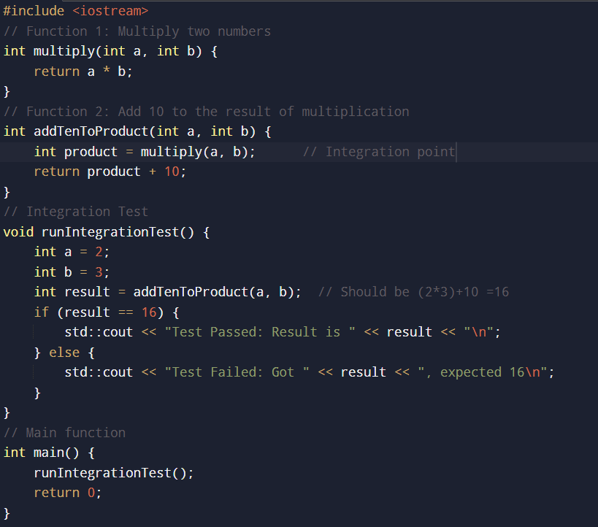
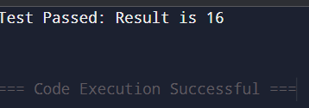
Integration Test
Example: output:

Slide 9
Unit Test vs Integration Test
Aspect | Unit Testing | Integration Testing
Purpose | Test individual components or functions in isolation | Test combined components/modules working together
Scope | Smallest testable parts of code | Interaction between multiple units
Focus | Logic correctness of single unit | Interfaces, data flow, and communication
Dependencies | Mocked or stubbed dependencies | Real or simulated dependent components
Speed | Fast | Slower than unit tests
Tools | Google Test, Catch2, etc. | Same tools but with broader setups
Complexity | Simple tests, limited scope | More complex, tests multiple components
When Run | Frequently during development | After unit tests, before system tests
Examples | Testing a function’s output | Testing database interaction with app logic

Slide 10
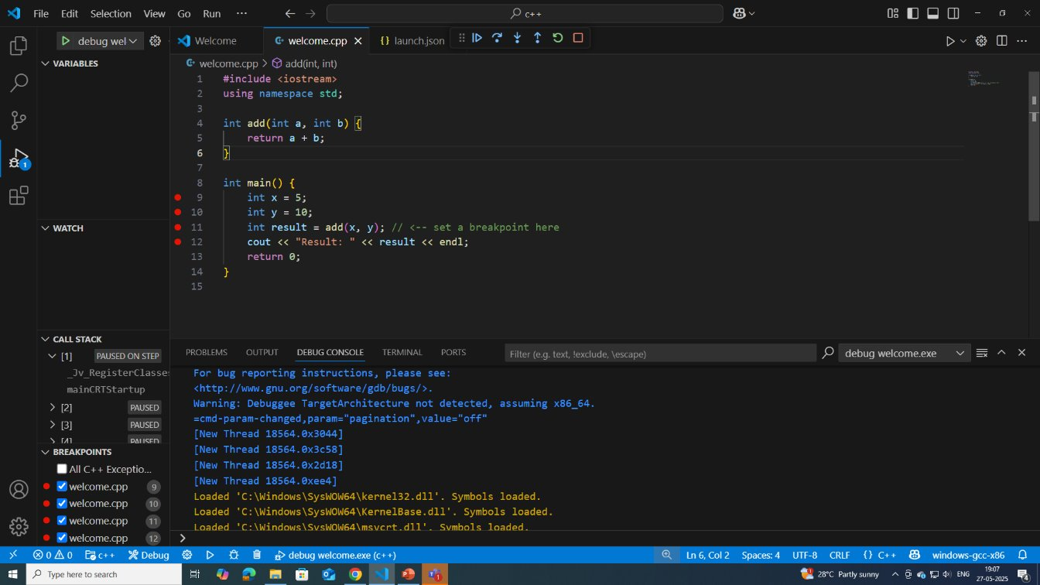
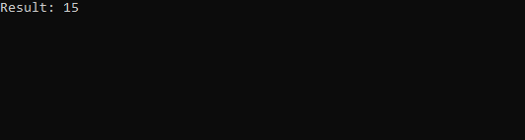
Code Debugging
Code debugging is the process of identifying, analyzing, and fixing bugs (errors or defects) in a software program to make it work correctly and efficiently.
It involves examining code behavior, finding the root cause of issues, and correcting them.
Example: output:

Slide 11
Challenges / Debugging Experience
Build configuration issues (Debug vs Release)
Code may work in debug builds but fail in optimized release builds due to undefined behavior or compiler optimizations.
Memory corruption
Overwriting memory outside buffer bounds, use-after-free, or writing to invalid memory addresses can cause unpredictable crashes.
Incorrect logic due to copy-paste errors
Repeated code with slight changes may have mistakes missed during review.
Mismatch between code and deployment environment
Bugs caused by wrong library versions, outdated dependencies, or misconfigured paths.
Incorrect use of time-related functions
Bugs caused by incorrect assumptions about timers, sleep, or asynchronous behavior.
Resource leaks (File handles, sockets, etc.)
Failing to close or release resources can exhaust system limits over time.

Slide 12
Additional Learning Resources / Notes
Official C++ Language and Standard Library References Authoritative sources for language specs and library details.
Beginner-Friendly Tutorials and Online Courses Step-by-step guides to help newcomers grasp C++ fundamentals.
Widely-Used C++ Testing Frameworks such as Google Test and Catch2 Tools to write and automate unit and integration tests efficiently.
Debugging Utilities including GDB, Visual Studio Debugger Powerful programs to inspect runtime behavior and memory issues.

Slide 13
Q&A
Q1: What is test-driven development (TDD)? A: A development approach where tests are written before the code, guiding the design and ensuring thorough testing.
Q2:How is integration testing different from unit testing? A: Unit testing tests components individually, while integration testing verifies interactions between them.
Q3: When should integration tests be performed? A: After unit tests, during the development of combined features or before system testing.
Q4: What is debugging? A: The process of finding and fixing errors or bugs in software.
Q5: Name common debugging techniques. A: Using breakpoints, printing logs, analyzing stack traces, and stepping through code.
Q6: What kinds of bugs are hard to debug? A: Intermittent bugs, race conditions, memory corruption, and environment-specific errors.

Slide 14
Plan for Tommorrow
Introduction to Threads
Thread Management
Thread Safety(Mutex ,Lock Guard)
Advanced Thread Management
Condition Variables
Deadlock

Slide 15
Overview
Unit testing involves verifying individual components or functions of a program in isolation to ensure they behave as expected. It helps catch bugs early and makes code maintenance easier.
Integration testing comes next, where multiple units or modules are combined and tested together to confirm they interact correctly and data flows properly between them.
This step uncovers issues that unit tests may miss, such as interface mismatches or communication errors.
Code debugging is the process of identifying, analyzing, and fixing errors in the program.
It often involves using tools like breakpoints, logging, and stepping through code to understand why bugs occur.
Effective debugging requires careful investigation, especially for complex issues like race conditions or intermittent errors.
Together, these practices ensure software reliability and quality throughout the development lifecycle.

Slide 16





Thank You
For More Quires, you can reach out to:

