Slide 1


T1911
Learning Document
A Quest Global Company
19/05/2025

Slide 2

Topics Covered Today
Gain proficiency in creating generic functions and classes using templates, including implementing template specialization and embedding templates within other templates.
Strengthen understanding by practically working with template instantiations and overloading operators in templated contexts.
Clearly distinguish between std::unique_ptr and std::shared_ptr, knowing their use cases and how to transition between them when necessary.
Enhance your skills in effective memory management by implementing and manipulating smart pointers in real code scenarios.

Slide 3
Templates in C++
Templates allow you to write generic and reusable code for different data types.
Template Classes
Template Functions
Template Specialization
Template Inside Another Template

Slide 4
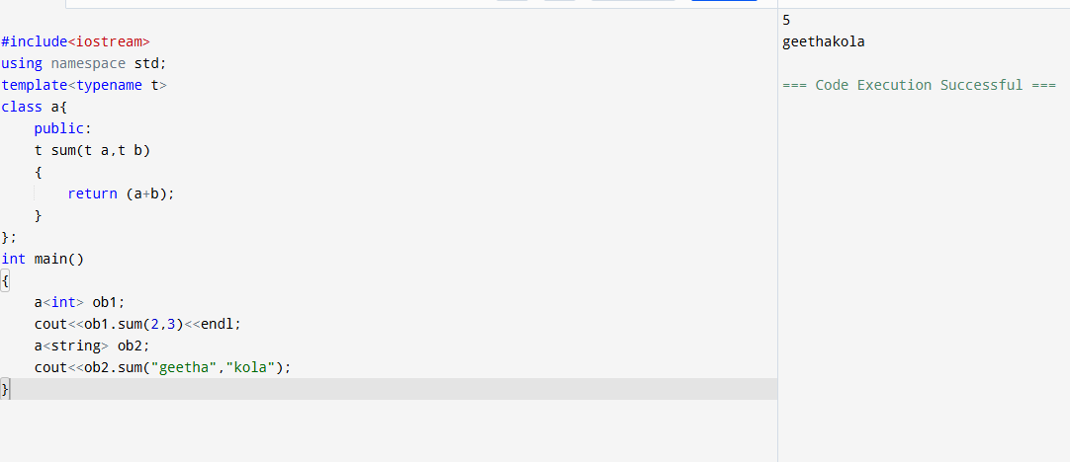
Template classes
Define data structures or components that work with any type (e.g., vector<T>).

Slide 5
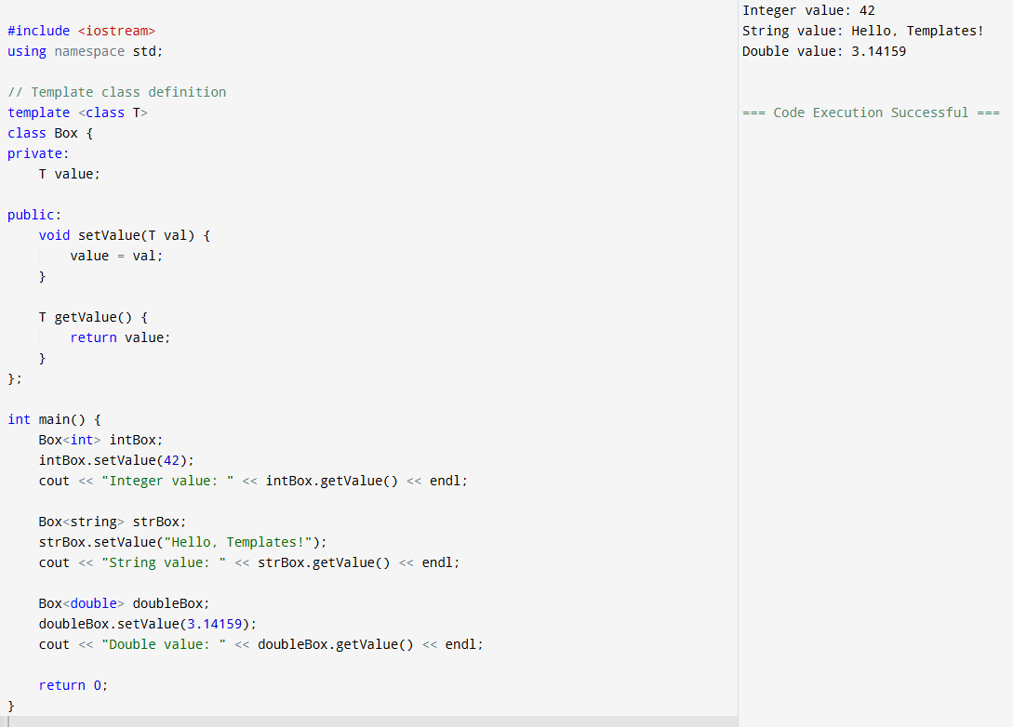
Template classes

Slide 6
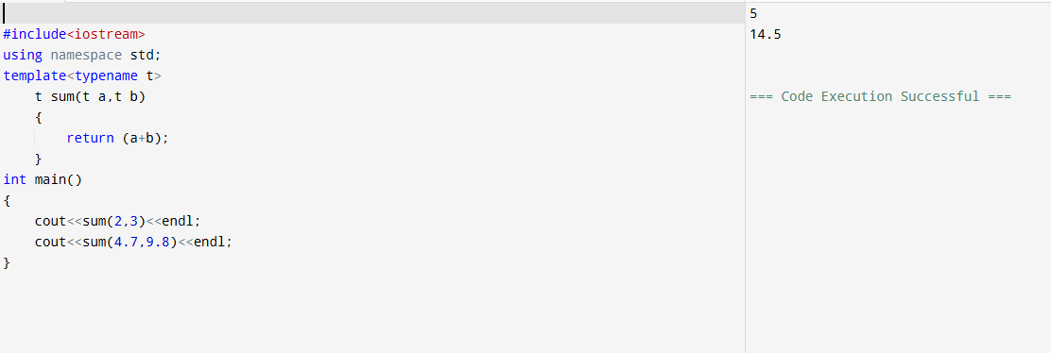
Template Function
Used when the logic is same, but data types vary.

Slide 7
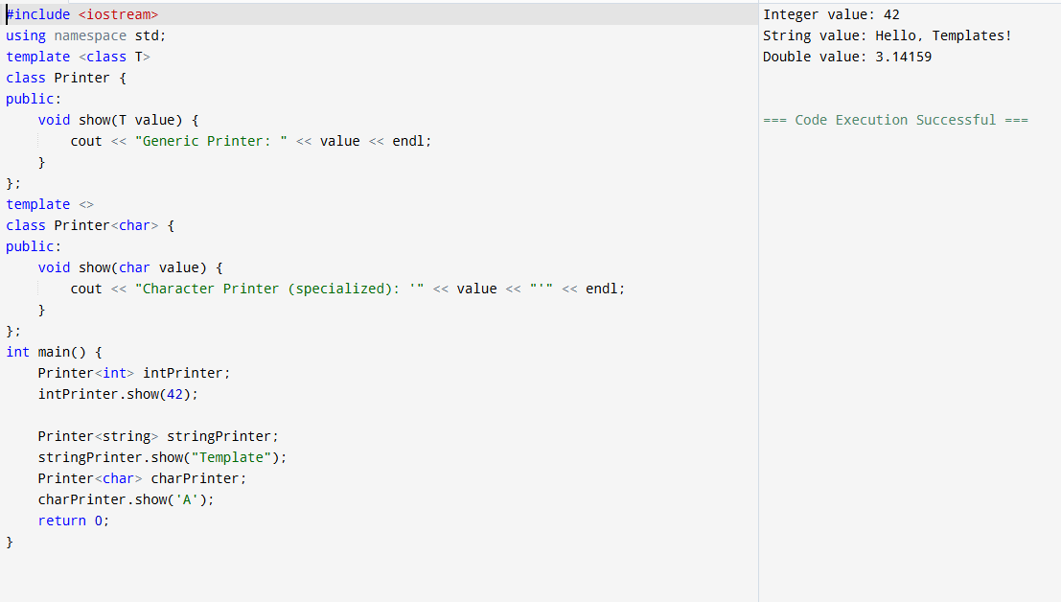
Template Specialization
You can customize behavior for a specific type.

Slide 8
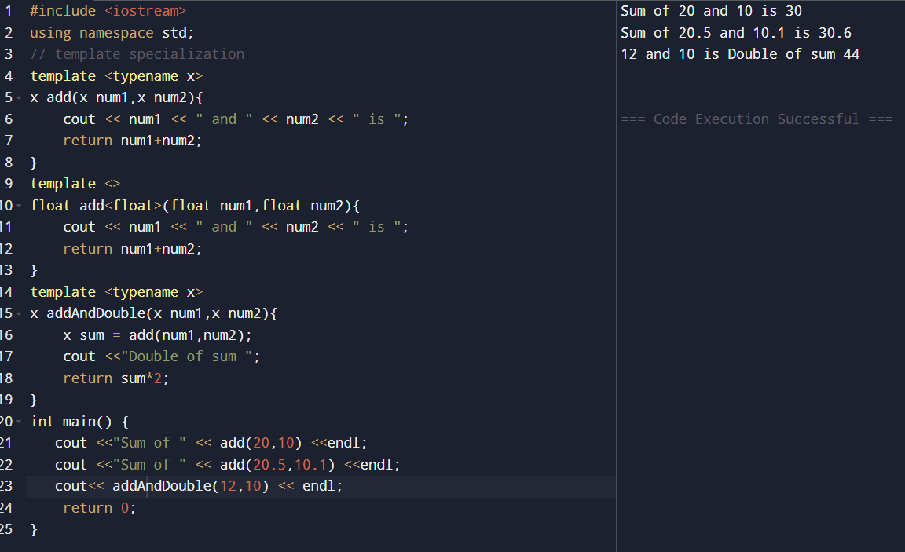
Template Inside Another Template
You can use one template inside another, either as: A template parameter & A member variable.

Slide 9
Smart pointers
A smart pointer is a class template provided by the C++ Standard Library that manages the lifetime of dynamically allocated objects. It automatically deallocates memory when it is no longer needed, preventing memory leaks and dangling pointers.
Smart pointers act like regular pointers but come with added ownership semantics and automatic resource management.
Types of Smart Pointers in C++:
std::unique_ptr – owns a resource exclusively.
std::shared_ptr – allows multiple pointers to share ownership of the same resource.
std::weak_ptr – observes shared_ptr without taking ownership (prevents circular reference).

Slide 10
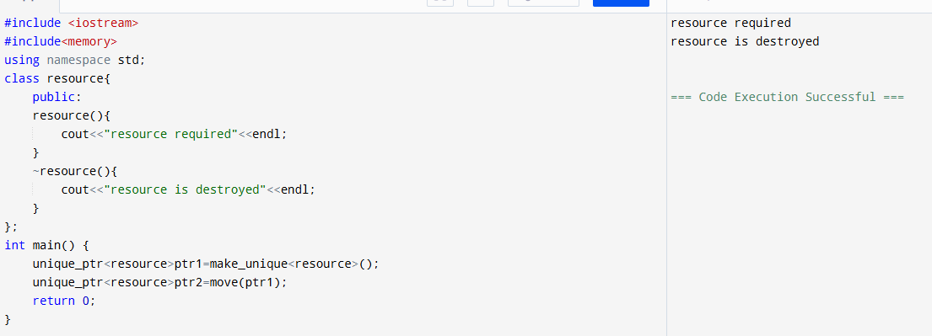
Unique_ptr

Slide 11
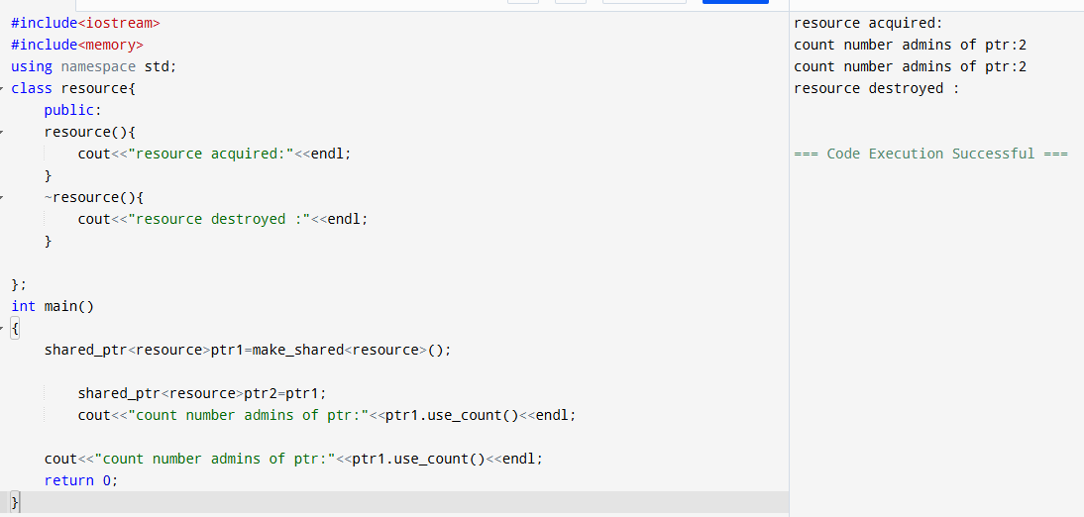
Shared_ptr

Slide 12
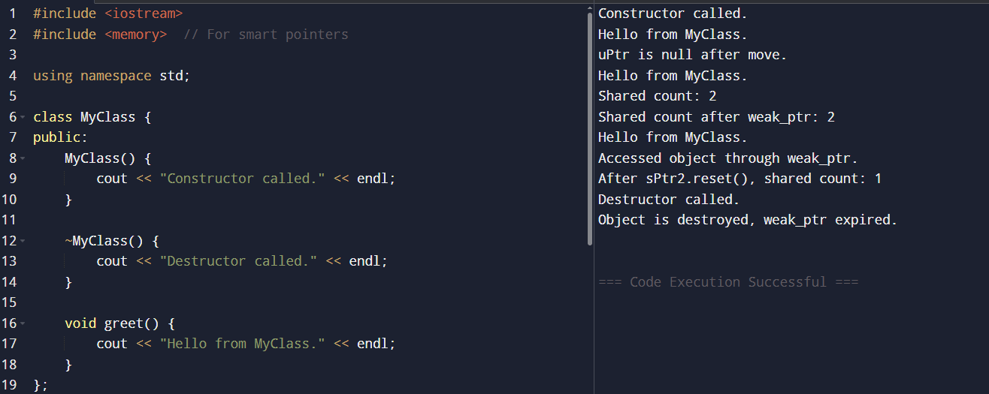
Typical conversion b/w unique_ptr, shared_ptr and weak_ptr

Slide 13
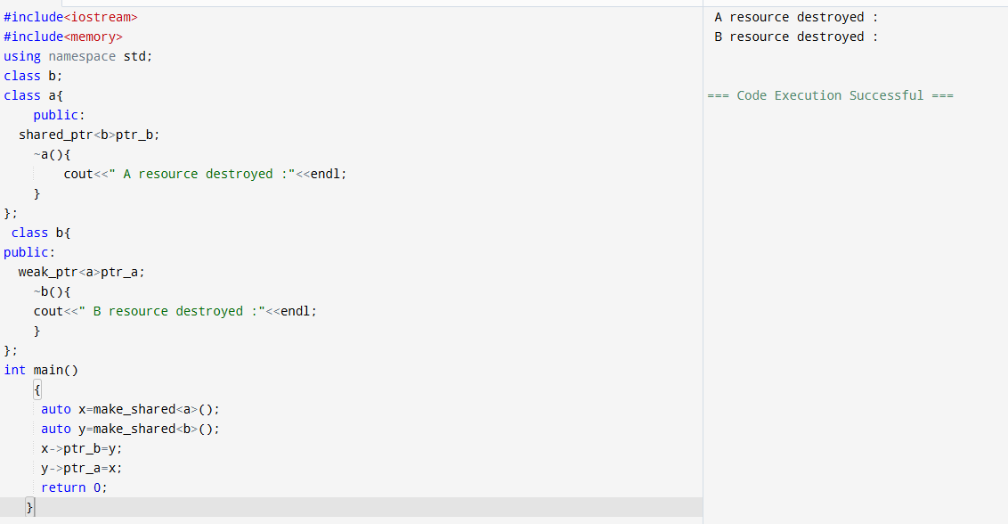

Slide 14
Challenges / Debugging Experience
Double Deletion (Raw Pointers vs Smart Pointers)
Problem: In manual memory management using raw pointers, forgetting to delete or deleting twice can cause undefined behavior. Smart Pointer Fix: Smart pointers automatically delete objects when no longer needed.
Accessing Null unique_ptr after move()
Problem: After using std::move, the original unique_ptr becomes null. Using it causes runtime errors. Fix: Always check with if (ptr) before accessing.
Problem: Assigning a unique_ptr without move() leads to compilation errors.

Slide 15
Additional Learning Resources / Notes
Online Tutorials and Articles
Refer to explanation-based articles with diagrams and code walkthroughs.
Learn the evolution of C++ (from C++98 to C++20) and when specific features were introduced.
Practice with code snippets that compare raw pointers vs smart pointers.
Look for articles that explain how templates are compiled and instantiated.
Online Practice Platforms
Practice template problems like generic max/min functions or custom smart pointers.
Solve memory-management challenges involving constructors, destructors, and smart pointers.
Try quiz-based C++ practice to test theoretical knowledge (e.g., what happens during copy/move).
Use problem sets that include creating data structures (like Stack or LinkedList) with templates.
Engage in hands-on projects (mini projects) using smart pointers for resource control.

Slide 16
Q&A
Q: Can you assign a shared_ptr to a unique_ptr?
A: No, unique_ptr cannot be copied. However, you can convert a unique_ptr to shared_ptr by moving.
Q: What happens when the last shared_ptr is destroyed?
A: The managed object is automatically deallocated and memory is freed.
Q: Can we assign nullptr to a smart pointer?
A: Yes, assigning nullptr resets the smart pointer and releases its ownership.
Q: What is the use of weak_ptr?
A: It avoids circular references by holding a non-owning reference to a shared_ptr.
Q: Does unique_ptr support copy constructor?
A: No, unique_ptr only supports move semantics, not copy.

Slide 17
Plan for Tomorrow
Using auto
range-based for loops
lambdas, constexpr
Tuples
strongly-typed enums.

