Slide 1


T1911
Learning Document
A Quest Global Company
21/05/2025

Slide 2

Topics Covered Today
Using auto
range-based for loops
Lambdas
Constexpr
tuples
strongly-typed enum

Slide 3
Topics Covered Today
1.Using auto: auto allows the compiler to deduce the type of a variable, simplifying code and reducing redundancy.
2. Range-Based For Loops: Range-based for loops make iterating over containers easier and more concise, but use auto& to modify the original elements.
3. Lambdas: Lambdas are anonymous functions that can capture variables from their surrounding scope, and the capture mode (by reference or value) should be carefully chosen.
4. constexpr: constexpr ensures that a function or variable is evaluated at compile-time, improving performance by avoiding runtime calculation.
5. Tuples: Tuples allow you to store multiple different types of values together in a single container, accessible using std::get.
6. Strongly-Typed Enum (enum class): enum class provides a scoped, type-safe enumeration that avoids implicit conversions to integers, requiring explicit casting when needed.

Slide 4
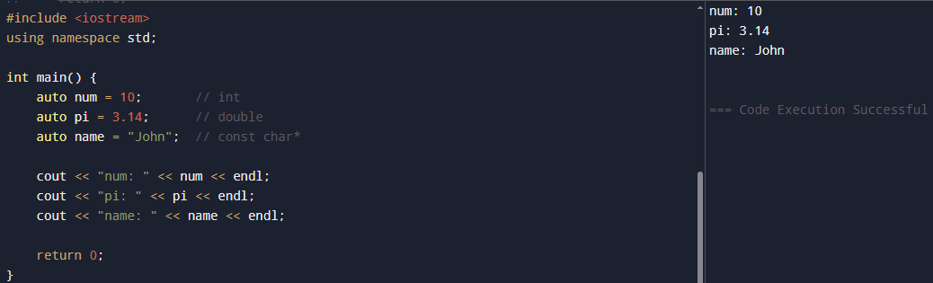
Using Auto in C++
Auto:
In C++, the auto keyword tells the compiler to automatically deduce the type of a variable from its initializer expression.Used for the data type is complex or verbose.You want cleaner and more readable code

Slide 5
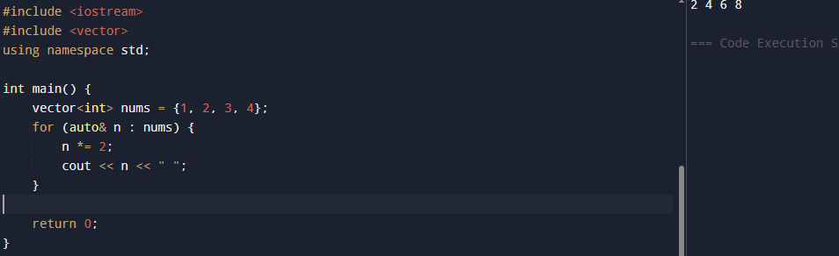
Range-based for loops
A range-based for loop is a modern and concise way to loop through each element in a container (like arrays, vectors, sets, etc.) without writing traditional loops with counters or iterators. It automatically handles the iteration, making the code cleaner, safer, and easier to read.

Slide 6
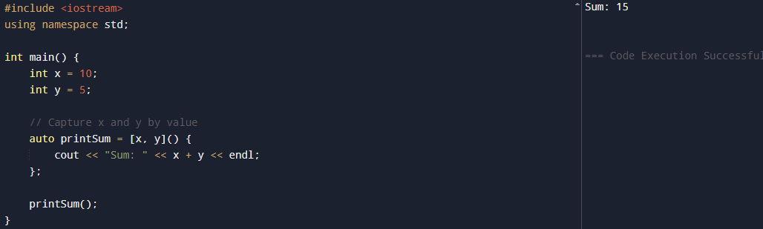
Lambdas
Lambdas are anonymous functions (closures) that can be defined inline and passed around as arguments or returned from other functions. They’re often used for short operations, like in algorithms.

Slide 7
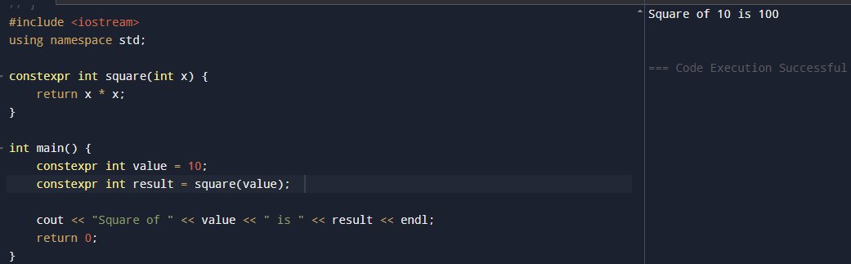
Constexpr
The constexpr keyword was introduced in C++11 and specifies that a function or variable can be evaluated at compile-time. This means the value of the variable or the result of the function call will be computed while compiling the code, rather than at runtime. This can lead to significant performance improvements because values that would normally need to be computed during program execution are instead calculated at compile-time.

Slide 8
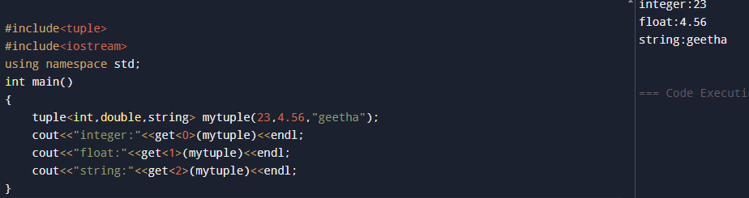
Tuples
A tuple is a fixed-size collection of elements, where each element can have a different data type. Unlike arrays or vectors, which are collections of elements of the same type, a tuple can store values of various types in a single object.

Slide 9
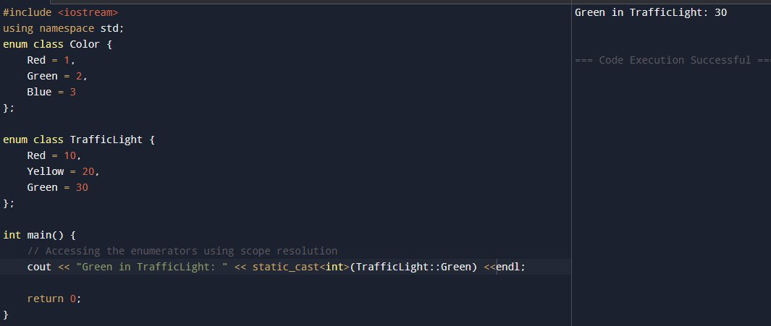
Strongly-Typed enum:
In traditional C++ enums, the values of an enum are essentially integers by default. This means they can be implicitly converted to other integer types (e.g., int, char), which can lead to bugs or unintended behavior.To address this, strongly-typed enums or enum classes were introduced in C++11. These provide better type safety, prevent implicit conversions, and make your code more robust.

Slide 10
Challenges / Debugging Experience
1.Auto Type Deduction Issues:
Problem: auto may not infer the type you expect, especially with complex types or pointers.
Solution: Use decltype to explicitly specify the desired type for better control.
2.Range-Based For Loop Modifications:
Problem: Without using auto&, modifications in a range-based for loop affect only local copies, not the original container.
Solution: Use auto& to ensure modifications affect the actual elements of the container.
3.Lambda Capture Errors:
Problem: Incorrect capture of variables by value vs. reference can lead to unexpected behavior (e.g., value captured by value is fixed when the lambda is created).
Solution: Be mindful of lambda captures, especially when using references (&) or values.
4.constexpr Limitations:
Problem: constexpr functions must be evaluated at compile-time, which means non-constexpr functions cannot be called inside them.
Solution: Ensure that only compile-time constant expressions are used inside constexpr functions.
5.Strongly-Typed Enum Conversions:
Problem: enum class does not allow implicit conversion to integers, which can cause issues in arithmetic or comparisons.
Solution: Explicitly cast enum class values to their underlying type using static_cast when needed.

Slide 11
Additional Learning Resources / Notes
Online Tutorials
Online Practice Platforms
You Tube classes
C++ Evolution and Features
Additional Resources
Online Tutorials and Articles

Slide 12
Q&A
What is the difference between auto and explicit type declarations in C++, and how does auto simplify type deduction in complex code?
auto automatically deduces the type of a variable, reducing verbosity and avoiding type mismatches, especially with complex or templated types.
2. How does a range-based for loop in C++ differ from a traditional for loop, and when should you use it for better code readability?
A range-based for loop iterates directly over elements of a container, making the code more concise and readable, without manually dealing with indices.
3. Explain how lambdas in C++ can be used with STL algorithms, and what are the benefits of capturing variables by reference versus by value in a lambda?
Lambdas allow inline function definition, and capturing by reference modifies the original variable, while capturing by value uses a copy of the variable, preserving its original value.
4. What are the limitations of constexpr in C++ and how does it enable compile-time evaluation? Provide an example where constexpr is useful.
constexpr functions must be evaluated at compile-time and can only contain a limited set of operations; it is useful for defining constant values like array sizes.

Slide 13
Plan for Tomorrow
NameSpace
Inline
Macros
Type casting

Slide 14
Overview
auto simplifies type declarations but needs careful attention for complex types.
Range-based for loops streamline iteration over collections, but use auto& for modifying original elements.
Lambdas offer inline function definitions with powerful capture mechanisms but require careful capture management.
constexpr allows compile-time evaluation but restricts the functions it can use.
Tuples allow storing multiple types in one container, but accessing elements requires extra effort.
Strongly-typed enums (enum class) improve type safety and prevent name collisions but require explicit casting for operations.

