Slide 1


T1911
Associative Containers
A Quest Global Company
10/06/2025

Slide 2
Agenda
Topics Covered Today
Key Learnings / Concepts Understood:
Key Concepts with Definitions/ Code Snippet – Hands-on Practice
Challenges / Debugging Experience
Tasks/Assignments Completed
Additional Learning Resources / Notes
Q&A
Plan for Tomorrow

Slide 3
Topics Covered Today
Associative Containers
Set
Multiset
Map
Multimap
Iterators

Slide 4
Key Learnings/Concepts Understood
Set stores only unique elements in sorted order automatically.
Multiset allows duplicate elements and keeps them sorted.
Map stores key-value pairs with unique keys, sorted by key.
Multimap supports duplicate keys, useful for mapping one key to multiple values.
All four containers (set, multiset, map, multimap) are based on balanced binary search trees (BST).
Use insert(), find(), and erase() methods to manipulate these containers.
Iterators are used to access and navigate elements inside STL containers like pointers.
Iterators with begin() and end() allow traversing containers using loops (e.g., for, while).

Slide 5
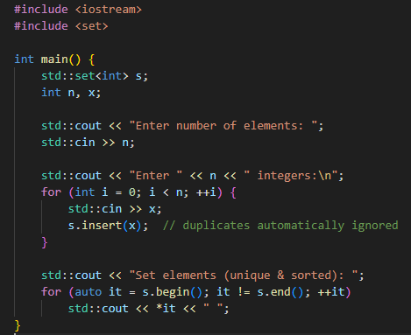

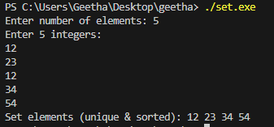
Key Concepts with Definitions/ Code Snippet – Hands –on Practice
Associative Containers
Set
Definition:
A set is an associative container that stores unique elements in sorted order.

Slide 6
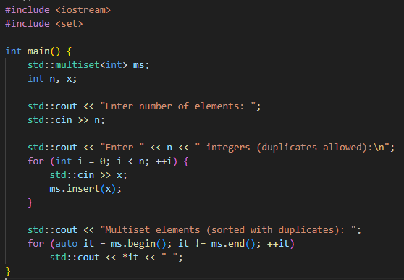
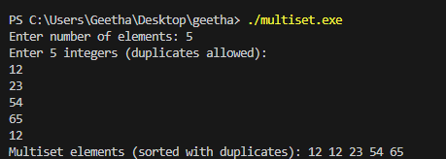
Multiset
Definition:
A multiset is similar to set but allows duplicate elements, also stored in sorted order.

Slide 7
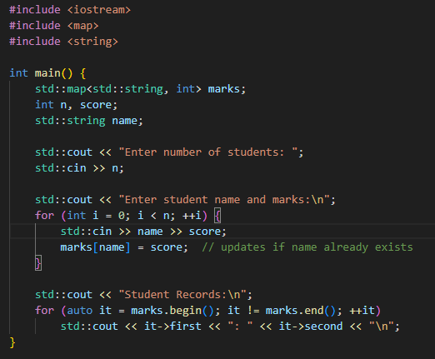
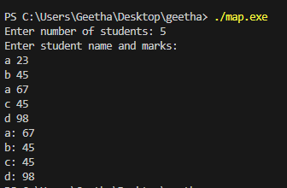
Map
Definition:
A map stores elements as key-value pairs with unique keys in sorted order based on the key.

Slide 8
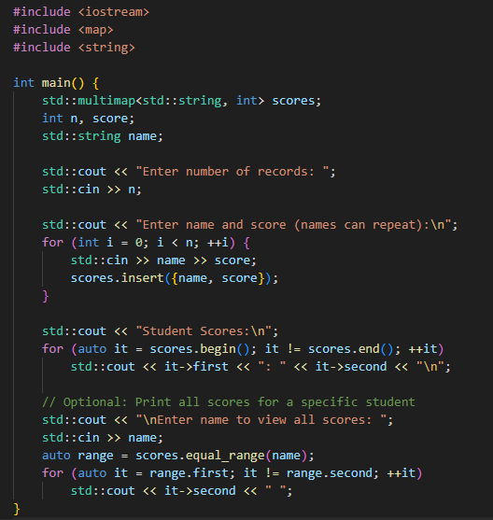
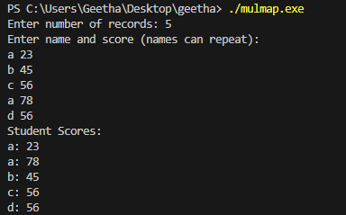
Multimap
Definition:
A multimap stores key-value pairs, allowing duplicate keys.

Slide 9
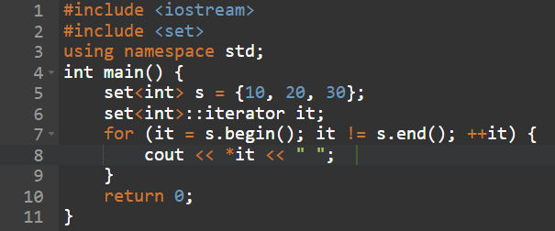

Iterators
Definition:
An iterator is an object (like a pointer) used to access and traverse elements of a container.

Slide 10
Challenges / Debugging Experience
Initially struggled with understanding how set automatically removes duplicates, which caused confusion when expected values didn't appear.
Faced difficulty in accessing values in map and multimap using iterators, especially remembering to use .first and .second for key-value pairs.
Encountered errors when trying to modify elements directly in a set, which is not allowed since the elements are immutable due to sorting constraints.
Debugged a logical issue where using [] operator on map unintentionally created default entries — learned to use .find() for safe checks.
Had trouble identifying why a multimap was showing multiple values for the same key — later understood that duplicates are allowed and must use equal_range() to access all.
Faced segmentation fault by using invalid iterators after erase() operation — learned to update the iterator correctly after erasing.
Spent time resolving compilation errors due to wrong iterator types when using auto vs. explicit iterator declarations.

Slide 11
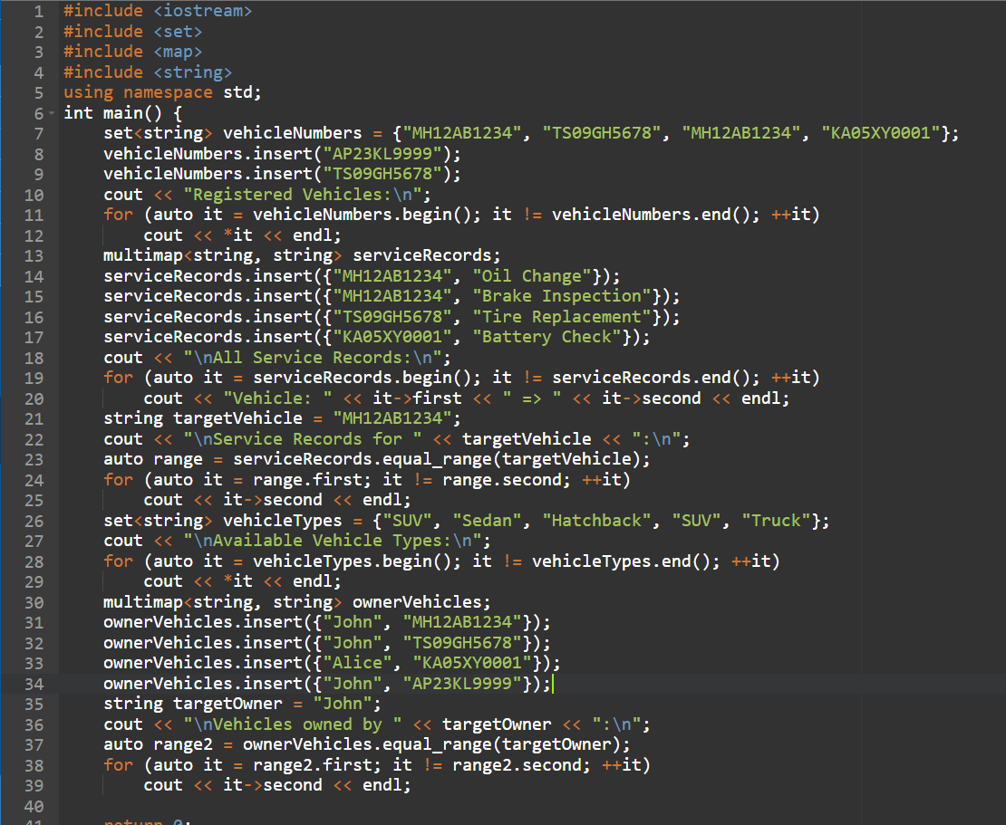
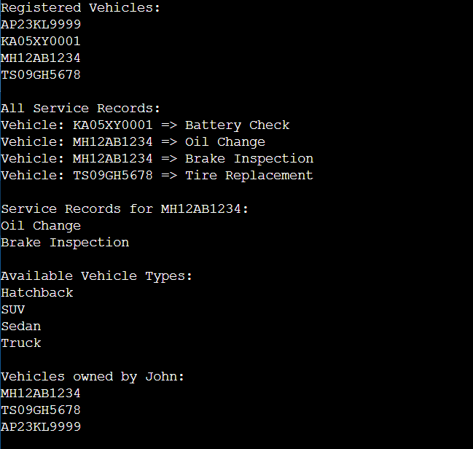
Tasks/Assignments Completed

Slide 12
Additional Learning Resources / Notes
GeeksforGeeks STL Tutorials – Useful for clear explanations and code examples on set, map, multiset, etc.
CppReference Documentation – Advanced-level official reference for STL containers and iterator behavior.
YouTube Channels like CodeBeauty or MyCodeSchool – Help with visual and real-world examples of STL usage.
LearnCpp.com STL Chapter – Beginner-friendly structured notes on each container and their functions.
Common Pitfall Note: Avoid modifying elements directly in set or map; erase and reinsert if changes are needed.
Use of auto keyword – Makes iterating cleaner, especially with complex types like map<int, string>::iterator.
STL Cheatsheets – One-page summaries of syntax, methods, and iterator usage are helpful for revision.
Practice through platforms like LeetCode or HackerRank – Solve problems using maps and sets to get hands-on experience.

Slide 13
Q&A
Q1: What does a set store? A: It stores unique elements in sorted order and automatically ignores duplicates.
Q2: What is the key feature of a multiset? A: It allows storing duplicate elements in sorted order.
Q3: What does a map store? A: It stores key-value pairs with unique keys, sorted by the key.
Q4: How is a multimap different from a map? A: A multimap allows duplicate keys, enabling multiple values for the same key.
Q5: What is an iterator used for in STL? A: It is used to traverse and access elements in containers like set, map, etc.
Q6: Can elements in a set or map be modified directly? A: No, because their internal structure relies on element ordering. You must erase and reinsert to modify.

Slide 14
Plan for Tomorrow
std::find
std::find_if
std::adjacent_find
std::count
std::count_if
std::equal
std::copy
std::fill
std::generate
std::transform
std::replace
std::remove_if
std::reverse
std::partition

Slide 15
Overall Overview
Understood the use of set to store unique elements in sorted order automatically.
Learned that multiset allows duplicate elements while maintaining sorted order.
Explored map, which stores key-value pairs with unique keys.
Studied multimap, which supports duplicate keys allowing multiple values per key.
All four containers (set, multiset, map, multimap) use Red-Black Trees internally for balanced and efficient operations.
Practiced inserting, accessing, and erasing elements in all containers using STL methods.
Gained a clear understanding of iterators to navigate and manipulate elements in STL containers.
Identified common debugging challenges, such as modifying set/map elements, and learned best practices for safe container usage.

Slide 16


Thank You

