Slide 1


T1911
Merge, Heap, Min, Max Algorithms
A Quest Global Company
12/06/2025

Slide 2
Agenda
Topics Covered Today
Key Learnings / Concepts Understood:
Key Concepts with Definitions/ Code Snippet – Hands-on Practice
Challenges / Debugging Experience
Tasks/Assignments Completed
Additional Learning Resources / Notes
Q&A
Plan for Tomorrow

Slide 3
Topics Covered Today
merge
inplace_merge
set_union
set_intersection
min_element
max_element

Slide 4
Key Learnings/Concepts Understood
std::merge combines two sorted input ranges into one sorted output, keeping all elements including duplicates.
std::inplace_merge efficiently merges two adjacent sorted ranges in the same container with minimal extra memory.
std::set_union outputs a sorted sequence of all elements from both ranges, automatically removing duplicates.
std::set_intersection returns a sorted range of elements that are common to both sorted input ranges.
std::min_element scans the range to find and return an iterator pointing to the smallest element.
std::max_element finds the largest element in a container and returns an iterator to it.
These STL algorithms operate on containers like vector, list, and array using standard iterators.
Sorted input is essential for correct results in merge and set-based algorithms like set_union and set_intersection.
STL algorithms simplify code, improve readability, and reduce the need for manual loops and error-prone logic.

Slide 5
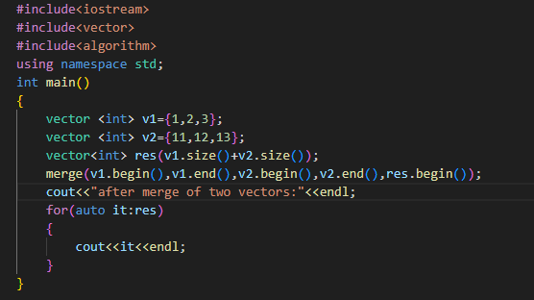

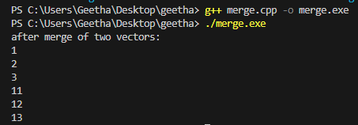
Key Concepts with Definitions/ Code Snippet – Hands –on Practice
merge
Definition:
Merges two sorted ranges into one sorted range, including all elements (duplicates allowed).

Slide 6
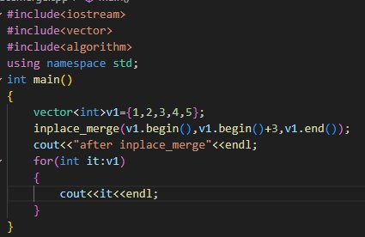
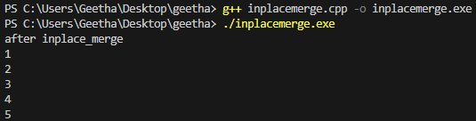
Key Concepts with Definitions/ Code Snippet – Hands –on Practice
inplace_merge
Definition:
std::inplace_merge merges two adjacent sorted subranges in a single container into one fully sorted range — in-place, meaning it uses minimal additional memory.
Syntax : std::inplace_merge(first, middle, last);
Efficient for merging sorted parts of a container (during a custom merge sort).Requires the range to be adjacent in memory.
Time complexity: O(N log N) (though faster in practice with partially sorted data).

Slide 7
Key Concepts with Definitions/ Code Snippet – Hands –on Practice
inplace_merge
Definition:
std::inplace_merge merges two adjacent sorted subranges in a single container into one fully sorted range — in-place, meaning it uses minimal additional memory.

Slide 8
Key Concepts with Definitions/ Code Snippet – Hands –on Practice
inplace_merge
Definition:
std::inplace_merge merges two adjacent sorted subranges in a single container into one fully sorted range — in-place, meaning it uses minimal additional memory.

Slide 9
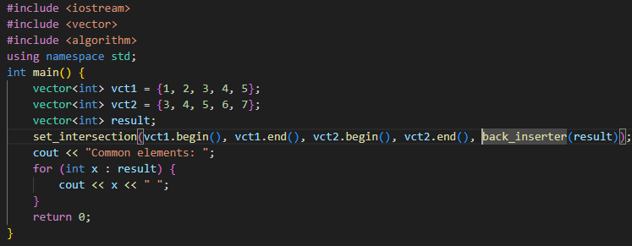

Key Concepts with Definitions/ Code Snippet – Hands –on Practice
Set_intersection
Definition:
std::set_intersection is an STL algorithm that finds common elements between two sorted ranges (like two sets or vectors), and writes them to a new container or output iterator.
Use Cases:
Find users/items common in two lists
Common keywords between documents
Matching records in sorted datasets

Slide 10
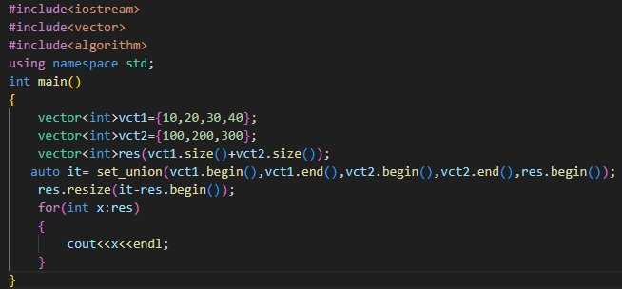
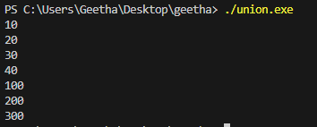
Key Concepts with Definitions/ Code Snippet – Hands –on Practice
set_union
Definition:
std::set_union is a C++ STL algorithm that combines two sorted ranges and returns a new sorted range containing all unique elements from both.
Syntax: std::set_union(first1, last1, first2, last2, result);
Use Cases:
Combining two sorted lists with no duplicates
Merging search results or user data
Set operations in algorithms or data processing

Slide 11
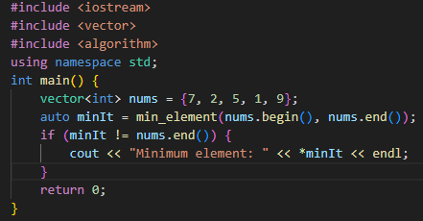

Key Concepts with Definitions/ Code Snippet – Hands –on Practice
min_element
Definition:
std::min_element is a C++ STL algorithm used to find the smallest element in a given range. It returns an iterator pointing to the minimum value in the container.
Syntax: std::min_element(first, last);
std::min_element(first, last, comp); // with custom comparator
Use Cases:
Finding the smallest number in a dataset
Selecting the minimum based on a custom condition (e.g., lowest price, shortest duration)

Slide 12
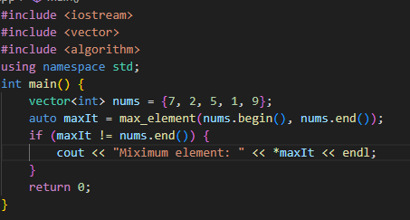

Key Concepts with Definitions/ Code Snippet – Hands –on Practice
max_element
Definition:
std::max_element is a C++ STL algorithm used to find the largest (greatest) element in a given range. It returns an iterator pointing to the maximum value in the container.
Syntax: std::max_element(first, last);
std::max_element(first, last, comp); // with custom comparator
Use Cases:
Finding the highest score, price, or value in a dataset
Custom sorting (e.g., longest string, oldest person)

Slide 13
Algorithm | Purpose | Input Requirement | Output Contains | Duplicates Kept? | In-place?
std::merge | Merge two sorted ranges | Sorted ranges | Merged sorted range | Yes | No
std::inplace_merge | Merge adjacent sorted subranges | Sorted subranges | Sorted entire range | Yes | Yes
std::set_union | Union of two sorted ranges | Sorted ranges | Unique sorted elements | No (removed) | No
std::set_intersection | Common elements of two sorted ranges | Sorted ranges | Common sorted elements | Yes (if common) | No
std::min_element | Find smallest element in range | Any range | Smallest element | — | —
std::max_element | Find largest element in range | Any range | Largest element | — | —

Slide 14
Challenges / Debugging Experience
Forgot to use std::sort before calling std::set_difference, which gave completely incorrect results.
Misunderstood that std::unique only removes consecutive duplicates, so failing to sort first led to partial deduplication.
Used std::back_inserter with an uninitialized vector, resulting in segmentation faults.
Assumed std::lower_bound returns -1 when element not found—instead it returns end(), causing logic errors.
Passed std::vector::iterator to functions expecting std::list::iterator, leading to type mismatch compilation errors.
Expected std::set to maintain insertion order instead of sorted order—misinterpretation caused debugging confusion.
Attempted to modify elements through a std::set iterator, forgetting that its elements are immutable.
Misused std::accumulate on a range of strings without setting the initial value to "", leading to unexpected type errors.
Used std::copy with overlapping ranges without realizing it results in undefined behavior (should use std::copy_backward).
Accidentally shadowed a container name in a lambda capture, causing mysterious compiler or runtime bugs.

Slide 15
Additional Learning Resources / Notes
Resources
C++ Reference: cppreference.com for detailed algorithm documentation.
Book: “The C++ Standard Library” by Nicolai Josuttis for in-depth algorithm explanations.
Tutorials: CPlusPlus.com and GeeksforGeeks for practical examples.
Online Platforms: LeetCode, HackerRank for algorithm practice.
Notes:
Always check iterator validity after modifying containers.
Use const containers for non-modifying algorithms to ensure safety.
Combine algorithms (e.g., find_if with transform) for complex tasks.
Prefer standard algorithms over manual loops for readability and optimization.

Slide 16
Q&A
Q1: When should you use std::merge instead of std::set_union?
A: Use std::merge when you want to combine two sorted ranges including all elements (with duplicates). Use std::set_union when you want only unique elements in the result.
Q2: What condition must the input ranges satisfy for std::merge and std::inplace_merge to work correctly?
A: The input ranges must be sorted in the same order (e.g., ascending) before applying these algorithms.
Q3: How is std::inplace_merge different from std::merge?
A: std::inplace_merge merges two adjacent sorted subranges within the same container, in-place. std::merge merges two separate ranges and outputs the result elsewhere.
Q4: What does std::set_intersection return?
A: It returns a sorted range containing only elements that are common to both input sorted ranges.
Q5: How can you find the minimum and maximum elements in an unsorted dataset using STL?
A: Use std::min_element to get an iterator to the smallest element, and std::max_element for the largest.
Q6: What kind of data can be passed to std::min_element and std::max_element?
A: Any forward iterable container like std::vector, std::list, or array, as long as it supports iterator access.

Slide 17
Plan for Tomorrow
Basic concepts and importance of algorithms
Time and space complexity (Big O notation)

Slide 18
Overall Overview
Practiced using std::set_difference, std::unique, std::lower_bound, and std::upper_bound to manipulate sorted ranges.
Understood how std::unique works only on consecutive duplicates, emphasizing the importance of sorting before deduplication.
Learned the difference between binary search tools like lower_bound, upper_bound, and equal_range.
Applied std::accumulate and std::for_each to efficiently process container data without manual loops.
Discovered how std::copy and std::copy_backward behave differently when handling overlapping ranges.
Used std::reverse, std::rotate, and std::next_permutation to manipulate sequences in-place.
Observed the immutability of elements in associative containers like std::set and std::map, which affects modification strategies.
Gained experience in choosing between vectors, lists, sets, and maps based on insertion, search, and iteration performance.

Slide 19


Thank You

