Slide 1


T1911
Learning Document
11/06/2025
A Quest Global Company

Slide 2
Agenda
Topics Covered Today
Key Learnings / Concepts Understood:
Key Concepts with Definitions/ Code Snippet – Hands-on Practice
Challenges / Debugging Experience
Tasks/Assignments Completed
Additional Learning Resources / Notes
Q&A
Plan for Tomorrow

Slide 3
List of Topics to be covered
Non-Modifying Algorithms:
std::for_each
std::find
std::find_if
std::adjacent_find
std::count
std::count_if
std::equal

Slide 4
List of Topics to be covered
Modifying Algorithms:
std::copy
std::fill
std::generate
std::transform
std::replace
std::remove_if
std::reverse
std::partition

Slide 5
Key Learnings/Concepts Understood
Non-Modifying Algorithms Definition, Purpose and Example
Modifying Algorithms Definition, Purpose and Example

Slide 6
Non-Modifying Vs Modifying Algorithms
Non-Modifying Algorithms:
Non-modifying algorithms operate on containers like vectors and arrays without changing their contents; they are primarily used for inspecting, searching, or counting elements efficiently.
Examples: std::for_each, std::find, std::find_if, std::adjacent_find, std::count, std::count_if, std::equal.
Modifying Algorithms:
Modifying algorithms actively change the contents of containers by altering elements, reordering them, or removing/adding elements to update or transform the data.
Examples: std::copy, std::fill, std::generate, std::transform, std::replace, std::remove_if, std::reverse, std::partition.

Slide 7
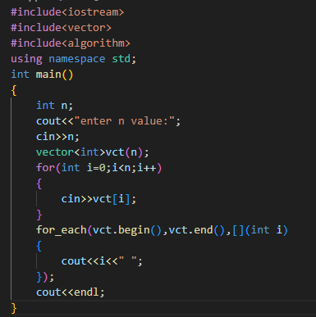

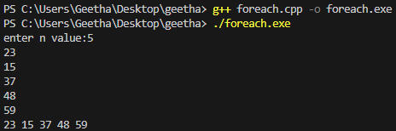
std::for_each
1. std::for_each
Definition: Applies a function to each element in a range [first, last).
Use Case: Useful for read-only operations like printing elements, computing statistics, or applying a side-effect operation.
Real-World Example: Logging user activities in a system.

Slide 8
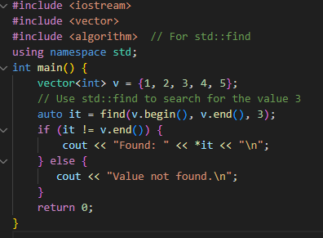

std::find
2. std::find
Definition: Searches for the first occurrence of a value in a range.
Use Case: Ideal for searching for a known value in a collection.
Real-World Example: Checking if a user ID exists in a list of registered users.

Slide 9
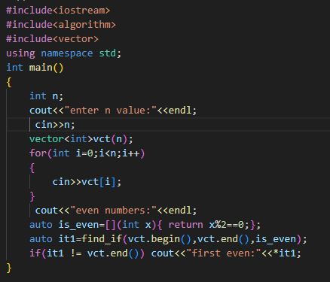
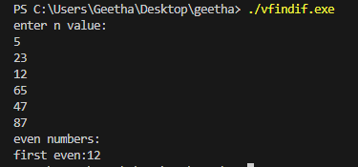
std::find_if
3. std::find_if
Definition: Searches for the first element satisfying a predicate (condition).
Use Case: Useful when searching based on complex criteria, like finding an element that meets a threshold.
Real-World Example: Finding the first employee with a salary above a certain threshold.

Slide 10
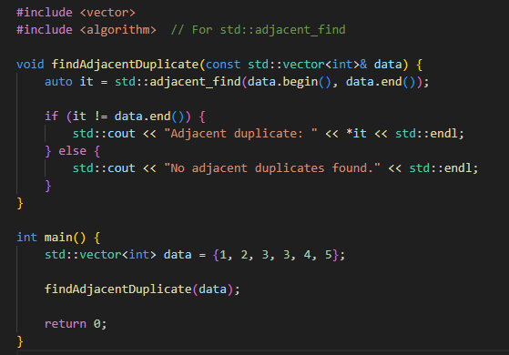

std::adjacent_find
4. std::adjacent_find
Definition: Finds the first pair of consecutive equal elements or elements satisfying a predicate.
Why Use: To detect duplicates or patterns in a sequence.
Use Case: Useful for finding patterns or anomalies in sequences.

Slide 11
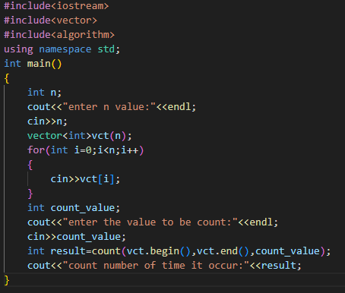
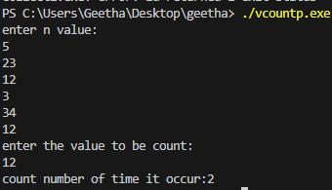
std::count
5. std::count
Definition: used to count how many times a specific value occurs in a container (like a vector, array, etc.).
Why Use: To tally how many times an element appears.
Use Case: Useful for frequency analysis or validation checks.
Real-World Example: Counting the number of defective items in a batch.

Slide 12
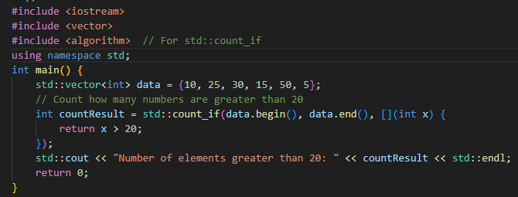

std::count_if
6. std::count_if
Definition: Counts elements satisfying a predicate.
Why Use: To count elements based on a condition.
Use Case: Useful for conditional frequency analysis.
Real-World Example: Counting orders above a certain value in an e-commerce system.

Slide 13
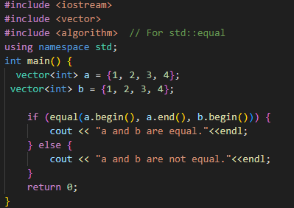

std::equal
7. std::equal
Definition:The std:equal algorithm is used to compare two sequences (like vectors or arrays) to check whether their elements are equal in order and value.
Use Case: Useful for validation or synchronization checks.
Real-World Example: Comparing two user permission sets to ensure consistency.

Slide 14
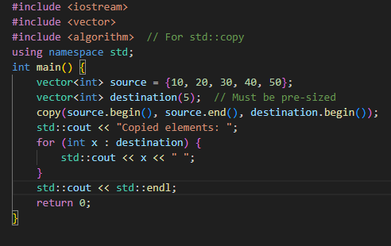

std::copy
8. std::copy
Definition: Copies elements from one range to another.
Why Use: To duplicate elements into another container or range.
Use Case: Useful for backing up data, initializing containers, or transferring data.
Real-World Example: Backing up a list of transactions to a new container.

Slide 15
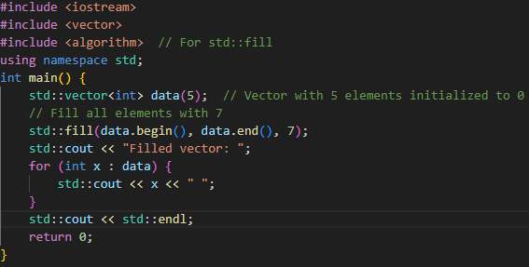

std::fill
9. std::fill
Definition: Assigns a specific value to all elements in a range.
Why Use: To initialize or reset elements in a container.
Use Case: Useful for setting default values or clearing data.
Real-World Example: Initializing a game board with zeros (or) Resetting a game scoreboard to zero.

Slide 16
std::generate
10. std::generate
Definition: Assigns values generated by a function to each element in a range.
Why Use: To populate a container with computed or random values.
Use Case: Useful for initializing containers with non-constant values.
Real-World Example: Generating unique IDs for new user accounts.

Slide 17

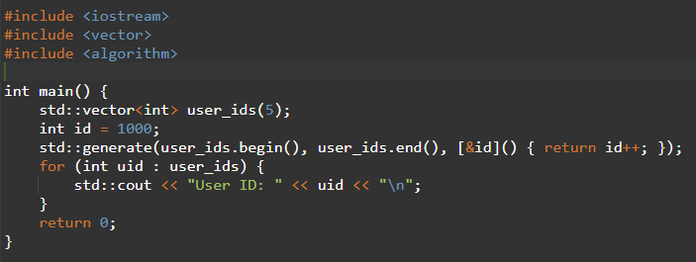

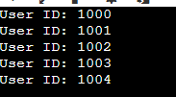
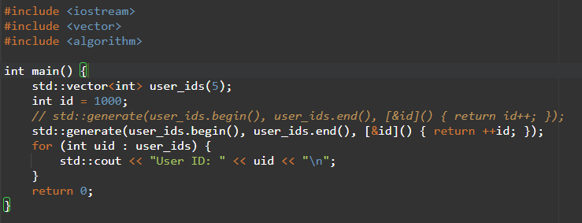
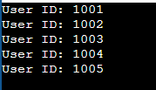
std::generate
Syntax

Slide 18
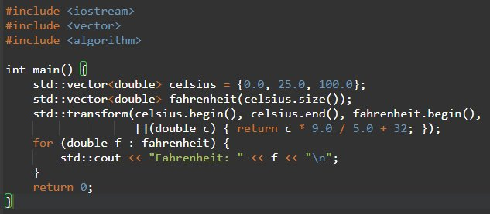

std::transform
11. std::transform
Definition: Applies a function to a range and stores results in another range.
Why Use: To modify elements based on a transformation (e.g., doubling values).
Use Case: Useful for data transformation, such as scaling values or combining ranges.
Real-World Example: Converting temperatures from Celsius to Fahrenheit.

Slide 19
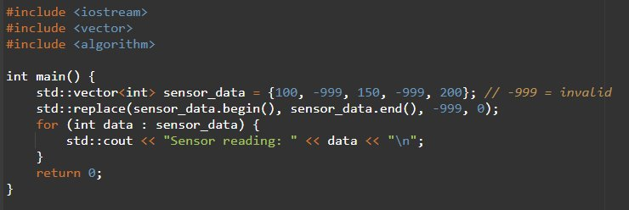
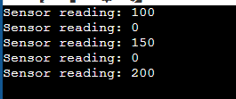
std::replace
12. std::replace
Definition: Replaces all occurrences of a value with another value.
Why Use: To update specific elements in a container.
Use Case: Useful for data correction or standardization.
Real-World Example: Replacing invalid sensor readings with a default value.

Slide 20
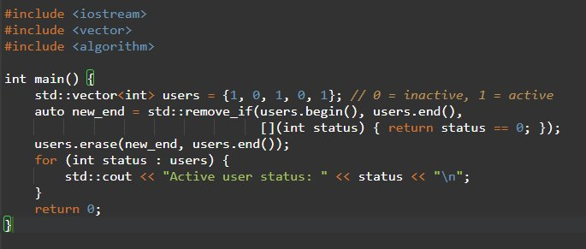

std::remove_if
13. std::remove_if
Definition: Moves elements satisfying a predicate to the end and returns an iterator to the new end.
Why Use: To logically remove elements based on a condition (used with erase for actual removal).
Use Case: Useful for filtering out unwanted elements from a container.
Real-World Example: Removing inactive users from a list.

Slide 21
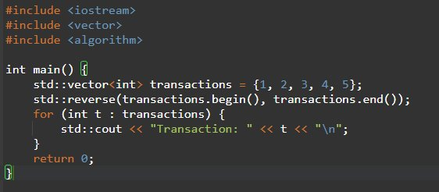

std::reverse
14. std::reverse
Definition: Reverses the order of elements in a range.
Why Use: To reorder elements in reverse.
Use Case: Useful for reversing sequences, such as logs or stacks.
Real-World Example: Reversing a list of recent transactions for display.

Slide 22
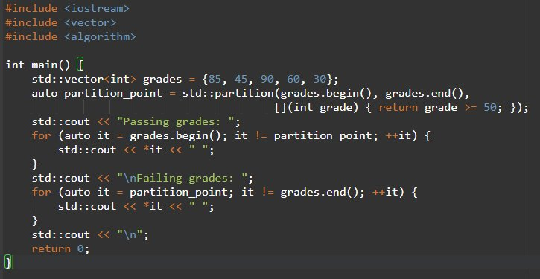

std::partition
15. std::partition
Definition: Reorders elements so that those satisfying a predicate come before those that do not.
Why Use: To group elements based on a condition.
Use Case: Useful for grouping or filtering data without removing elements.
Real-World Example: Separating passing and failing students based on grades.

Slide 23
Challenges/Debugging Experience and Additional Learning Resources
Understanding iterator behavior was crucial, especially when using algorithms like std::find, std::equal, and std::copy, where range boundaries matter a lot.
Debugging std::remove_if taught me that it doesn't erase elements — it just shifts them logically. Realized .erase() must be used to actually remove data.
Mistakenly using uninitialized containers with std::copy and std::fill led to runtime errors — learned to always ensure the destination has enough space or use std::back_inserter.
Using lambda expressions in std::for_each, std::count_if, and std::find_if helped apply complex conditions easily, but debugging logic inside lambdas required careful attention.
std::adjacent_find was new to me; using it helped detect logical patterns (like repeated sensor readings), which was useful in diagnostic tasks.
Mixing modifying and non-modifying algorithms in the same program taught me to be cautious — modifying data affects the outcome of later algorithms.

Slide 24
Additional Learning Resources / Notes
Resources:
C++ Reference: cppreference.com for detailed algorithm documentation.
Book: “The C++ Standard Library” by Nicolai Josuttis for in-depth algorithm explanations.
Tutorials: CPlusPlus.com and GeeksforGeeks for practical examples.
Online Platforms: LeetCode, HackerRank for algorithm practice.
Notes:
Always check iterator validity after modifying containers.
Use const containers for non-modifying algorithms to ensure safety.
Combine algorithms (e.g., find_if with transform) for complex tasks.
Prefer standard algorithms over manual loops for readability and optimization.

Slide 25
Q & A
Q1: Q: What’s the difference between std::count and std::count_if?
A:
std::count looks for exact value matches (e.g., count how many times 100 appears).
std::count_if uses a predicate to count elements based on a condition (e.g., count how many are > 100).
Q2: How is std::equal useful in comparing containers?
A:
std::equal checks if two containers have identical elements in the same order.
Useful for verifying results (e.g., checking if sorted output matches expected output).
Can also use a custom comparator for approximate or special comparisons.
Q3: When should I use std::transform instead of a loop?
A:
Use std::transform to apply a function to each element and store results in another container (e.g., squaring every number).
It improves readability and reduces boilerplate compared to manual loops.
Q4: What’s the purpose of std::generate?
A:
std::generate fills a range by calling a function repeatedly, often used for generating random or sequential values (e.g., filling a vector with random numbers).

Slide 26


Thank You

