Slide 1


T1911
LIST
A Quest Global Company
03/06/2025

Slide 2
Agenda
Topics Covered Today
Key Learnings / Concepts Understood:
Key Concepts with Definitions/ Code Snippet – Hands-on Practice
Challenges / Debugging Experience
Tasks/Assignments Completed
Additional Learning Resources / Notes
Q&A
Plan for Tomorrow

Slide 3
Topics Covered Today
1. Singly Linked List
2. Doubly Linked List
3. Circular Linked List
4. STL std::list (Standard Template Library List)

Slide 4
Key Learnings/Concepts Understood
Understanding Linked Lists – Structure and memory representation of lists.
Singly Linked List – Nodes connected in one direction (next pointer).
Doubly Linked List – Nodes connected in both directions (next and prev pointers).
Circular Linked List – Last node points back to the first node.
List Operations – Insertion, deletion, traversal (forward and backward).
Memory Management – Dynamic memory usage with new and pointer manipulation.
List Implementation in C++ – Creating custom list classes/structs.
Error Handling in Lists – Handling null pointers and edge conditions.
Use Cases – Applying lists in real-world examples like managing vehicle records.

Slide 5
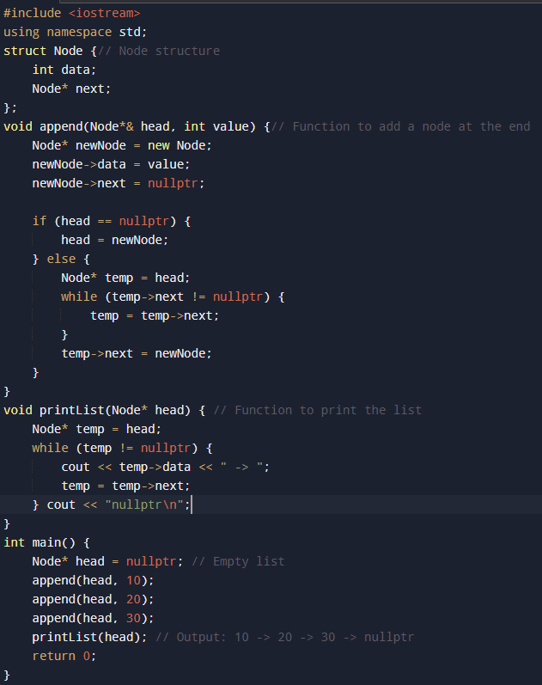


1. Singly Linked List
1. Singly Linked List
Definition:
Singly Linked List – Each node points only to the next node, allowing one-way traversal.

Slide 6
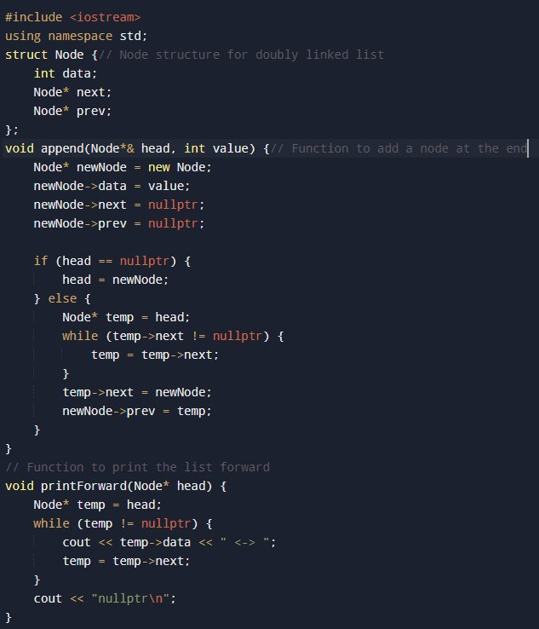
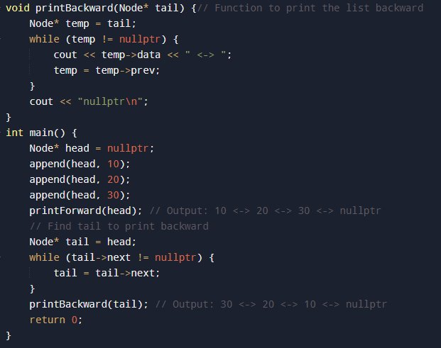

2. Doubly Linked List
2. Doubly Linked List
Definition:
Doubly Linked List – Each node has pointers to both the next and previous nodes, allowing traversal in both forward and backward directions.

Slide 7
3. Circular Linked List
3. Circular Linked List
Definition:
The last node points back to the first node, making the list circular. It can be singly or doubly linked.

Slide 8
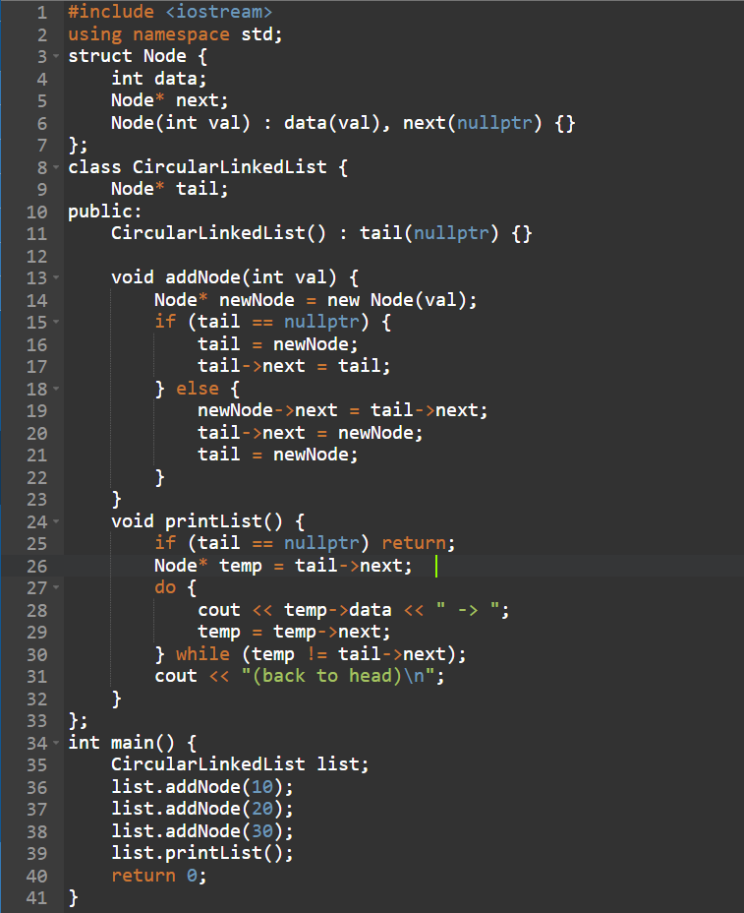

3. Circular Linked List
Definition:
The last node points back to the first node, making the list circular. It can be singly or doubly linked.

Slide 9
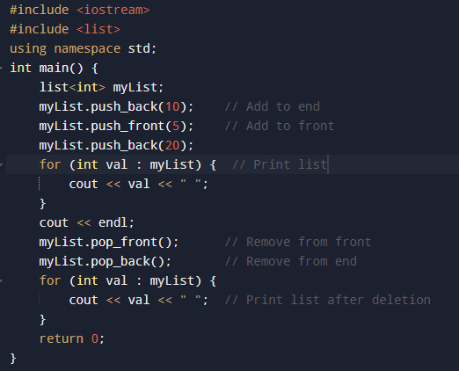

4. STL List (Standard Template Library List)
Definition:
list is a doubly linked list implementation in the C++ STL, providing built-in methods for easy list

Slide 10
Challenges / Debugging Experience
Null pointer errors occur when accessing head or next without checking for NULL.
Forgetting to update both next and prev pointers in doubly linked lists breaks the links.
Circular linked lists can cause infinite loops if traversal lacks proper stopping conditions.
Memory leaks happen when dynamically allocated nodes are not deleted after removal.
Traversal mistakes like wrong loop conditions can cause skipping nodes or endless loops.
Inserting or deleting nodes at the head or tail often leads to pointer update bugs.
Reverse traversal in doubly linked lists fails if prev pointers aren’t correctly maintained.
Segmentation faults arise from dereferencing uninitialized or deleted pointers.
Dangling pointers cause crashes when accessing nodes that were already deleted.

Slide 11
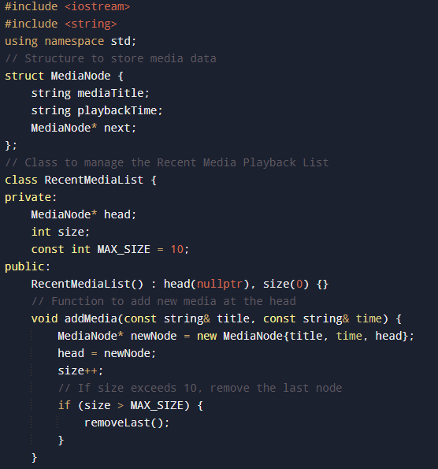
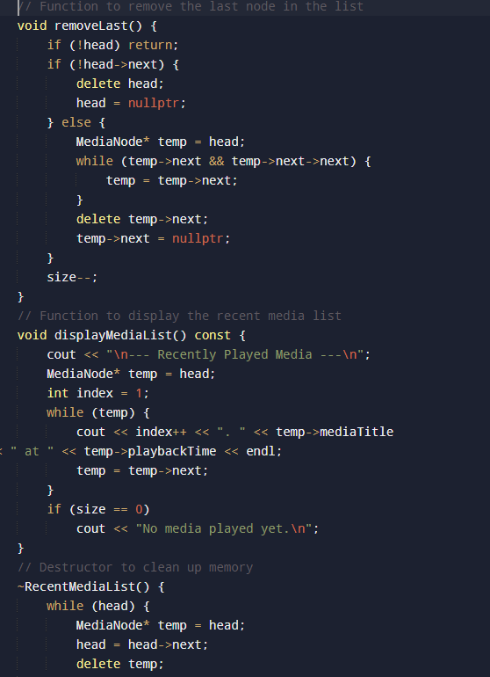
Tasks/Assignments Completed

Slide 12
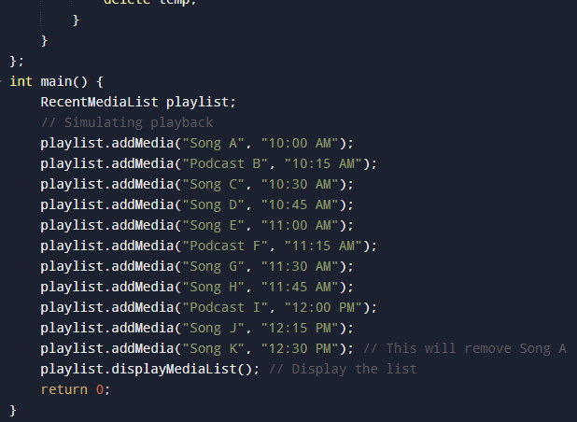
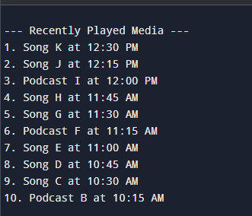
Tasks/Assignments Completed

Slide 13
Additional Learning Resources / Notes
CPP Reference — Comprehensive and official C++ documentation.
cplusplus.com — Beginner-friendly tutorials and examples for STL algorithms.
Containers in C++ STL | GeeksforGeeks
YouTube tutorials — Search for C++ STL algorithms and sorting tutorials.
Practice coding problems on platforms like LeetCode, Codechef.
Experiment with custom comparators to learn more about flexible sorting.

Slide 14
Q&A
Q1: What is the head of a linked list? A: The head is the first node in a linked list and acts as the entry point to access all nodes.
Q2: What happens if the head is NULL? A: It means the linked list is empty and has no nodes.
Q3: How do you delete a node from a linked list? A: Update the pointer of the previous node to skip the node to be deleted, then delete it using delete.
Q4: What is a null pointer in a linked list? A: A pointer that doesn’t point to any node; it marks the end of a non-circular list.
Q5: Can we traverse a singly linked list backward? A: No, backward traversal is only possible in a doubly linked list.
Q6: What is the time complexity of inserting a node at the beginning? A: It is O(1) because no traversal is needed—just update the head pointer.

Slide 15
Plan for Tomorrow
Vector
Deque
List
Queue
Priority Queue
Stack
Methods and Iterators

Slide 16
Overall Overview
Understanding the concept of a list as a dynamic data structure
Learning about singly linked lists for sequential data storage
Exploring doubly linked lists for bidirectional traversal
Studying circular linked lists where the last node links back to the first
Knowing the advantages of each list type in different scenarios
Implementing insertion, deletion, and traversal operations
Comparing lists with other container types like arrays and vectors
Applying lists in real-world problems for efficient data management

Slide 17


Thank You

