Slide 1


T1911
Binary trees, Tree traversals
A Quest Global Company
06/06/2025

Slide 2
Agenda
Topics Covered Today
Key Learnings / Concepts Understood:
Key Concepts with Definitions/ Code Snippet – Hands-on Practice
Challenges / Debugging Experience
Tasks/Assignments Completed
Additional Learning Resources / Notes
Q&A
Plan for Tomorrow

Slide 3
Topics Covered Today
Binary trees
Tree traversals

Slide 4
Key Learnings/Concepts Understood
A binary tree is a hierarchical structure where each node has up to two children (left and right).
Each node contains data and pointers to its left and right child nodes.
Types include full, perfect, complete, skewed, and balanced binary trees.
A Binary Search Tree (BST) maintains the property: left child < parent < right child.
Inorder traversal visits nodes in left-root-right order and gives sorted output in BST.
Preorder traversal visits nodes in root-left-right order, useful for copying trees.
Postorder traversal visits nodes in left-right-root order, used for deleting trees.
Level order traversal visits nodes level-by-level using a queue (BFS).

Slide 5
Key Concepts with Definitions/ Code Snippet – Hands –on Practice
1.Binary trees
Full Binary Tree
Definition:
A binary tree is a hierarchical structure where each node has up to two children (left and right).
Node Structure: Each node contains data and pointers to its left and right child nodes.
Types:
Full Binary Tree: Every node has either 0 or 2 children.
Perfect Binary Tree: All internal nodes have two children, and all leaf nodes are at the same level.
Complete Binary Tree: All levels are fully filled except possibly the last, which is filled from left to right.
Skewed Binary Tree: All nodes have only one child, either left or right.
Balanced Binary Tree: The height difference between left and right subtrees of every node is at most one.

Slide 6
Key Concepts with Definitions/ Code Snippet – Hands –on Practice
Tree Traversal Methods
Inorder Traversal (LNR): Visit left subtree, node, then right subtree. In a BST, this traversal visits nodes in ascending order.
Preorder Traversal (NLR): Visit node, left subtree, then right subtree. Useful for creating a copy of the tree.geeksforgeeks.org+3en.wikipedia.org+3jointaro.com+3
Postorder Traversal (LRN): Visit left subtree, right subtree, then node. Used for deleting the tree or evaluating expressions.
Level-Order Traversal: Visit nodes level by level from top to bottom. Implemented using a queue (Breadth-First Search).
Advantages of Binary Trees
Efficient Searching: Binary Search Trees (BSTs) allow for efficient searching, insertion, and deletion operations with an average time complexity of O(log n), assuming the tree is balanced. This is faster than linear data structures like linked lists. geeksforgeeks.org
Ordered Data: BSTs maintain elements in a sorted order. In-order traversal of a BST yields elements in ascending order, facilitating operations like finding the minimum or maximum element efficiently.
Dynamic Operations: BSTs support dynamic insertion and deletion of nodes while maintaining the order, though additional operations may be necessary to rebalance the tree if it becomes skewed.

Slide 7
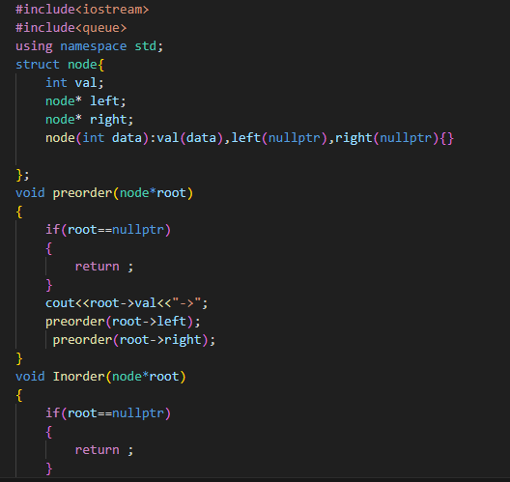
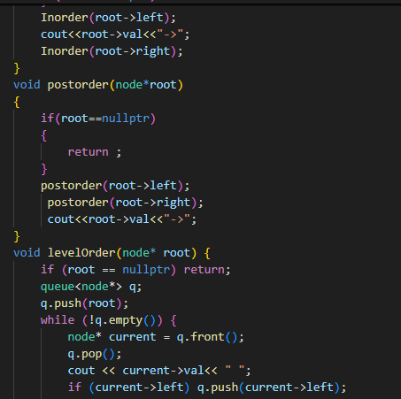
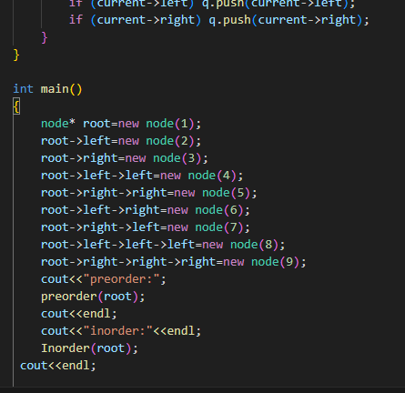
Binary Tree (BT)
Example:-

Slide 8
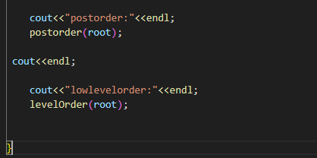
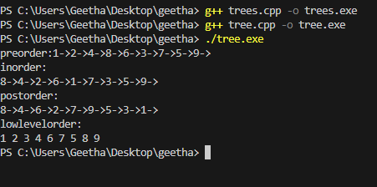
Binary Tree (BT)
Output:-

Slide 9
Binary Search Tree
Definition:Binary Search Tree (BST) is a binary tree where each node’s left child contains a smaller value, and the right child contains a larger value.
BSTs enable efficient search, insertion, and deletion, typically in O(log n) time when the tree is balanced.
The inorder traversal of a BST returns all elements in sorted order, making it useful for sorting tasks.
BSTs do not allow duplicate values in standard implementations to maintain the ordering property.
Operations like min/max retrieval are efficient — the minimum value is found at the leftmost node, and the maximum at the rightmost.
Recursive and iterative methods can be used to implement insertion, search, and deletion.
Unbalanced BSTs (e.g., created by inserting sorted data) can degrade performance to O(n), resembling a linked list.
Self-balancing BSTs like AVL and Red-Black Trees maintain height balance to ensure logarithmic time complexity.
Deletion in a BST involves three cases: deleting a leaf node, a node with one child, or a node with two children.

Slide 10
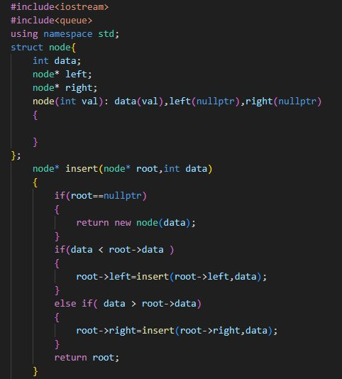
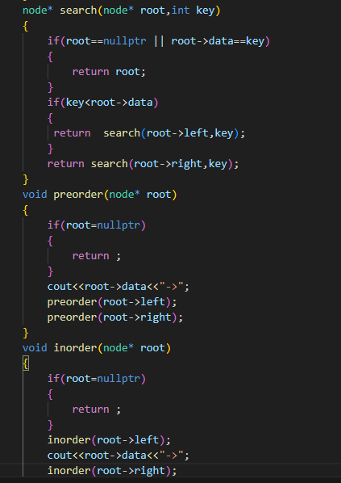
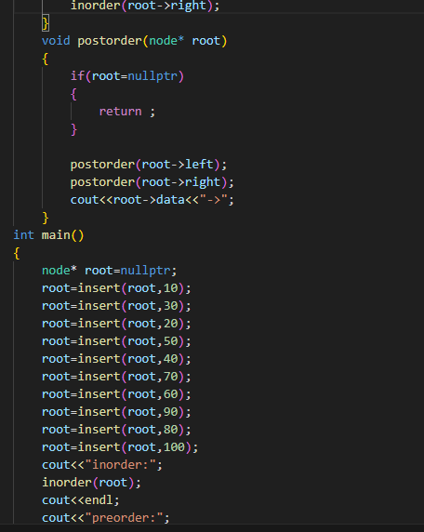
Key Concepts with Definitions/ Code Snippet – Hands –on Practice
Tree Traversal MethodsBinary Tree (BT)

Slide 11

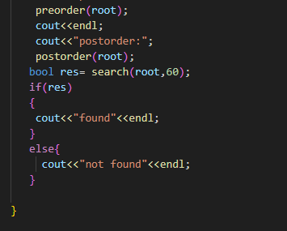
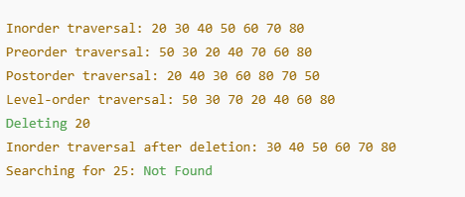
Key Concepts with Definitions/ Code Snippet – Hands –on Practice
Tree Traversal MethodsBinary Tree (BT)

Slide 12
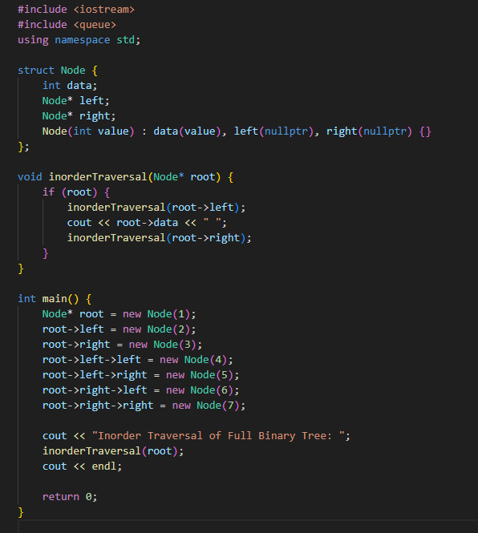
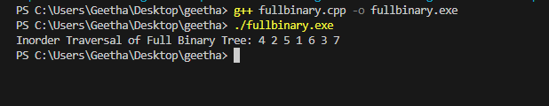
Key Concepts with Definitions/ Code Snippet – Hands –on Practice
Full Binary Tree in C++
A Full Binary Tree is a binary tree in which every node has either 0 or 2 children. Here's how you can implement it:

Slide 13
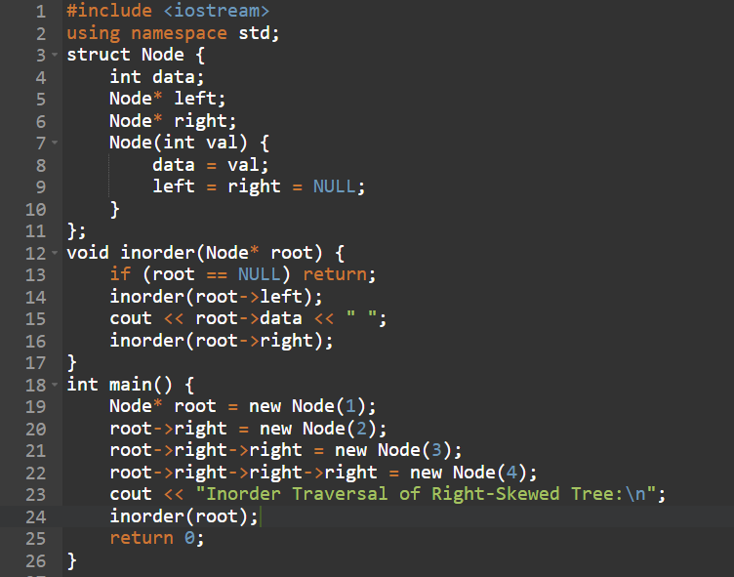


Degenerate (Skewed) Tree
Definition:
Each parent has only one child.

Slide 14
Type | Characteristics
Full Binary Tree | 0 or 2 children per node
Perfect Binary Tree | All internal nodes have 2 children & all leaves at same level
Complete Binary Tree | Last level left-filled
Balanced Binary Tree | Height difference ≤ 1
Degenerate Tree | Like a linked list (1 child per node)
Binary Search Tree | Left < root < Right
Threaded Binary Tree | NULL pointers replaced to speed up traversal
AVL / Red-Black Tree | Self-balancing BSTs

Slide 15
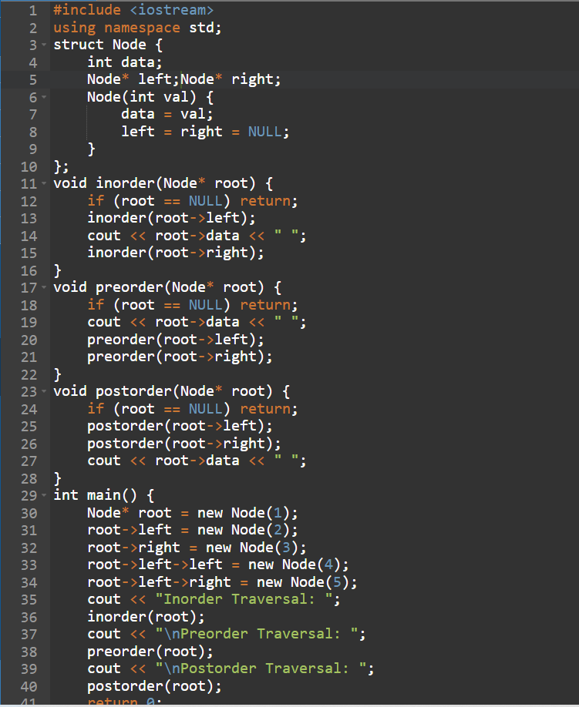

2.Tree traversals
Definition:
Tree traversal refers to the process of visiting all the nodes of a tree in a specific order. There are three main types for binary trees:
Inorder Traversal (Left → Root → Right)
Preorder Traversal (Root → Left → Right)
Postorder Traversal (Left → Right → Root)

Slide 16
Challenges / Debugging Experience
Null pointer access when trying to use child nodes that don’t exist.
Infinite recursion due to missing base cases in traversal or insertion functions.
Incorrect traversal order from placing recursive calls in the wrong sequence.
Memory leaks caused by dynamically creating nodes without proper deletion.
Breaking BST rules through wrong insertion logic (e.g., misplacing left/right children).
Stack overflow from deep recursion in skewed or unbalanced trees.
Mixing traversal types, like confusing preorder, inorder, and postorder logic.
Off-by-one errors in iterative traversals using loops or stacks.
Not checking for null before dereferencing, especially during traversal or deletion.
Missing root initialization, leading to undefined behavior or crashes during insertion.

Slide 17
Additional Learning Resources / Notes
CPP Reference — Comprehensive and official C++ documentation.
cplusplus.com — Beginner-friendly tutorials and examples for STL algorithms.
Containers in C++ STL | GeeksforGeeks
YouTube tutorials — Search for C++ STL algorithms and sorting tutorials.
Practice coding problems on platforms like LeetCode, Codechef.
Experiment with custom comparators to learn more about flexible sorting.

Slide 18
Q&A
Q1: What is a full binary tree? A: A binary tree where every node has either 0 or 2 children.
Q2: What is a complete binary tree? A: A binary tree where all levels are fully filled except possibly the last, which is filled from left to right.
Q3: What is the time complexity of searching in a balanced BST? A: O(log n).
Q4: What is the main advantage of using a BST? A: Fast searching, insertion, and deletion in average-case O(log n) time.
Q5: What can cause a BST to become inefficient? A: Inserting sorted data without balancing can turn it into a skewed tree (like a linked list).
Q6: Which data structure is commonly used for level order traversal? A: Queue.
Q7: What is the height of a tree? A: The number of edges on the longest path from root to a leaf.
Q8: What does a balanced binary tree ensure? A: That the height difference between left and right subtrees is minimal, maintaining efficiency.
Q9: What is the base case in recursive traversal functions? A: When the node is nullptr.

Slide 19
Plan for Tomorrow
Basics of Graphs
Graph Traversal
Shortest Path
Minimum Spanning Tree
Cycle Detection in Graphs

Slide 20
Overall Overview
Binary trees are widely used data structures where each node can have at most two children: left and right.
They provide a clear way to represent hierarchical relationships and form the backbone of many advanced structures like heaps and expression trees.
Balanced binary trees (like AVL or Red-Black trees) maintain height balance to ensure optimal performance in operations.
Traversals are essential for accessing and processing all nodes in a specific order.
Inorder traversal (Left, Root, Right) is ideal for retrieving elements in sorted order from a BST.
Preorder traversal (Root, Left, Right) is commonly used for saving tree structure or generating prefix expressions.
Postorder traversal (Left, Right, Root) is often used for deleting or freeing tree memory safely.
Level order traversal uses a queue to access nodes level-by-level, useful for breadth-first algorithms.
Proper handling of base cases in recursion and null pointer checks is vital to prevent runtime errors.

Slide 21


Thank You

