Slide 1


T1911
Learning Document
A Quest Global Company
23/05/2025

Slide 2

Agenda
Topics Covered Today
Key Learnings / Concepts Understood:
Key Concepts with Definitions/ Code Snippet – Hands-on Practice
Challenges / Debugging Experience
Tasks/Assignments Completed
Additional Learning Resources / Notes
Q&A
Plan for Tomorrow

Slide 3
Topics Covered Today
1.Functional Objects 2.Utilities & Advanced I/O

Slide 4
2.Key Learnings/Concepts Understood
Understanding how to use std::transform, and utility functions like plus(), minus(), and ptr_fun for manipulating data. Practice hands-on with complex and simple data. Manipulate I/O streams using cout/cin, format flags, and operators like boolalpha, setprecision, setw, etc. Practice formatting complex output for data containers.

Slide 5
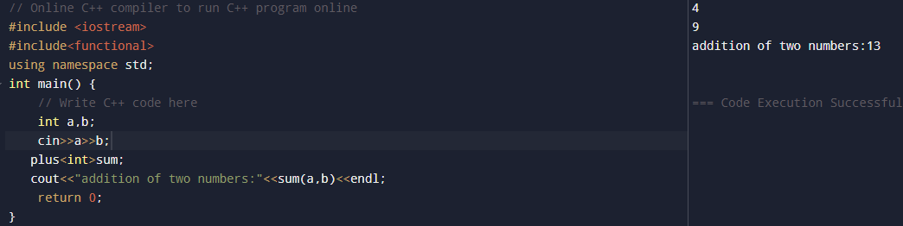
3.Key Concepts with Definition/Code Snippet-Hands on Practice
1.Functional Objects and Utilities in C++
A functional object, also known as a functor, is an object that acts like a function. It does this by overloading the () operator, so you can call it just like a regular function.
Functors are useful when you want an object to carry some state or behavior and still behave like a function.
Utilities in C++ are helpful tools (like helper functions or smart pointers) that help write cleaner, reusable, and safe code by handling common programming tasks in a standard way.
Std::plus
Definition: A functor is an object that behaves like a function.This one specifically is designed to add two values together and return the result when called.
Example:

Slide 6
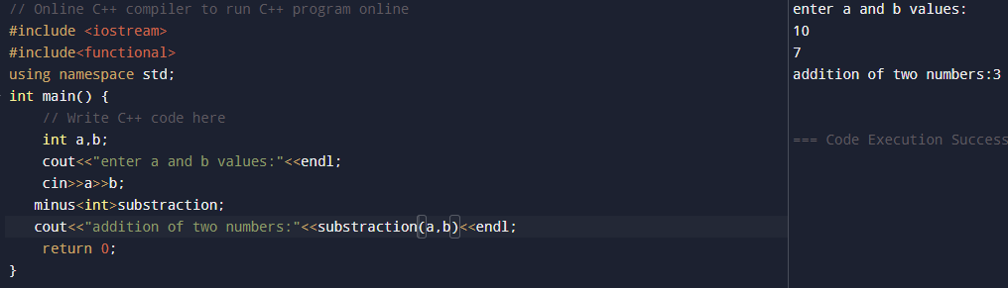
Key Concepts with Definition/Code Snippet-Hands on Practice
Std::minus
Definition: A functor (function object) that, when called with two inputs, computes and returns their difference — effectively acting like a subtraction function.Example:
Example:

Slide 7
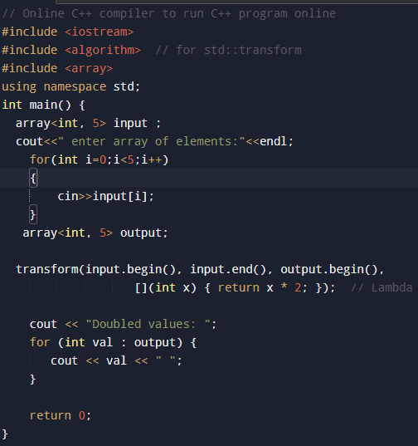
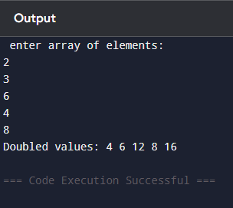
Key Concepts with Definition/Code Snippet-Hands on Practice
Std::transform:
Definition: std::transform is a standard library function in C++ that goes through each element in a collection, applies a given operation to it, and stores the result in a new location.
Example: output:

Slide 8
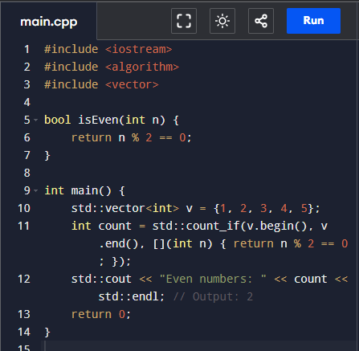
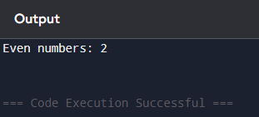
Key Concepts with Definition/Code Snippet-Hands on Practice
Ptr_fun:
Definition: Adapter that converts a regular function pointer into a function object (deprecated in C++11, replaced by std::function or lambdas). Example: Output:

Slide 9
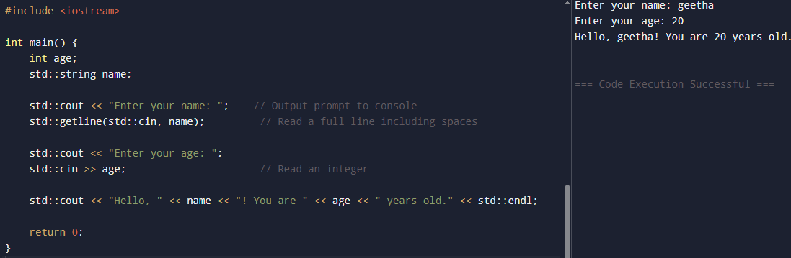
Key Concepts with Definition/Code Snippet-Hands on Practice
2. Advanced I/O:
Advanced input/output (I/O) in C++ means performing more sophisticated data reading and writing than just simple console input/output. This includes features like formatting output, controlling how data appears, and using special manipulators to customize streams.
cout / cin:
They are the built-in C++ objects for sending data to the console (cout) and reading data from the console (cin). Example:

Slide 10
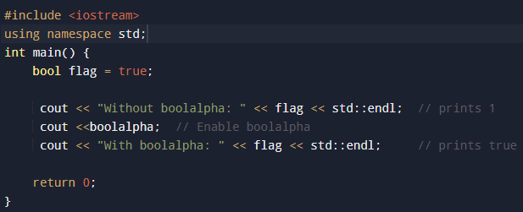
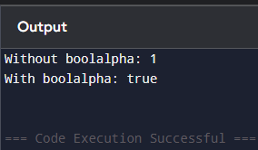
Key Concepts with Definition/Code Snippet-Hands on Practice
Format Flags:
Boolalpha
Definition: When turned on, it shows true or false instead of 1 or 0 for boolean values
Example: Output:

Slide 11
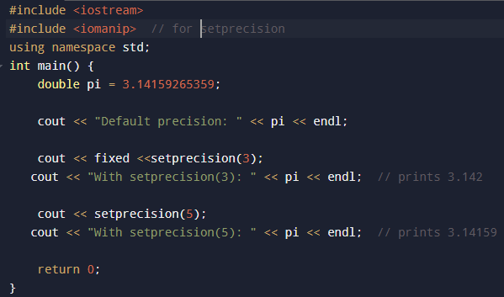
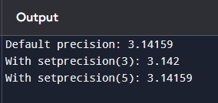
Key Concepts with Definition/Code Snippet-Hands on Practice
Setprecision
Definition: Controls how many digits are shown after the decimal point when printing floating-point numbers.
Example: Output:

Slide 12
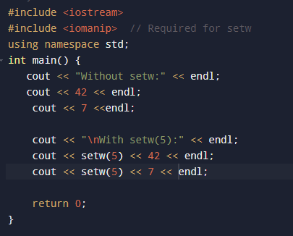
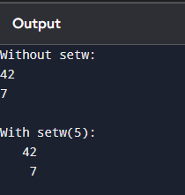
Key Concepts with Definition/Code Snippet-Hands on Practice
Setw
Definition: setw sets the width of the next output value (-) if the value is shorter than the width, it pads it with spaces on the left.
Example: output:

Slide 13
Challenges/Debugging Experience and Additional Learning Resources
Improper use of std::transform – Using containers of different sizes or incorrect lambda functions can lead to unexpected behavior or runtime crashes.
Using ptr_fun in modern C++ – This utility is outdated and removed in newer C++ standards; using it can break your code in modern compilers.
Calling plus() or minus() without <functional> – Forgetting to include the proper header will result in compile-time errors.
Missing <iomanip> header – Required for using I/O manipulators like setw, setprecision, and boolalpha. Without it, you’ll get compiler errors.
Misusing boolalpha – If not used or reset properly, boolean values might display inconsistently across outputs.
Not clearing formatting flags – Once formatting options like boolalpha or fixed are set, they stay active unless explicitly changed back.
Broken stream chaining – Forgetting << between values or mixing types incorrectly causes compile errors or incorrect output.

Slide 14
Q & A
What is a functor in C++? A: A functor is an object that behaves like a function by overloading the () operator.
Why is std::function useful? A: It allows storing and calling any callable object like a function, lambda, or functor.
What does std::fixed do in output formatting? A: It ensures floating-point numbers are printed in fixed-point notation (not scientific).
Why use smart pointers like unique_ptr? A: They automatically manage memory and prevent memory leaks.
What is the use of std::endl in cout? A: It prints a newline and flushes the output buffer.
What happens if cin reads the wrong type? A: Input fails, and the stream enters a bad state, which can stop further input.

Slide 15
Overall Overview
Practiced using functional objects (functors) for function-like behavior with objects.
Applied utility functions like std::plus() and std::minus() for arithmetic operations.
Learned how std::transform helps apply functions to a range of elements efficiently.
Noted that ptr_fun is deprecated and should be avoided in modern C++ code.
Used cout and cin for formatted console input and output.
Applied boolalpha to display boolean values as true or false instead of 1 or 0.
Used setprecision to control the number of decimal places in floating-point output.
Applied setw to format output fields with fixed widths, useful for tables or alignment.
Focused on making console output clean, structured, and easy to read.

