Slide 1
LIBRARY MANAGEMENT SYSTEM
Sangeetha . M
Guide : Amruta Deore

Slide 2
Abstract
This project is concentrate on the workflow of library management. Librarian and admin can access this system for the easiest way to know the details of books and authors also the book retrieval,returns. Basically, it reduces the time so that we can know all the details immediately. It also gives some constraints to access the details according to their roles. Similar the system of Online public access catalogue(OPAC).

Slide 3
Objective
To reduce the time of the management.
Giving efficient searching within a minute
Easy to see the progress and our fine dues
Easy to add and delete details

Slide 4
Workflow Diagram

Slide 5
Role authentication
IF
ELSE
Admin
User
Book details()-Stock return,Issued
Fine-FineCalculaion()
Author details()-Book details author details what we taken and when to return, Renewals

Slide 6
Concepts Used
Method overriding
Single Inheritance
Switch case
Super keyword
Scanner class
If else if else statement
Class and Object initialization

Slide 7
Output Screenshots

Slide 8
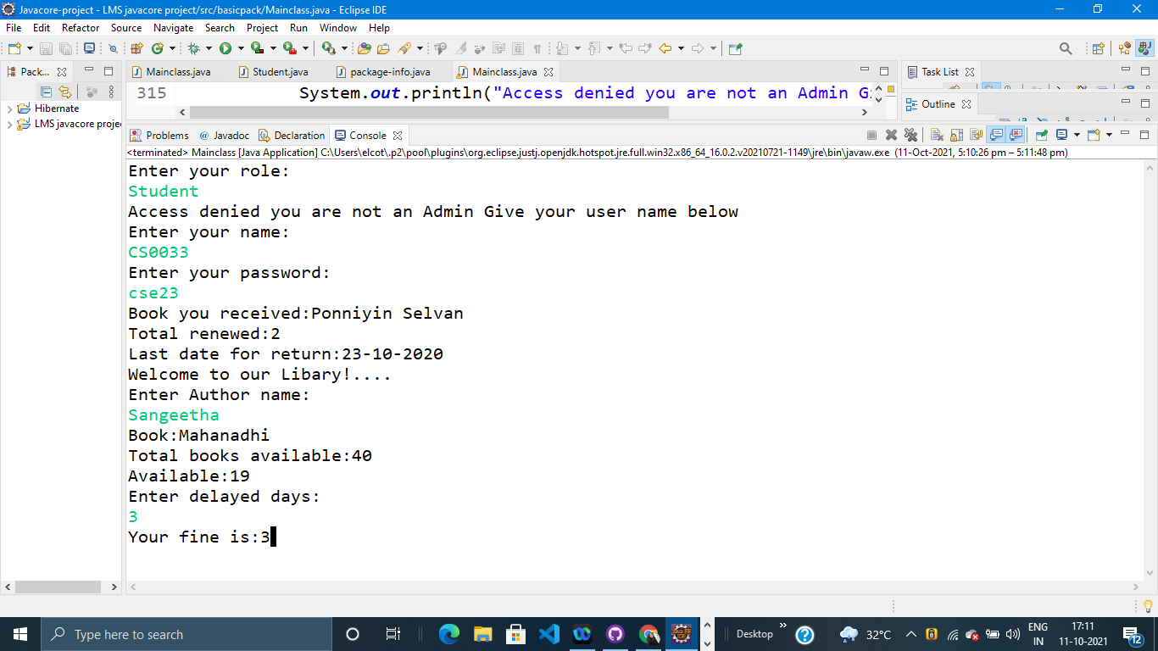

Slide 9
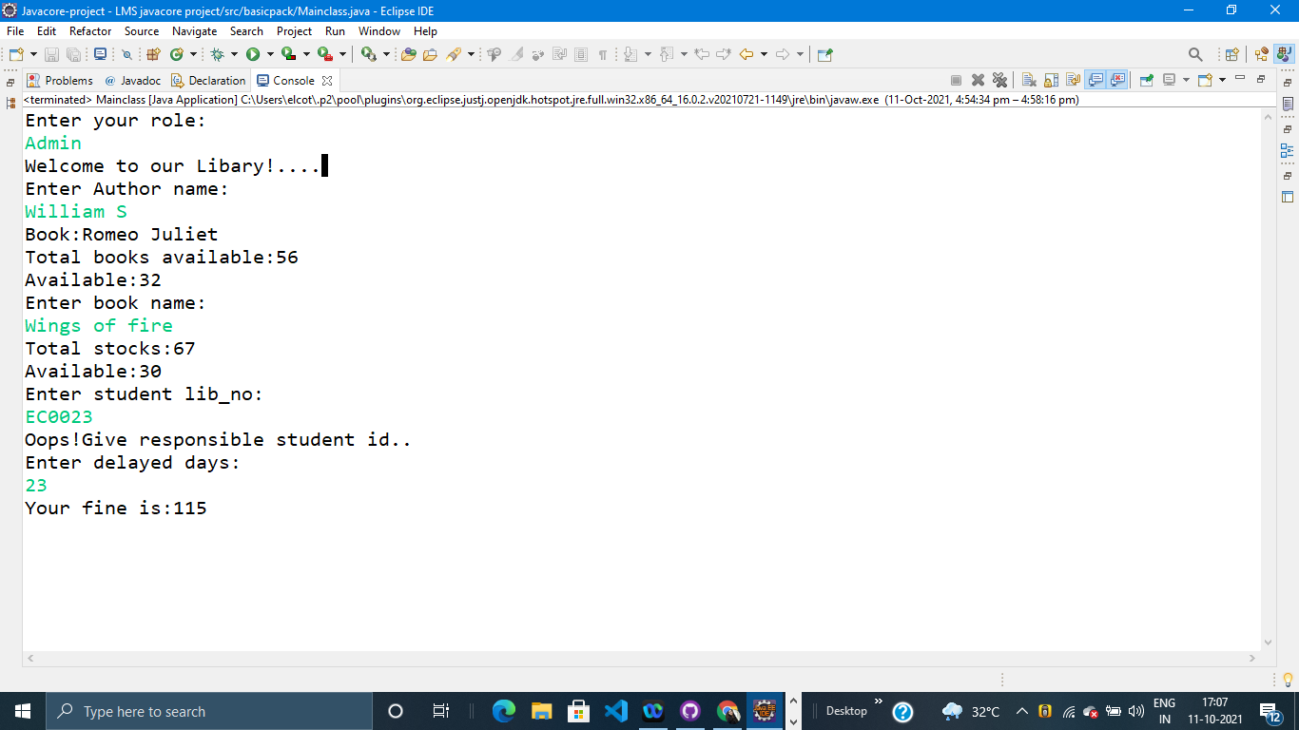

Slide 10
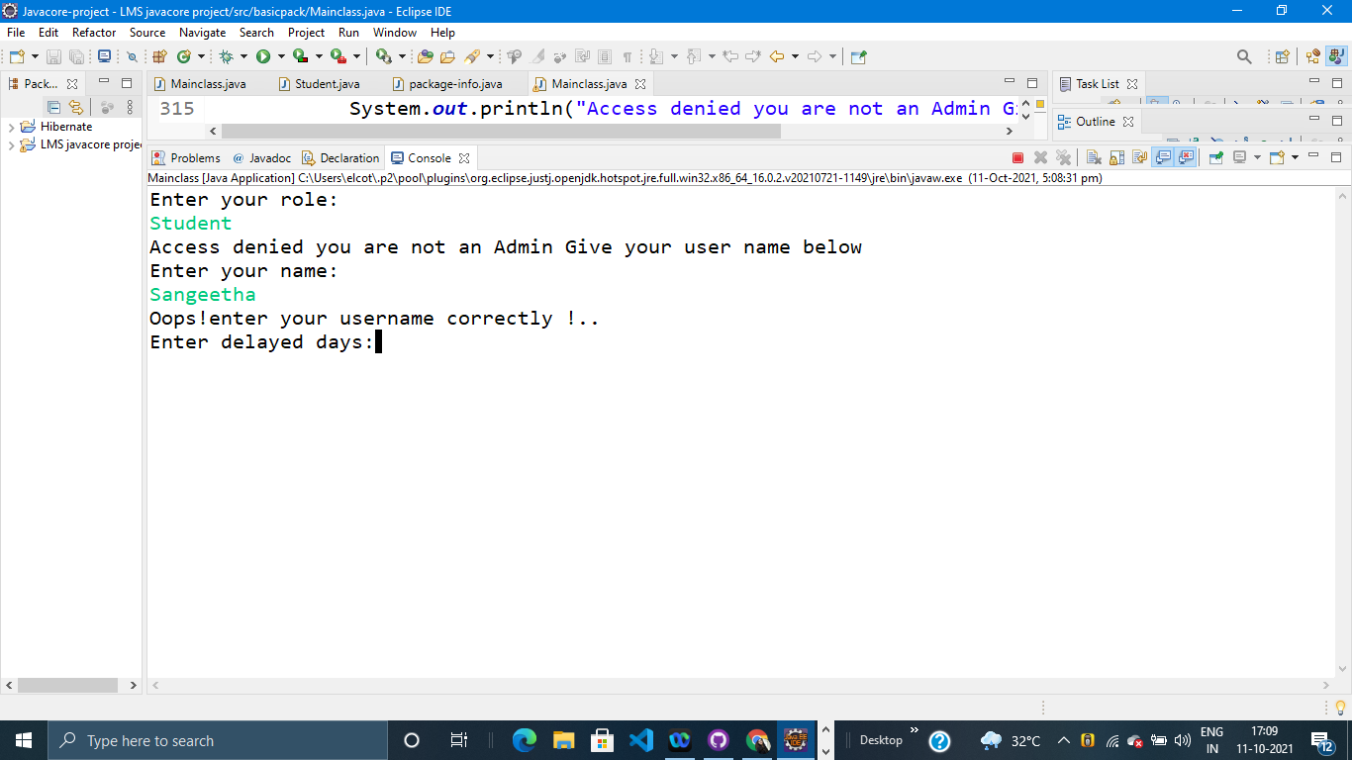

Slide 11
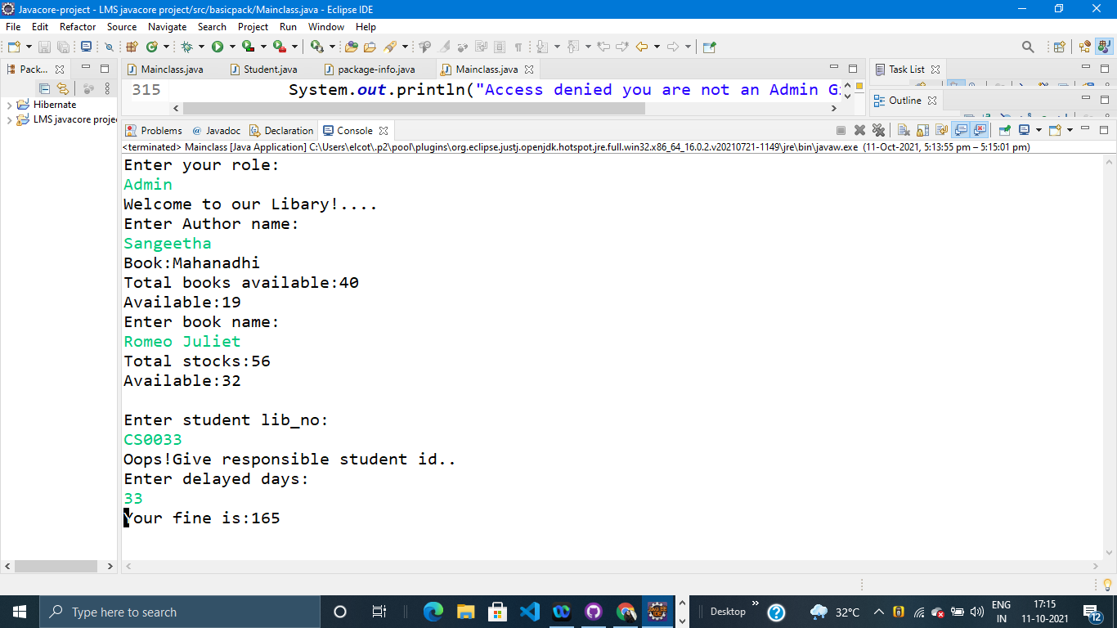

Slide 12
Advantages:
Easy to access the details what we want
Time reduce
Separate the access types
Provides role authentication

Slide 13
Key points:
Classes - author , userAccount, book and etc.
method overriding- a_details()
UserAccount class extends author class
Super keyword - access the other class methods
Switch cases -mainly used to select the lots of conditions

Slide 14
Conclusion
The library management system basically having the operations of book issue(),
book returns(), search of author , books, etc. Here it completes and satisfies the user to gives all those option to use.
It provides all the choices to search books,author name, fine calculation and user details ,user login, gives the details of what the user taken.

Slide 15
Any queries?

