Slide 1

Case Study
Statement: Develop a model to predict delinquency of Home Equity loan customers.
Data Analysis and Cleaning
Model Training
01
03
Independent features
Discriptive Statistics
Outliers & Uncertain Values
Removing Missing data
Imputing
Classification problem
Logistic regression
Dession Trees
Data Consideration
Model Evaluation
02
04
Mar - Jul historical data
Target value creation
Map target value to historical data
Mean value of historical
Imbalanced data set
Accuracy
AUC Score
Confusion Matrix
Presenter: Geethamadhuri Malempati
Improving the Performance
05
Balance data – SMOTE
Hyper parameter tuning
Cost complexity pruning

Slide 2
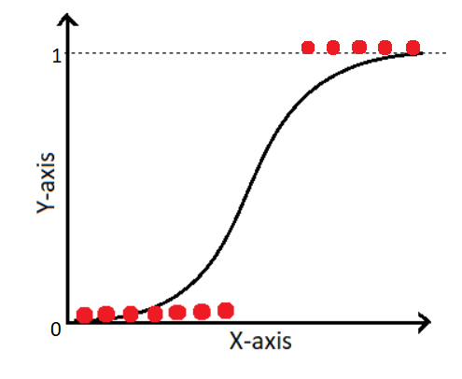
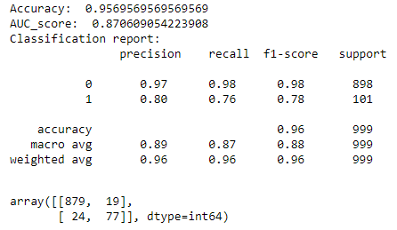
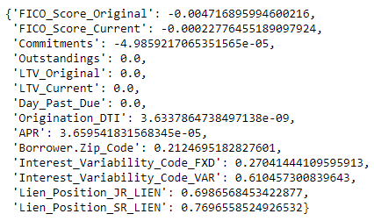
Logistic Regression
GitHub URL
Hyper parameter tuning metrics
Regression coefficients
Imbalanced data set
Accuracy: 0.89
AUC Score: 0.50
Applied SMOTE
Accuracy: 0.79
AUC Score: 0.55

Slide 3
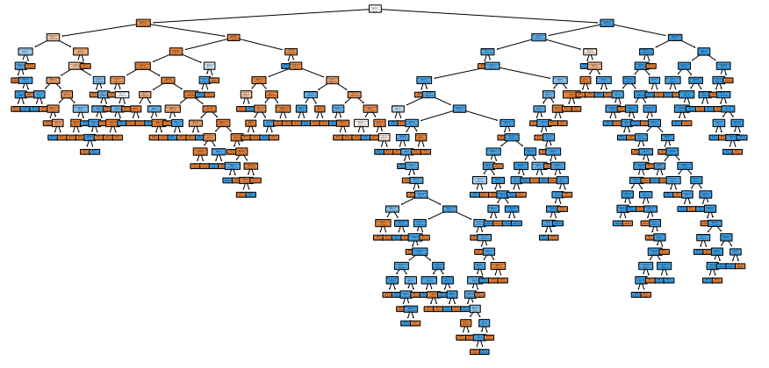
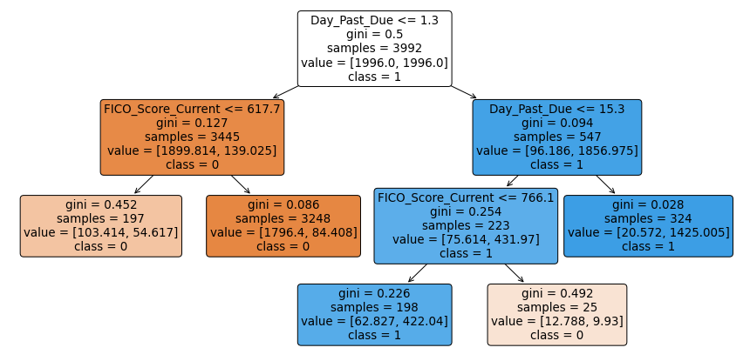
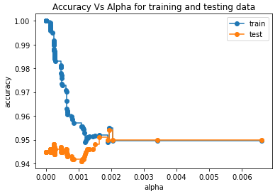
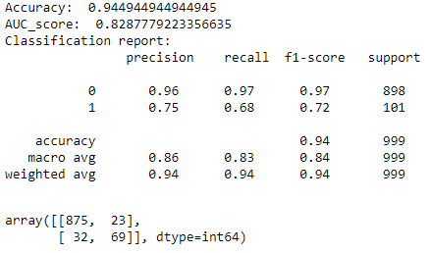
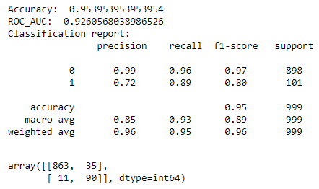
Decision Tree
GitHub URL
Training Tree:
Pruned Tree:
Metrics:
Metrics:

Slide 4
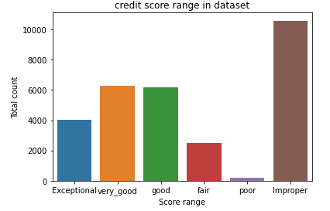
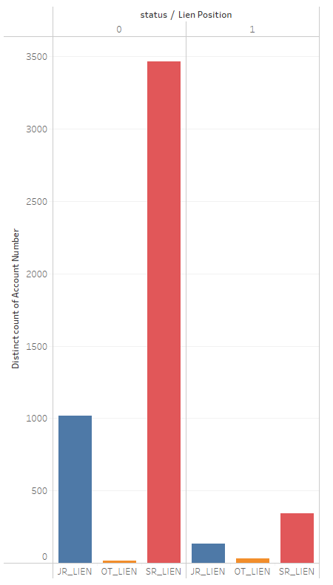
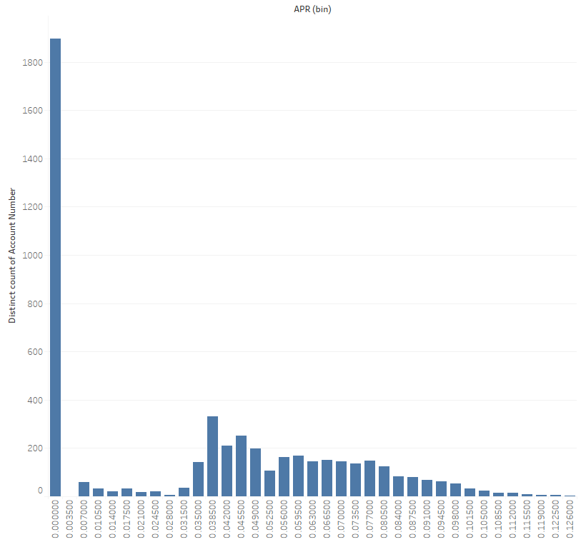
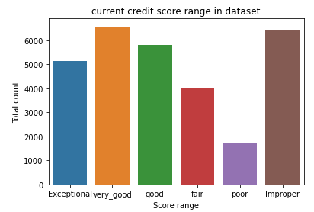
Strengths
Methods to balance dataset
Hyperparameter tuning
Cost complexity pruning
Removal of static variables
Mean of 5 months
Visualization
Weakness
With more domain understanding, handling of uncertain values could have been better
Replace max values with 95th percentile
Thank you!

