Slide 1


Martin Walsh
March 29th, 2024

Slide 2

Outline
Executive Summary
Introduction
Methodology
Results
Conclusion
Appendix

Slide 3
Executive Summary
Summary of methodologies
Data collection via API
Data collection with Web Scraping
Data wrangling
Exploratory Data Analysis with SQL
Exploratory Data Analysis with Visualization
Interactive Visual Analytics with Folium
Interactive Dashboard with Plotly Dash
Machine Learning Prediction
Summary of all results
Success Rate over Time: An improvement in success rate was observed over time.
Success Rate by Launch Site: KSC LC-39A shows the highest success rate of all launch sites.
Success Rate by Orbit: ES-L1, SSO, HEO, and GEO were observed to have the highest success rates.
Payload: Heavier payloads have a high failure rate early on with a significant improvement over time.
Predictive Analysis: The DecisionTreeClassifier algorithm has proven highly accurate in predicting landing outcomes.

Slide 4
Introduction
SpaceX advertises Falcon 9 rocket launches on its website with a cost of 62 million dollars.
Other providers cost upward of 165 million dollars each.
Much of the savings is due to SpaceX's ability to reuse the first stage.
If we can determine if the first stage will land, we can determine the cost of a launch.
Our company, IBM Developer Skills Network, can use this information to successfully bid against SpaceX for a rocket launch.

Slide 5
Introduction
SpaceX advertises Falcon 9 rocket launches on its website with a cost of 62 million dollars. Other providers cost upward of 165 million dollars each. Much of the savings is due to SpaceX's ability to reuse the first stage. If we can determine if the first stage will land, we can determine the cost of a launch. Our company, IBM Developer Skills Network, can use this information to successfully bid against SpaceX for a rocket launch.
The project endeavors to...
Collect as much publicly available data as possible.
Wrangle the data to improve its quality and prepare it for analysis.
Explore the processed data with SQL and various visualizations.
Drill down into finer levels of detail by splitting the data into groups defined by categorical variables.
Build, evaluate, and refine predictive models for discovering additional insights.
Problem Statement
Predict the successful landing of SpaceX's Falcon 9 first stage, a critical factor in determining the cost-efficiency of reusable rocket launches.
Why we should solve this problem?
Solving this problem allows companies like IBM Developer Skills Network to make competitive bids against SpaceX by accurately estimating launch costs.
Questions
What is the historical success rate of Falcon 9 first stage landings?
What factors most significantly influence the success or failure of a landing?
Can we develop a predictive model that accurately forecasts the outcome of a landing?

Slide 6

Section 1

Slide 7
Methodology
Executive Summary
Data collection methodology
Retrieval and consolidation from multiple SpaceX API endpoints
Web scaping tabular data from Wikipedia
Perform data wrangling
Extracted relevant records
Flattened fields and resolved missing values
Perform exploratory data analysis (EDA) using visualization and SQL
Visualize variable relationships
Look at the data in aggregate
Perform interactive visual analytics using Folium and Plotly Dash
Mark all launch sites on a map
Mark successful and failed launches
Calculate distances to proximate locations
Provide for interactive exploration of the data
Perform predictive analysis using classification models
Build, evaluate, and compare several predictive classification models

Slide 8
Data Collection
Data was collected using a combination of retrieval techniques:
HTTP requests against various SpaceX API endpoints:
Initial launch data was obtained from: /v4/launches/past
Additional data was backfilled from:
/v4/rockets
/v4/launchpads
/v4/payloads
/v4/cores
Tabular data from the List of Falcon 9 and Falcon Heavy launches Wikipedia page.

Slide 9
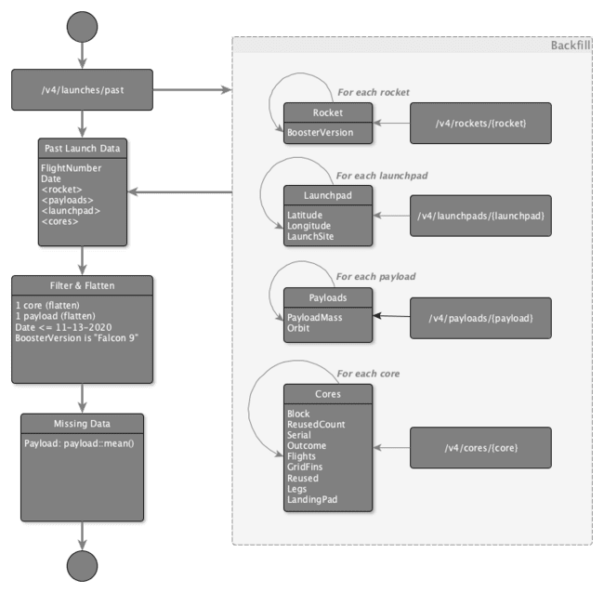
Data Collection – SpaceX API
The initial data was obtained from the `/v4/launches/past` API endpoint.
Additional data was backfilled from the `rocket`, `launchpad`, `payloads`, and `cores` API endpoints, for records with extant corresponding IDs.
Notebook (GitHub URL)

Slide 10
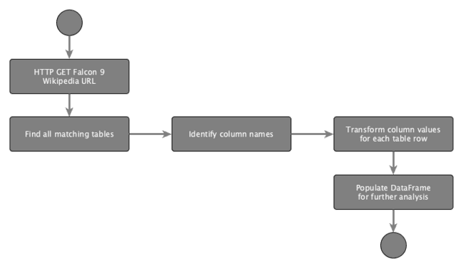
Data Collection - Scraping
Web scraping workflow:
Send HTTP Get to Falcon 9 Launch page at Wikipedia, to retrieve the HTML source
Create a BeautifulSoup object to extract the tables containing launch data
Populate a Pandas DataFrame using the extracted columns
Notebook (GitHub URL)

Slide 11
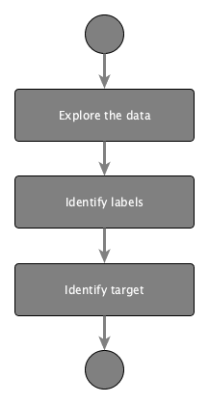
Data Wrangling
Goals:
Use Exploratory Data Analysis (EDA) to find patterns in the data.
Determine the labels for training supervised models.
Steps:
Find missing values as a percentage of each attribute
Identify column types, numerical or categorical
Show launches per Launch Site
Show distribution of Orbit type in the data set
Explore outcomes, and group them by binary outcome (success or failure)
Store outcome as "Class" label, to be used as target value in training
Notebook (GitHub URL)

Slide 12
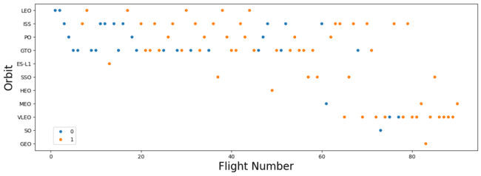
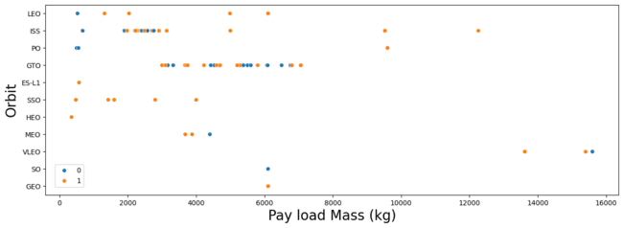
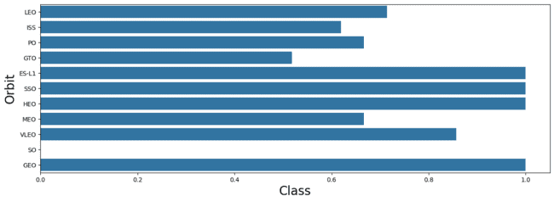
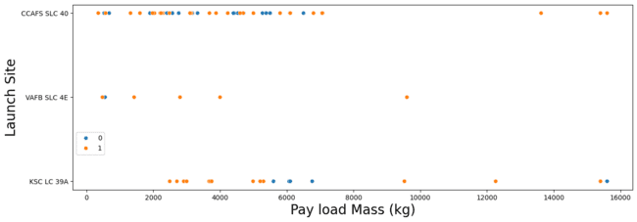
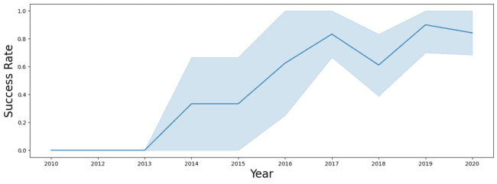
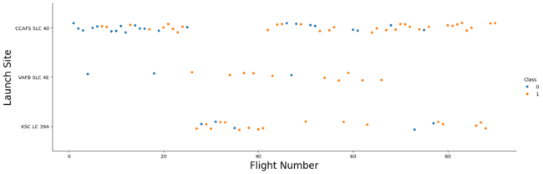
EDA with Data Visualization
Visualize relationships to gain insight into the importance of each variable:
Flight Number and Outcome
Flight Number and Launch Site
Payload and Launch Site
Orbit and Outcome
Flight Number and Orbit
Payload and Orbit
Yearly success rate
Expand categorical variables into "dummy" columns
Convert numerical columns into float64
Notebook (GitHub URL)

Slide 13
EDA with SQL
SQL Queries Performed:
Show each unique launch site
Show 5 records where launch site names begin with 'CCA'
Display the total payload mass carried by boosters launched by 'NASA (CRS)'
Display the average payload mass carried by the v1.1 Falcon 9 booster
List the date of the first successful ground landing outcome
List the booster versions with successful outcomes landing on the drone ship with payloads between 4000kg and 6000kg.
List the number of successful and failed mission outcomes
List all of the booster versions that carried the max payload mass
List the month name, outcome, booster version, and launch site for missions with failure outcomes landing on a drone ship in 2015.
Show the distribution of outcomes between June 4th, 2010 and March 20th, 2017
Notebook (GitHub URL)

Slide 14
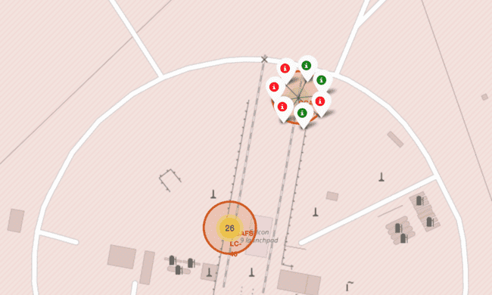
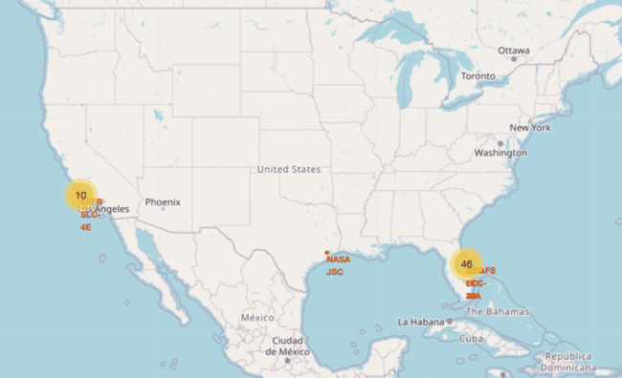
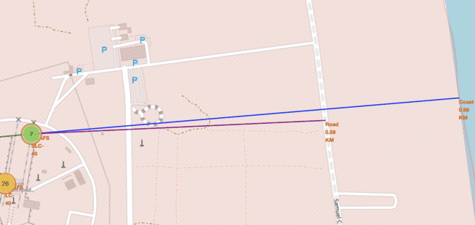
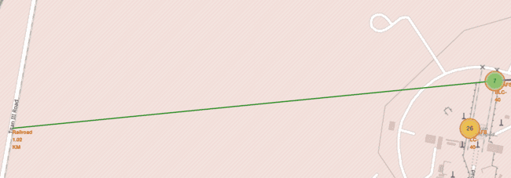
Build an Interactive Map with Folium
To find geographical patterns in the data the following items were marked on a map of launch sites:
All Launch Sites
Successful and Failed Launches
Distances between a launch site and proximate landmarks
Notebook (GitHub URL)

Slide 15
Build a Dashboard with Plotly Dash
To enable interactive exploration of the data, a Plotly Dash dashboard was developed to include:
A dropdown selector to choose a Launch Site, affecting:
A pie chart
All sites selected: shows the breakdown of successful outcomes across all sites
A launch site selected: shows the breakdown of successful vs failed launches for the given site
A scatter plot
All sites selected: shows outcome by payload mass and booster version for all sites
A launch site selected: shows outcome by payload mass and booster version for the given site
A Payload Mass range selector that filters data points on the scatter plot
Plotly Dash App (GitHub URL)

Slide 16
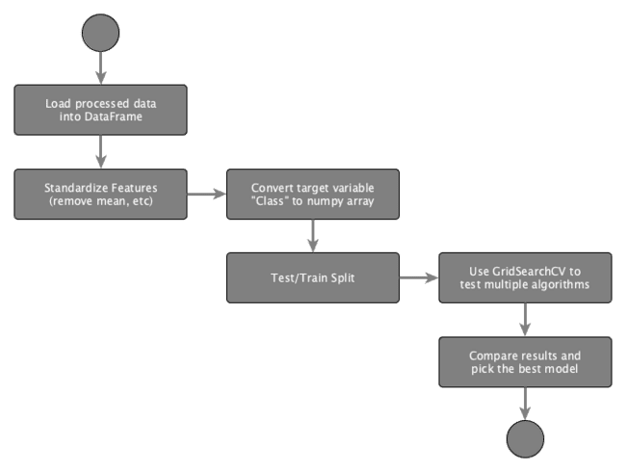
Predictive Analysis (Classification)
Load data
Apply StandardizedScaler on X
Convert Y to numpy array
Split training and testing data
Use GridSearchCV to test hyperparameters for multiple algorithms:
Logistic Regression
SVC
Decision Tree Classifier
K Neighbors Classifier
Notebook (GitHub URL)

Slide 17
Results
Exploratory data analysis results
Interactive analytics demo in screenshots
Predictive analysis results

Slide 18

Section 2

Slide 19
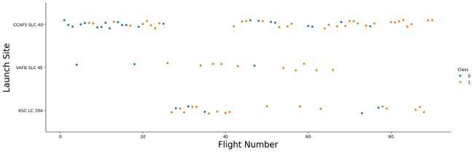
Flight Number vs. Launch Site
All sites show a mix of first stage landing successes and failures, with successes increasing over time.
Early flights predominantly resulted in failures, indicating improvements to technology or process.
While CCAFS SLC 40 has the most total flights, VAFB SLC 4E appears to have a relatively higher proportion of successful landing outcomes.

Slide 20
Payload vs. Launch Site
All sites show a wide range of payload weights, from light to heavy payloads.
Early flights trend toward lighter payloads, representing the bulk of the landing failures.
This suggests technological or operational improvements lead to a greater rate of success with heavier payloads.

Slide 21
Success Rate vs. Orbit Type
Some orbits, such as ES-L1, SSO, HEO, and GEO consistently show high success rates.
Others such as GTO show more mixed outcomes, suggesting some orbit types may introduce operational or technological challenges.
With only one launch, there is not enough data for the SO orbit type to provide an accurate analysis.

Slide 22
Flight Number vs. Orbit Type
Many orbits are represented throughout the flight number range, some orbits are not attempted until later flights.
There is a noticeable improvement in landing success as flight numbers increase, indicating an accumulation of experience and ongoing improvements.

Slide 23
Payload vs. Orbit Type
Many orbits are represented across a wide range of payload masses, but others like SSO, MEO, HEO and GEO show a generally lower range.
Orbits with a constrained payload range, tend to show a higher rate of landing success.
While payload mass does not appear to directly determine mission success, its interplay with orbit suggests a significant correlation.

Slide 24
Launch Success Yearly Trend
Yearly trend shows a consistent progression from early challenges to high reliability in first stage landings over time.
From 2016 onward, SpaceX experienced year over year improvement in success rate with a minor setback in 2018.

Slide 25
All Launch Site Names
There are four unique Launch Sites
CCAFS LC-40
VAFB SLC-4E
KSC LC-39A
CCAFS SLC-40
SELECT DISTINCT Launch_Site from SPACEXTABLE;

Slide 26
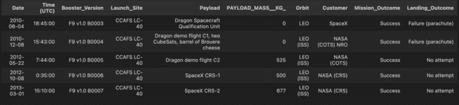
Launch Site Names Begin with 'CCA'
First five records where launch sites begin with `CCA`
SELECT * FROM SPACEXTABLE WHERE Launch_Site LIKE 'CCA%' LIMIT 5;

Slide 27
Total Payload Mass
The total payload carried by boosters from NASA (CRS) is 45,596kg.
SELECT SUM(PAYLOAD_MASS__KG_) AS TOTAL_PAYLOAD
FROM SPACEXTABLE WHERE Customer = 'NASA (CRS)';

Slide 28
Average Payload Mass by F9 v1.1
The average payload mass carried by booster version F9 v1.1 is 2,534.67kg.
SELECT AVG(PAYLOAD_MASS__KG_) AS AVG_PAYLOAD_MASS
FROM SPACEXTABLE WHERE Booster_Version LIKE 'F9 v1.1%';

Slide 29
First Successful Ground Landing Date
The first successful landing outcome on ground pad occurred on December 22nd, 2015.
SELECT MIN(Date) as LaunchDate
FROM SPACEXTABLE
WHERE Landing_Outcome = 'Success (ground pad)';

Slide 30
Successful Drone Ship Landing with Payload between 4000 and 6000
The boosters which have successfully landed on drone ship and had payload mass greater than 4000 but less than 6000 are:
SELECT Booster_Version, PAYLOAD_MASS__KG_
FROM SPACEXTABLE
WHERE Landing_Outcome = 'Success (drone ship)'
AND PAYLOAD_MASS__KG_ BETWEEN 4000 AND 6000;
Booster | Payload Mass
F9 FT B1022 | 4,696kg
F9 FT B1026 | 4,600kg
F9 FT B1021.2 | 5,300kg
F9 FT B1031.2 | 5,200kg

Slide 31
Total Number of Successful and Failure Mission Outcomes
Total number of successful and failure mission outcomes
SELECT CASE
WHEN Mission_Outcome LIKE 'Success%' THEN 'Success'
WHEN Mission_Outcome LIKE 'Failure%' THEN 'Failure'
END as Mission_Status, COUNT(*)
FROM SPACEXTABLE
GROUP BY Mission_Status;
Mission Status | Count
Failure | 1
Success | 100

Slide 32
Boosters Carried Maximum Payload
Booster Version
F9 B5 B1048.4
F9 B5 B1048.5
F9 B5 B1049.4
F9 B5 B1049.5
F9 B5 B1049.7
F9 B5 B1051.3
F9 B5 B1051.4
F9 B5 B1051.6
F9 B5 B1056.4
F9 B5 B1058.3
F9 B5 B1060.2
F9 B5 B1060.3
The maximum payload sent was 15,600kg.
The boosters that carried the maximum payload are:
SELECT
DISTINCT Booster_Version,
PAYLOAD_MASS__KG_
FROM SPACEXTABLE
WHERE PAYLOAD_MASS__KG_ = (
SELECT MAX(PAYLOAD_MASS__KG_) FROM SPACEXTABLE
)
ORDER BY Booster_Version;

Slide 33
2015 Launch Records
List of failed landing outcomes in drone ship, their booster versions, and launch site names for in year 2015:
SELECT
CASE strftime('%m', Date)
WHEN '01' THEN 'January'
WHEN '02' THEN 'February'
WHEN '03' THEN 'March'
WHEN '04' THEN 'April'
WHEN '05' THEN 'May'
WHEN '06' THEN 'June'
WHEN '07' THEN 'July'
WHEN '08' THEN 'August'
WHEN '09' THEN 'September'
WHEN '10' THEN 'October'
WHEN '11' THEN 'November'
WHEN '12' THEN 'December'
END as Month,
Landing_Outcome, Booster_Version, Launch_Site, Date
FROM SPACEXTABLE
WHERE strftime('%Y', Date) = '2015' AND Landing_Outcome = 'Failure (drone ship)';
Month | Outcome | Booster | Launch Site
January | Failure (drone ship) | F9 v1.1 B1012 | CCAFS LC-40
April | Failure (drone ship) | F9 v1.1 B1015 | CCAFS LC-40

Slide 34
Rank Landing Outcomes Between 2010-06-04 and 2017-03-20
Rank the count of landing outcomes between the date 2010-06-04 and 2017-03-20, in descending order:
SELECT
Landing_Outcome,
COUNT(*) as Count
FROM SPACEXTABLE
WHERE
Date BETWEEN
'2010-06-04' AND '2017-03-20'
GROUP BY Landing_Outcome
ORDER BY Count DESC;
Landing Outcome | Count
No attempt | 10
Success (drone ship) | 5
Failure (drone ship) | 5
Success (ground pad) | 3
Controlled (ocean) | 3
Uncontrolled (ocean) | 2
Failure (parachute) | 2
Precluded (drone ship) | 1

Slide 35

Section 3

Slide 36
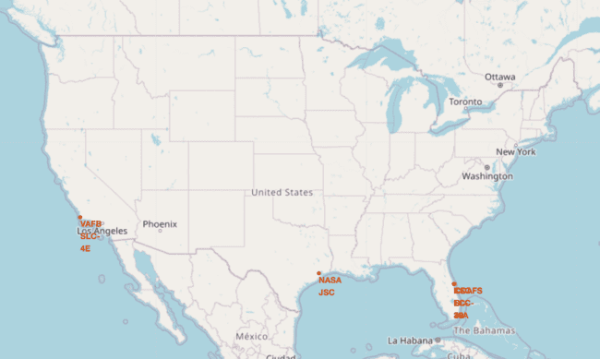
Launch Site Locations
Launch sites are located near coastal regions in Florida and California to reduce risk of catastrophic failures affecting human activities.

Slide 37
Launch Outcomes

Slide 38
Notable Proximate Locations
Notable locations shown
Railway (1.02KM)
Roadway (0.59KM)
Coast (0.86KM)

Slide 39

Section 4

Slide 40
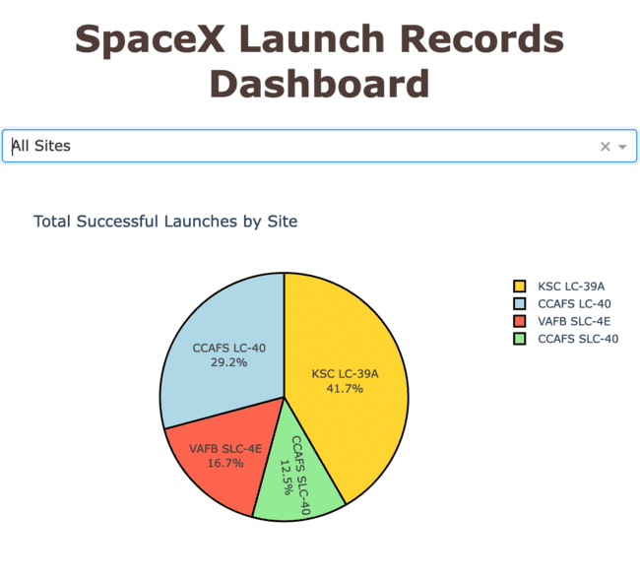
All Launch Sites: Successful Landings
KSC LC-39A experienced the highest proportion of successful landings, followed by CCAFS LC-40.
VAFB SLC-4E and CCAFS SLC-40 the lowest.

Slide 41
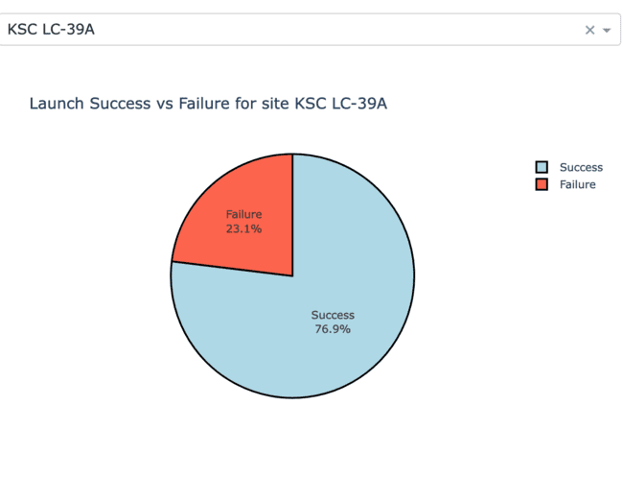
Per-site Launch Success Ratio: High
KSC LC-39A had the highest ratio of successful landings

Slide 42
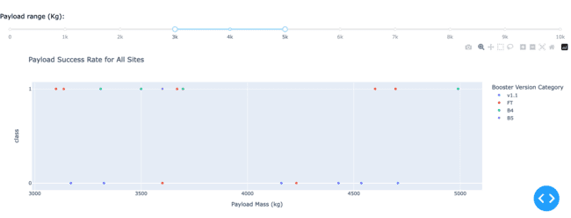
Payload Range
With a payload mass between 3,000kg and 5,000kg, v1.1 boosters performed the worst.
In the same payload range, B4 and B5 boosters had the best success rate, followed by FT.

Slide 43

Section 5

Slide 44
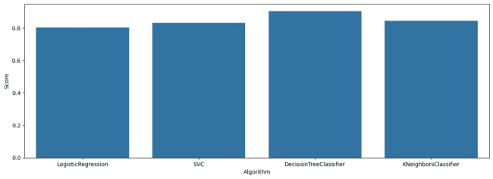
Classification Accuracy
Of the algorithms tested, the DecisionTreeClassifier was the most accurate.

Slide 45
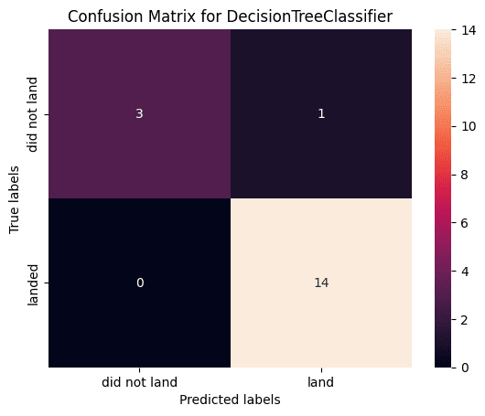
Confusion Matrix
14 observations were correctly predicted as successful landings (true positive)
3 observations were correctly predicted as failed landings (true negative)
1 observation was incorrectly predicted as a successful landing (false positive)
No observations were incorrectly predicted as a failed landing (false negative)

Slide 46
Conclusions
Success rates increase over time, across all factors, which indicates continuous and incremental operational improvements and technological advancements.
Different orbits have varying success rates, with ES-L1, SSO, HEO, and GEO showing consistently successful outcomes.
Launch site was a highly predictive factor, with KSC LC-39A being a top performer, closely followed by CCAFS LC-40.
Many of the predictive models evaluated were able to predict landing outcome with an acceptable level of accuracy. In the testing performed, DecisionTreeClassifier produced best results with high accuracy, precision, and recall.

Slide 47
Appendix
Data Sources
SpaceX API
Collected Data: dataset_part_1.csv
Wikipedia: List of Falcon 9 and Falcon Heavy launches (June 2021)
Data after wrangling: dataset_part_2.csv
Geographical data: spacex_launch_geo.csv
Interactive data source: spacex_launch_dash.csv

Slide 48


