Slide 1

Excel Final Assessment
Geethanjali D
Employee ID:4280

Slide 2
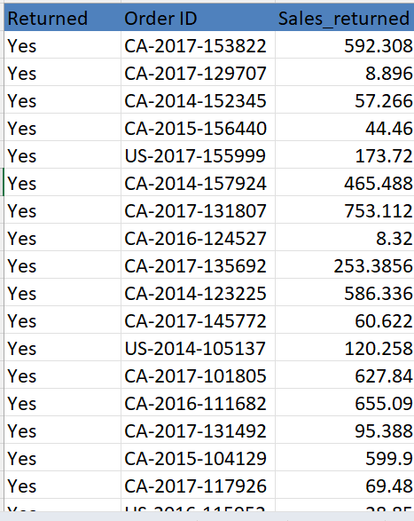
Q1:
Insights:
Formulas used:
COUNTA('Orders - copy'!A2:A9995)
COUNTIF('Orders - copy'!Y2:Y9995,"Yes")
COUNTIF('Orders - copy'!Y2:Y9995,"Yes")
SUMIFS('Orders - copy'!V2:V9995,'Orders - copy'!Y2:Y9995,"No")
SUMIFS('Orders - copy'!X2:X9995,'Orders - copy'!X2:X9995,">0",'Orders - copy'!Y2:Y9995,"No")
ABS(SUMIFS('Orders - copy'!X2:X9995,'Orders - copy'!X2:X9995,"<0"))
Inference:
Calculated the percentage of loss and percentage of orders returned over total orders.

Slide 3
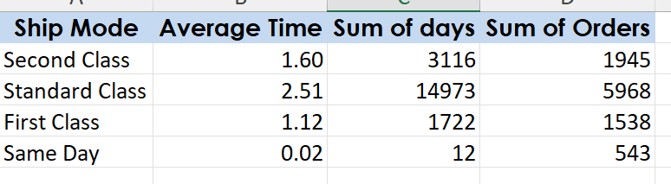
Q2:
Insights:
Identified difference using ship date and order date
Formula:B2-A2
Group by ship mode-using pivot.
By taking average of difference, we can be able to know fastest and slowest ship mode.
Inference:
Fastest mode based on average time –Same Day
Slowest mode-Second Class

Slide 5
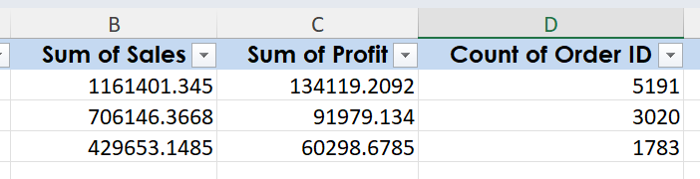
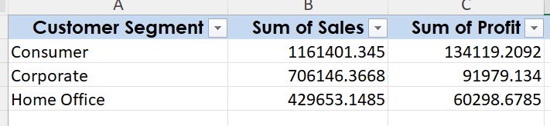
Q3:
Insights:
Using pivotable find sum of sales and profit.
Inference:
Highest value-consumer
Lowest value-Home office

Slide 7
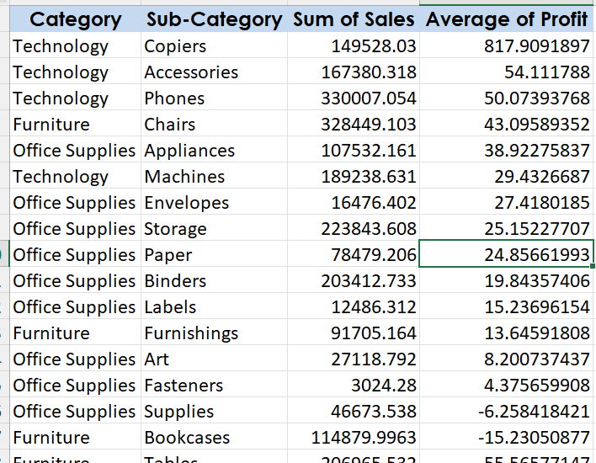
Q4:
Insights:top sales by category and subcategory using pivot table..
Inference:
The average profit provides various insights about profitability of product within each category.

Slide 10
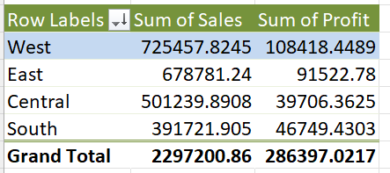
Q5:
Insights:
Group by region based on sum of sales-pivot table.
Include profitability analysis
Inference:
Highest sales: West
Lowest sales: South
From the trend we can be able to know that Central region affects profitability.

Slide 11
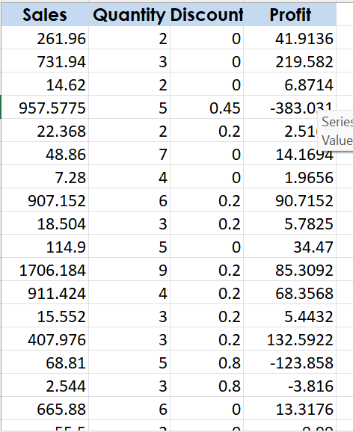
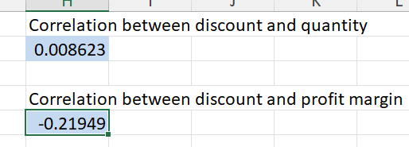
Q6:
Insights:
Impact of sales and profitability shown in the chart .
Formula used:
Profit margin:profit/sales*100
Discount rate:discount/sales*100
Correlation:
CORREL(E:E,B:B)
CORREL(E:E,F:F)
Inference:
Able to know the trend of discount over sales and profit.
Correlation between discount rate and profit:--0.21949%
Correlation between discount rate and quantity sold:0.008623%

Slide 12
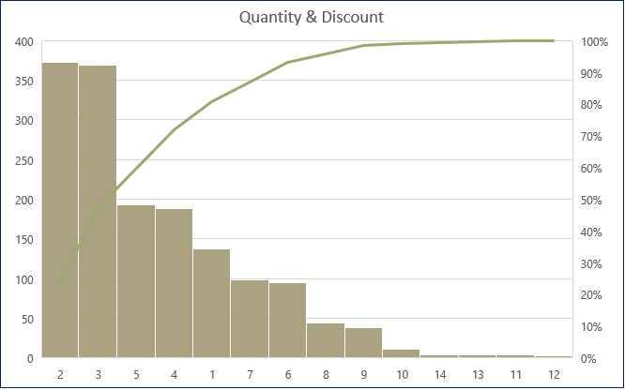

Slide 13
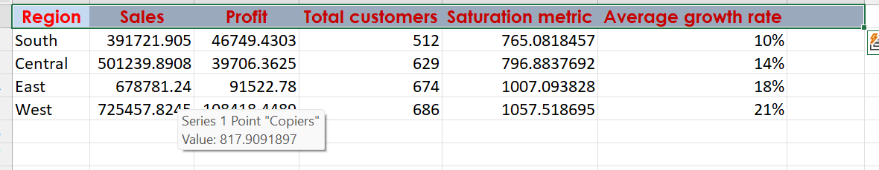
Q7:
Insights:
Here saturation metric is total sales divided by number of customers in that region
South has the lowest saturation metric
Here the formula for growth rate is (current sales - previous sales)/previous sales
We took the average values across the 4 years for each region

Slide 15
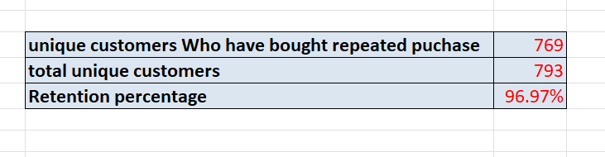
Q8:
Inference:
Unquie customers repeated purchase:769
Unique customers:793
Retention rate:96.97%

Slide 16
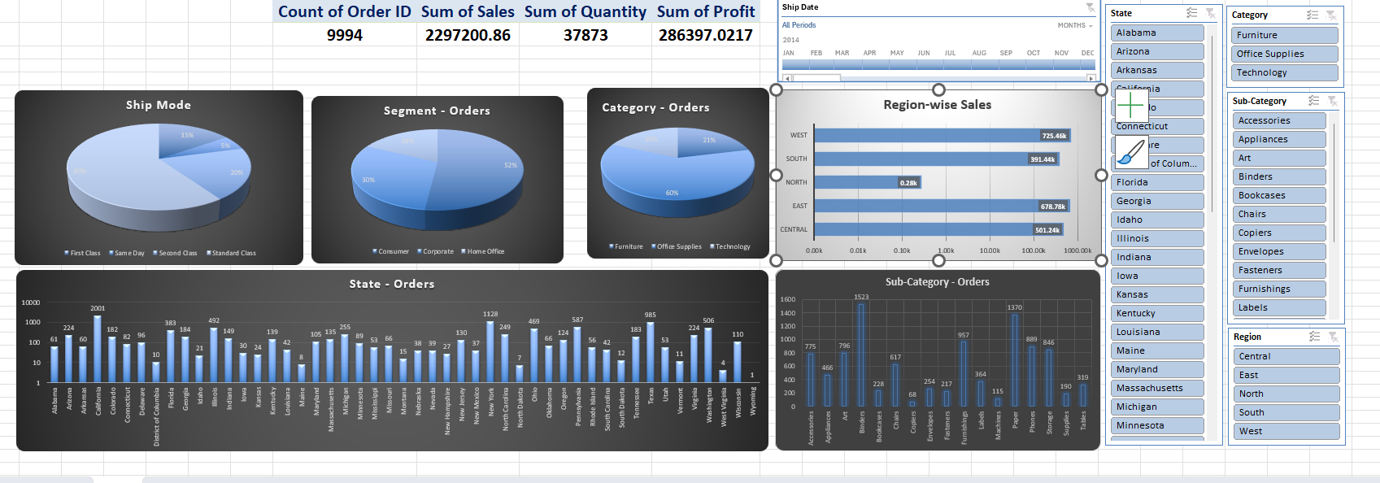
Dashboard:

