Slide 1

jQuery

Slide 2
Agenda
jQurey Basics
jQuery Selectors
jQuery Traversing
jQuery DOM Manipulation
jQuery Events

Slide 3
What is jQuery
jQuery is a JavaScript Library.
jQuery greatly simplifies JavaScript programming.
jQuery is easy to learn.
jQuery is a small and lightweight JavaScript library.
jQuery is cross-platform.
jQuery means "write less do more".
jQuery simplifies AJAX call and DOM manipulation.

Slide 4
jQuery Features
HTML manipulation
DOM manipulation
DOM element selection
CSS manipulation
Effects and Animations
Utilities
AJAX
HTML event methods
JSON Parsing
Extensibility through plug-ins

Slide 5
Why jQuery is required
It is very fast and extensible.
It facilitates the users to write UI related function codes in minimum possible lines.
It improves the performance of an application.
Browser's compatible web applications can be developed.
It uses mostly new features of new browsers.

Slide 6
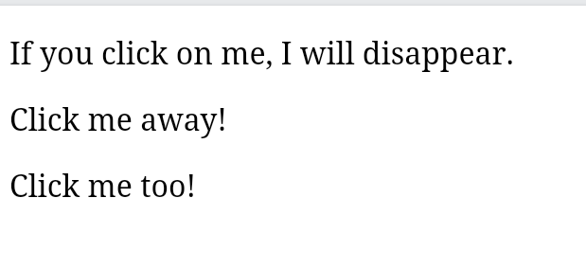
<!DOCTYPE html>
<html>
<head>
<script src="https://ajax.googleapis.com/ajax/libs/jquery/3.5.1/jquery.min.js"></script>
<script>
$(document).ready(function(){
$("p").click(function(){
$(this).hide();
});
});
</script>
</head>
<body>
<p>If you click on me, I will disappear.</p>
<p>Click me away!</p>
<p>Click me too!</p>
</body>
</html>

Slide 7
jQuery Selectors
jQuery selectors are one of the most important parts of the jQuery library.
jQuery selectors allow you to select and manipulate HTML element(s).
jQuery selectors are used to "find" (or select) HTML elements based on their name, id, classes, types, attributes, values of attributes and much more. It's based on the existing CSS Selectors, and in addition, it has some own custom selectors.
All selectors in jQuery start with the dollar sign and parentheses: $().

Slide 8
The element Selector
The #id Selector
The .class Selector

Slide 9
The element Selector
The jQuery element selector selects elements based on the element name.
You can select all <p> elements on a page like this:
$("p")

Slide 10
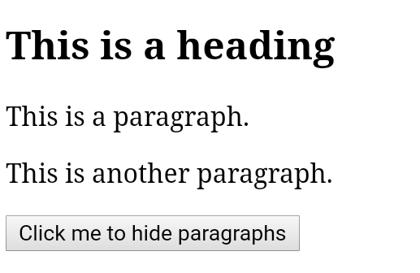
<!DOCTYPE html>
<html>
<head>
<script src="https://ajax.googleapis.com/ajax/libs/jquery/3.5.1/jquery.min.js"></script>
<script>
$(document).ready(function(){
$("button").click(function(){
$("p").hide();
});
});
</script>
</head>
<body>
<h2>This is a heading</h2>
<p>This is a paragraph.</p>
<p>This is another paragraph.</p>
<button>Click me to hide paragraphs</button>
</body>
</html>

Slide 11
The #id Selector
The jQuery #id selector uses the id attribute of an HTML tag to find the specific element.
An id should be unique within a page, so you should use the #id selector when you want to find a single, unique element.
To find an element with a specific id, write a hash character, followed by the id of the HTML element:
$("#test")

Slide 12
<!DOCTYPE html>
<html>
<head>
<script src="https://ajax.googleapis.com/ajax/libs/jquery/3.5.1/jquery.min.js"></script>
<script>
$(document).ready(function(){
$("button").click(function(){
$("#test").hide();
});
});
</script>
</head>
<body>
<h2>This is a heading</h2>
<p>This is a paragraph.</p>
<p id="test">This is another paragraph.</p>
<button>Click me</button>
</body>
</html>

Slide 13
The .class Selector
The jQuery .class selector finds elements with a specific class.
To find elements with a specific class, write a period character, followed by the name of the class:
$(".test")

Slide 14
What is Traversing?
jQuery traversing, which means "move through", are used to "find" (or select) HTML elements based on their relation to other elements.
Start with one selection and move through that selection until you reach the elements you desire.

Slide 15
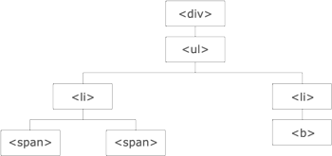

Slide 16
Traversing the DOM
Three useful jQuery methods for traversing up the DOM tree are:
parent()
parents()
parentsUntil()

Slide 17
jQuery parent() Method
The parent() method returns the direct parent element of the selected element.
This method only traverse a single

Slide 18
jQuery parents() Method
The parents() method returns all ancestor elements of the selected element, all the way up to the document's root element (<html>).

Slide 19
jQuery parentsUntil() Method
The parentsUntil() method returns all ancestor elements between two given arguments.

Slide 20
jQuery DOM Manipulation
One very important part of jQuery is the possibility to manipulate the DOM.
jQuery comes with a bunch of DOM related methods that make it easy to access and manipulate elements and attributes
DOM = Document Object Model
The DOM defines a standard for accessing HTML and XML documents:

Slide 21
Get Content - text(), html(), and val()
Three simple, but useful, jQuery methods for DOM manipulation are:
text() - Sets or returns the text content of selected elements
html() - Sets or returns the content of selected elements (including HTML markup)
val() - Sets or returns the value of form fields

Slide 22
jQuery - Set Content and Attributes
Set Content - text(), html(), and val()
We will use the same three methods from the previous page to set content:
text() - Sets or returns the text content of selected elements
html() - Sets or returns the content of selected elements (including HTML markup)
val() - Sets or returns the value of form fields

Slide 23
jQuery - Add Elements
Add New HTML Content
We will look at four jQuery methods that are used to add new content:
append() - Inserts content at the end of the selected elements
prepend() - Inserts content at the beginning of the selected elements
after() - Inserts content after the selected elements
before() - Inserts content before the selected elements

Slide 24
jQuery - Remove Elements
With jQuery, it is easy to remove existing HTML elements.
Remove Elements/Content
To remove elements and content, there are mainly two jQuery methods:
remove() - Removes the selected element (and its child elements)
empty() - Removes the child elements from the selected element

Slide 25
jQuery Event Methods
All the different visitors' actions that a web page can respond to are called events.
An event represents the precise moment when something happens.
Examples:
moving a mouse over an element
selecting a radio button
clicking on an element

Slide 26
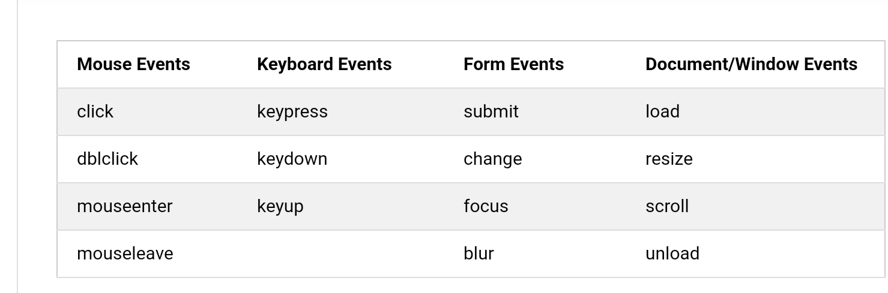

Slide 27
