Slide 1


Slide 2
Agenda
Getting started with PL/SQL
Conditional control
Iterative processing with loops
Select Into
Exception handlers
Records
Cursors
Stored procedures and Functions
Packages
PL/SQL Collections

Slide 3
Getting started with PL/SQL

Slide 4
What is PL/SQL – introduce you to PL/SQL programming language and its architecture.
Anonymous Block – explain PL/SQL anonymous blocks and shows you how to execute an anonymous block in SQL*Plus and Oracle SQL Developer tools.
Data Types – give you a brief overview of PL/SQL data types including number, Boolean, character, and datetime.
Variables – introduce you to PL/SQL variables and shows you how to manipulate variables in programs efficiently.
Comments – use single-line or multi-line comments to document your code to make it more readable and maintainable.
Constants – learn how to declare constants that hold values that remain unchanged throughout the execution of the program.

Slide 5
Introduction to PL/SQL
PL/SQL stands for “Procedural Language extensions to the Structured Query Language”.
SQL is a popular language for both querying and updating data in the relational database management systems (RDBMS).
PL/SQL adds many procedural constructs to SQL language to overcome some limitations of SQL.

Slide 6
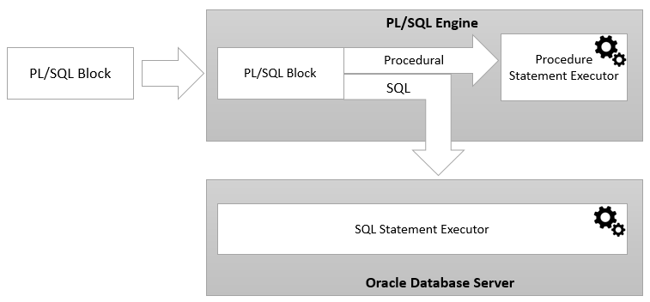
PL/SQL architecture

Slide 7
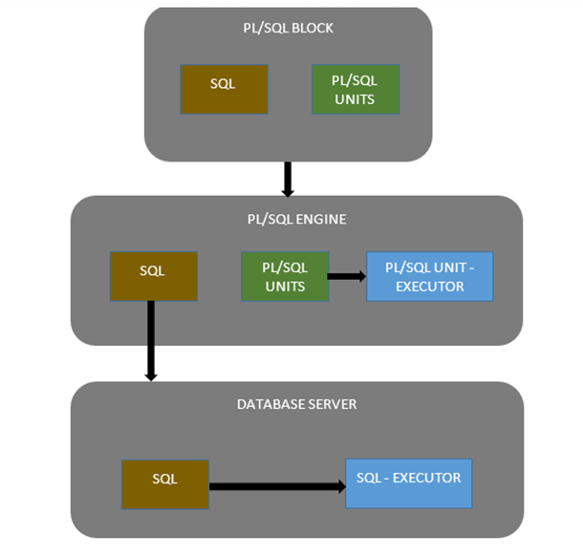

Slide 8
Features & Advantages of PL/SQL
Better performance, as SQL is executed in bulk rather than a single statement
High Productivity
Tight integration with SQL
Full Portability
Tight Security
Supports Object Oriented Programming concepts.
Scalability and Manageability
Supports Web Application Development
Supports Server Page Development

Slide 9
Disadvantages of PL/SQL
Stored Procedures in PL/SQL uses high memory
Lacks functionality debugging in stored procedures
Any change in underlying database requires change in the presentation layer also
Does not completely separate roles of back-end developer and fron-end developer
Difficult to separate HTML development with PL/SQL development

Slide 10
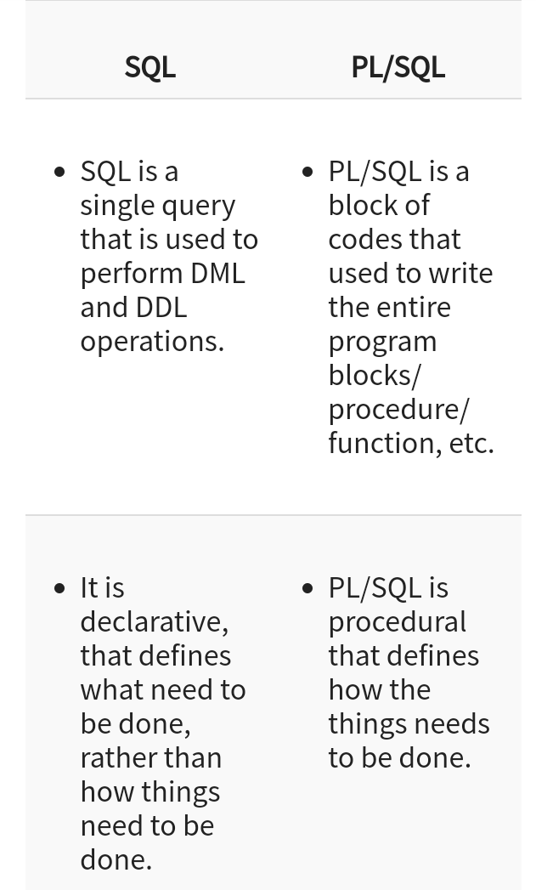
Difference between SQL and PL/SQL

Slide 11
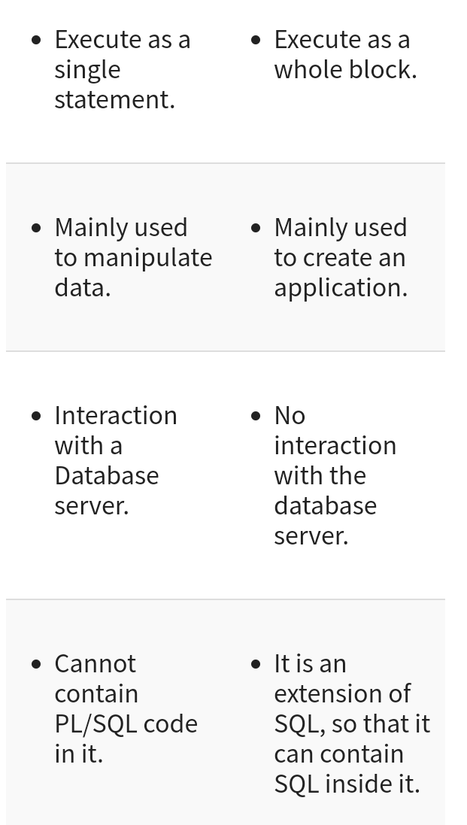

Slide 12
PL/SQL Anonymous Block
PL/SQL is a block-structured language whose code is organized into blocks.
A PL/SQL block consists of three sections: declaration, executable, and exception-handling sections.
In a block, the executable section is mandatory while the declaration and exception-handling sections are optional.

Slide 13
A PL/SQL block has a name. Functions or Procedures is an example of a named block. A named block is stored into the Oracle Database server and can be reused later.
A block without a name is an anonymous block. An anonymous block is not saved in the Oracle Database server, so it is just for one-time use. However, PL/SQL anonymous blocks can be useful for testing purposes.

Slide 14
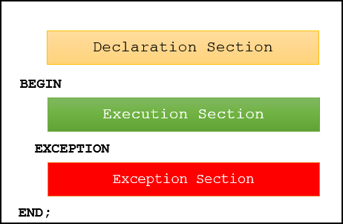

Slide 15
PL/SQL anonymous block example
BEGIN
DBMS_OUTPUT.put_line ('Hello World!');
END;
DECLARE
l_message VARCHAR2( 255 ) := 'Hello World!';
BEGIN
DBMS_OUTPUT.PUT_LINE( l_message );
END;

Slide 16
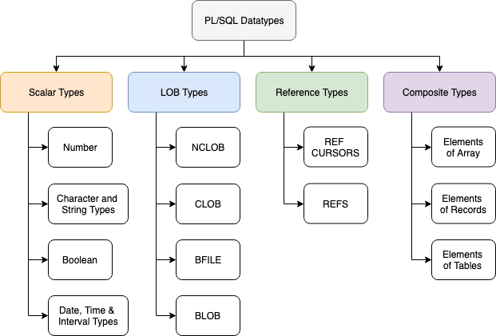
PL/SQL Data Types

Slide 17
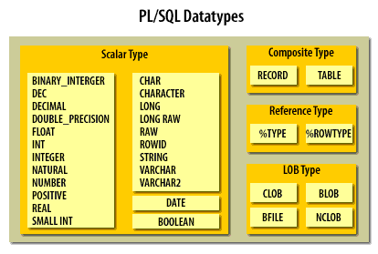

Slide 18
PL/SQL Variables
First, specify the name of the variable. The name of the variable should be as descriptive as possible, e.g., l_total_sales, l_credit_limit, and l_sales_revenue.
Second, choose an appropriate data type for the variable, depending on the kind of value which you want to store, for example, number, character, Boolean, and datetime.
By convention, local variable names should start with l_ and global variable names should have a prefix of g_ .
variable_name datatype [NOT NULL] [:= initial_value];

Slide 19
DECLARE
l_total_sales NUMBER(15,2);
l_credit_limit NUMBER (10,0);
l_contact_name VARCHAR2(255);
BEGIN
NULL;
END;

Slide 20
PL/SQL Comments
Single-line comments
-- valued added tax 10%
DECLARE co_vat_rate CONSTANT NUMBER := 0.1;
Multi-line comments
/*
This is a multi-line comment
that can span multiple lines
*/

Slide 21
PL/SQL Constants
Unlike a variable, a constant holds a value that does not change throughout the execution of the program.
Constants make your code more readable.
constant_name CONSTANT datatype [NOT NULL] := expression
DECLARE
co_payment_term CONSTANT NUMBER := 45; -- days
co_payment_status CONSTANT BOOLEAN := FALSE;
BEGIN
NULL;
END;

Slide 22
PL/SQL IF Statement
The IF statement allows you to either execute or skip a sequence of statements, depending on a condition. The IF statement has the three forms:
– IF THEN
– IF THEN ELSE
– IF THEN ELSIF

Slide 23
PL/SQL CASE Statement
CASE selector
WHEN selector_value_1 THEN
statements_1
WHEN selector_value_1 THEN
statement_2
...
ELSE
else_statements
END CASE;

Slide 24
PL/SQL GOTO Statement
The GOTO statement allows you to transfer control to a labeled block or statement. The following illustrates the syntax of the GOTO statement:
GOTO label_name;
<<label_name>>;

Slide 25
NULL Statement
The PL/SQL NULL statement has the following format:
NULL;
Code language: SQL (Structured Query Language) (sql)
The NULL statement is a NULL keyword followed by a semicolon ( ;). The NULL statement does nothing except that it passes control to the next statement.

Slide 26
PL/SQL LOOP
The PL/SQL LOOP statement has the following structure:
<<label>> LOOP
statements;
END LOOP loop_label;
Code language: SQL (Structured Query Language) (sql)
This structure is the most basic of all the loop constructs including FOR LOOP and WHILE LOOP. This basic LOOP statement consists of a LOOP keyword, a body of executable code, and the END LOOP keywords.

Slide 27
It is a good practice to use the LOOP statement when:
You want to execute the loop body at least once.
You are not sure the number of times you want the loop to execute

Slide 28
PL/SQL FOR LOOP
PL/SQL FOR LOOP executes a sequence of statements a specified number of times. The PL/SQL FOR LOOP statement has the following structure:
FOR index IN lower_bound .. upper_bound
LOOP
statements;
END LOOP;
Code language: SQL (Structured Query Language) (sql)
The index is an implicit variable. It is local to the FOR LOOP statement. In other words, you cannot reference it outside the loop.

Slide 29
PL/SQL WHILE Loop
Here is the syntax for the WHILE loop statement:
WHILE condition
LOOP
statements;
END LOOP;
Code language: SQL (Structured Query Language) (sql)
The condition in the WHILE is a Boolean expression that evaluates to TRUE, FALSE or NULL.
The WHILE loop statement continues to execute the statements between the LOOP and END LOOP as long as the condition in the WHILE clause evaluates to TRUE

Slide 30
PL/SQL CONTINUE
The CONTINUE statement allows you to exit the current loop iteration and immediately continue on to the next iteration of that loop.
The CONTINUE statement has a simple syntax:
CONTINUE;
Code language: SQL (Structured Query Language) (sql)
Typically, the CONTINUE statement is used within an IF THEN statement to exit the current loop iteration based on a specified condition as shown below:
IF condition THEN
CONTINUE;
END IF;
Code language: SQL (Structured Query Language) (sql)
The CONTINUE can be used in all loop constructs including LOOP, FOR LOOP and WHILE LOOP.

Slide 31
PL/SQL SELECT INTO
PL/SQL SELECT INTO statement is the simplest and fastest way to fetch a single row from a table into variables. The following illustrates the syntax of the PL/SQL SELECT INTO statement:.
SELECT
select_list
INTO
variable_list
FROM
table_name
WHERE
condition;

Slide 32
PL/SQL Exception
PL/SQL treats all errors that occur in an anonymous block, procedure, or function as exceptions.
The exceptions can have different causes such as coding mistakes, bugs, even hardware failures.
It is not possible to anticipate all potential exceptions, however, you can write code to handle exceptions to enable the program to continue running as normal.
The code that you write to handle exceptions is called an exception handler.

Slide 33
BEGIN
-- executable section
...
-- exception-handling section
EXCEPTION
WHEN e1 THEN
-- exception_handler1
WHEN e2 THEN
-- exception_handler1
WHEN OTHERS THEN
-- other_exception_handler
END;

Slide 34
PL/SQL Raise Exceptions
To raise an exception explicitly, you use the RAISE statement. The RAISE statement allows you to:
Raise a user-defined exception.
Raise an internally defined exception.
Reraising the current exception.

Slide 35

PL/SQL Record
A PL/SQL record is a composite data structure which consists of multiple fields; each has its own value.
The following picture shows an example record that includes first name, last name, email, and phone number:

Slide 36
PL/SQL record helps you simplify your code by shifting from field-level to record-level operations.
PL/SQL has three types of records: table-based, cursor-based, programmer-defined. Before using a record, you must declare it.
Declaring records
You define and declare records in the declaration section of a block or via package specification.

Slide 37
PL/SQL Cursor
Implicit cursors
Whenever Oracle executes an SQL statement such as SELECT INTO, INSERT, UPDATE, and DELETE, it automatically creates an implicit cursor.
Oracle internally manages the whole execution cycle of implicit cursors and reveals only the cursor’s information and statuses such as SQL%ROWCOUNT, SQL%ISOPEN, SQL%FOUND, and SQL%NOTFOUND.
The implicit cursor is not elegant when the query returns zero or multiple rows which cause NO_DATA_FOUND or TOO_MANY_ROWS exception respectively.

Slide 38
Explicit cursors
An explicit cursor is an SELECT statement declared explicitly in the declaration section of the current block or a package specification.
For an explicit cursor, you have control over its execution cycle from OPEN, FETCH, and CLOSE.
Oracle defines an execution cycle that executes an SQL statement and associates a cursor with it.

Slide 39
1) %ISOPEN
This attribute is TRUE if the cursor is open or FALSE if it is not.
2) %FOUND
This attribute has four values:
NULL before the first fetch
TRUE if a record was fetched successfully
FALSE if no row returned
INVALID_CURSOR if the cursor is not opened
3) %NOTFOUND
This attribute has four values:
NULL before the first fetch
FALSE if a record was fetched successfully
TRUE if no row returned
INVALID_CURSOR if the cursor is not opened
3) %ROWCOUNT
The %ROWCOUNT attribute returns the number of rows fetched from the cursor. If the cursor is not opened, this attribute returns INVALID_CURSOR.

Slide 40
PL/SQL Procedure
A PL/SQL procedure is a reusable unit that encapsulates specific business logic of the application. Technically speaking, a PL/SQL procedure is a named block stored as a schema object in the Oracle Database.
CREATE [OR REPLACE ] PROCEDURE procedure_name (parameter_list)
IS

Slide 41
[declaration statements]
BEGIN
[execution statements]
EXCEPTION
[exception handler]
END [procedure_name ];

Slide 42
Packages
In PL/SQL, a package is a schema object that contains definitions for a group of related functionalities. A package includes variables, constants, cursors, exceptions, procedures, functions, and subprograms. It is compiled and stored in the Oracle Database.
Typically, a package has a specification and a body. A package specification is mandatory while the package body can be required or optional, depending on the package specification.

Slide 43
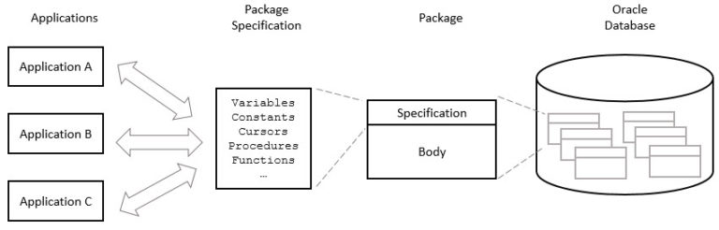

Slide 44
Triggers
Triggers – introduce you to the Oracle trigger and show you how to create a new trigger.
Statement-level triggers – learn how to use statement-level triggers to enforce additional security to the transaction.
Row-level triggers – show you how to use row-level triggers for data-related activities.
INSTEAD OF triggers – learn how to use the INSTEAD OF triggers to update tables via their views which cannot be modified directly through DML statements.
Disable triggers – show you to disable a trigger or all triggers of a table.
Enable triggers – describe steps to enable a trigger or all triggers of a table.
Drop Triggers – guide you on how to drop a trigger from the database.
How to fix the mutating table error – learn about the mutating table error and how to fix it using a compound trigger

Slide 45
A trigger is a named PL/SQL block stored in the Oracle Database and executed automatically when a triggering event takes place. The event can be any of the following:
A data manipulation language (DML) statement executed against a table e.g., INSERT, UPDATE, or DELETE. For example, if you define a trigger that fires before an INSERT statement on the customers table, the trigger will fire once before a new row is inserted into the customers table.
A data definition language (DDL) statement executes e.g., CREATE or ALTER statement. These triggers are often used for auditing purposes to record changes of the schema.
A system event such as startup or shutdown of the Oracle Database.
A user event such as login or logout

Slide 46
PL/SQL Collections
Associative Arrays – introduce you to associative arrays including declaring associative arrays, populating values, and iterating over array elements.
Nested Tables – learn about nested tables.
VARRAY – learn about variable-sized array and how to manipulate its elements effectively.

Slide 47
Associative arrays are single-dimensional, unbounded, sparse collections of homogeneous elements.
First, an associative array is single-dimensional. It means that an associative array has a single column of data in each row, which is similar to a one-dimension array.
Second, an associative array is unbounded, meaning that it has a predetermined limits number of elements.
Third, an associative array is sparse because its elements are not sequential. In other words, an associative array may have gaps between elements.
Finally, an associative array has elements which have the same data type, or we call them homogenous elements.

Slide 48


