Slide 1
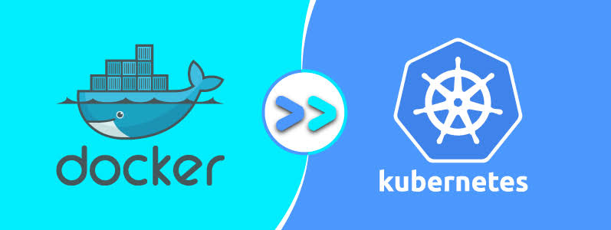

Slide 2
Agenda
What is an Image
Image Creation and sharing
Docker File
Optimizing a Docker File
Docker hub
What is Kubernetes
Introduction to Kubernetes and Orchestrating Apps

Slide 3
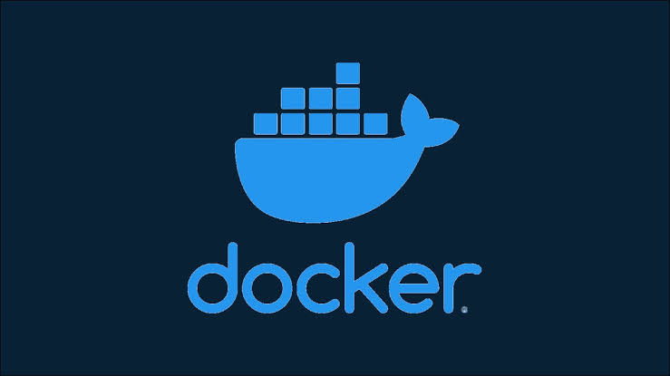
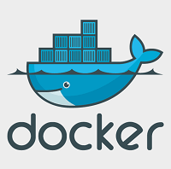

Slide 4
What is Docker?
Docker is an open-source centralized platform designed to create, deploy, and run applications.
Docker uses container on the host's operating system to run applications. It allows applications to use the same Linux kernel as a system on the host computer, rather than creating a whole virtual operating system.
Containers ensure that our application works in any environment like development, test, or production.
Docker includes components such as Docker client, Docker server, Docker machine, Docker hub, Docker composes, etc

Slide 5
Docker Containers
Docker containers are the lightweight alternatives of the virtual machine.
It allows developers to package up the application with all its libraries and dependencies, and ship it as a single package.
The advantage of using a docker container is that you don't need to allocate any RAM and disk space for the applications.
It automatically generates storage and space according to the application requirement.

Slide 6
Virtual Machine
A virtual machine is a software that allows us to install and use other operating systems (Windows, Linux, and Debian) simultaneously on our machine. The operating system in which virtual machine runs are called virtualized operating systems.
These virtualized operating systems can run programs and preforms tasks that we perform in a real operating system.

Slide 7
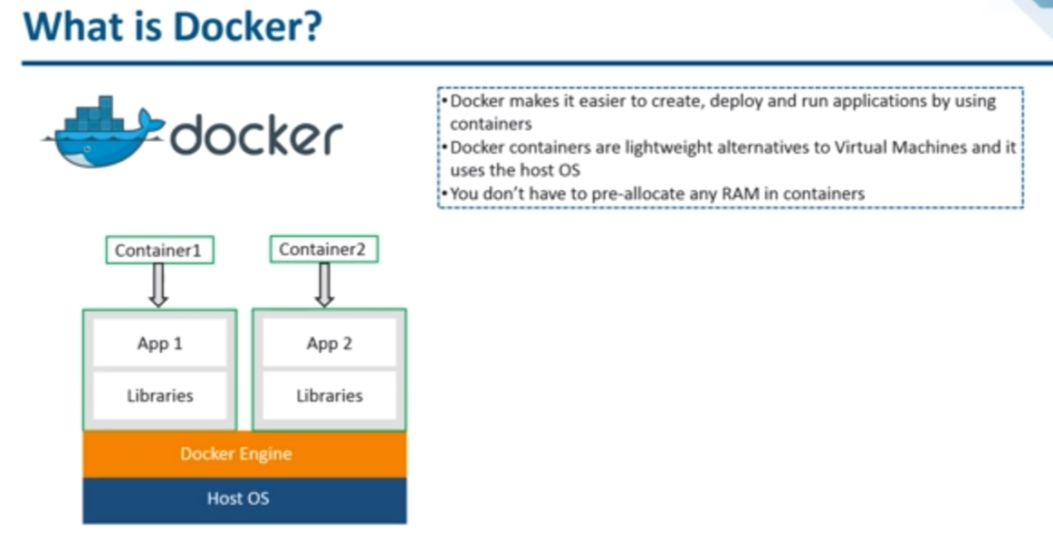

Slide 8
Docker Features
Easy and Faster Configuration
Increase productivity
Application Isolation
Swarm
Routing Mesh
Services
Security Management

Slide 9
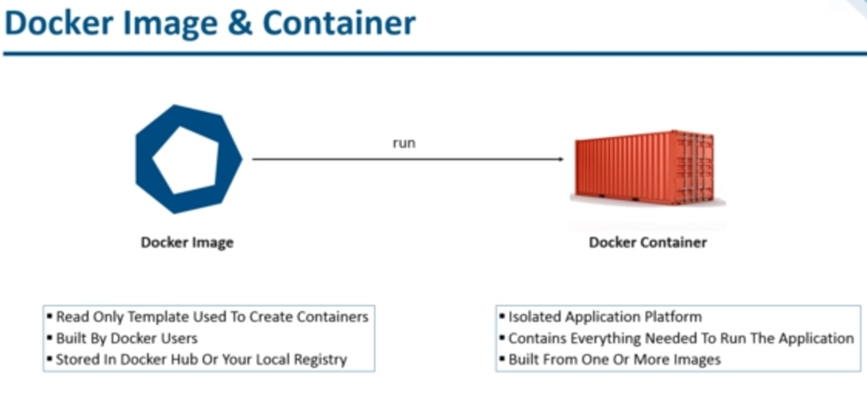

Slide 10
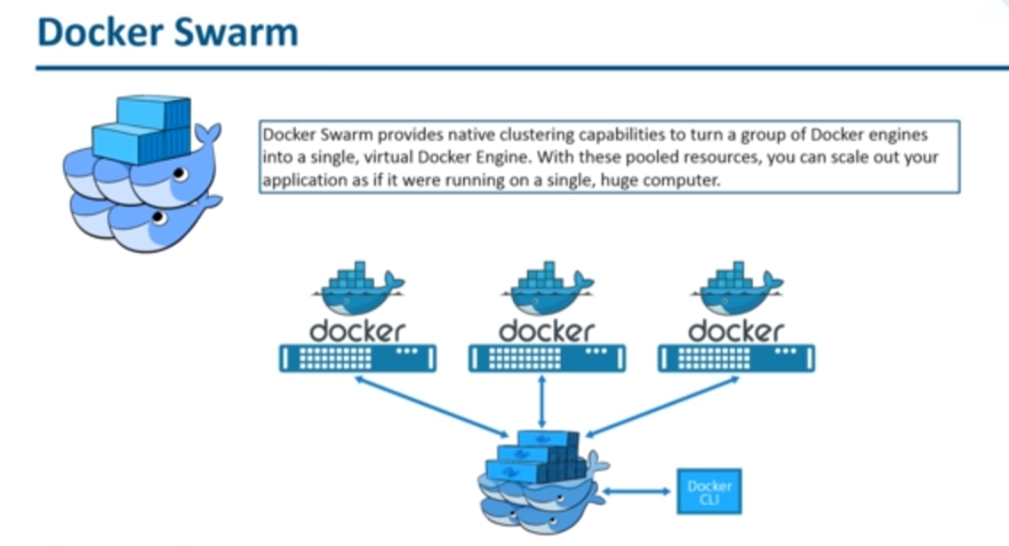

Slide 11
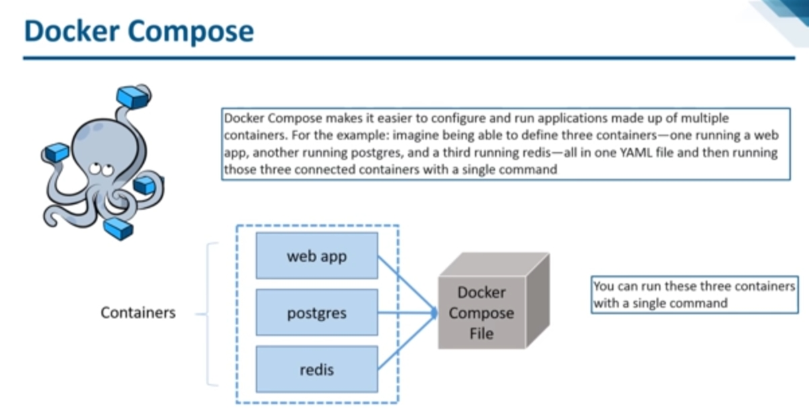

Slide 12
Advantages of Docker
It runs the container in seconds instead of minutes.
It uses less memory.
It provides lightweight virtualization.
It does not a require full operating system to run applications.
It uses application dependencies to reduce the risk.
Docker allows you to use a remote repository to share your container with others.

Slide 13
Docker Engine
A server which is a type of long-running program called a daemon process.
The REST API is used to specify interfaces that programs can use to talk to the daemon and instruct it what to do.
A command line interface client.

Slide 14
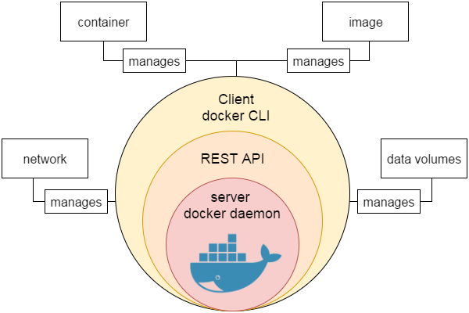

Slide 15
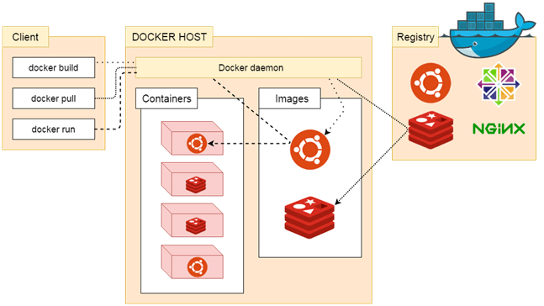
Docker Architecture

Slide 16
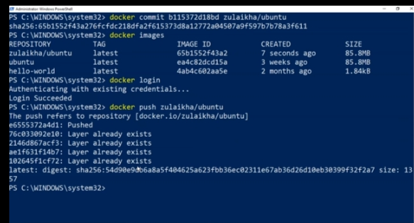

Slide 17
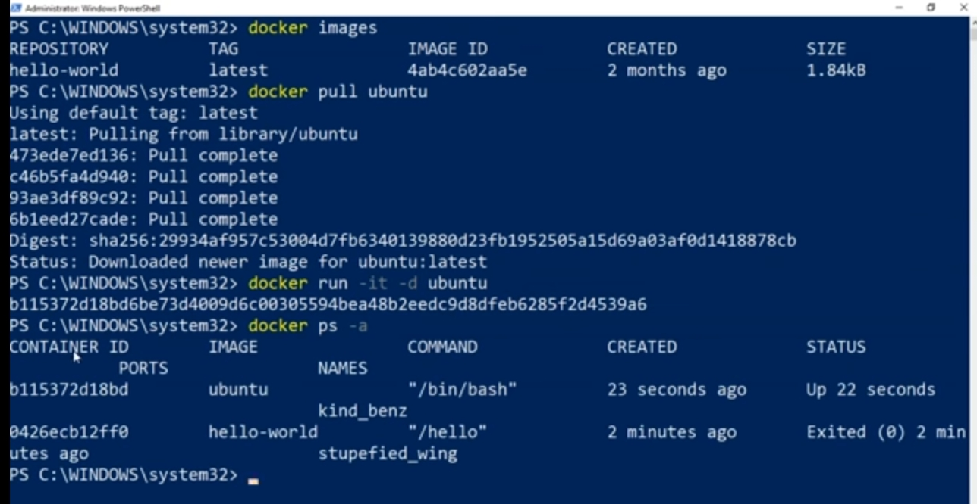

Slide 18
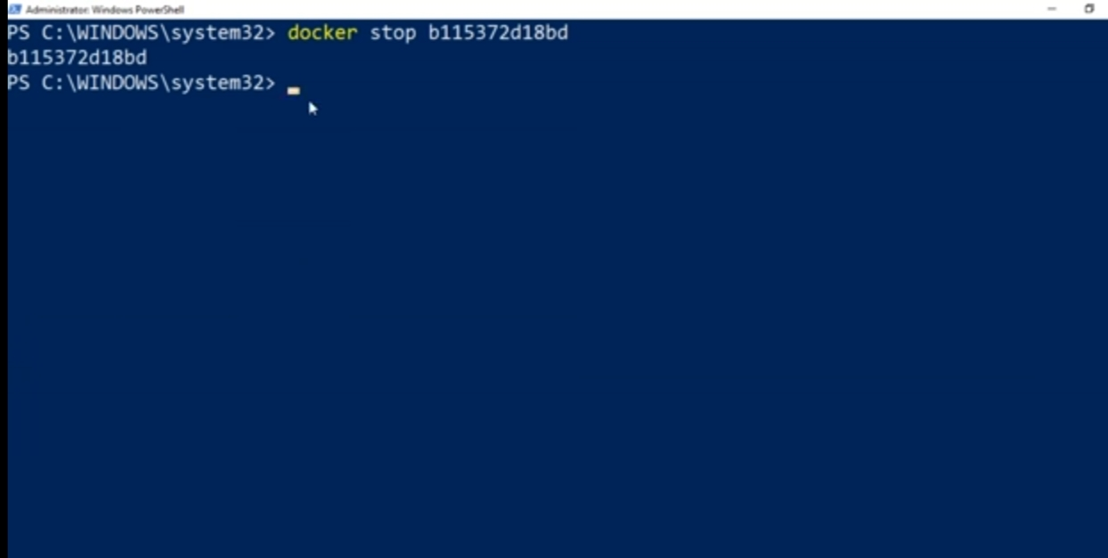

Slide 19
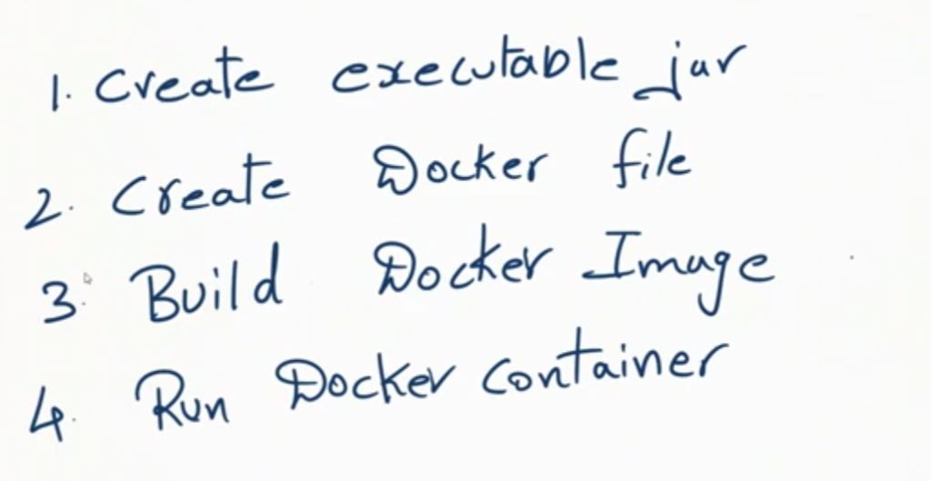

Slide 20
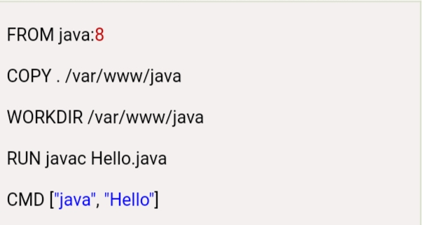
Docker file

Slide 21
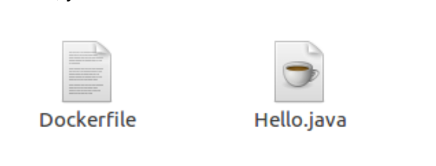

Slide 22
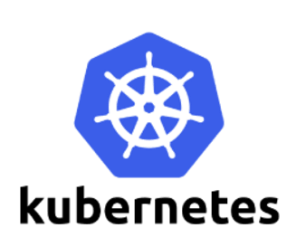
Kubernetes - Container Orchestration

Slide 23
Agenda
Introduction to Kubernetes
What, Why and Features of Kubernetes, Kubernetes Architecture
Kubernetes Cluster, Master, Node
Kubernetes Architecture
Kubernetes Basics Modules ( Create a Kubernetes Cluster, Deploy an App, Explore your App, Expose your app publicly, Scale up your App, Update your app)

Slide 24
What is Kubernetes?
Kubernetes is also known as 'k8s'.
Kubernetes is a container management technology developed in Google lab to manage containerized applications in different kind of environments such as physical, virtual, and cloud infrastructure.
It is mainly used to automate the deployment, scaling, and operations of the container-based applications across the cluster of nodes. It is also designed for managing the services of containerized apps using different methods which provide the scalability, predictability, and high availability.
It is an open source system which helps in creating and managing containerization of application.

Slide 25
Features of Kubernetes
Continues development, integration and deployment
Containerized infrastructure
Application-centric management
Auto-scalable infrastructure
Environment consistency across development testing and production
Loosely coupled infrastructure, where each component can act as a separate unit
Higher density of resource utilization
Predictable infrastructure which is going to be created

Slide 26
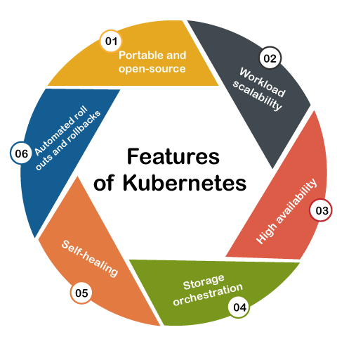

Slide 27
Key Objects of Kubernetes
Pod:It is the smallest and simplest basic unit of the Kubernetes application. This object indicates the processes which are running in the cluster.
Node:A node is nothing but a single host, which is used to run the virtual or physical machines. A node in the Kubernetes cluster is also known as a minion.
Service:A service in a Kubernetes is a logical set of pods, which works together. With the help of services, users can easily manage load balancing configurations.
ReplicaSet:A ReplicaSet in the Kubernetes is used to identify the particular number of pod replicas are running at a given time. It replaces the replication controller because it is more powerful and allows a user to use the "set-based" label selector.
Namespace:Kubernetes supports various virtual clusters, which are known as namespaces. It is a way of dividing the cluster resources between two or more users.

Slide 28
Kubernetes Architecture

Slide 29
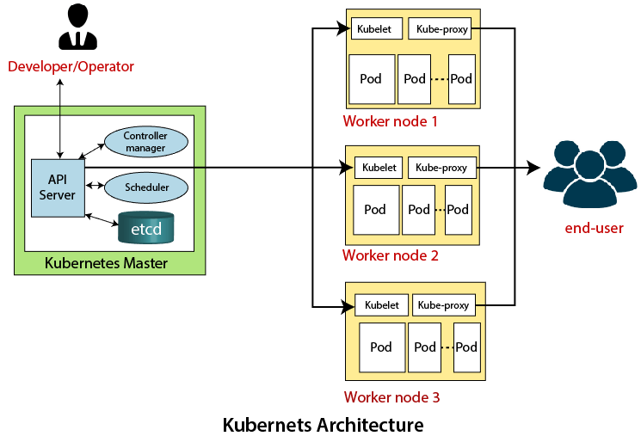

Slide 30
Installation of Kubernetes
https://dev.to/devcrafter91/how-to-install-kubernetes-on-windows-10-55b6

Slide 31
create kubernetes cluster on windows 10
kind
minikube
kubeadm
https://kubernetes.io/docs/tasks/tools/

Slide 32
minikube start
minikube is local Kubernetes, focusing on making it easy to learn and develop for Kubernetes.
All you need is Docker (or similarly compatible) container or a Virtual Machine environment, and Kubernetes is a single command away: minikube start
https://minikube.sigs.k8s.io/docs/start/

Slide 33
Specifying Application Information
App name (essential): Name for our application. A label along with a name will be included in the Service and Deployment will be deployed.
An application name should be specific in the chosen Kubernetes namespace. It should begin with the lowercase character, and it will be ended with the lowercase number or a character. It also includes lowercase letters, dashes, and numbers only. It is restricted to up to 24 characters. Trailing and leading spaces are avoided.
Container image (essential): Any URL of the public Docker container image over a private image or registry (hosted commonly on a Docker Hub or Google Container Registry). The specification of a container image must be ended with the colon.
Pods number (essential): The pod's target number we wish our application to be expanded in. The value should be any positive digit.A Deployment will be made for maintaining the pod desired number around our cluster.
Service (optional): We may wish to expose any Service to a public or maybe external IP address outer to our cluster (outside Service) for a few parts of our application (such as for frontends).

Slide 34
Kubernetes Dashboard
The Dashboard can be defined as a web-based user interface of Kubernetes.
We can use the dashboard for deploying containerized applications to any Kubernetes cluster, manage the resources of the cluster, and troubleshoot our containerized applications.
Dashboard UI Deployment
By default, the Dashboard UI isn't deployed. Run the below command for deploying it:
kubectl apply https://raw.githubusercontent.com/kubernetes/dashboard/v2.0.0/aio/deploy/recommended.yaml

Slide 35
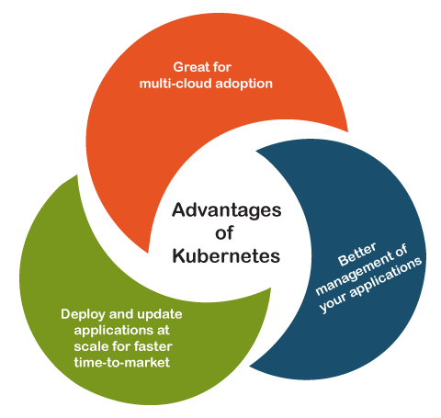

Slide 36
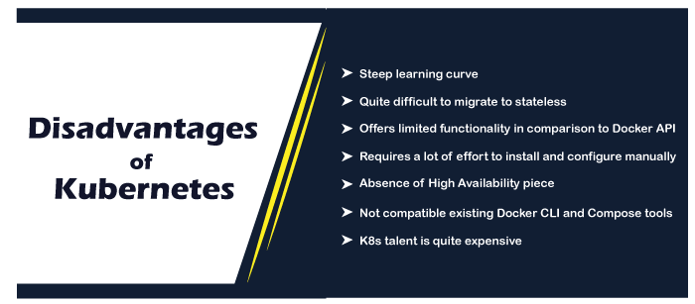

Slide 37
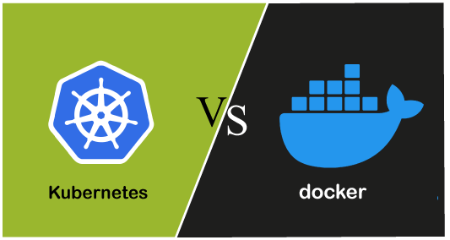

Slide 38
Application definition
Installation and set-up
Working on two systems
Logging and monitoring
Scalability
High availability
Networking

Slide 39
