Slide 1


Slide 2

Agenda
CSS3 - Introduction
CSS3 - Selectors
CSS3 - Styling
CSS3 - Box Model
CSS3 - Advanced

Slide 3

CSS3 - Introduction
Need and Benefits of CSS
Setup
CSS Syntax
CSS Comments
Including CSS in HTML Documents(Inline styles, Embedded styles, External style sheets)

Slide 4
CSS stands for Cascading Style Sheets
CSS describes how HTML elements are to be displayed on screen, paper, or in other media
CSS saves a lot of work. It can control the layout of multiple web pages all at once
External stylesheets are stored in CSS files

Slide 5
Need and benefits of css
Easier to maintain and update
Create Stunning Web site
Greater consistency in design
More formatting options
Lightweight code
Pages load faster
Faster download times
Search engine optimization benefits
Ease of presenting different styles to different viewers
Greater accessibility

Slide 6
Setups
Basic word processing using any text editor notepad++, sublime text 3,vscode, eclipse.
How to create directories and files.
How to navigate through different directories.
Internet browsing using popular browsers like Internet Explorer or Firefox.
Developing simple Web Pages using HTML or XHTML.

Slide 7
Syntax
<!DOCTYPE html>
<html>
<head>
<style>
body {
background-color: lightblue;
}
h1 {
color: white;
text-align: center;
}
p {
font-family: verdana;
font-size: 20px;
}
</style>
</head>

Slide 8
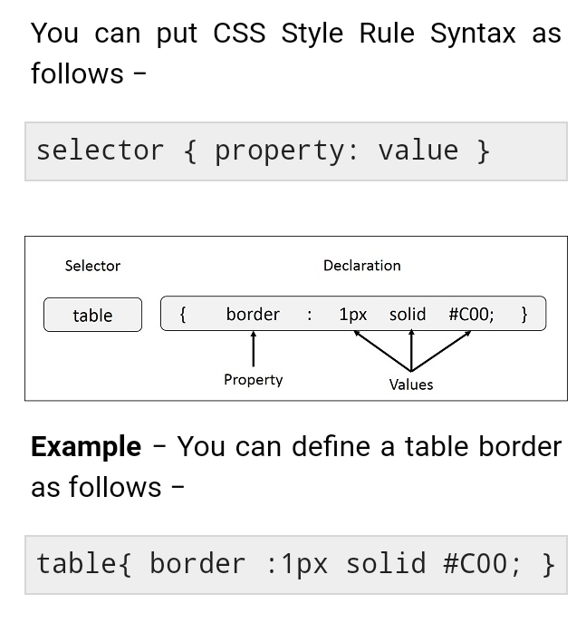

Slide 9
CSS Comments
Comments are used to explain the code, and may help when you edit the source code at a later date.
Comments are ignored by browsers.
A CSS comment is placed inside the <style> element, and starts with /* and ends with */

Slide 10
<!DOCTYPE html>
<html>
<head>
<style>
/* This is a single-line comment */
p {
color: red;
}
</style>
</head>
<body>
<p>Hello World!</p>
<p>This paragraph is styled with CSS.</p>
<p>CSS comments are not shown in the output.</p>
</body>
</html>

Slide 11
Embedded CSS - The <style> Element
You can put your CSS rules into an HTML document using the <style> element.
This tag is placed inside the <head>...</head> tags. Rules defined using this syntax will be applied to all the elements available in the document.

Slide 12
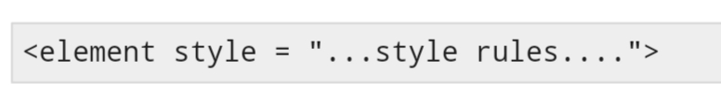
Inline CSS - The style Attribute
You can use style attribute of any HTML element to define style rules.
These rules will be applied to that element only

Slide 13
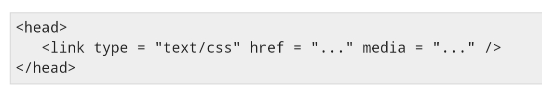
External CSS - The <link> Element
The <link> element can be used to include an external stylesheet file in your HTML document.
An external style sheet is a separate text file with .css extension. You define all the Style rules within this text file and then you can include this file in any HTML document using <link> element.

Slide 14

CSS3 - Selectors
CSS3 Selectors - Universal Selector
Element Type Selector
Id Selectors
Class Selectors
Grouping Selectors

Slide 15
CSS Selectors
CSS selectors are used to "find" (or select) the HTML elements you want to style.
We can divide CSS selectors into five categories:
Simple selectors (select elements based on name, id, class)
Combinator selectors (select elements based on a specific relationship between them)
Pseudo-class selectors (select elements based on a certain state)
Pseudo-elements selectors (select and style a part of an element)
Attribute selectors (select elements based on an attribute or attribute value)
This page will explain the most basic CSS selectors.

Slide 16
CSS element selector
CSS I'd selector
CSS class selector
CSS universal selector

Slide 17

CSS3 - Styling
CSS Color
CSS Background
CSS Fonts
CSS Text
CSS Links
CSS Lists
CSS Tables

Slide 18
CSS colors
CSS Color Names
CSS Background Color
CSS Text Color
CSS Border Color
Hex
Hsl

Slide 19
Font Selection
Generic Font Families
In CSS there are five generic font families:
Serif fonts have a small stroke at the edges of each letter. They create a sense of formality and elegance.
Sans-serif fonts have clean lines (no small strokes attached). They create a modern and minimalistic look.
Monospace fonts - here all the letters have the same fixed width. They create a mechanical look.
Cursive fonts imitate human handwriting.
Fantasy fonts are decorative/playful fonts.
All the different font names belong to one of the generic font families.

Slide 20
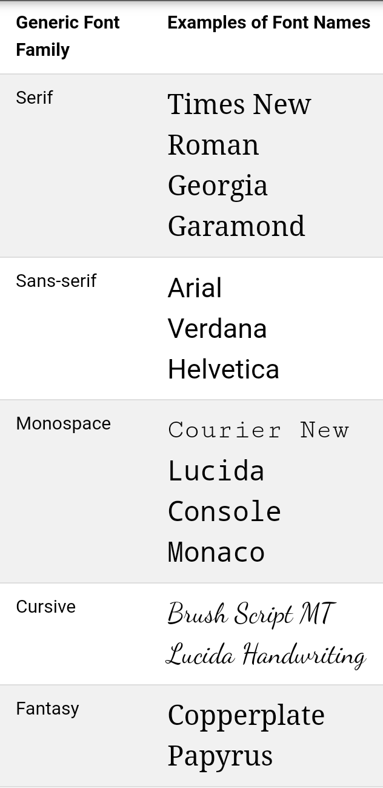

Slide 21
CSS Text
The color property is used to set the color of the text. The color is specified by:
a color name - like "red"
a HEX value - like "#ff0000"
an RGB value - like "rgb(255,0,0)"

Slide 22
CSS Link
Styling Links
Links can be styled with any CSS property (e.g. color, font-family, background, etc.).

Slide 23
CSS list
The CSS list properties allow you to:
Set different list item markers for ordered lists
Set different list item markers for unordered lists
Set an image as the list item marker
Add background colors to lists and list items

Slide 24
CSS table
Table Borders
Full-Width Table
Collapse Table Borders

Slide 25

CSS3 - Box Model
CSS Box Model
Margin
padding
border
Outline
Visibility vs. Display
Multiple Columns

Slide 26
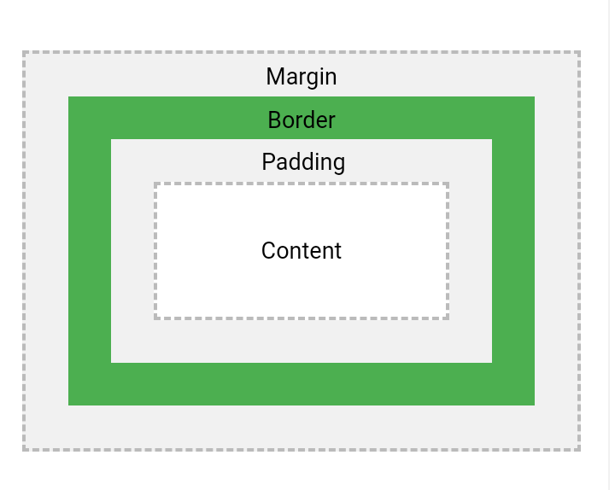
CSS Box Model

Slide 27
Explanation of the different parts:
Content - The content of the box, where text and images appear
Padding - Clears an area around the content. The padding is transparent
Border - A border that goes around the padding and content
Margin - Clears an area outside the border. The margin is transparent

Slide 28
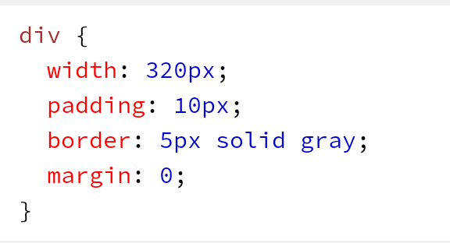
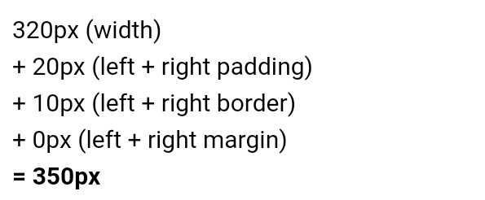

Slide 29

CSS3 - Advanced
Media Queries
RWD

Slide 30
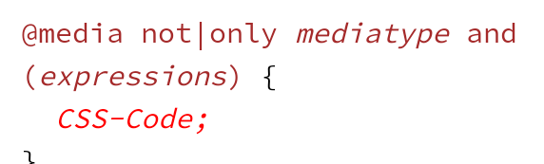
CSS Media Queries
Media queries can be used to check many things, such as:
width and height of the viewport
width and height of the device
orientation (is the tablet/phone in landscape or portrait mode?)
resolution
Syntax

Slide 31
Responsive Web Design
Responsive web design makes your web page look good on all devices.
Responsive web design uses only HTML and CSS.
Responsive web design is not a program or a JavaScript.

Slide 32
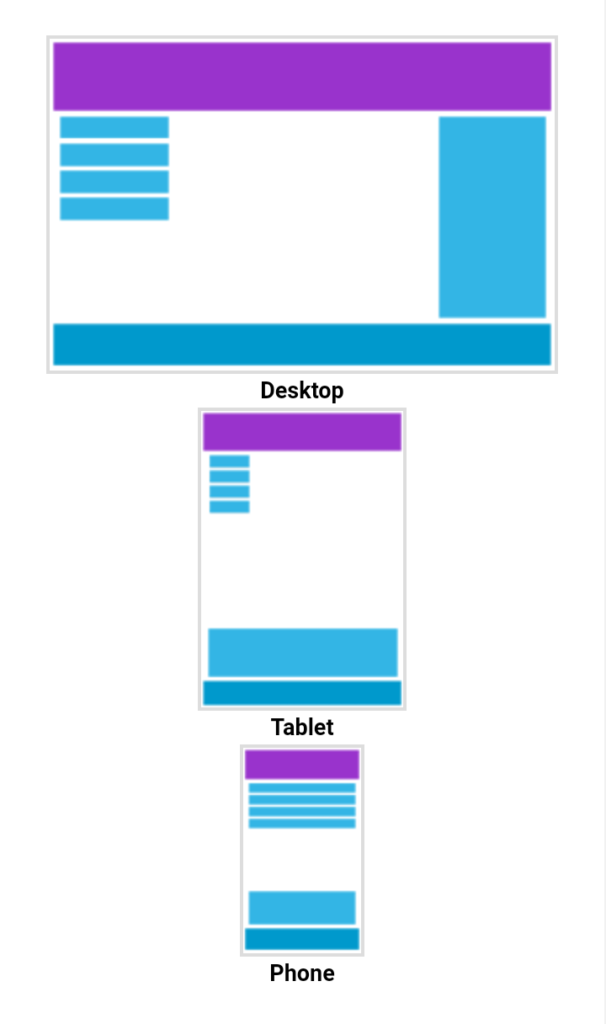

Slide 33
The Viewport
The viewport is the user's visible area of a web page.
The viewport varies with the device, and will be smaller on a mobile phone than on a computer screen.
Before tablets and mobile phones, web pages were designed only for computer screens, and it was common for web pages to have a static design and a fixed size.

Slide 34
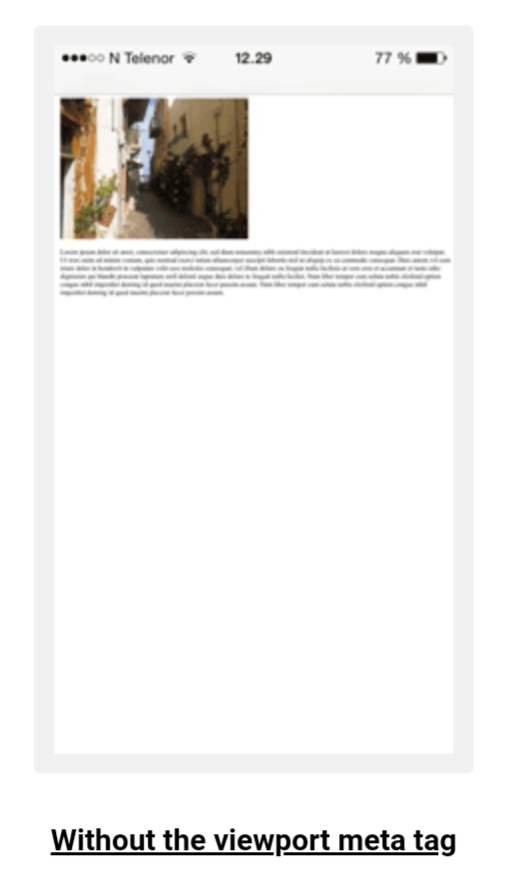
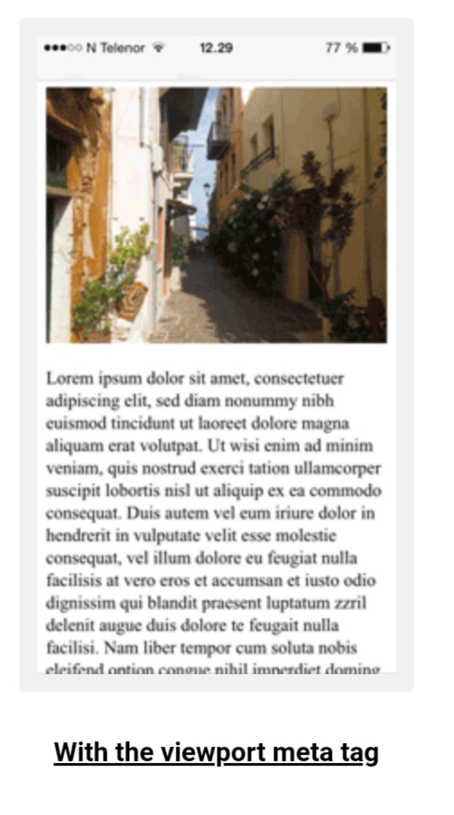

Slide 35

Grid-View

Slide 36
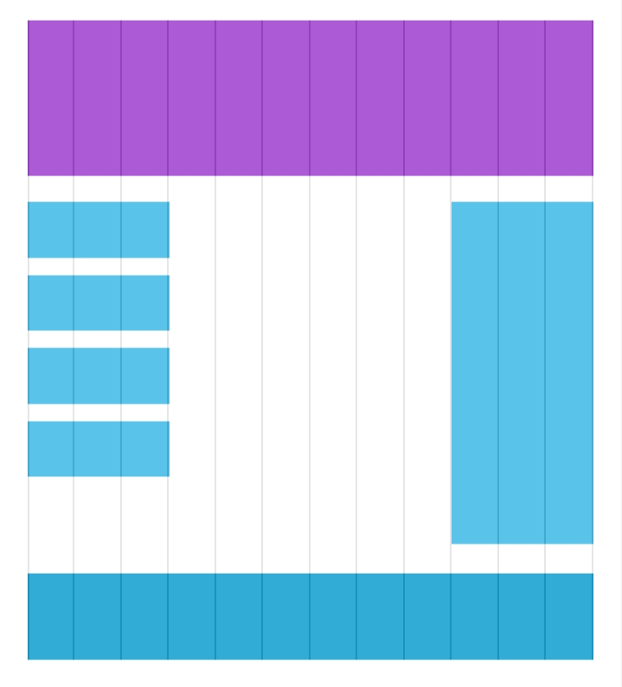

Slide 37


