Slide 1

Bootstrap

Slide 2
Agenda
Bootstrap Fundamentals
Grid System
Demonstrate troubleshooting UI issues using Chrome Developer Tools
Bootstrap Components
Bootstrap Styles

Slide 3
Bootstrap Fundamentals
Responsive Web Design (RWD),
Disadvantages of sites without RWD,
Mobile First design,
Bootstrap 4, emulate devices in Chrome Browser

Slide 4
What is Responsive Web Design?
Responsive web design makes your web page look good on all devices.
Responsive web design uses only HTML and CSS.
Responsive web design is not a program or a JavaScript.

Slide 5
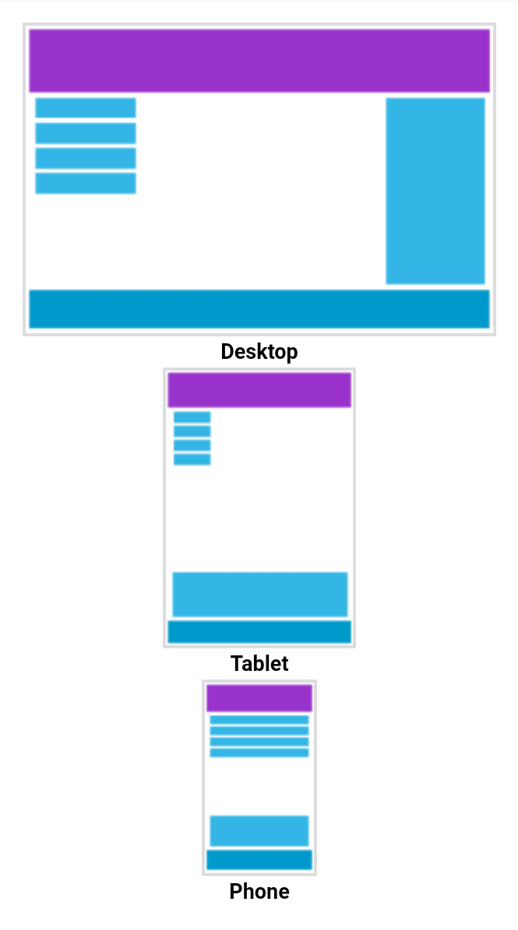

Slide 6
What is The Viewport?
The viewport is the user's visible area of a web page.
The viewport varies with the device, and will be smaller on a mobile phone than on a computer screen.
Before tablets and mobile phones, web pages were designed only for computer screens, and it was common for web pages to have a static design and a fixed size.

Slide 7
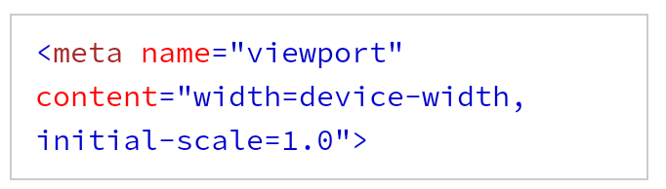
Setting The Viewport
The width=device-width part sets the width of the page to follow the screen-width of the device (which will vary depending on the device).
The initial-scale=1.0 part sets the initial zoom level when the page is first loaded by the browser.

Slide 8
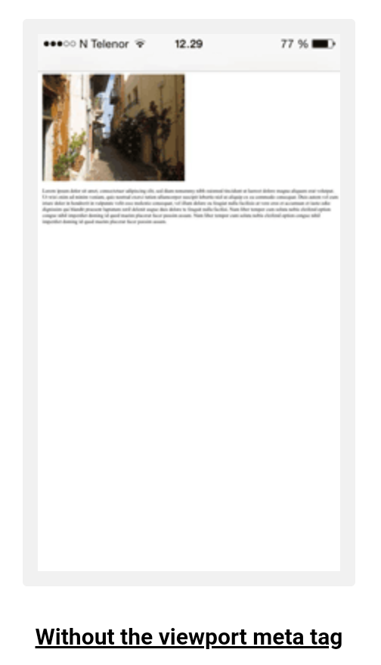
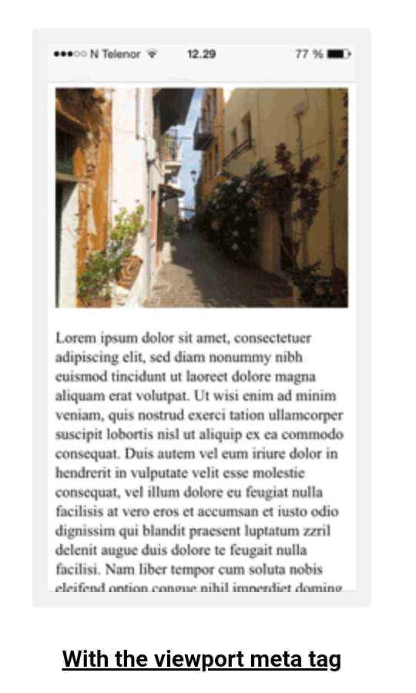

Slide 9
Disadvantages of Responsive Web Design
Not fully optimized – unless you use a mobile-first approach your content will not have been fully optimized for mobile devices
Slower performance – mobile pages often have the same, or even larger, file sizes than their desktop counterparts
Usability issues – mobile users often wish to perform different tasks to desktop users and may be accustomed to mobile-specific user interfaces

Slide 10
Mobile First Design
With the Bootstrap 4 powerful mobile first flexbox grid system creating the responsive and mobile friendly websites and applications has become much easier.
Bootstrap 4 is responsive and mobile friendly from the start.
Its five tier grid classes provides better control over the layout as well as how it will be rendered on different types of devices like mobile phones, tablets, laptops and desktops, large screen devices, and so on.

Slide 11
Bootstrap 4
Bootstrap 4 is the newest version of Bootstrap, which is the most popular HTML, CSS, and JavaScript framework for developing responsive, mobile-first websites.
Bootstrap 4 is the newest version of Bootstrap; with new components, faster stylesheet and more responsiveness.
Bootstrap 4 supports the latest, stable releases of all major browsers and platforms. However, Internet Explorer 9.
If you require IE8-9 support, use Bootstrap 3. It is the most stable version of Bootstrap, and it is still supported by the team for critical bugfixes and documentation changes. However, new features will NOT be added to it.

Slide 12
Grid System
Grid System,
12 columns,
devices and corresponding prefix of bootstrap class,
container,
container-fluid,
row, col

Slide 13
What is a Grid-View?
Many web pages are based on a grid-view, which means that the page is divided into columns
Using a grid-view is very helpful when designing web pages. It makes it easier to place elements on the page.
A responsive grid-view often has 12 columns, and has a total width of 100%, and will shrink and expand as you resize the browser window.

Slide 14
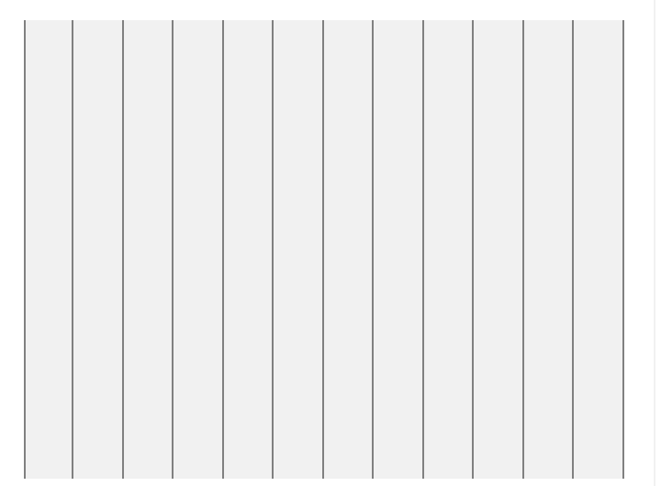

Slide 15
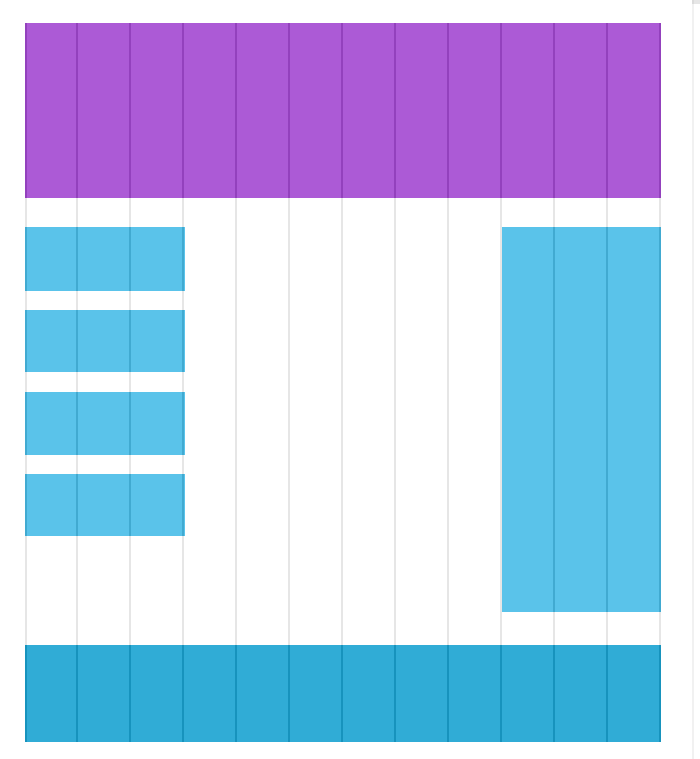

Slide 16
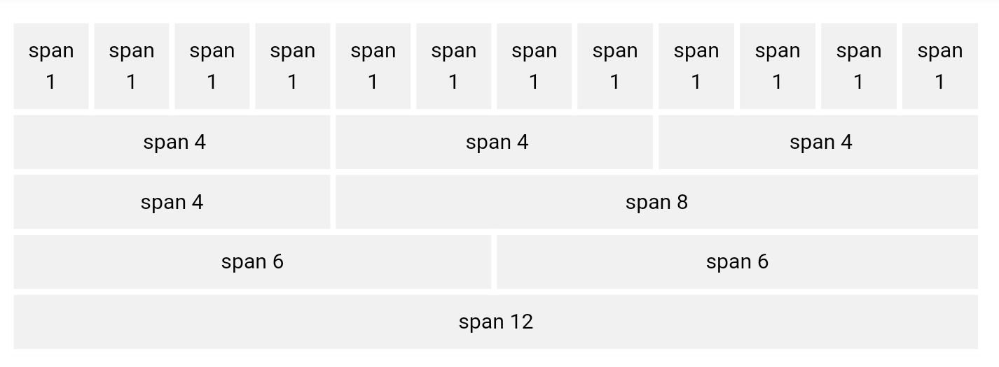
Bootstrap 4 Grid System

Slide 17
Grid Classes
.col- (extra small devices - screen width less than 576px)
.col-sm- (small devices - screen width equal to or greater than 576px)
.col-md- (medium devices - screen width equal to or greater than 768px)
.col-lg- (large devices - screen width equal to or greater than 992px)
.col-xl- (xlarge devices - screen width equal to or greater than 1200px)

Slide 18
Grid System Rules
Rows must be placed within a .container (fixed-width) or .container-fluid (full-width) for proper alignment and padding
Use rows to create horizontal groups of columns
Content should be placed within columns, and only columns may be immediate children of rows
Predefined classes like .row and .col-sm-4 are available for quickly making grid layouts
Columns create gutters (gaps between column content) via padding. That padding is offset in rows for the first and last column via negative margin on .rows
Grid columns are created by specifying the number of 12 available columns you wish to span. For example, three equal columns would use three .col-sm-4

Slide 19
NAV Bar
navbar, navbar-expand-lg, navbar-dark, bg-dark, navbar-brand
navbar-nav, nav-item, nav-link
navbar-toggler, navbar-toggler-icon, collapse, navbar-collapse, ml-auto

Slide 20
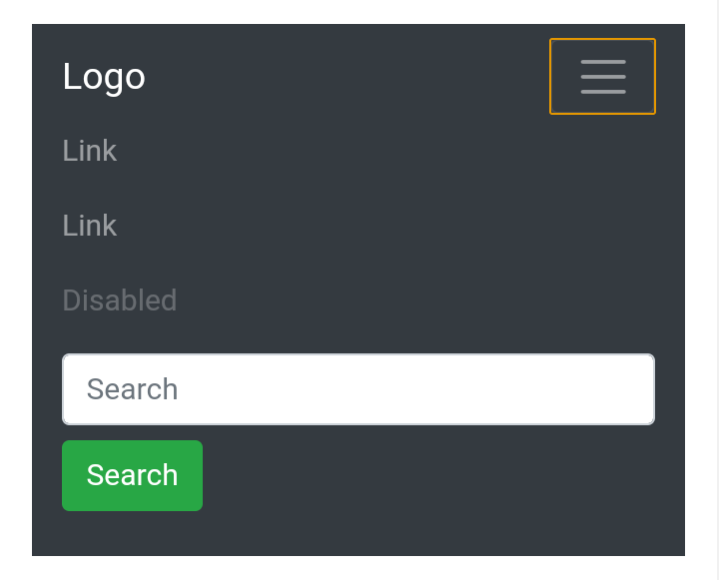
Navigation Bars
A navigation bar is a navigation header that is placed at the top of the page:

Slide 21
Vertical Navbar
Centered Navbar
Colored Navbar
Brand / Logo
Collapsing The Navigation Bar
Navbar With Dropdown

Slide 22
Demonstrate troubleshooting UI issues using Chrome Developer Tools
Element selection
1) using Inspect
2) selection tool in Developer Console
3) Hovering over the elements in the HTML code within the "Element" section of Developer Tool

Slide 23
Bootstrap Components
badge, badge-primary
Google Material Icon, Content Delivery Network (CDN), include icons in web page
list-group, list-group-item
card, card-title, card-body, card-text, change mouse cursor on hovering an icon
Display a list of cards using grid system and thus enabling RWD
gijgo, getting started, setting date format
Develop form with textbox, password, drop down, date using gijgo, radio button and checkbox form-row, form-group, form-control, form-check, form-check-input, form-check-label, form-check-input

Slide 24
Bootstrap Styles
Separate CSS file for customization, overriding the styles of Bootstrap

Slide 25
