Slide 1
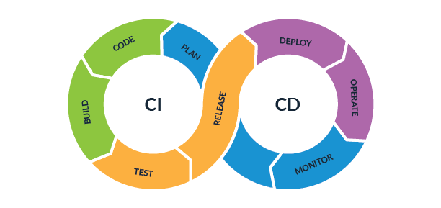
CI/CD

Slide 2
Agenda
CI/CD Intro
GIT Basics,
Setting Up Github,
Working with Local & remote repositories
Continuous Integration & Continuous Delivery with Jenkins
Getting Started With Jenkins

Slide 3
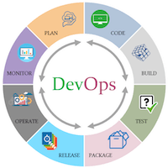
CI/CD
Introducing devops (CI/CD)

Slide 4
DevOps
The DevOps is the combination of two words, one is Development and other is Operations.
It is a culture to promote the development and operation process collectively.
This allows a single team to handle the entire application lifecycle, from development to testing, deployment, and operations.
DevOps helps you to reduce the disconnection between software developers, quality assurance (QA) engineers, and system administrators.
DevOps tools such as Git, Ansible, Docker, Puppet, Jenkins, Chef, Nagios, and Kubernetes.

Slide 5
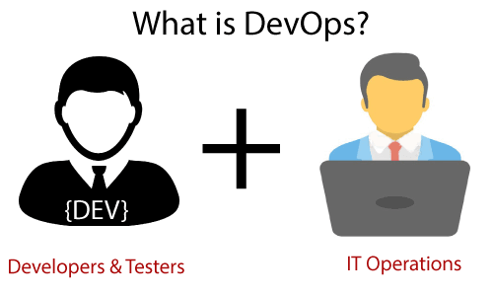
DevOps promotes collaboration between Development and Operations team to deploy code to production faster in an automated & repeatable way.
DevOps is nothing but a practice or methodology of making "Developers" and "Operations" folks work together. DevOps represents a change in the IT culture with a complete focus on rapid IT service delivery through the adoption of agile practices in the context of a system-oriented approach

Slide 6
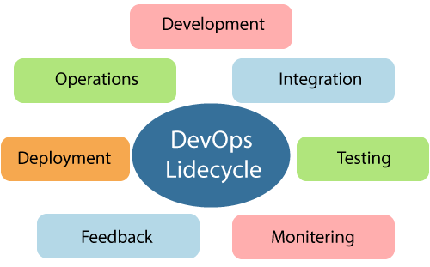
DevOps Lifecycle

Slide 7
1) Continuous Development
This phase involves the planning and coding of the software.
The vision of the project is decided during the planning phase.
And the developers begin developing the code for the application.
There are no DevOps tools that are required for planning, but there are several tools for maintaining the code.

Slide 8
2) Continuous Integration
This stage is the heart of the entire DevOps lifecycle.
It is a software development practice in which the developers require to commit changes to the source code more frequently.
This may be on a daily or weekly basis. Then every commit is built, and this allows early detection of problems if they are present.
Building code is not only involved compilation, but it also includes unit testing, integration testing, code review, and packaging.

Slide 9
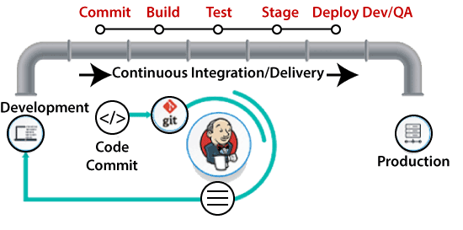
The code supporting new functionality is continuously integrated with the existing code.
Therefore, there is continuous development of software. The updated code needs to be integrated continuously and smoothly with the systems to reflect changes to the end-users.

Slide 10
DevOps Pipeline
A pipeline in software engineering team is a set of automated processes which allows DevOps professionals and developer to reliably and efficiently compile, build, and deploy their code to their production compute platforms.
The most common components of a pipeline in DevOps are build automation or continuous integration, test automation, and deployment automation.
Continuous Integration Pipeline
Continuous Delivery Pipeline

Slide 11
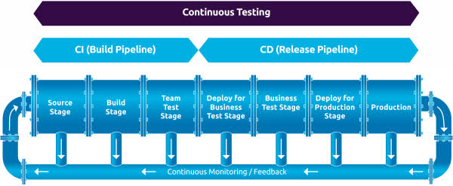

Slide 12
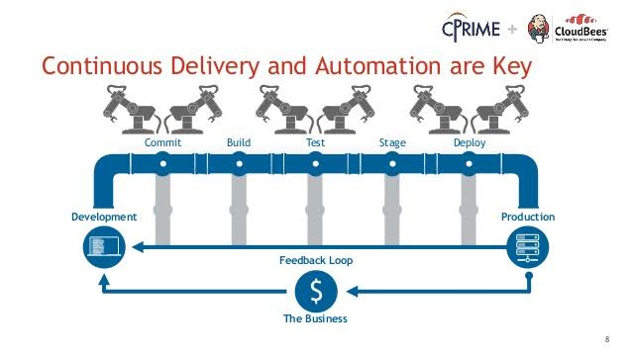


Slide 13
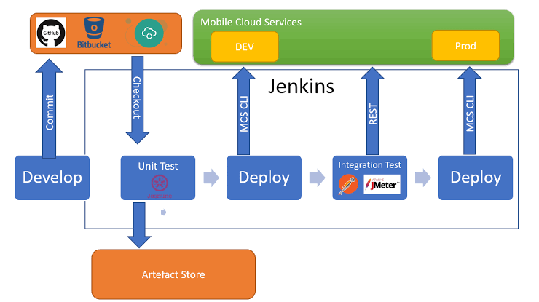

Slide 14
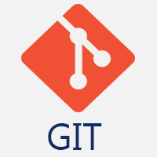
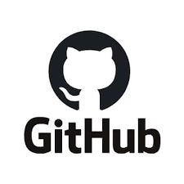
GIT BASICS
GIT

Slide 15
GIT
Git is a modern and widely used distributed version control system in the world.
It is developed to manage projects with high speed and efficiency.
The version control system allows us to monitor and work together with our team members at the same workspace

Slide 16
Git is an open-source distributed version control system.
It is designed to handle minor to major projects with high speed and efficiency.
It is developed to co-ordinate the work among the developers.
The version control allows us to track and work together with our team members at the same workspace.
Git is foundation of many services like GitHub and GitLab, but we can use Git without using any other Git services.
Git can be used privately and publicly.

Slide 17
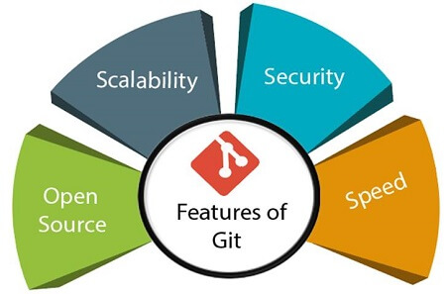

Slide 18
Distributed
One of Git's great features is that it is distributed. Distributed means that instead of switching the project to another machine, we can create a "clone" of the entire repository.
Also, instead of just having one central repository that you send changes to, every user has their own repository that contains the entire commit history of the project.
We do not need to connect to the remote repository; the change is just stored on our local repository.
If necessary, we can push these changes to a remote repository.

Slide 19
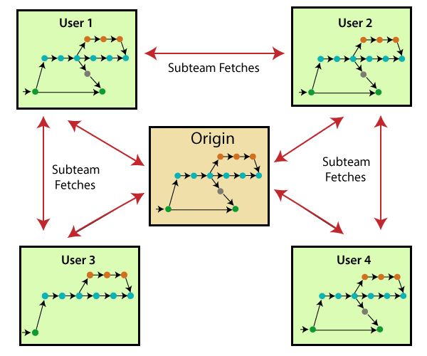

Slide 20
Staging Area
The Staging area is also a unique functionality of Git.
It can be considered as a preview of our next commit, moreover, an intermediate area where commits can be formatted and reviewed before completion.
When you make a commit, Git takes changes that are in the staging area and make them as a new commit. We are allowed to add and remove changes from the staging area.
The staging area can be considered as a place where Git stores the changes.
Although, Git doesn't have a dedicated staging directory where it can store some objects representing file changes (blobs).
Instead of this, it uses a file called index.

Slide 21
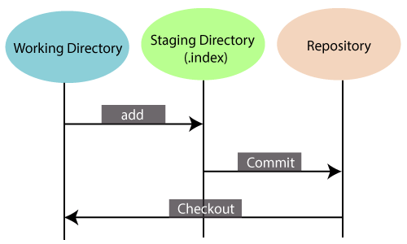

Slide 22
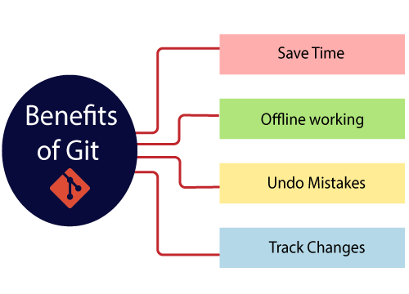
Benefits of Git

Slide 23
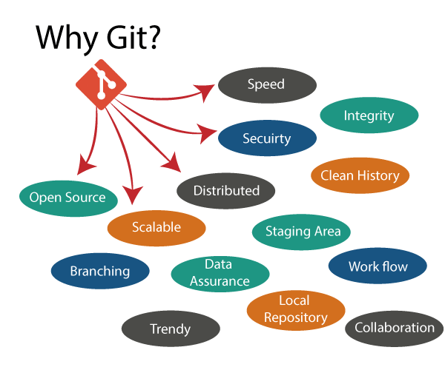

Slide 24
What is GitHub?
GitHub is a Git repository hosting service.
GitHub also facilitates with many of its features, such as access control and collaboration. It provides a Web-based graphical interface.
It offers both distributed version control and source code management (SCM) functionality of Git.
It also facilitates with some collaboration features such as bug tracking, feature requests, task management for every project.

Slide 25
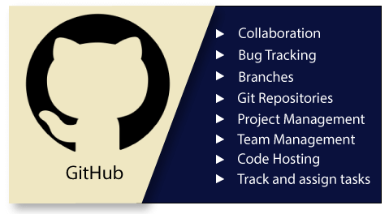

Slide 26
Benefits of GitHub
It is easy to contribute to open source projects via GitHub.
It helps to create an excellent document.
You can attract recruiter by showing off your work.
If you have a profile on GitHub, you will have a higher chance of being recruited.
It allows your work to get out there in front of the public.
You can track changes in your code across versions.

Slide 27
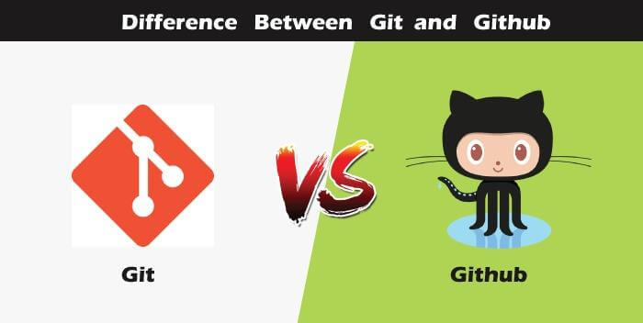

Slide 28
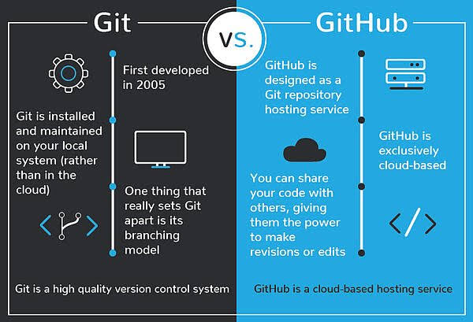

Slide 29
Git Version Control System
A version control system is a software that tracks changes to a file or set of files over time so that you can recall specific versions later. It also allows you to work together with other programmers.
The version control system is a collection of software tools that help a team to manage changes in a source code.
It uses a special kind of database to keep track of every modification to the code.
Developers can compare earlier versions of the code with an older version to fix the mistakes

Slide 30
Types of Version Control System
Localized version Control System
Centralized version control systems
Distributed version control systems

Slide 31
Local and Remote Repository

Slide 32
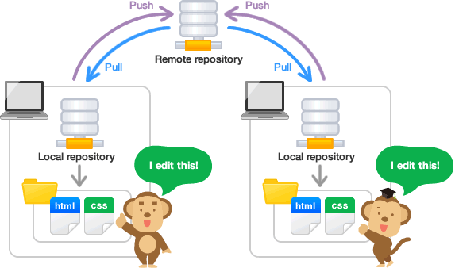

Slide 33
Localized Version Control Systems
The localized version control method is a common approach because of its simplicity.
But this approach leads to a higher chance of error.
In this approach, you may forget which directory you're in and accidentally write to the wrong file or copy over files you don't want to

Slide 34
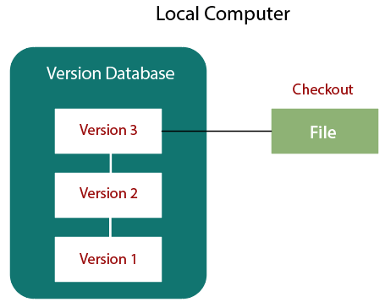

Slide 35
Centralized Version Control System
The developers needed to collaborate with other developers on other systems.
The localized version control system failed in this case.
To deal with this problem, Centralized Version Control Systems were developed.
These systems have a single server that contains the versioned files, and some clients to check out files from a central place.

Slide 36
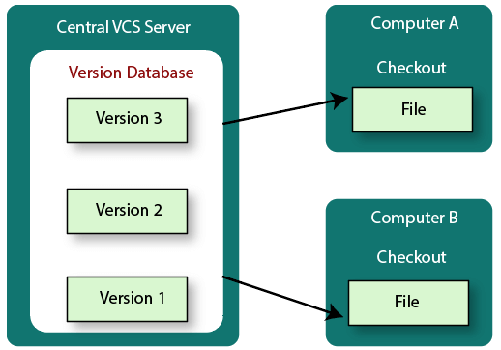

Slide 37
Distributed Version Control System
Centralized Version Control System uses a central server to store all the database and team collaboration.
But due to single point failure, which means the failure of the central server, developers do not prefer it.
Next, the Distributed Version Control System is developed.
In a Distributed Version Control System (such as Git, Mercurial, Bazaar or Darcs), the user has a local copy of a repository.
So, the clients don't just check out the latest snapshot of the files even they can fully mirror the repository.
The local repository contains all the files and metadata present in the main repository.

Slide 38
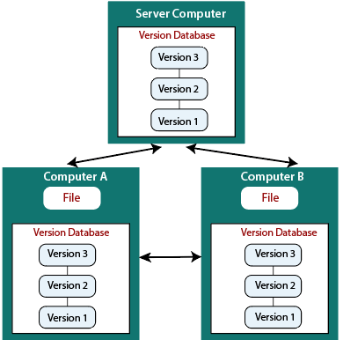

Slide 39
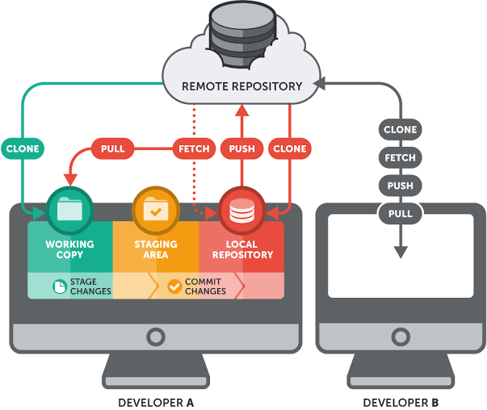

Slide 40
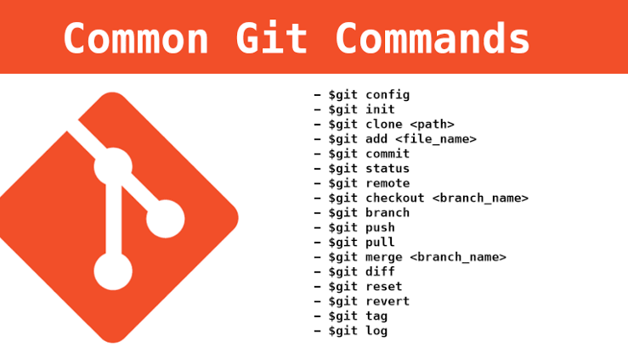

Slide 41
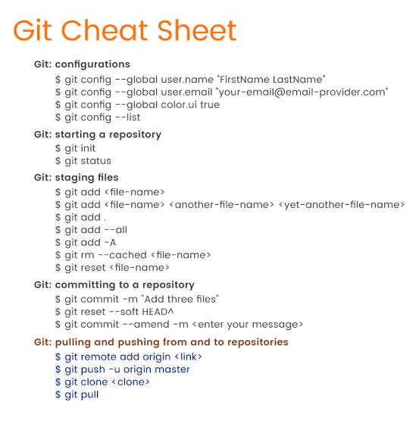

Slide 42
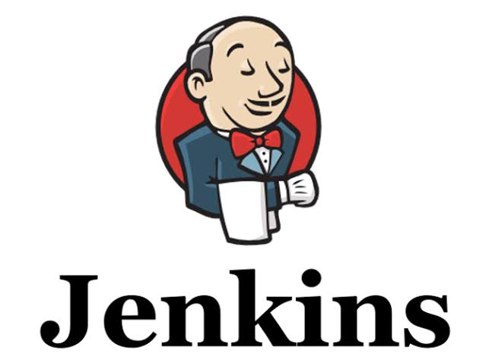

Slide 43
What is Jenkins?
Jenkins is an open source automation tool written in Java programming language that allows continuous integration.
Jenkins builds and tests our software projects, which continuously making it easier for developers to integrate changes to the project, and making it easier for users to obtain a fresh build.
It also allows us to continuously deliver our software by integrating with a large number of testing and deployment technologies.

Slide 44
Jenkins offers a straightforward way to set up a continuous integration or continuous delivery environment for almost any combination of languages and source code repositories using pipelines, as well as automating other routine development tasks.
Jenkins achieves CI (Continuous Integration) with the help of plugins.
Plugins is used to allow the integration of various DevOps stages.
If you want to integrate a particular tool, you have to install the plugins for that tool. For example: Maven 2 Project, Git, HTML Publisher, Amazon EC2, etc.

Slide 45
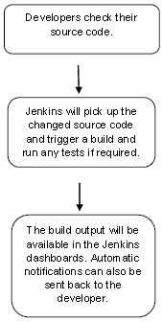

Slide 46
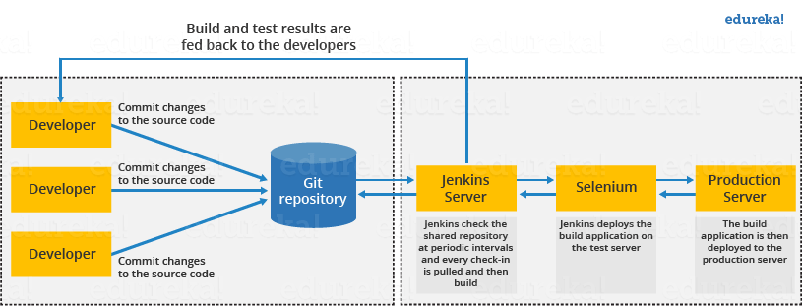
Continuous Integration with Jenkins

Slide 47
Advantages of Jenkins
It is an open source tool.
It is free of cost.
It does not require additional installations or components. Means it is easy to install.
Easily configurable.
It supports 1000 or more plugins to ease your work. If a plugin does not exist, you can write the script for it and share with community.
It is built in java and hence it is portable.
It is platform independent. It is available for all platforms and different operating systems. Like OS X, Windows or Linux.
Easy support, since it open source and widely used.
Jenkins also supports cloud based architecture so that we can deploy Jenkins in cloud based platforms

Slide 48
Disadvantages of Jenkins
Its interface is out dated and not user friendly compared to current user interface trends.
Not easy to maintain it because it runs on a server and requires some skills as server administrator to monitor its activity.
CI regularly breaks due to some small setting changes. CI will be paused and therefore requires some developer's team attention.

Slide 49
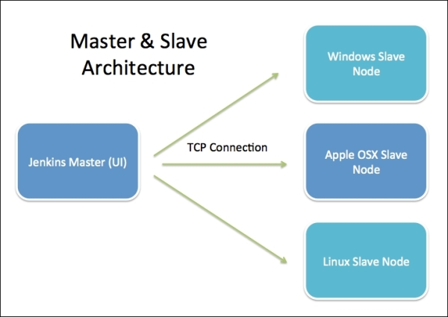
Jenkins Architecture

Slide 50
GitHub Setup for Jenkins
https://www.javatpoint.com/github-setup-for-jenkins

Slide 51
Jenkins Maven Setup
https://www.javatpoint.com/jenkins-maven-setup

Slide 52
Why Use Jenkins Pipeline?
Jenkins pipeline is implemented as a code which allows several users to edit and execute the pipeline process.
Pipelines are robust. So if your server undergoes an unpredicted restart, the pipeline will be automatically resumed.
You can pause the pipeline process and make it wait to continue until there is an input from the user.
Jenkins Pipelines support big projects. You can run many jobs, and even use pipelines in a loop.

Slide 53


Slide 54
Maven
Maven is a powerful project management tool that is based on POM (project object model).
It is used for projects build, dependency and documentation.
It simplifies the build process like ANT. But it is too much advanced than ANT.

Slide 55
Understanding the problem without Maven
1) Adding set of Jars in each project: In case of struts, spring, hibernate frameworks, we need to add set of jar files in each project. It must include all the dependencies of jars also
2) Creating the right project structure: We must create the right project structure in servlet, struts etc, otherwise it will not be executed.
3) Building and Deploying the project: We must have to build and deploy the project so that it may work.

Slide 56
Maven simplifies the above mentioned problems. It does mainly following tasks.
It makes a project easy to build
It provides uniform build process (maven project can be shared by all the maven projects)
It provides project information (log document, cross referenced sources, mailing list, dependency list, unit test reports etc.)
It is easy to migrate for new features of Maven

Slide 57
Apache Maven helps to manage
Builds
Documentation
Reporing
SCMs
Releases
Distribution

Slide 58
Maven Repository
A maven repository is a directory of packaged JAR file with pom.xml file. Maven searches for dependencies in the repositories. There are 3 types of maven repository:
Local Repository
Central Repository
Remote Repository

Slide 59
Maven pom.xml file
POM is an acronym for Project Object Model.
The pom.xml file contains information of project and configuration information for the maven to build the project such as dependencies, build directory, source directory, test source directory, plugin, goals etc.

Slide 60
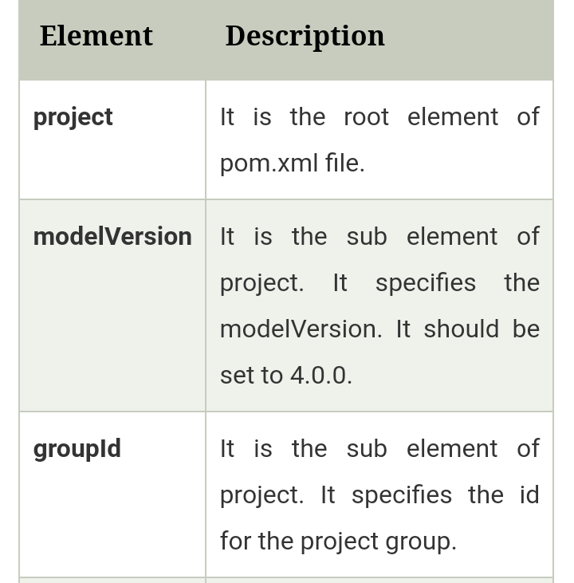

Slide 61
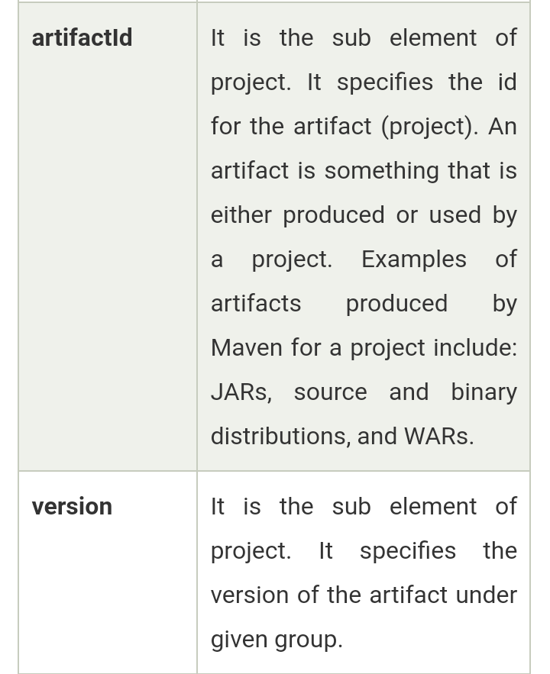

Slide 62
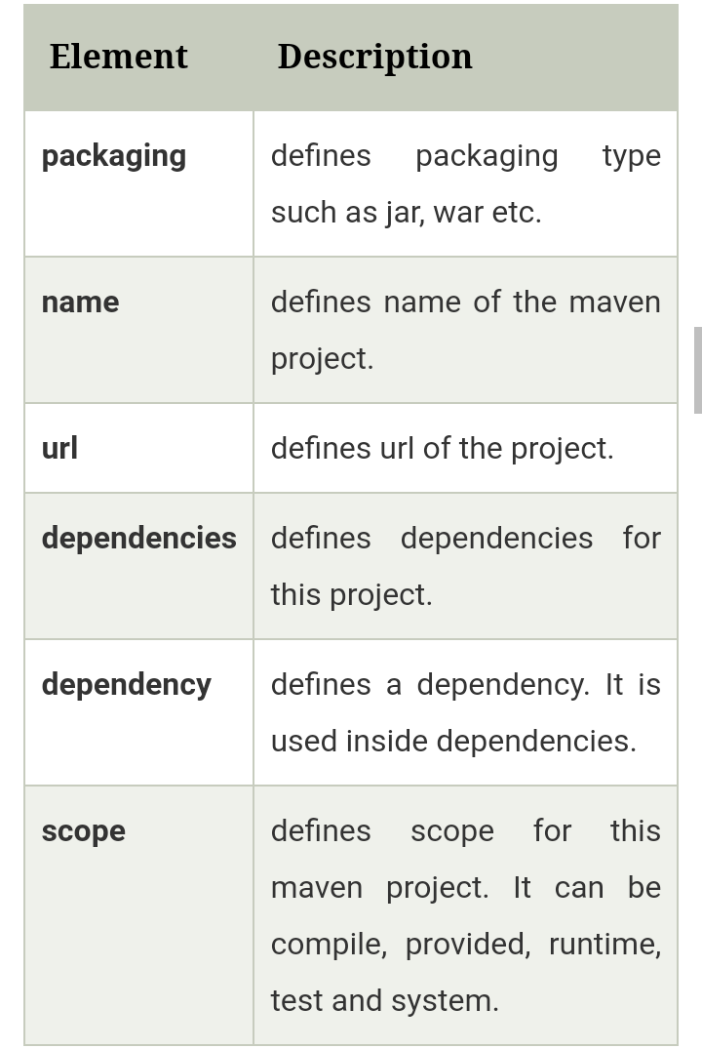

Slide 63


