Slide 1



KEC – IDEATHON 2023
Team Members:
GEETHAPRIYA E 21ITR028
JEEVIKA L M 21ITR045
PRATHIKSHA S 21ITR082
SANJUGA G 21ITR094
Title: ODOP Mart for TN

Slide 2
ODOP Mart for TN
TEAM NAME: THE STRIKERS
THEME : APPLICATION
Problem Statement : The development of an ODOP (One District One Product) scheme-based mobile application for Tamil Nadu is designed to boost entrepreneurship and economic growth at the district level by promoting unique local products and crafts. However, the lack of a dedicated digital platform for Tamil Nadu poses several problems, including limited awareness, inefficient communication, data fragmentation, and regulatory complexities. The proposed mobile application seeks to solve these issues by providing a user-friendly, secure, and comprehensive solution. This app aims to empower local businesses, promote traditional products, and drive sustainable economic development throughout Tamil Nadu under the ODOP scheme.
Brief Summary for the solution:
The development of an ODOP (One District One Product) scheme-based mobile application for Tamil Nadu is designed to boost entrepreneurship and economic growth at the district level by promoting unique local products and crafts. However, the lack of a dedicated digital platform for Tamil Nadu poses several problems, including limited awareness, inefficient communication, data fragmentation, and regulatory complexities. The proposed mobile application seeks to solve these issues by providing a user-friendly, secure, and comprehensive solution. This app aims to empower local businesses, promote traditional products, and drive sustainable economic development throughout Tamil Nadu under the ODOP scheme.
Application and Technology:
1. Augmented Reality (AR)
2. Machine Learning (Item based CF recommendation algorithm)

Slide 3
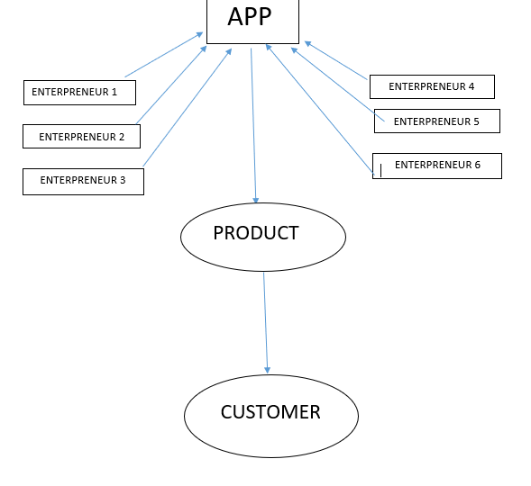
Workflow diagram

Slide 4
How can your solution help to improve the current situation?
Intermediate sellers gain more profit than the producers.
Low awareness about the small scale and cottage industries for the buyers.
Only accessibility for the local people.
Lack of awareness about the media and digital marketing.
Current
After
Threat for the intermediate sellers.
More profit for the producers and small scale industries.
Accessibility for all kind of people and people from other districts.
Can be a best platform for basic stage business people and entrepreneurs.
People can customize their own product.

Slide 5
ODOP Mart for TN
Mostly the small level local entrepreneurs can’t get same profit compared to the higher level entrepreneurs.
Our app provides same value for all the products so that the small scale entrepreneurs can also get equal profit.
Problem / Need
Solution
Unique Value Proposition
Revenue Streams
Customer Segments
App to connect many local entrepreneurs with the customers to get profit by selling their small products and raw materials as same as the large scale industries.
selling both products and raw materials from the local entrepreneurs.
We are providing learning platform for the interested customers. So It increases the revenue for the entrepreneurs too…
We canvass our app through advertisements, canvassing people through public functions like fun street.
Existing alternatives
Unfair Advantage
Early adopters
Apps like meesho are available
Connecting many local entrepreneurs so that they call sell their sell their products and raw materials for the equal cost compared to other high level industries.
Local entrepreneurs and small business owners
Key risks that might impact the solution
Products are not delivered to the customers at the correct time.
How will you reach your customers
Through Advertisement
Key Risks
Key Metrics
How will you measure the success of this idea
usage of our App
Cost Structure
List the fixed and variable costs
Based on App requirements
Channels

