Slide 1

JAWAHARLAL NEHRU TECHNOLOGICAL UNIVERSITY KAKINADA UNIVERSITY COLLEGE OF ENGINEERING NARASARAOPET Department of Computer Science and Engineering
SmartDoc: Image-Based Retrieval System for Government and
Personal Documents
Presented By:
Shaik Sha Ali Mastan Akram 22031A0546
Valluri Geetha 23035A0509
Paidi Keerthika 22031A0533
Chukka Gowthami 22031A0512
Alajangi Chandu 22031A0503
Under the esteemed guidance of zzz
Project Guide: Mrs. B. Jyothi

Slide 2
CONTENTS
Abstract
Introduction
Existing System
Limitations of Existing System
Overcoming drawbacks of Existing System
Proposed System
Advantages of Proposed System
Literature Review
Dataset Description
Functional and Non Function Requirements
Software and Hardware Requirements
Modules
System Architecture
Class Diagram
Sequence Diagram
Activity Diagram
Component Diagram

Slide 3
Abstract
Managing and retrieving scanned government and personal documents such as Aadhaar cards, PAN cards, certificates, and invoices is a common challenge due to unorganized storage and inconsistent file naming. This project introduces an image-based document retrieval system that enables users to locate documents by uploading a reference image instead of relying on text-based search. The system extracts visual features and performs similarity matching to retrieve relevant documents along with their file locations. Optical Character Recognition (OCR) is applied to extract textual content, which is further processed using a Large Language Model to generate semantic labels and document summaries. The novelty of the system lies in combining lightweight image retrieval with language-based understanding while avoiding computationally intensive deep-learning models. Evaluation metrics include retrieval accuracy and response time. The system significantly improves document accessibility and organization, making it suitable for personal, institutional, and administrative use.

Slide 4
Introduction
Traditional methods of storing and retrieving government and personal documents depend on manual organization and text-based file naming, which is inefficient, error-prone, and difficult to manage as the number of documents increases.
To address this problem, the proposed system SmartDoc enables image-based document retrieval, allowing users to locate documents by uploading a reference image instead of relying on keyword-based searches.
The system extracts lightweight visual features from document images and performs similarity matching to retrieve relevant documents along with their file locations.
Optical Character Recognition (OCR) is applied to extract textual information from documents, enabling better identification and classification of document content.
The extracted text is further processed using a Large Language Model (LLM) to generate semantic labels and concise document summaries, improving document understanding and organization.
By combining efficient image retrieval with language-based semantic analysis while avoiding computationally intensive deep-learning models, SmartDoc offers a scalable, fast, and user-friendly solution for personal, institutional, and administrative document management.

Slide 5
Problem Statement
Traditional document management systems in organizations and institutions rely on manual filling or basic digital storage .
As document volumes grow , filename-based search and manual categorization become time consuming and ineffective .
Scanned documents further complicate retrieval due to the need for OCR, which may produce errors.
Centralized storage increases the risk of duplication and mismanagement. SmartDoc addresses these challenges by providing a secure, fully local system that integrates OCR feature extraction, local language models, and database indexing to enable intelligent, efficient, and privacy-focused document management.

Slide 6
Existing System
Documents like Aadhaar, PAN, mark sheets, certificates, and invoices are stored as scanned images or PDFs.
Files are saved without standardized naming or structured categorization.
Retrieval is done through manual folder browsing or basic text-based search.
Users must remember file names, dates, or storage locations to find documents.
Scanned files are not analyzed for internal text content.
Documents cannot be searched based on their actual content.
The system is inefficient, memory-dependent, and lacks intelligent processing.
Selected Base Paper: “The retrieval of document images: a brief survey”: Doermann, D., “The Indexing and Retrieval of Document Images,” IEEE Computer. “

Slide 7
Limitations of Existing System
Dependence on Text-Based Search – Existing systems rely on file names and keywords, which fails when documents are poorly named or unorganized.
OCR Limitations on Low-Quality Documents – OCR-only approaches struggle with noisy, rotated, or low-resolution scanned documents, leading to inaccurate retrieval.
High Computational Cost – Deep-learning-based document retrieval systems require high processing power and memory, making them unsuitable for low-end or personal systems.
Lack of Semantic Understanding – Traditional systems cannot understand document context or meaning, limiting accurate document classification and retrieval.
Slow Retrieval and Poor Scalability – As the document database grows, search time increases, resulting in slow response and reduced usability.

Slide 8
Overcoming drawbacks of Existing System
Limited Search Capability - Smart Search
Traditional systems rely on filenames or keywords
SmartDoc enables text-based + visual similarity search
Scanned Documents Not Searchable - OCR Support
Existing systems cannot read image text
SmartDoc uses OCR (Tesseract) to extract searchable text
Cloud Dependency → Fully Offline System
Existing systems depend on internet/cloud
SmartDoc works completely offline, ensuring privacy
Manual Processing → Automation
Manual document handling is time-consuming
SmartDoc automates indexing and processing

Slide 9
Proposed System
Our project introduces an AI-assisted image-based document retrieval system that enables users to efficiently locate government and personal documents using reference images.
The system extracts lightweight visual features from document images and performs similarity matching to retrieve the most relevant documents with high accuracy.
OCR is used to automatically extract textual content from scanned documents, eliminating the need for manual document labeling and organization.
A Large Language Model (LLM) processes the extracted text to generate semantic labels and concise summaries, improving document understanding and classification.
The system supports retrieval of multiple document types such as Aadhaar cards, PAN cards, certificates, and invoices.
A user-friendly interface allows users to upload document images easily and receive fast, accurate retrieval results along with file locations.

Slide 10
Advantages of Proposed System
High Accuracy in Document Retrieval The image-based similarity matching approach enables accurate retrieval of documents even when file names or textual metadata are missing or inconsistent.
Efficient Visual Feature Extraction Lightweight image feature extraction ensures reliable matching across variations in document orientation, scale, and quality without using heavy deep-learning models.
Fast Response and Resource Efficiency By avoiding computationally intensive models, the system operates efficiently on standard desktop systems with minimal memory and processing requirements.
Enhanced Semantic Understanding The integration of OCR with a Large Language Model generates meaningful semantic labels and summaries, improving document classification and retrieval accuracy.
Scalable and Easy to Extend The system can be easily scaled to support new document types and expanded datasets, making it suitable for long-term personal, institutional, and administrative use.

Slide 11
Dataset Description
No public dataset used.
Dataset contains scanned personal and government documents (Aadhaar, PAN, certificates, ID proofs, invoices).
Stored in image formats such as JPG and PNG.
Includes varying resolutions and quality levels to simulate real-world conditions.
Contains both camera-captured and scanner-based documents.
Documents include printed text, logos, stamps, and signatures.
No fixed naming convention (represents unorganized storage).
OCR used to extract textual content from images.
Visual features generated for image similarity matching.
Used to evaluate:
Document retrieval accuracy
OCR performance
System response time

Slide 12
Functional Requirements
The system shall perform the following functions:
Scan selected folders and discover new documents automatically
Extract visual features from documents using ORB algorithm
Perform OCR text extraction using Tesseract
Analyze extracted text using Local LLM to generate:
➢ Document labels
➢ Short summaries
➢ Metadata insights

Slide 13
Functional Requirements
Store features, text, and metadata in SQLite database
Accept a query image from the user through JavaFX interface
Perform similarity matching and retrieve top relevant documents
Display search results with file location and metadata
Monitor folders in real time and trigger re-indexing on changes

Slide 14
Non-Functional Requirements
The system must satisfy the following quality requirements:
Performance: Document retrieval should be completed within a few seconds
Accuracy: Similarity matching must return relevant results
Usability: JavaFX interface should be simple and interactive
Reliability: System should work offline without internet
Scalability: Should support increasing number of documents
Security: Local storage of documents and metadata
Maintainability: Modular architecture for easy upgrades
Portability: Should run on multiple operating systems

Slide 15
Software Requirements
Operating System: Windows / Linux / macOS
Programming Language: Java
User Interface: JavaFX
Image Processing: OpenCV (ORB Feature Extraction)
OCR Engine: Tesseract OCR
Language Processing: Local LLM for document analysis
Database: SQLite
Development Tools: IntelliJ IDEA / Eclipse / VS Code
Build Tool: Maven/Gradle

Slide 16
Hardware Requirements
The minimum hardware configuration required to run the system is as follows:
Processor: Intel i3 or above
RAM: 4 GB minimum (8 GB recommended)
Hard Disk: 20 GB free space
Camera/Scanner: For capturing document images
Display: Standard monitor
Input Devices: Keyboard and mouse

Slide 17
Modules
Document Collection Module
This module is responsible for discovering and collecting scanned documents from user specified folders. It continuously scans directories to identify files such as Aadhaar cards, PAN cards, certificates, invoices, and identity proofs in formats like JPG, PNG, and PDF. The module also detects newly added or modified files for further processing.
Image Feature Extraction Module
This module extracts visual features from each document using the ORB (Oriented FAST and Rotated BRIEF) algorithm through OpenCV. The extracted features act as a unique fingerprint for every document and are stored in the SQLite database for similarity comparison.
OCR Text Extraction Module
Tesseract OCR is applied to extract embedded textual content from scanned images and PDFs. The module performs preprocessing such as noise removal, resizing, and orientation correction before text extraction
LLM Document Analysis Module
The extracted text is processed using a Local Large Language Model to generate: • Document type identification • Semantic labels • Short summaries • Important keywords and metadata

Slide 18
Modules
Database Management Module
Functionality This module stores and manages: • ORB feature vectors • OCR extracted text
• Generated metadata and summaries • Document file locations using SQLite database tables.
Search & Similarity Matching Module
When a user uploads a query image through JavaFX interface, this module extracts its features and compares them with stored features using similarity matching algorithms. Top matching documents are retrieved along with metadata.
Real-Time Monitoring Module
Monitors selected folders for file changes such as: • New document addition • Modification of existing files • Deletion events and triggers automatic re-indexing when required
User Interface Module
A JavaFX-based graphical interface allows users to: • Upload query images • View retrieved documents • See summaries and metadata • Navigate to actual file locations

Slide 19
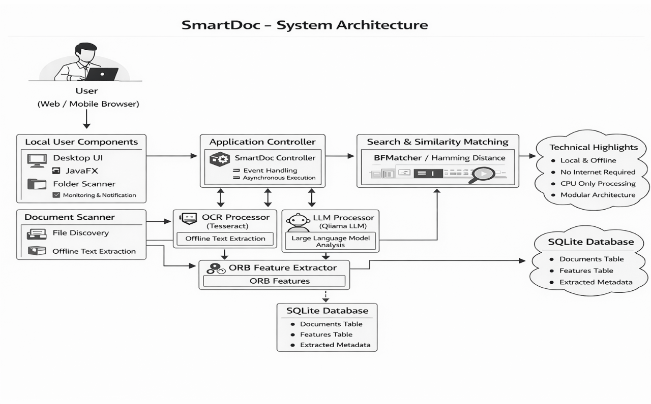
SYSTEM ARCHITECTURE:

Slide 20
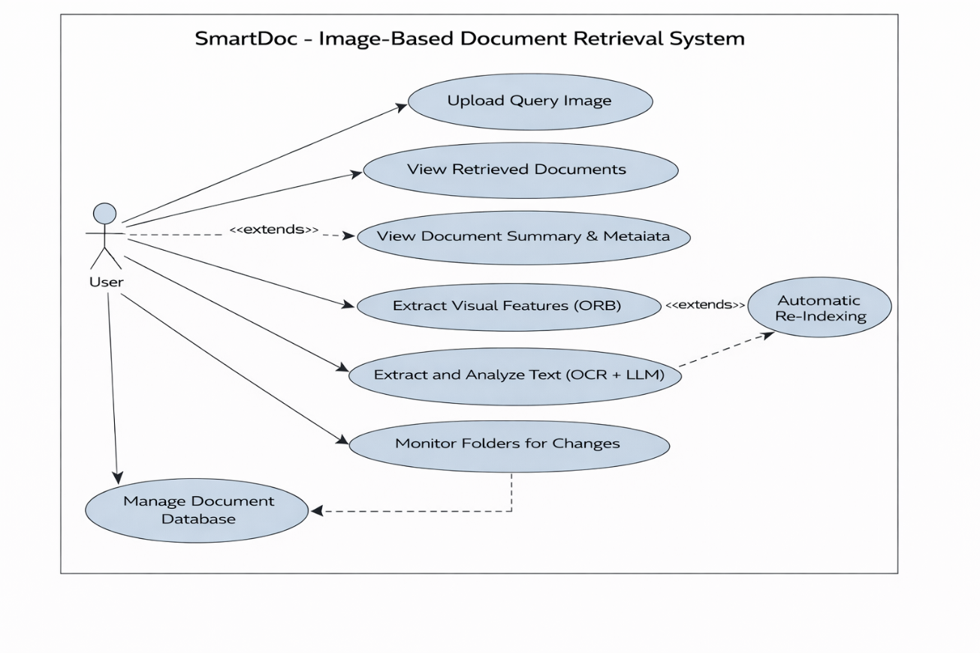
USECASE DIAGRAM:

Slide 21
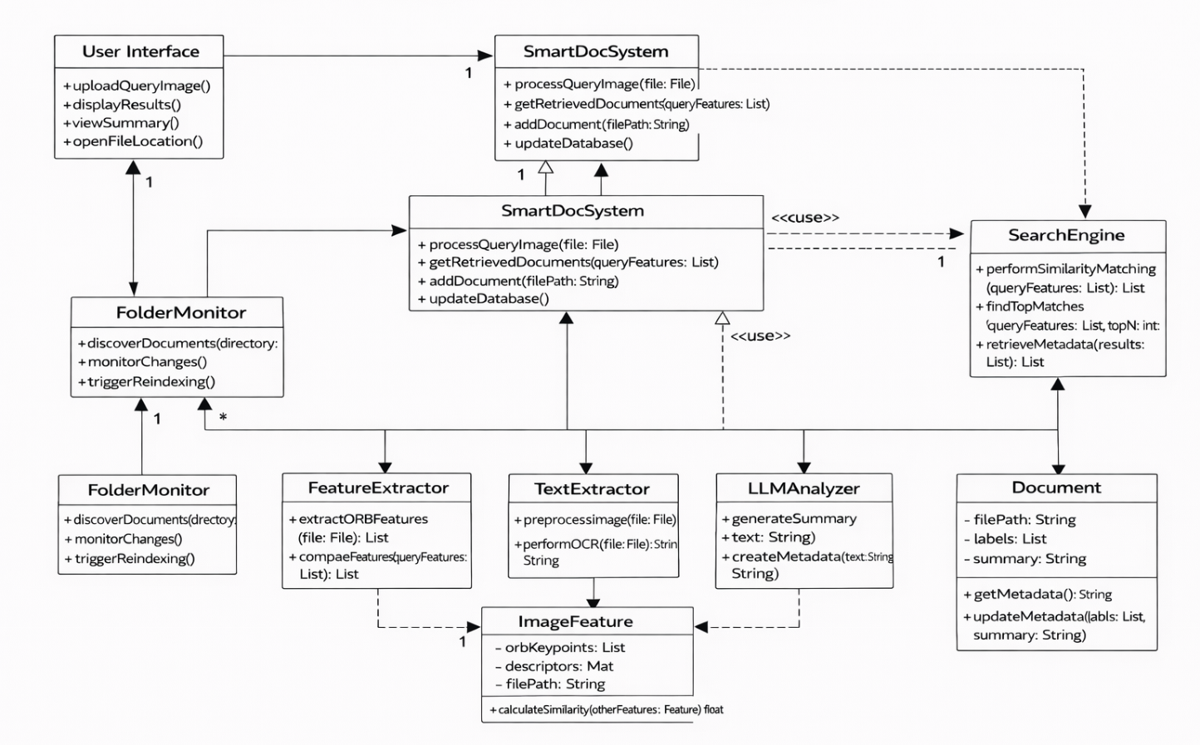
CLASS DIAGRAM

Slide 22
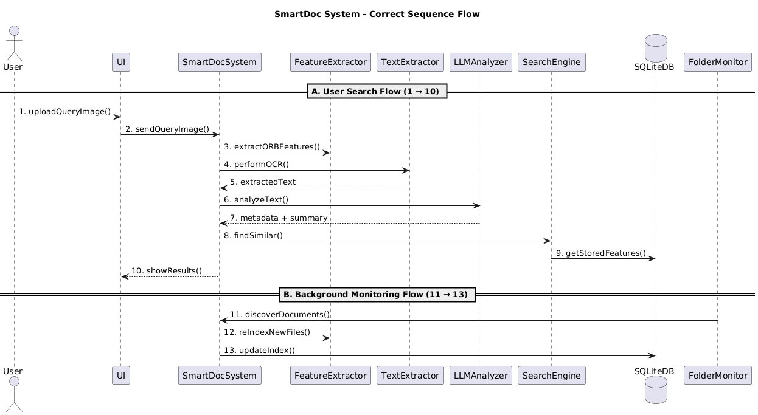
SEQUENCE DIAGRAM:

Slide 23
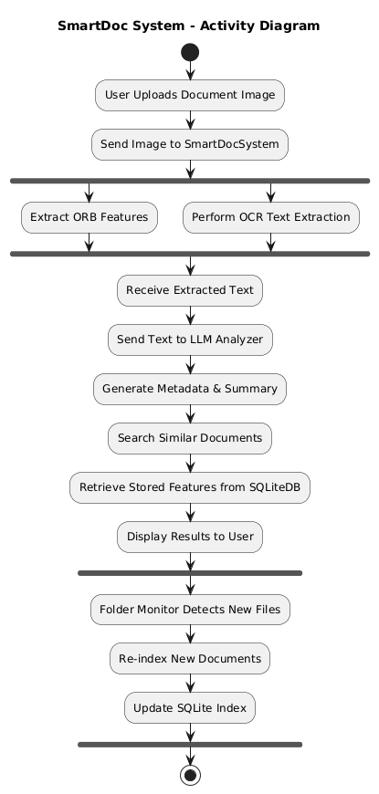
ACTIVITY DIAGRAM:

Slide 24
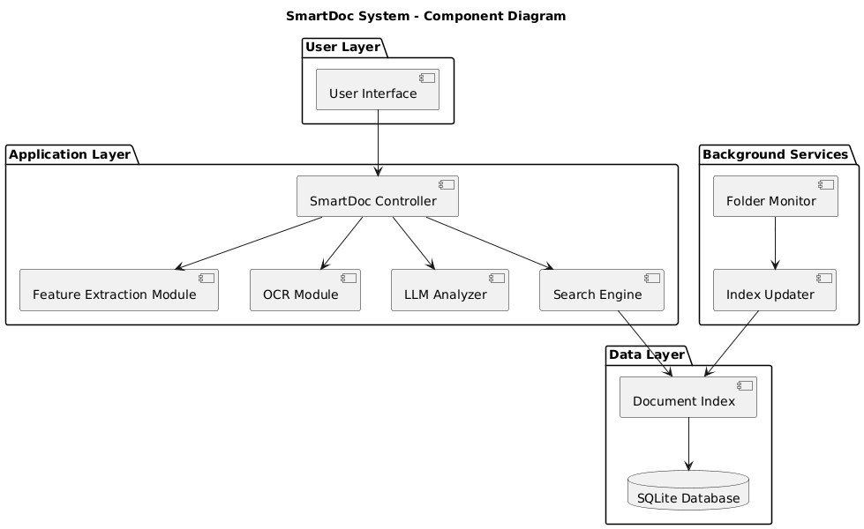
COMPONENT DIAGRAM:

Slide 25
System Implementation
Developed as a desktop-based offline document retrieval system using Java & JavaFX.
Implemented document indexing by scanning selected folders and storing image metadata
Used ORB (OpenCV) for extracting visual features from document images
Integrated OCR (Tesseract) for text extraction to improve search accuracy
Applied hybrid similarity matching (visual features + OCR text) for better results
Implemented SHA-256 hashing to detect and avoid duplicate documents
Added aHash fallback mechanism for matching when feature detection is weak
Designed a two-panel UI for indexing (left) and result display (right)
Displays similarity score, document preview, and file path for verification

Slide 26
System Testing
Performed JUnit Testing to validate individual methods and core logic
Conducted testing to evaluate accuracy, performance, and reliability of document retrieval
Performed functional testing for indexing, search, and result display modules
Verified retrieval using multiple document types (Aadhaar, PAN, mark memo, invoices)
Measured similarity accuracy based on correct top-match results
Tested OCR performance for text extraction and its impact on retrieval
Evaluated processing time for indexing and search operations
Verified similarity accuracy based on correct top-match results

Slide 27
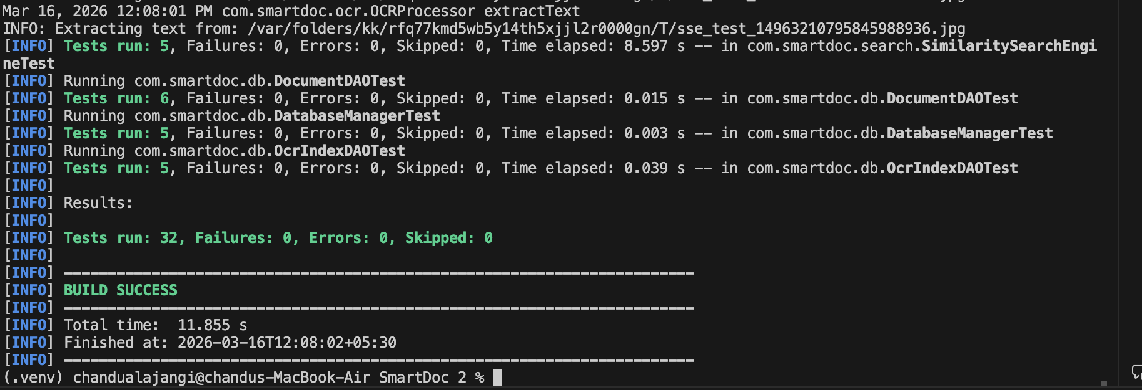
Testing result

Slide 28
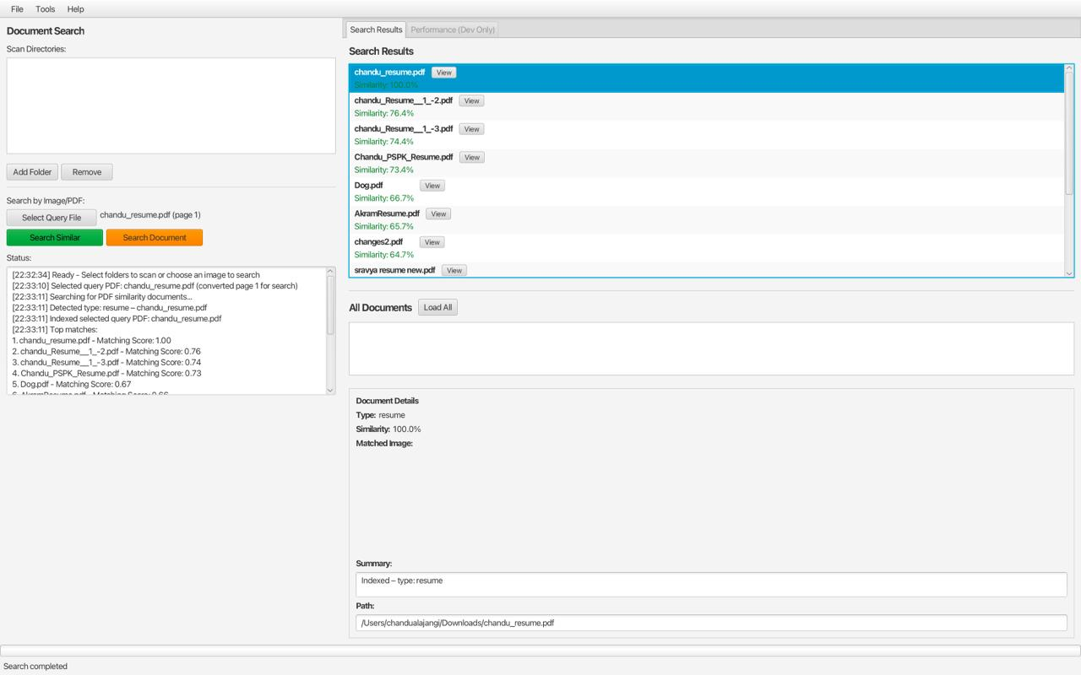
Performance testing

Slide 29
System Results
Successfully implemented a fully offline document retrieval system
Achieved accurate results using hybrid matching (ORB + OCR)
System correctly retrieves top-matching documents with similarity scores
Supports multiple document types (Aadhaar, PAN, mark memos, invoices)
Demonstrates fast retrieval time after indexing
Ensures efficient indexing of bulk documents from folders
Achieved reliable duplicate detection using SHA-256 hashing

Slide 30
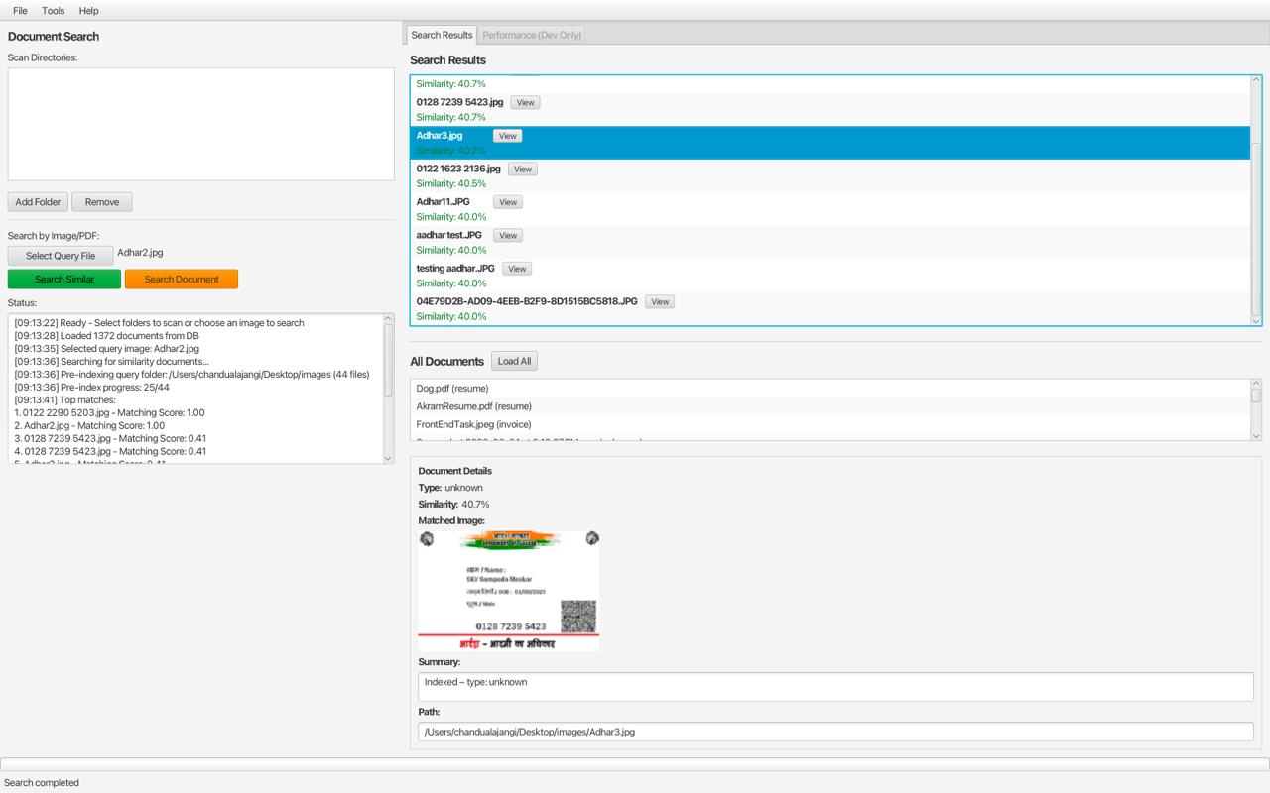
System Results

Slide 31
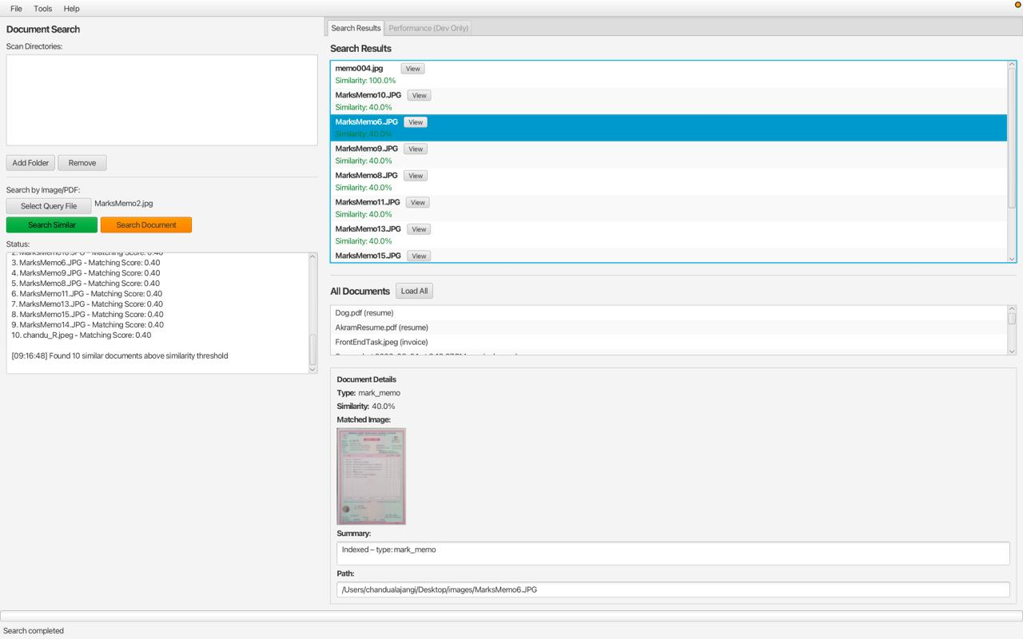
System Results

Slide 32
Conclusion
Successfully implemented a fully offline document retrieval system
SmartDoc improves efficiency of image-based document management and retrieval.
Combines OCR and image processing to convert scanned documents into searchable text
Automatically indexes new documents for continuous availability.
Supports similarity-based searches for more accurate results.
User-friendly interface enables easy upload, search, and access.
Reduces manual effort and enhances productivity in handling large document collections.

Slide 33
Future Work
Add multilingual OCR support for global applications.
Enable cloud storage for remote access and scalability.
Improve OCR accuracy with advanced image preprocessing (noise removal, enhancement).
Develop mobile app for direct scanning and uploading.
Implement stronger security (authentication, access control, encrypted storage).

Slide 34
THANK YOU!

