Slide 1

TripMate
DSA Project
Presented By: AV.SC.U4AIE24007 B. Meghana
AV.SC.U4AIE24009 B. Yochana
AV.SC.U4AIE24054 S. Jahnavi Sri Latha
AV.SC.U4AIE24060 V. V. Geethika

Slide 2

Problem Statement
Planning a trip often becomes stressful and inefficient
due to:
Uncertain Route Selection
Time & Distance Estimates
Unclear Cost Estimation
Manual and Time-Consuming Process
TripMate makes travel planning easy by:
Giving you the best route
Showing clear time, distance & cost estimations
Creating a full trip plan in minutes
Saving money, time and hassle

Slide 3






System Software
Frontend
HTML
CSS
JavaScript
Backend
Framework/libraries
Express.js
Leaflet.js
Node.js

Slide 4
Related work/ Background
Solution | Limitations | TripMate Advantage
Google Maps / Waze | Shows route & time but no cost estimation. | Combines route, time, and full cost prediction.
Budget Calculators | Only provides cost estimates, no route planning. | Integrates route, time, and cost in one tool.
Itinerary Planners | Organizes destinations | Offers route, time, and cost updates.
Manual Planning | Time-consuming and error-prone. | Fully automated and user-friendly system.

Slide 5





Why TripMate is Important
Important because it makes trip planning smarter, faster, and easier — helping users save time, money, and effort.
Saves Time & Reduces Stress
Simplifies Travel Planning
Improves Travel Reliability
Scalable for Everyday Use
Promotes Cost Efficiency

Slide 6
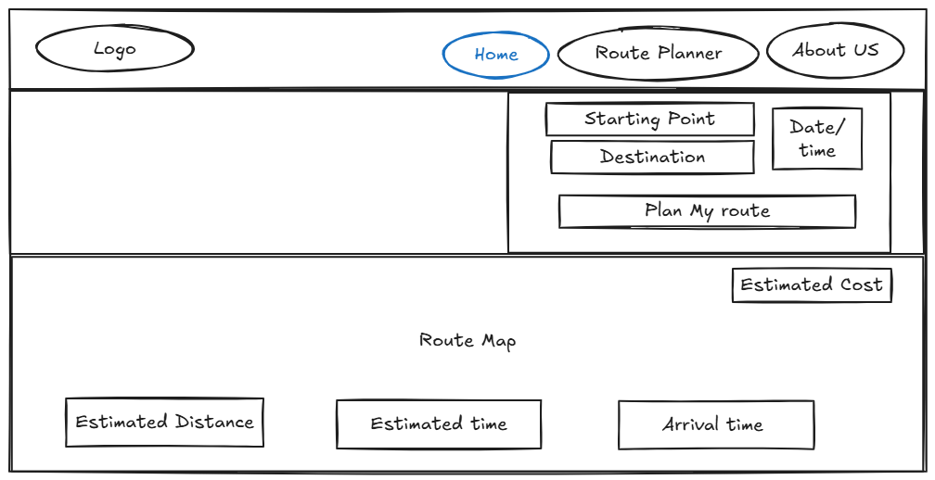
System Architecture/Design

Slide 7
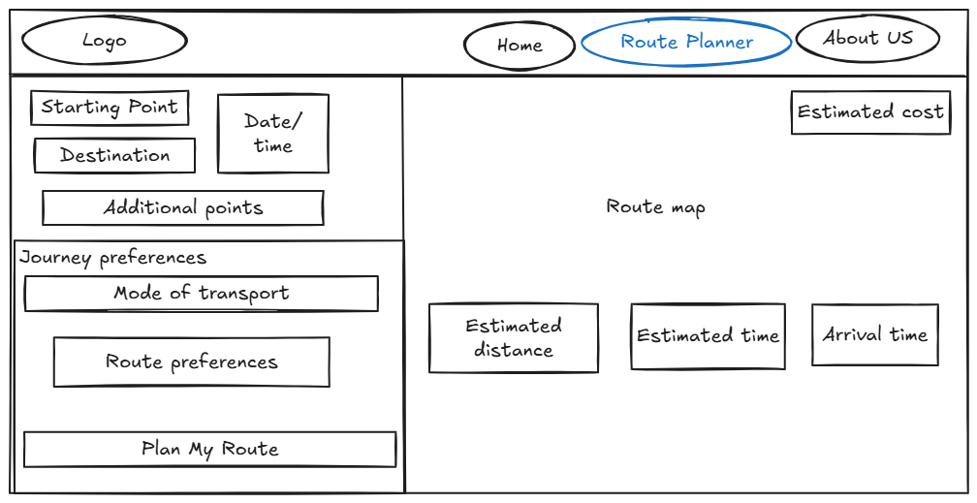

Slide 8

Methodology
Collected user needs for trip planning (starting point, destination, date, time).
Designed the system using suitable Data Structures like Graphs, Sets, Lookup Tables, and Queues.
Implemented Dijkstra’s Algorithm (Simplified BFS) for finding the shortest path.
Used Math Formulas & Functional Mapping for cost and time calculations.
Developed real-time Dynamic DOM Updates for smooth user interaction.
Tested for accuracy and performance using real-world routes.
Final deployment for real user feedback and improvements.

Slide 9



Project Objectives
Analysis Phase
Strategy Development
Implementation Plan
Understand user needs and trip planning challenges.
Study existing tools and their limitations.
Identify essential features like route, distance, time, and cost calculation.
Design a user-friendly system for entering trip details (start, end, date, time).
Plan data integration for real-time routes, cost estimation, and time prediction.
Define system architecture, tech stack, and backend logic.
Integrate distance calculations.
Test for accuracy, performance, and ease of use.
Deploy and gather user feedback for improvements.

Slide 10

Implemented DSA concepts
Data Structures
These are ways to store and organize data
Graph Data Structure
Set
Lookup Tables
Linked List
Queue (as Array)
Algorithms / Logic concepts
These are step-by-step procedures to solve problems.
Math Formulas
Functional Mapping
Dijkstra's Algorithm (Simplified BFS Version)
Conditional Logic
Dynamic DOM updates

Slide 11
Data Structures
Set A Set stores unique values — no duplicates allowed. → Used to track visited cities in dijkstra.js, preventing loops in the route search.
Example: visited.add(currentCity);
Purpose: Avoids infinite loops and repeated processing.
Graph A graph is a structure with nodes (cities) connected by edges (routes). → Used in dijkstra.js to model city-to-city connections for route planning.
Example: { 'Mumbai': ['Pune', 'Surat'], 'Pune': ['Indore'], }
Purpose:
Helps the algorithm understand which cities are directly connected.
Lookup Table A Lookup Table stores key-value pairs for fast access. → Used in route.js to map transport modes to speed and cost.
Example: { car: {speed: 60, cost: 8},
bus: {speed: 45, cost: 3} }
Purpose:
Simplifies travel cost & time calculations.

Slide 12
Data Structures
Linked List Logic
A linked list stores elements with references to the next one.→ Simulated in dijkstra.js using path arrays to reconstruct the route step-by-step.
Example:
path.concat({from: city, to: neighbor});
Purpose:
Builds the final route path from start to end.
Queue (as Array)
A Queue is a First In First Out (FIFO) structure.→ Used in dijkstra.js for Breadth-First Search during route finding.
Example:
queue.push(newPath);queue.shift();
// processes the earliest added path
Purpose:
Ensures the algorithm finds the shortest path first.

Slide 13
Algorithms and Logic concepts
Math Formulas → Used in route.js to calculate distance between two cities using their coordinates.
Formula: Distance = √(Δlat² + Δlon²) × 111
Purpose:
Converts geographic coordinates into real-world distances for accurate time and cost calculations.
Functional Mapping → Used to transform lists (arrays) in route.js & routeplanner.js.
Example: coordinates = fullRoute.map(city => cityCoords[city]);
Purpose:
Efficiently converts a city list into coordinates for map rendering.
Dynamic DOM Updates → Used in routeplanner.js to add or remove waypoints and update the map results.
Example: waypointsContainer.appendChild(waypointDiv); waypointDiv.remove();
Purpose:
Makes the interface interactive — allowing users to customize their trip plan without page reloads.

Slide 14
Algorithms and Logic concepts
Dijkstra's Algorithm (Simplified BFS)→ Used in dijkstra.js to find the best path between two cities.
How it works:
Explores nearby cities first using a queue (FIFO).Builds the shortest route using path accumulation. Avoids loops using a Set.
Purpose: Determines the most efficient route for travel.
Conditional Logic
→ Used in homepage.js & routeplanner.js for validating user inputs.
Example:
if (!departureDate || !departureTime) { alert('Enter valid info!'); }
Purpose:
Prevents invalid route searches and ensures correct input data.

Slide 15
Expected Outcomes
Smart Route Optimization
Users will receive the most efficient travel route using Dijkstra’s algorithm.- Supports different transport modes: Car, Train, Flight.
Dynamic Travel Information
Live display of: - Total Distance - Estimated Travel Time - Arrival Time - Travel Cost Estimate
Personalized Route Preferences
Users can customize their routes by avoiding: - Tolls - Highways - Ferries
Seamless User Experience
Beautiful, responsive multi-page UI.- Smooth integration between frontend (HTML/CSS/JS) and backend (Node.js).
Real-world Application Potential
Ready to scale with additional features like: - Multi-stop trip planning
Educational Value
Demonstrates practical implementation of: - Data Structures & Algorithms (Dijkstra’s) - API Integration (OpenRouteService)

Slide 16

Challenges Faced
Data Accuracy
Ensuring real-time data for routes, traffic, and cost estimates is challenging and requires reliable APIs.
Scaling the System
Adapting the platform for various use cases, from personal travel to logistics, can increase complexity.
User Input Variability
Users may enter different types of data (e.g., multiple destinations or varying preferences), which can complicate planning.

Slide 17
Conclusion
TripMate was designed to make travel planning simple, fast, and reliable.
By combining route, distance, time, and cost estimation in one platform, it reduces the time and effort needed for trip planning.
It helps users make smarter decisions, avoid unexpected costs, and enjoy smoother, well-prepared journeys.

Slide 18
Thank you
Plan Smart. Travel Easy
Thank you for your attention
Any questions. ?

