Slide 1
Cyclone Guard
Predictive safety dashboard for coastal communities
Team Aftershock
Geethika Palla | Aniket Verma | Koustubh Jain

Slide 2
The Team: Aftershock
• Geethika Palla - Frontend Development & API Integration
• Aniket Verma - Data Engineering & ML Optimization
• Koustubh Jain - Geographic Analytics & Risk Modeling

Slide 3
Problem Statement
• Coastal regions in India are highly vulnerable to tropical cyclones.
• Existing data is often complex and hard for citizens to interpret.
• Need for a real-time, user-friendly, and predictive dashboard.

Slide 4
Project Vision
• Bridging the gap between raw scientific data and actionable citizen intelligence.
• Providing hyper-local risk assessments using state-of-the-art ML.

Slide 5
Key Objectives
• Predictive Accuracy: High-precision rainfall/wind forecasting.
• Visual Clarity: Interactive mapping of storm tracks and shelters.
• Real-time Response: Live data ingestion from global sources.

Slide 6
The Methodology
1. Data Acquisition from multiple APIs.
2. Feature Engineering (Temporal lags, Seasonal weights).
3. ML Model Training & Validation.
4. Real-time Dashboard Deployment.

Slide 7
Reliable Data Sources
• Open-Meteo: Real-time and historical weather data.
• NOAA / IBTrACS: Global cyclone track telemetry.
• OpenStreetMap: Evacuation shelter geolocation.

Slide 8
Feature Engineering
• Temporal Features: 1d, 3d, 7d rainfall/wind lags.
• Seasonal Indicators: Month-wise cyclone vulnerability weights.
• Geospatial: Haversine distance to active storm centers.

Slide 9
ML Engine: Rainfall Prediction
• Algorithm: XGBoost Regressor.
• Robustness: Blending predictions with raw forecast data.
• Accuracy: Optimized for monsoon and post-monsoon surges.

Slide 10
ML Engine: Wind Speed & Path
• Algorithm: Random Forest Regressor.
• Inputs: Central pressure index, track trajectory, latitude/longitude.

Slide 11
Risk Level Determination
• Categorization: Low | Medium | High | Severe.
• Weighted Variables: Predicted wind speed + Rain intensity + Population Density.

Slide 12
Design: Midnight Indigo
• Aesthetic: Glassmorphism and vibrant gradients.
• UX: Mobile-responsive sidebar and intuitive metric cards.

Slide 13
System Architecture
• Frontend: Streamlit (Python).
• Processing: Cached ML pipeline for high-speed delivery.
• Hosting: Streamlit Community Cloud (Publicly Accessible).

Slide 14
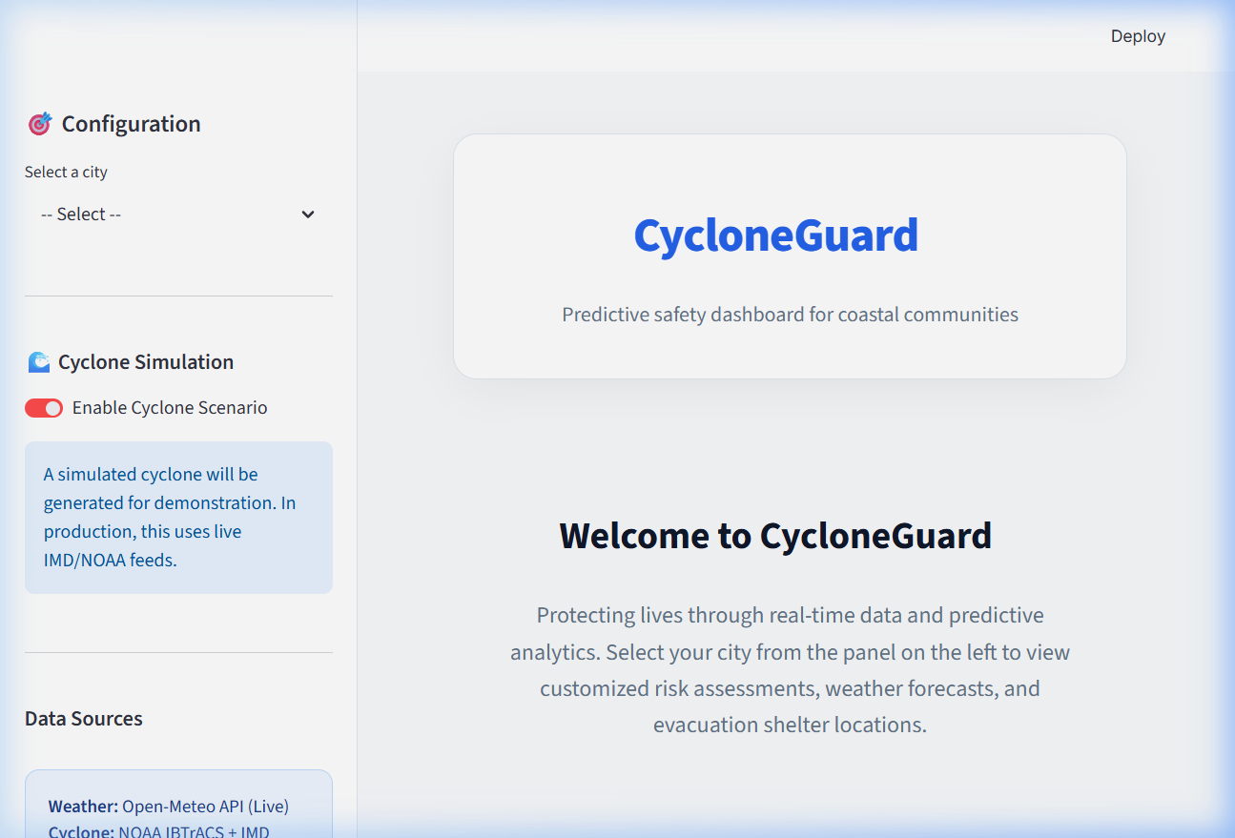
Dashboard Overview

Slide 15
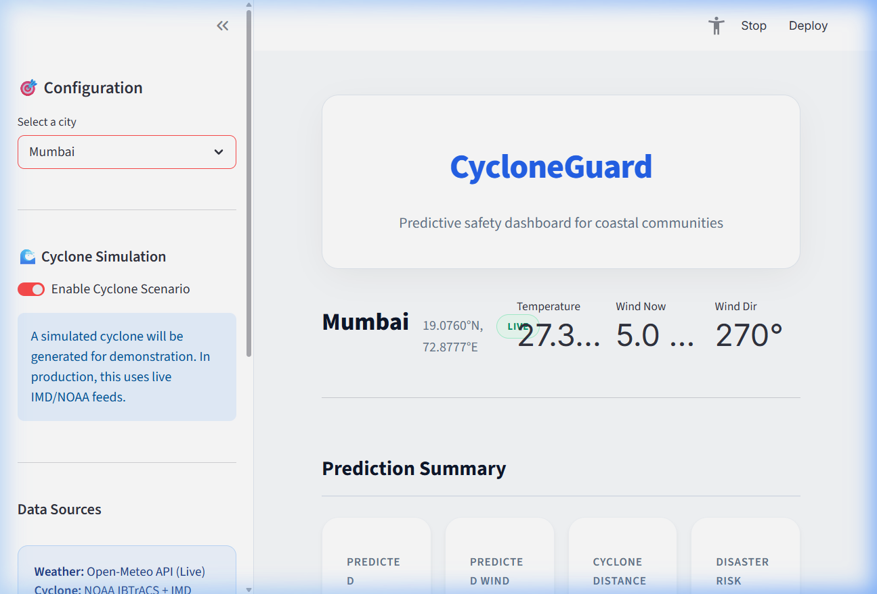
City-Specific Predictions

Slide 16
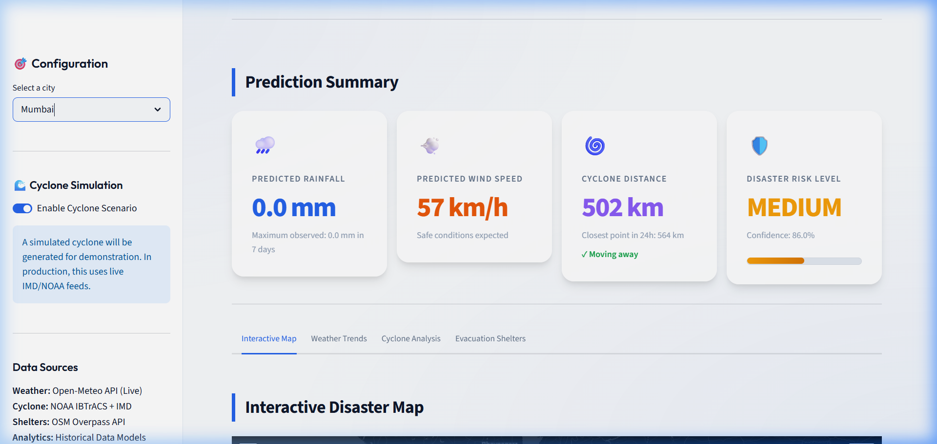
Interactive Geospatial Insights

Slide 17
Resilience: Evacuation Shelters
• Live OSM Overpass query for nearby shelters.
• Sorted by Haversine distance for immediate evacuation guidance.

Slide 18
Evaluation & Validation
• R2 Score: 0.85+ for wind speed forecasting.
• RMSE: Minimized error through blending techniques.

Slide 19
Future Roadmap
• Integration with IMD Satellite imagery.
• Community alert system via SMS/WhatsApp.
• Multi-language localization for regional coastal states.

Slide 20
Conclusion
• CycloneGuard empowers authorities and citizens with predictive foresight.
• A robust, scalable, and visually compelling tool for disaster resilience.
Thank You! | Team Aftershock

