Slide 1
AgriFlow
Advanced algorithms, made interactive on a farm-data app
2500030117 | 2500030142 | 2500032128 | 2500032215
2nd year CSE | Guide: Dr. Maganti Syamala
M1
M2
M3
M4
M5
M6
Notes:
Good morning everyone. Our project is AgriFlow. It is a website where you can run advanced algorithms and watch them work, using farm data. In the next few minutes I will show what it is, why we built it, how each of the six syllabus modules is used, and then I will demo it live.

Slide 2
What is AgriFlow?
A farm-data web app where every algorithm from our syllabus runs live.
15 farm records (crop, disease, soil, season) are the data
31 interactive labs, one per algorithm
Java only. The engine is hand-built, with no java.util
Click Run, watch it work, read the 'explain it like I'm 10' box
31
6
interactive labs
syllabus modules
15
54,614
farm records
self-checks, 0 failed
Notes:
AgriFlow is a farm-data web app. Every algorithm from our syllabus runs inside it. We have 15 farm records like crop, disease, soil and season. We have 31 interactive labs, one for each algorithm. Everything is in Java, and our engine is hand-built with no java.util. Each lab has a box that explains it in simple words. And we checked correctness with 54,614 random tests against slow brute-force answers, with zero failures.

Slide 3



Why this project
Books stay still
Farm data fits
Built by hand
A textbook shows one frozen example. Here you click Run and watch the grid, graph or map fill in.
Crops, diseases and routes are real text, graphs and choices, so every module gets a natural job.
No java.util in the engine. Every line is ours, so we can explain how it works.
Notes:
Why did we build it? Three reasons. One: a textbook shows one frozen example, but here you click Run and watch the grid, graph or map fill in. Two: farm data fits naturally. Crops and diseases are text, farm sites are routes, and water pipes are networks, so every module gets a real job. Three: it is built by hand. Every line is ours, so we can explain how it works.

Slide 4



Why Module 1 is used
M1
Hand-built engine
Only arrays and java.lang. IntList and Rng are written by us, as the syllabus requires.
Foundations: the hand-built engine
Cost you can see
Counters tally comparisons, so Big-O stops being a formula and becomes a number.
Algorithm analysis, Big-O, cost counters, similarity search
Find similar records
Edit distance finds the nearest crop even when the search word has a typo.
In AgriFlow: /api/engine /api/similar /api/health
Notes:
Module 1 is the foundation. Our engine uses only arrays and basic Java, and we wrote our own list and random number maker. We also added counters that tally comparisons, so Big-O becomes a real number you can see. And edit distance lets us find similar records even if someone makes a typo.

Slide 5


Why Module 2 is used
M2
Search one word fast
KMP and Z never re-read letters they already matched, so the cost is O(n + m).
String algorithms
Search many at once
Aho-Corasick finds every disease name in the farm text in a single pass.
KMP, Z-function, Rabin-Karp, Aho-Corasick, suffix array, LCP
Spot repeats
Suffix array and LCP give the longest repeated phrase and count distinct substrings.
In AgriFlow: /api/search /race /multi /strlab /suffix /repeats
Notes:
Farm records are mostly words, so string search comes first. KMP and Z never re-read letters they already matched. Aho-Corasick finds many words in one pass, like every disease name at once. And the suffix array with LCP finds repeated text. Aho-Corasick is also used in security tools to scan logs for attack patterns.

Slide 6



Why Module 3 is used
M3
Compare text
Edit distance and alignment score how close two records or words really are.
Advanced dynamic programming
Plan routes
Held-Karp finds the shortest tour through all 12 farm sites, and it is exact.
Edit distance, alignment, matrix-chain, optimal BST, TSP, set cover, tree DP
Choose smartly
Set cover, tree DP and the coin demo show when greedy fails and DP wins.
In AgriFlow: /api/edit /align /route /setcover /tree /sos /greedy
Notes:
Dynamic programming means writing down answers so we never solve the same small puzzle twice. We use edit distance and alignment to compare text. We use Held-Karp to find the exact shortest route through the farm sites. And we use set cover and tree DP to choose smartly. Our coin demo also shows that greedy choices can look smart and still lose.

Slide 7



Why Module 4 is used
M4
Max flow, min cut
How much water can reach the fields? The min-cut shows the bottleneck pipes.
Network flow
Cheapest shipping
Min-cost flow fills every market at the lowest total cost.
Edmonds-Karp, Dinic, min-cut, min-cost flow, bipartite matching, project selection
Match and select
Bipartite matching pairs workers with jobs. Project selection is a min-cut.
In AgriFlow: /api/flow /matching /mcmf /projects
Notes:
Think of pipes with different widths. Max-flow is the most water we can push through. The min-cut shows the bottleneck, the pipes holding everything back. Min-cost flow ships crops to markets at the lowest cost. And matching pairs workers with jobs, while project selection is solved as a min-cut.

Slide 8



Why Module 5 is used
M5
Know the limits
Some problems blow up as inputs grow. The exact solvers show where it starts to hurt.
NP-completeness and approximation
Good enough, with proof
2-approximations for vertex cover and TSP, plus a knapsack FPTAS, with provable error.
NP-completeness, vertex cover, knapsack, subset sum, TSP approximation, FPT
Fast when k is small
FPT vertex cover shrinks the graph first (Buss kernel), then searches.
In AgriFlow: /api/vcover /knapsack /subsetsum /route
Notes:
Some problems are so hard that perfect answers take forever as inputs grow. The exact solvers in our app show where it starts to hurt. So we also use approximation: vertex cover and TSP get 2-approximations, and knapsack gets an FPTAS. These are answers that are provably close to perfect. For vertex cover, when the number k is small, we shrink the graph first and then search quickly.

Slide 9



Why Module 6 is used
M6
Let dice help
Randomised quicksort dodges the worst case. Miller-Rabin tests big primes fast.
Randomised and parallel algorithms
Hash and sample
Perfect hashing has zero collisions. Reservoir sampling picks fairly from a stream.
Miller-Rabin, randomised quicksort, universal and perfect hashing, reservoir sampling, parallel algorithms
Use every core
Parallel sum, scan and merge sort, with work, span and the Brent bound.
In AgriFlow: /api/prime /qsort /hash /reservoir /parallel
Notes:
Rolling dice can make algorithms safer. Randomised quicksort avoids the worst case, and Miller-Rabin tests big primes fast. Perfect hashing gives zero collisions, and reservoir sampling picks a fair sample from a stream. For parallel algorithms, we split work across CPU cores. To be honest, on small inputs threads can even be slower, and our lab shows that truthfully.

Slide 10
How a click becomes a picture
Browser
web/index.html. You click Run.
Server
AgriFlowServer routes the path. Q reads the query.
API classes
ApiStrings or ApiGraph pick the algorithm.
Algorithms
Hand-built Java does the real work.
JSON
Json builds the answer to send back.
JSON goes back, and the page draws the grid, graph or map
Example: GET /api/flow runs Dinic max-flow, returns the flow and min-cut as JSON, and the page draws the pipe network with the cut edges.
Notes:
Here is how it works inside. You click Run in the browser. The server reads the web address and decides where it goes. The API classes pick the right algorithm. The algorithms, in hand-built Java, do the real work. Then the answer is packed as JSON and sent back, and the page only draws it. For example, the max-flow lab runs Dinic's algorithm and draws the pipe network with the cut edges.

Slide 11
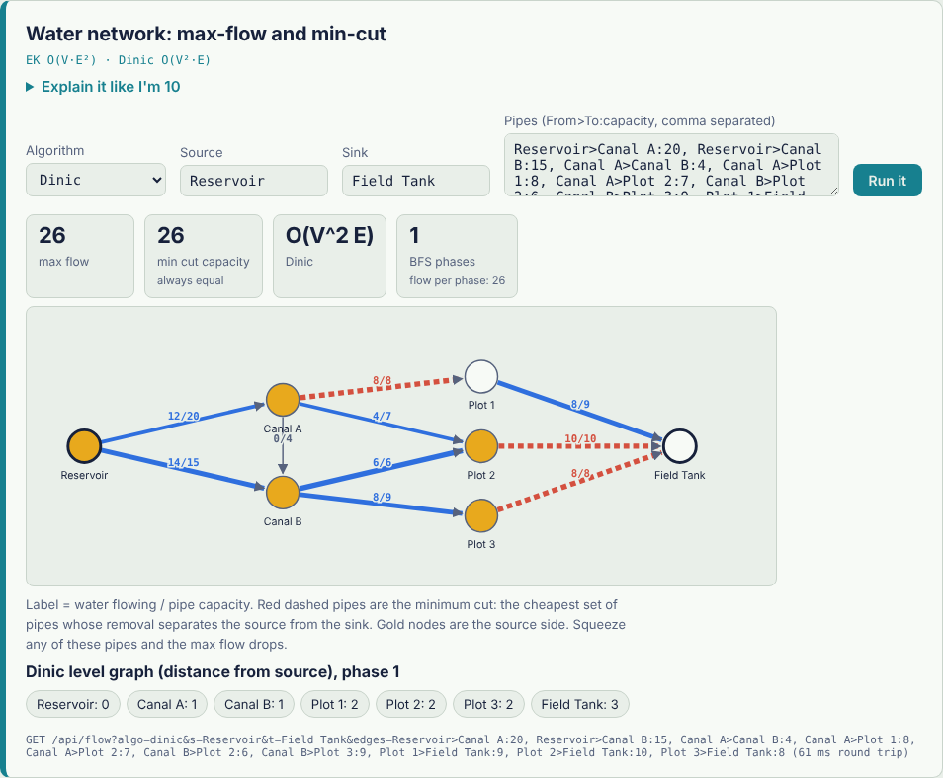
Results from the running app
30x
fewer comparisons, KMP vs naive on the worst case
26 = 26
max flow equals min cut in the water network
+14%
nearest-neighbour route vs exact, 8 farms
0 fails
in 54,614 random self-checks
Notes:
Now the results, read straight from the running app. On a worst-case text, naive search made about 1.2 million comparisons and KMP about 40 thousand, roughly thirty times fewer. In the water network, max flow and min-cut both came to 26, exactly as the theorem says. For a route over 8 farms, the exact answer is 241.8, nearest neighbour is 14 percent longer, and the MST 2-approximation is 1.23 times optimal. And all of it was checked with 54,614 random tests, with zero failures.

Slide 12






Future implementation
Load real datasets
Step-by-step player
Live farm feeds
Upload a CSV of real farm records instead of the built-in 15.
Pause, rewind and step through each algorithm like a video.
Plug in weather and soil-sensor data to drive the flow and routing labs.
Security use-case
Save and compare
Put it online
Run Aho-Corasick over log files to spot attack signatures, SOC style.
Store runs, compare algorithms side by side, export results.
Package with Docker and host it so anyone can open the link.
Ideas for the next version. None of these are built yet.
Notes:
Here is what we would add next. These are plans, not finished features. Real datasets: upload a CSV of actual farm records. A step-by-step player to pause and rewind algorithms. Live feeds like weather and soil sensors. A security use-case, scanning logs with Aho-Corasick. Saving and comparing runs. And hosting it online with Docker so anyone can open it.

Slide 13
Thank you
Questions? Pick any lab and we will run it live.
M1
M2
M3
M4
M5
M6
Notes:
That is AgriFlow. Thank you. I would love to show you the live demo now. Pick any lab and I will run it. Good ones to start with: the KMP versus naive race, the max-flow min-cut picture, and the quicksort lab.

