Slide 1
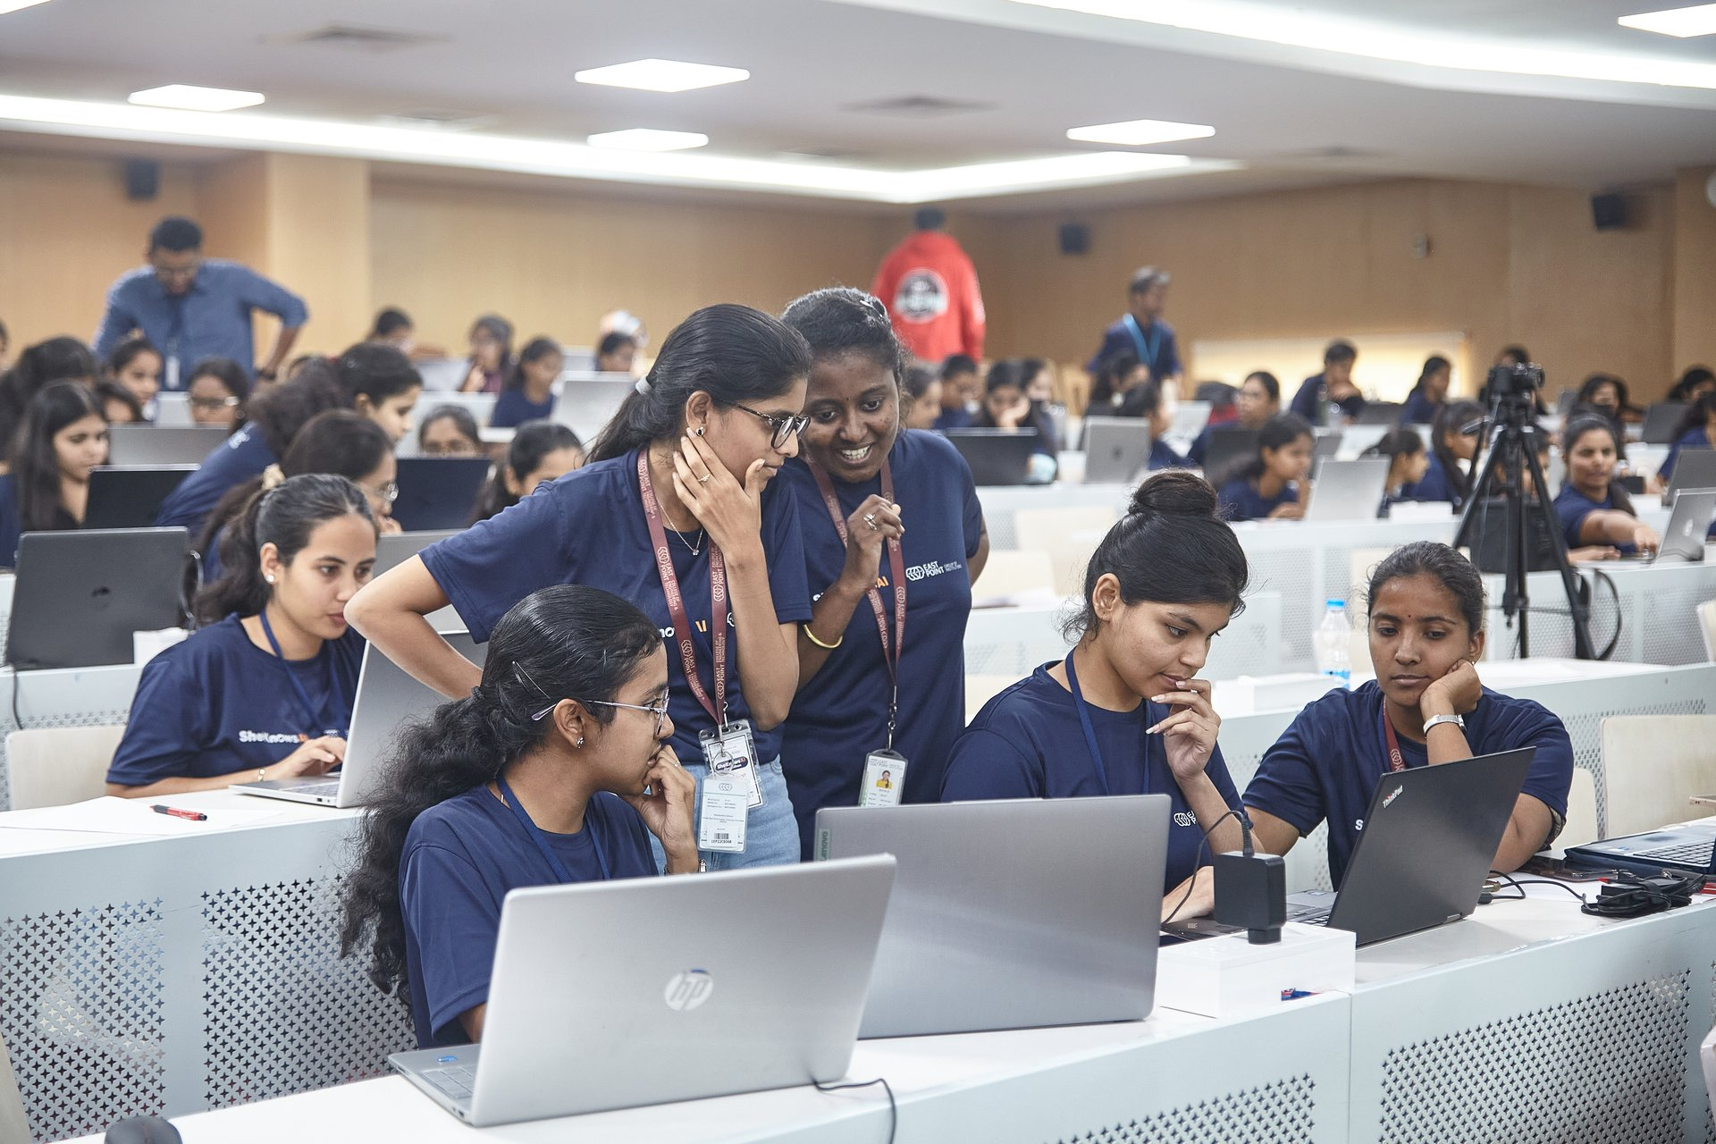


ASPIRE FOR HER × LOGITECH
🏆 In collaboration with AICTE & applied for “Guinness Book of World Records”
Women Who Master — Individual GenAI Hackathon Submission
Submitted by: Geethika Dasari | Roll number: WWM26-VIZ-G-T074-L01
Location: Visakhapatnam

Slide 2
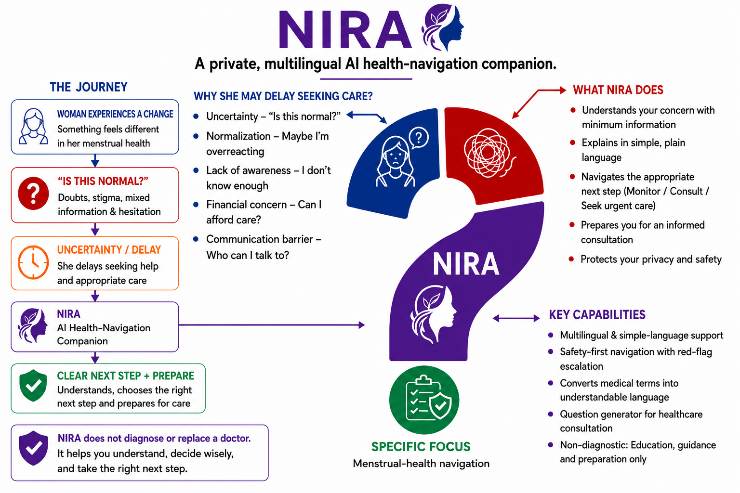
Problem Statement 1 — Health: From Confusion to the Right Next Step

Slide 3
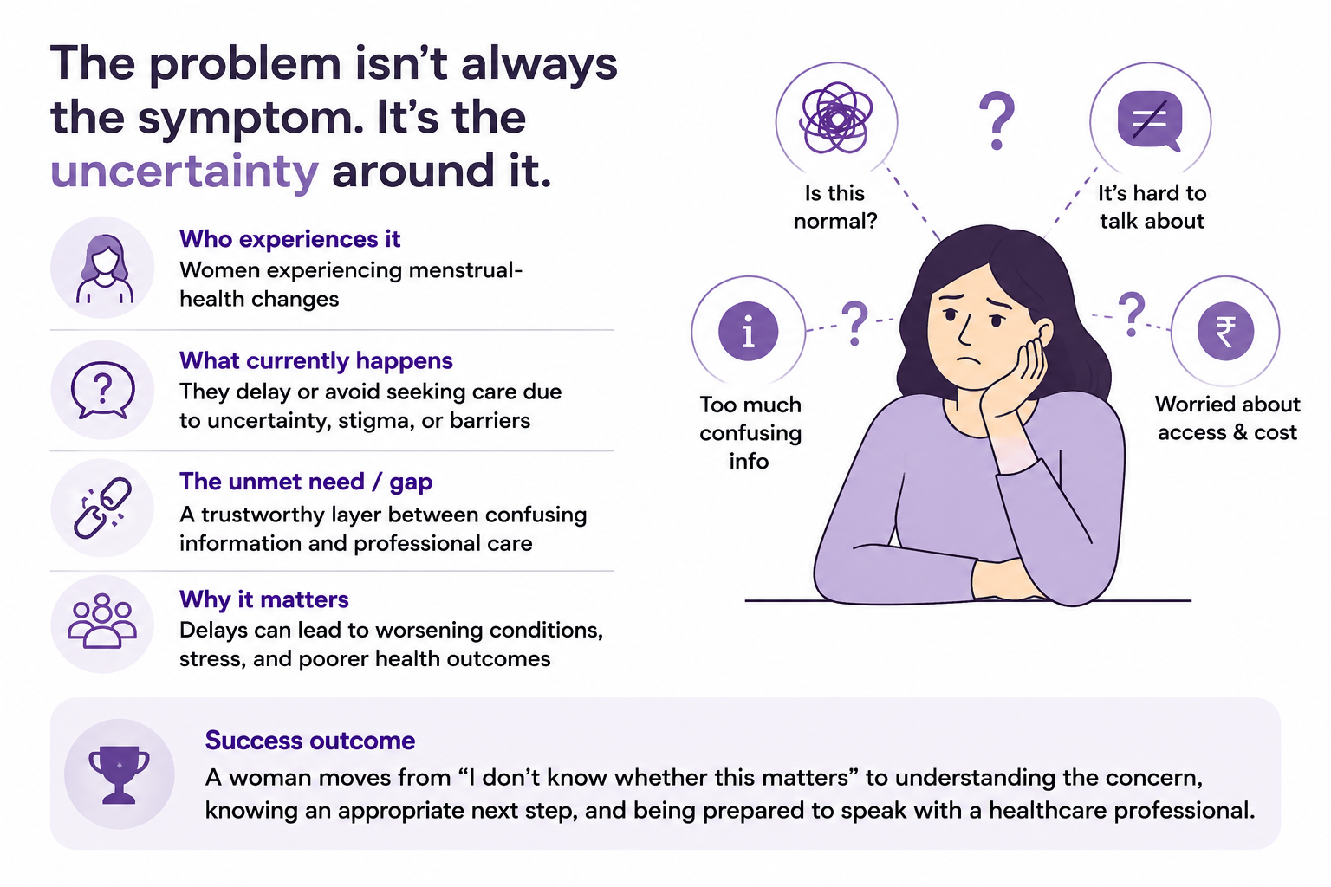
User and Problem Definition

Slide 4
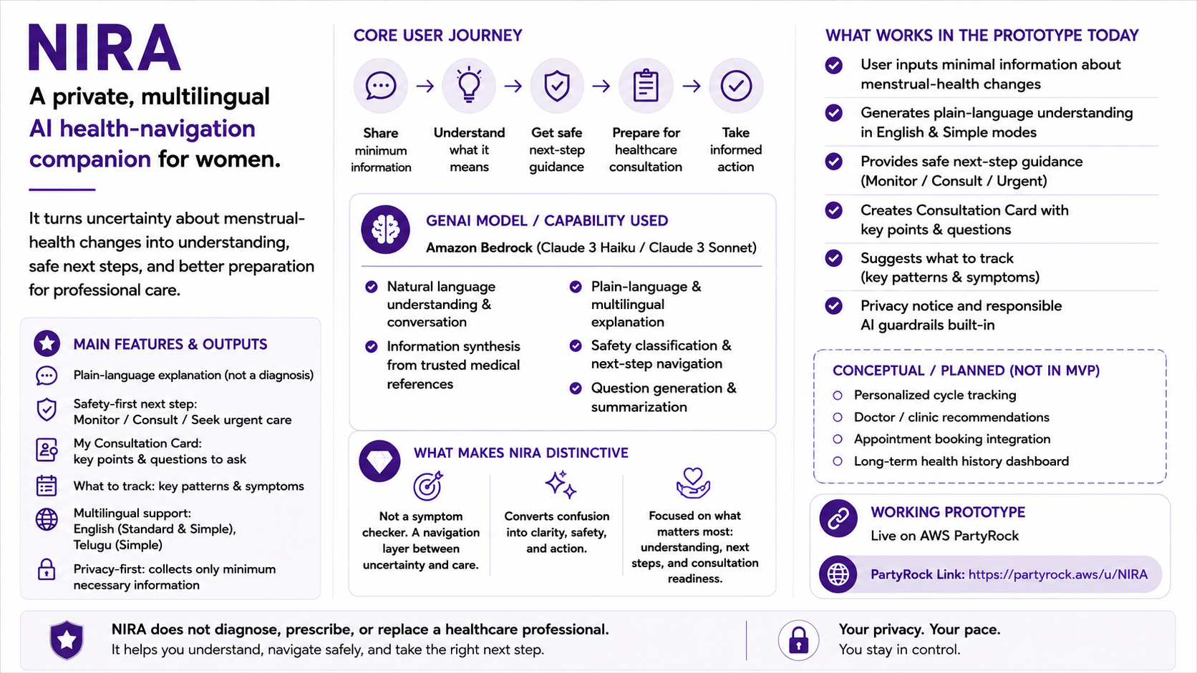
Proposed Solution

Slide 5
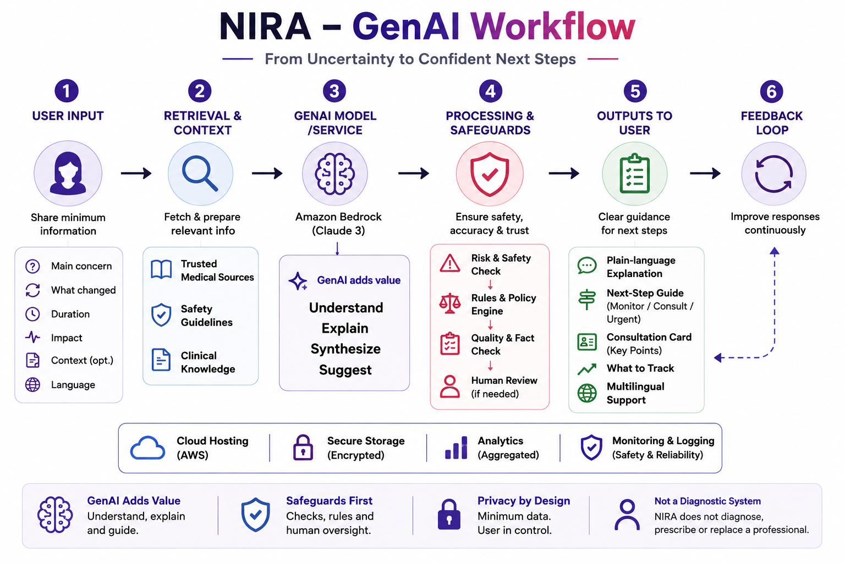
GenAI Workflow or System Design
Show how information moves through your solution. A simple flow, annotated screenshot or architecture sketch is sufficient.
Identify:
• User input and any data source
• Prompt/instruction sent to the model
• GenAI model or service used
• Processing, rules or validation steps
• Output returned to the user
Make it clear where GenAI adds value and where human review or safeguards are needed.

Slide 6
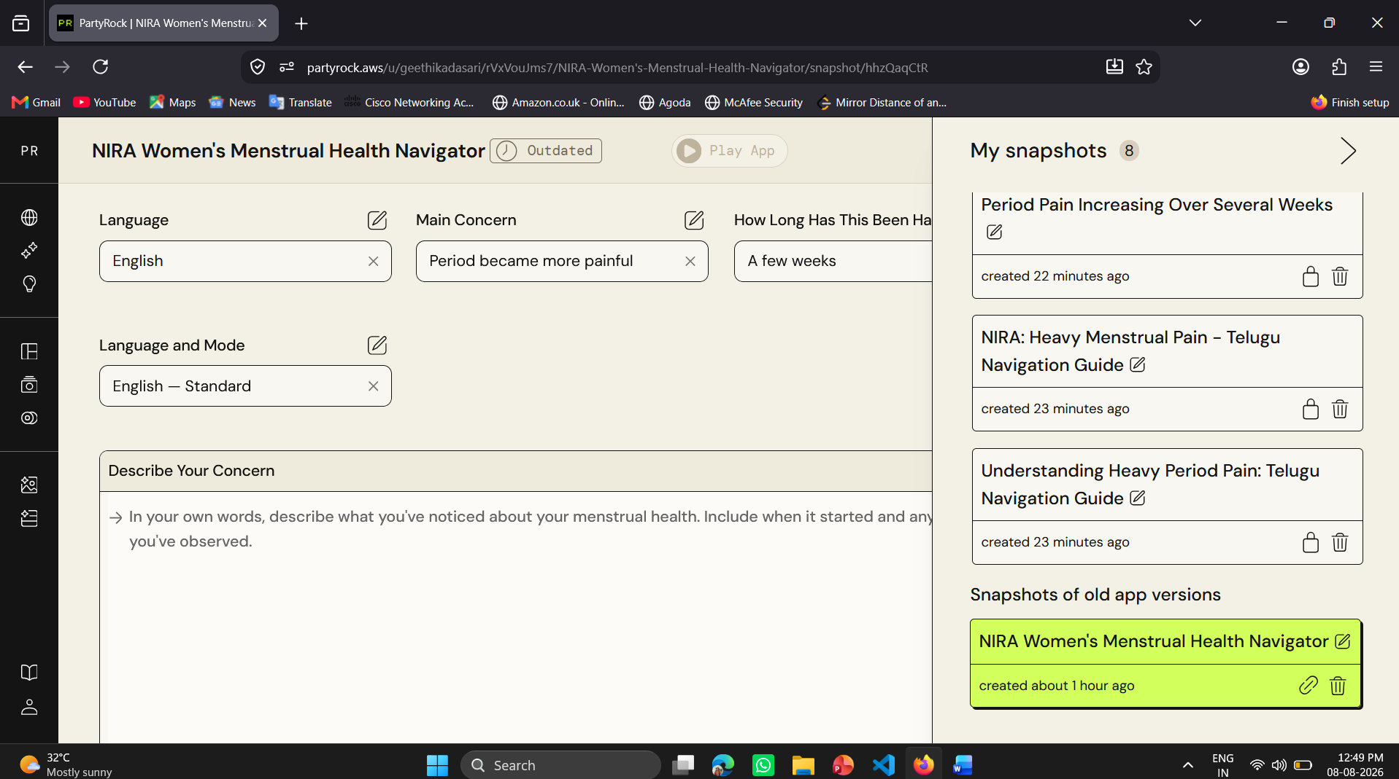
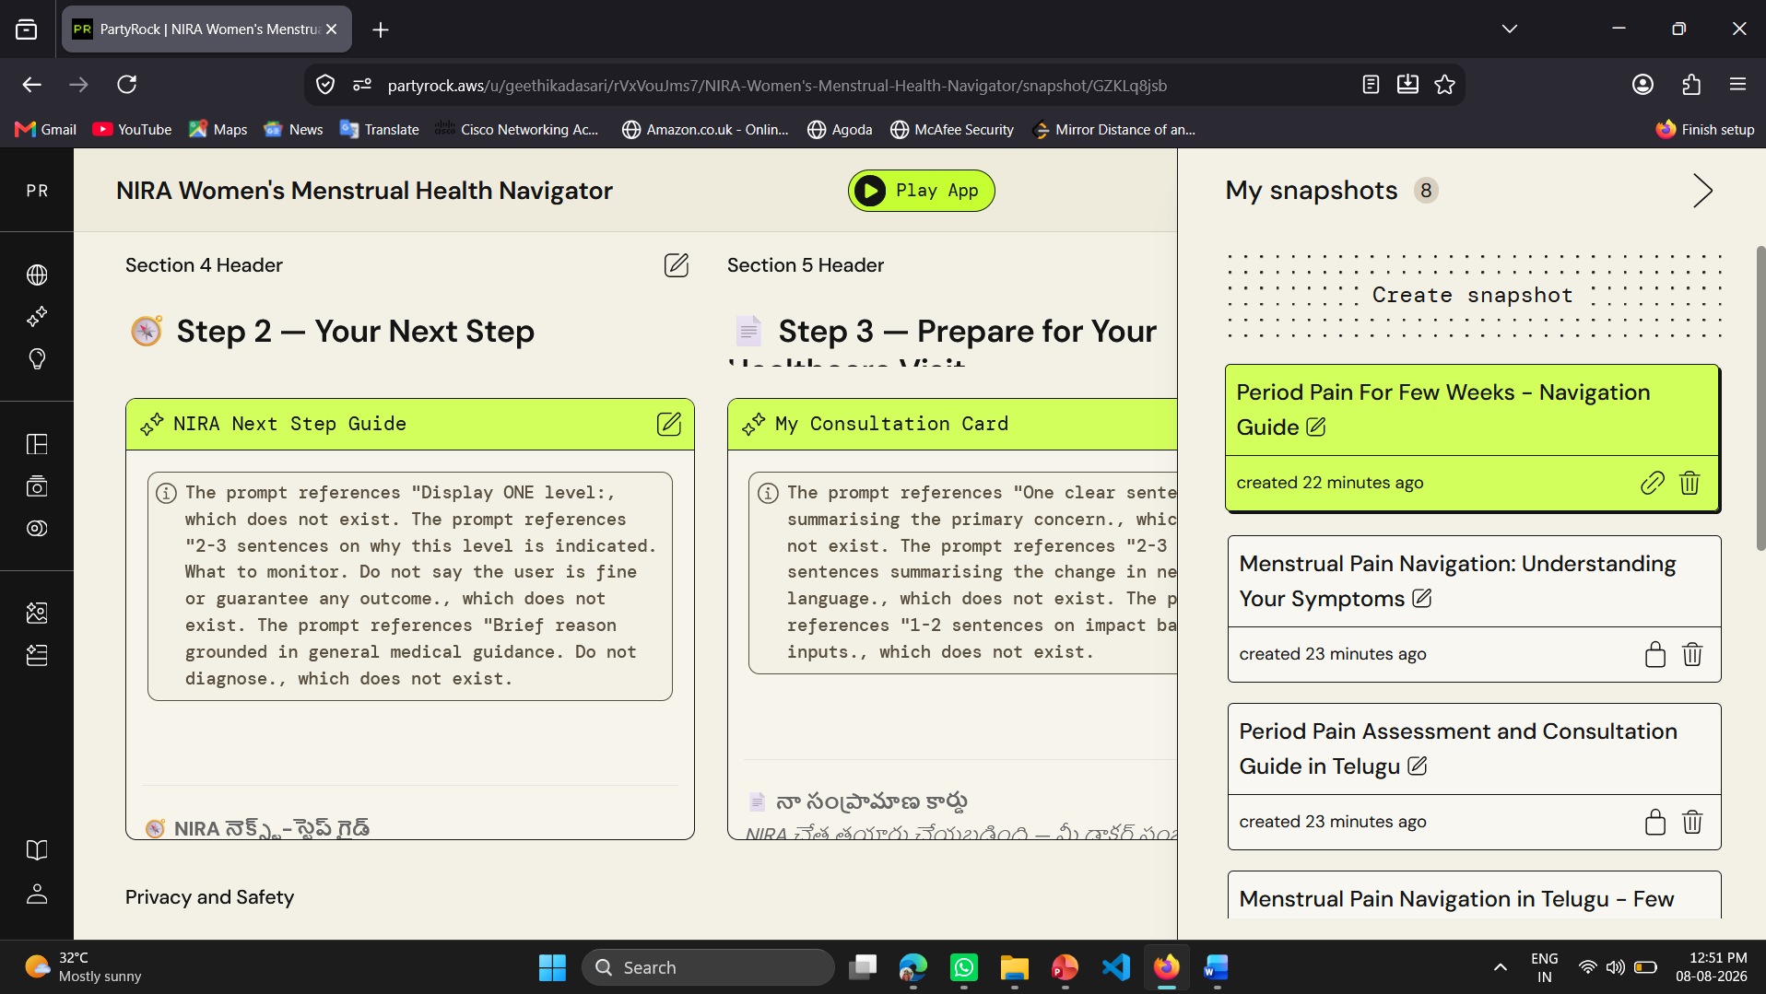
Mandatory Progress Evidence — 11:00 AM and 02:00 PM
11:00 AM | EARLY BUILD
Initial prototype
Selected menstrual-health focus
Defined NIRA's core journey
Built the first PartyRock structure
Tested the initial prompt
02:00 PM | DEVELOPED BUILD
Refined prototype
Improved prompt and response quality
Added safety-first navigation
Added consultation preparation
Tested multilingual/simple-language responses
From a basic concept to a tested health-navigation prototype through rapid iteration and prompt refinement.

Slide 7
AI Tools and Prompts Used
AWS PartyRock, ChatGpt & Gemini
Purpose Built and refined NIRA as a working GenAI health-navigation prototype.
Prompt Iterations
Understand — “Understand the user’s menstrual-health concern.”
Explain — “Explain in simple language without diagnosing.”
Navigate — “Identify red flags, suggest the next step, and prepare questions for a healthcare professional.”
Generate — “Create clear, minimal, visually engaging PPT slides in a simple, easy-to-understand format.”
Refinement Broad responses → safety boundaries → structured guidance → actionable output
Grounding Trusted health information used for educational and safety guidance.
This gives the evaluator the tool + purpose + 3 prompt excerpts + refinement + references required by the template, without becoming a text-heavy slide.

Slide 8
Testing Performed and Results
Key Learning
The best result came from iterative prompting—not the first prompt.
Prompt → Observe → Refine → Manually configure → Retest
Improvement: Iterative prompting + manual widget configuration produced a more usable NIRA interface.
Test / Iteration | Expected | Actual | Result
Initial prompt | Generate NIRA app | Server issue; output not generated | ⚠️ Retried
First build | Create app structure | Basic skeleton generated | ✅ PASS
UI refinement | Improve NIRA interface | Cleaner UI generated | ✅ PASS
Widget refinement | Add widgets for NIRA journey | Widgets added; manually adjusted | ✅ PASS
Dropdown request | Simplify widget interaction | Dropdown added | ✅ PASS

Slide 9
Responsible AI Considerations
RISK | NIRA SAFEGUARD
🔒 Privacy | Collect only necessary information; avoid storing sensitive details
⚖️ Bias | Simple, inclusive language + multilingual support
⚠️ Harmful Output | No diagnosis/prescription + red-flag escalation
🛡️ Misuse | Clear boundaries: education ≠ medical advice
👩‍⚕️ Human Oversight | Encourage professional care when symptoms require it
Bottom highlight
NIRA informs — it never diagnoses.
AI explains → Safety checks → Woman decides → Professional care when needed
For the slide design
Keep it white background + black text, with one small accent color only. Use 5 compact risk → safeguard cards, large text, plenty of whitespace, and no large illustrations.
AWS Partyrock APP Link: https://partyrock.aws/u/geethikadasari/rVxVouJms7/NIRA-Women's-Menstrual-Health-Navigator

Slide 10
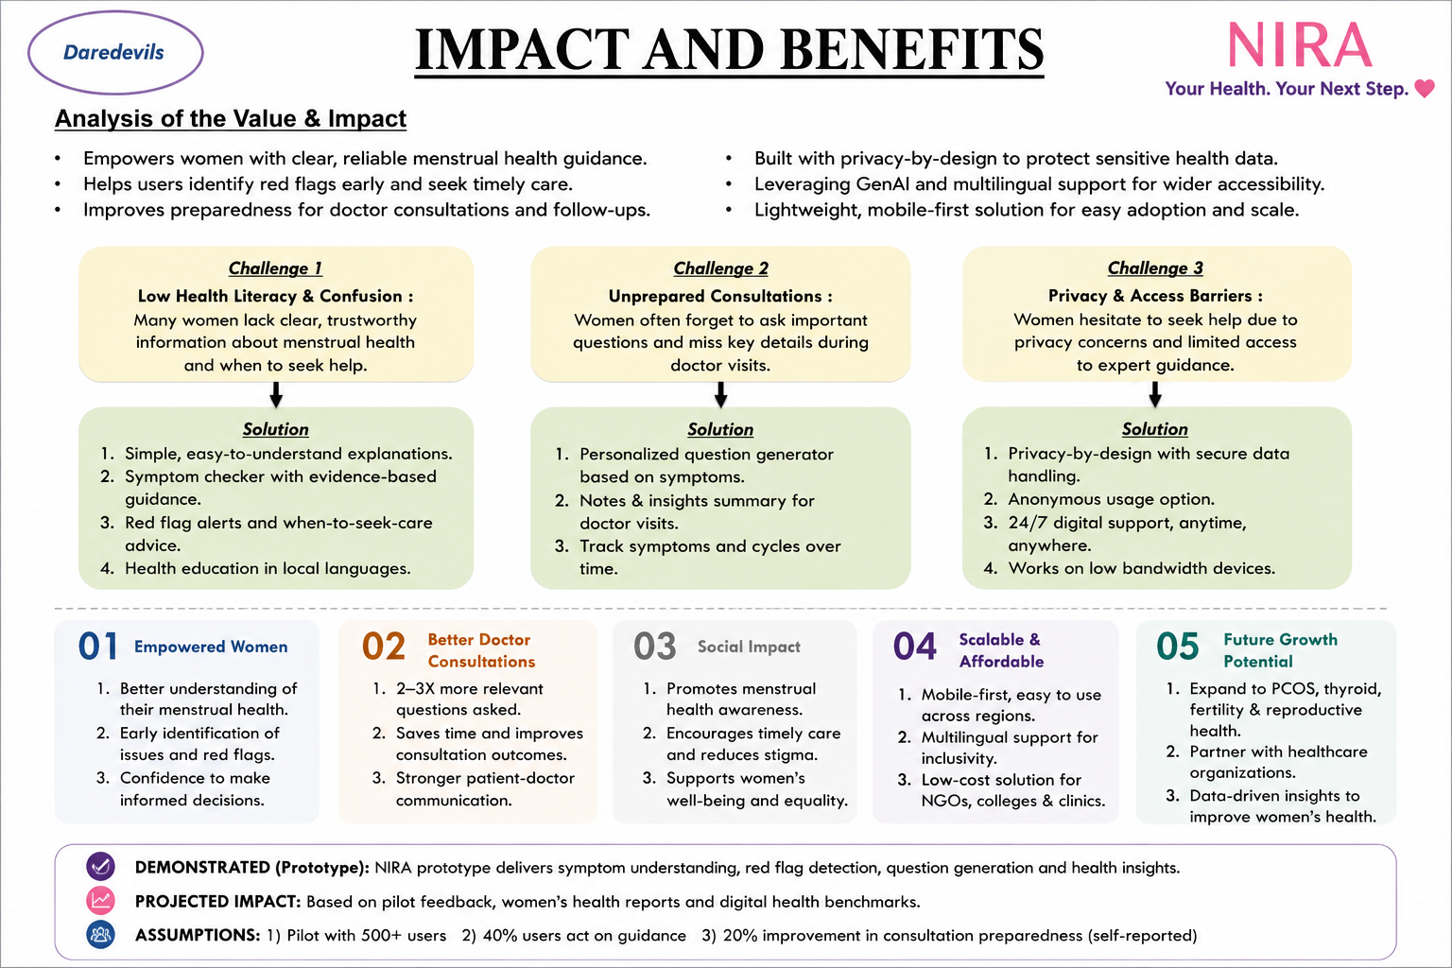
Impact, Feasibility and Sustainability

