Slide 1

Agentic AI
Agentic AI: Beyond
Simple Prompting
An introduction to
autonomous system de-
sign and the shift from
LLMs to Agents

Slide 2
What are the core components of an AI
agent?
Perception
Processes multi-modal inputs and
environmental context to build a
world model.
Brain
The LLM core responsible for high-
level planning, reasoning, and
decision-making.
Action
The execution layer: calling APIs,
running code, or interacting with
external tools.

Slide 3
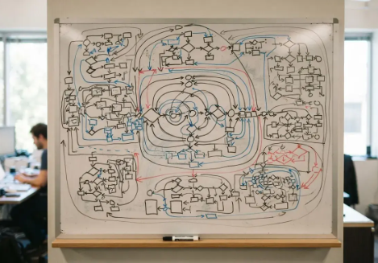
The Reasoning
Loop: ReAct and
Beyond
How agents use iterative thought
processes to solve complex, multi-step
problems
01
02
03
ReAct
Chain of Thought
Self-Reflection
Synergizing reasoning and acting by interleaving
Breaking down complex prompts into logical,
The agent reviews its own output against the goal
thought traces and action execution.
intermediate steps for better accuracy.
to correct errors before final delivery.

Slide 4
Which memory architecture should be used
for the AI agent?
State Management
Tracking variables and task progress
Long-Term Memory
Vector databases for persistent
knowledge storage
Short-Term Memory
In-context learning and conversation
history

Slide 5
Tool Use and Function Calling
Bridging the gap between static models and dynamic execution environments
API
Integration
Selecting,
Sandboxing
parameterizing,
Code
formatting
Execution
Ensuring security
requests
and isolation
Writing and
running
Python/SQL

Slide 6
Solving Enterprise Problems with MAS
Role
Communica-
Orchestration
Assignment
tion Protocols
Patterns
Assign personas for
Standardized task
Hierarchical or peer-
focus
handoffs
to-peer
collaboration

Slide 7

The Developer Stack
LangChain / LangGraph
The industry standard for building complex,
stateful agent graphs.
AutoGPT / CrewAI
High-level frameworks focused on autonomous
task completion and multi-agent teams.
Microsoft AutoGen
An event-driven framework for enabling
conversations between multiple agents.
Popular frameworks and libraries for building
agentic workflows

Slide 8
Evaluation
Evaluation
and
Objectivity
Observability
Measures reliability
Reliability
Benchmark-
using standardized
ing
tests
Visualizes reasoning
Trace Analysis
path for deviations
Uses superior
LLM-as-a-
models for
Judge
evaluation
Benchmarking utilizes standardized
sets like AgentBench to measure
reliability and success rates.

Slide 9
Security
Security
Control
measures
range from
Requires human
automated to
Human-in-
approval for high-
the-loop
stakes actions
human-
controlled.
Manages API
Rate Limiting
consumption costs
Prompt
Prevents external
Injection
data hijacking
Filters

Slide 10
Challenges
and
Limitations
Latency
Reliability
Multi-step reasoning loops introduce
Success rates often degrade rapidly as task
significant delays for real-time user
complexity and step count increase.
experiences.
Context Window Limits
Managing massive execution traces in long-
running, complex agent sessions.
The current hurdles facing
production-grade agentic
AI

Slide 11

The Future: Towards
AGI?
Where agentic research is heading and the
roadmap for the next 12-24 months
01
02
03
On-device Agents
Standardized Protocols
Autonomous Discovery
Small, highly efficient models running locally for
Developing a 'TCP/IP for Agents' to enable cross-
Agents capable of learning and integrating new
privacy and low latency.
platform collaboration.
tools without manual coding.

Slide 12

Conclusion
Q&A and Resources
Links to documentation, repos,
and community forums to start
building

