Slide 1
FaceTime Tracker
Final Project
Presented By:
Geethu(STB03-T0005

Slide 2
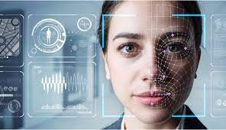

Slide 3
Face Recognition
Face recognition is a technology that involves identifying and verifying a person's identity by analyzing and comparing patterns of their facial features. It is a subset of biometric technology, which uses unique physical or behavioral characteristics for identification purposes.

Slide 4
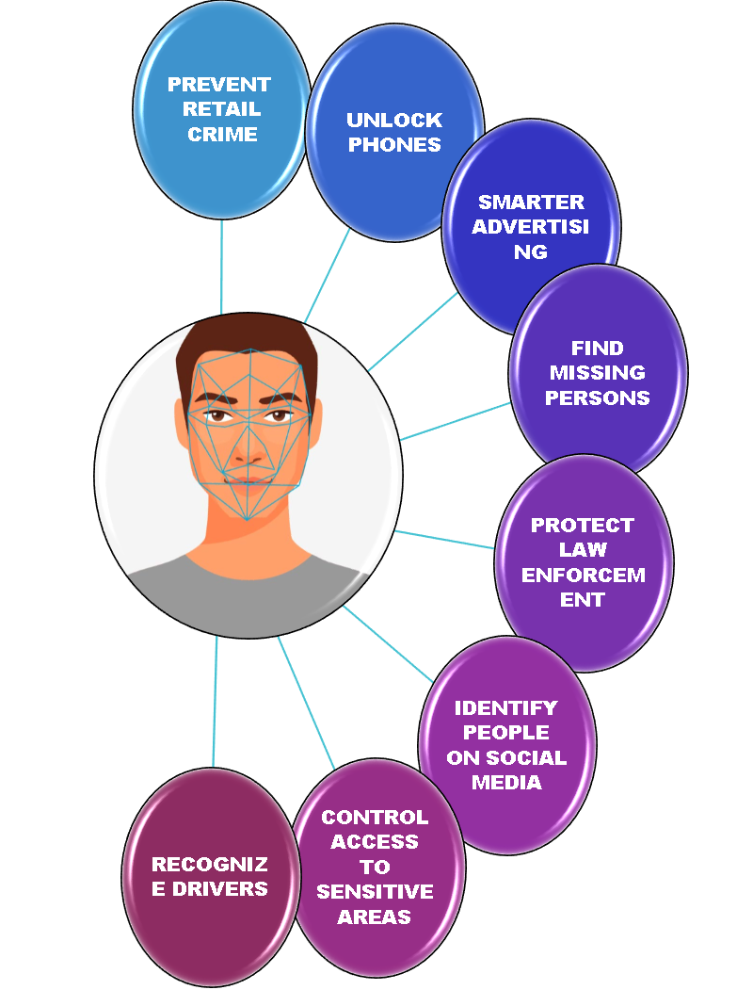

Slide 5
Phases of Process
Capture Image or Video
The process begins by capturing an image or video of a person's face using a camera or a video feed.
Face Detection
The system then uses face detection algorithms to locate and extract the face from the captured image or video. This step involves identifying facial features such as eyes, nose, and mouth.
Feature Extraction
Once the face is detected, the system extracts unique features from the face, such as the distances between eyes, the shape of the nose, and the contours of the face.

Slide 6
Cont..
Face Representation
The extracted features are used to create a unique representation or template of the face, often referred to as a facial signature or face print.
Database Comparison
The generated face template is then compared to a database of known faces. If a match is found, the person is identified; otherwise, the system may classify the face as unknown.
Decision Making
Based on the comparison results, the system makes a decision about the identity of the person, providing a recognition or rejection response.

Slide 7
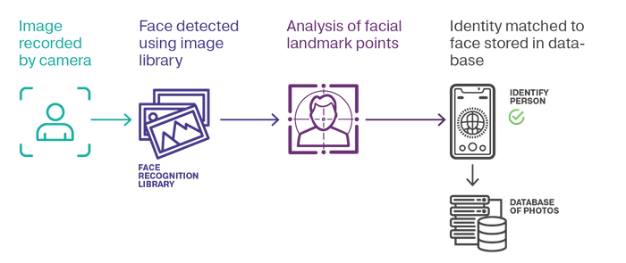

Slide 8
Tools & Libraries
Python
Streamlit
OpenCV
Face_recognition Library
Numpy
Uuid
PIL(Pillow)
dlib

Slide 9
Face_Recognition Library
The face_recognition library in Python library designed to simplify face recognition tasks.
It builds on top of Dlib to offer a more user-friendly interface.
The library includes methods for detecting faces in images using pre-trained models.
Once a face is detected, the library can identify facial landmarks, such as the positions of eyes, nose, mouth, etc.
The library can encode faces into numerical representations.These encodings are used to represent unique characteristics of each face.

Slide 10
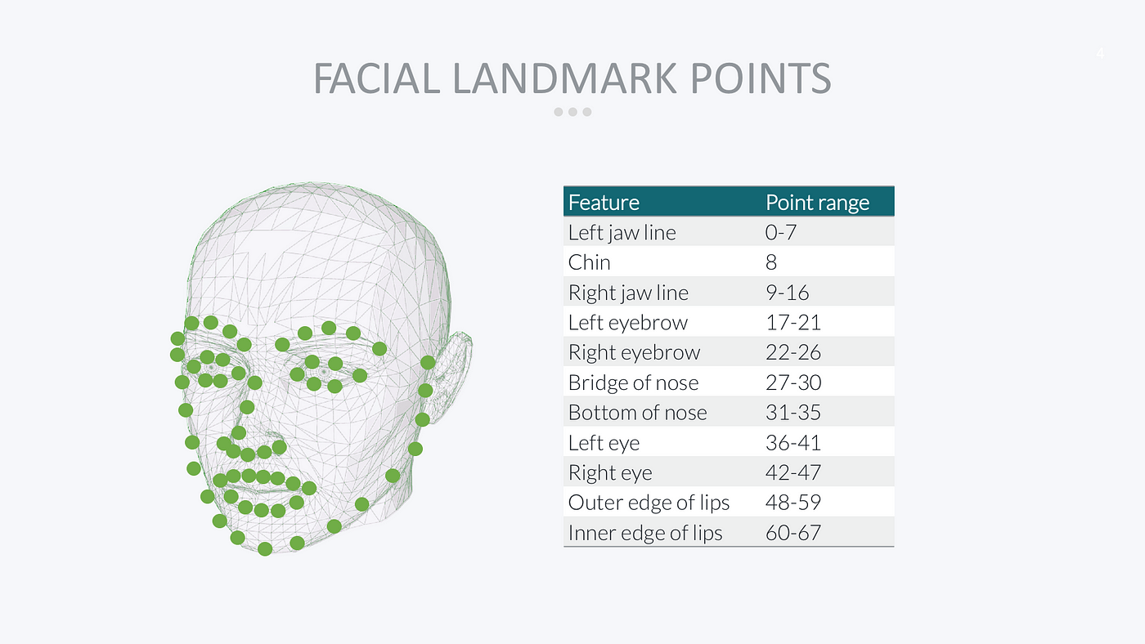

Slide 11
Advantages & Disadvantages
Pros
Biometric Security
Convenience
Quick Identification
Wide Applicability
Integration with Smart Devices
Cons
Privacy Concerns
Accuracy and Reliability
Bias and Diversity Issues
Security Vulnerabilities
Resource Intensive
Legal and Ethical Challenges

Slide 12
Future Scope
Improved Accuracy and Robustness
Integration with AI and IoT
Health and Wellness Applications
Enhanced Security Measures
Retail and Marketing
Education and Attendance Tracking
Human-Computer Interaction
Ethical and Regulatory Considerations
Biometric Authentication in Finance
Global Adoption and Standardization

Slide 13
THANK YOU

