Slide 1


Project: Road Sparks Team Name: Tech Sparkerss

Slide 2

Problem Statement : ROAD SAFETY
Team Name | Tech Sparks
Institute Name | Manipal University Jaipur
Team Members > | 1 (Leader) | 2 | 3
Name | Geetika Kaushik | Prannov Jamadagni | Ananya Dutta
Batch | 2024 | 2024 | 2024

Slide 3
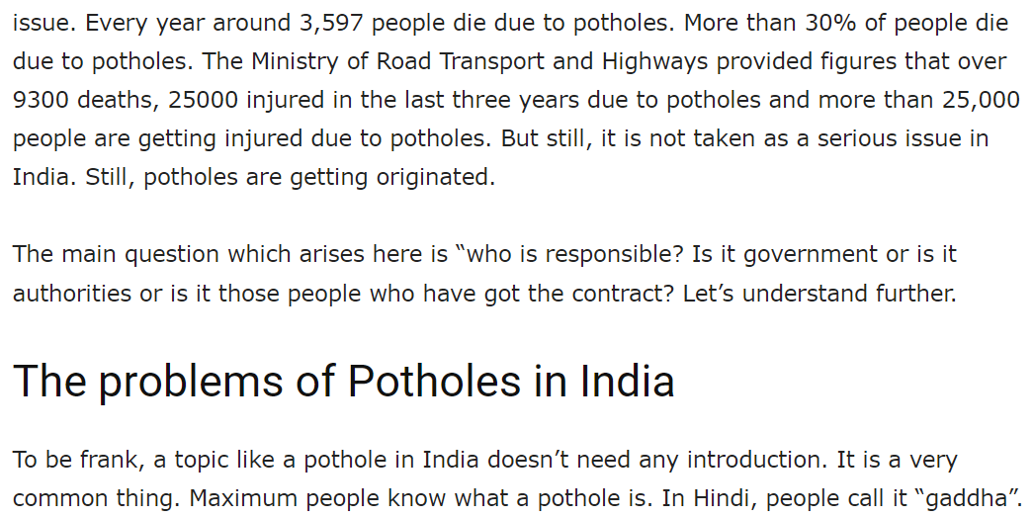
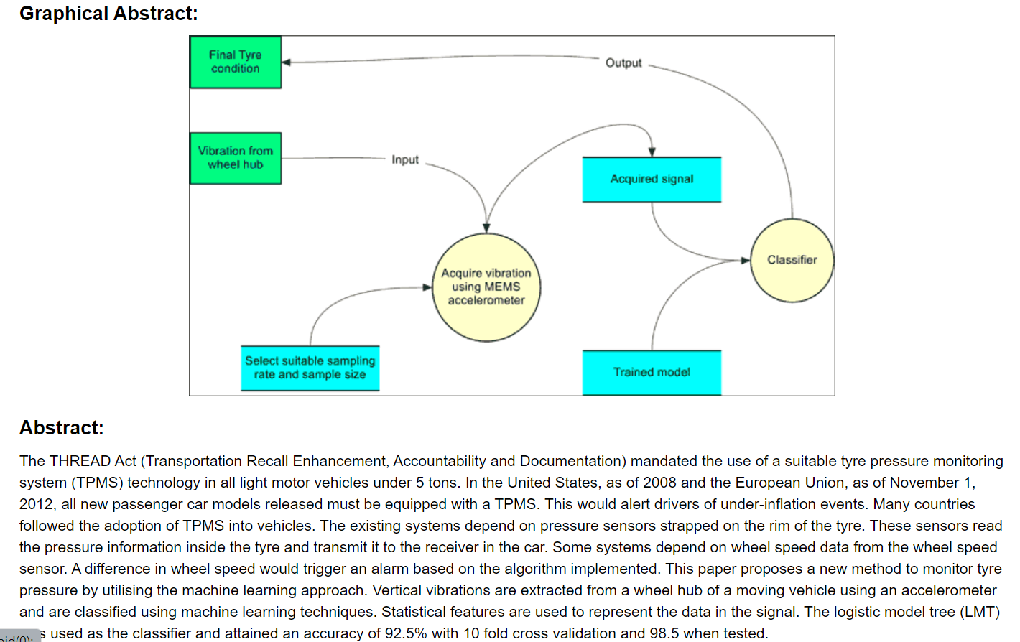
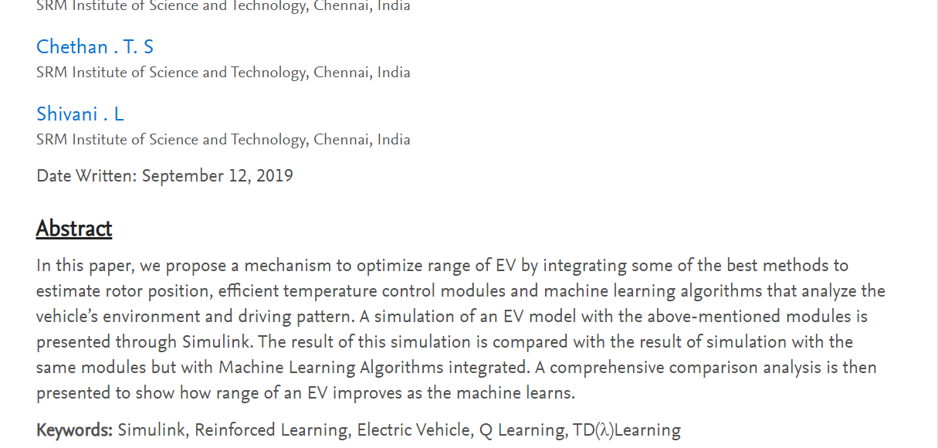
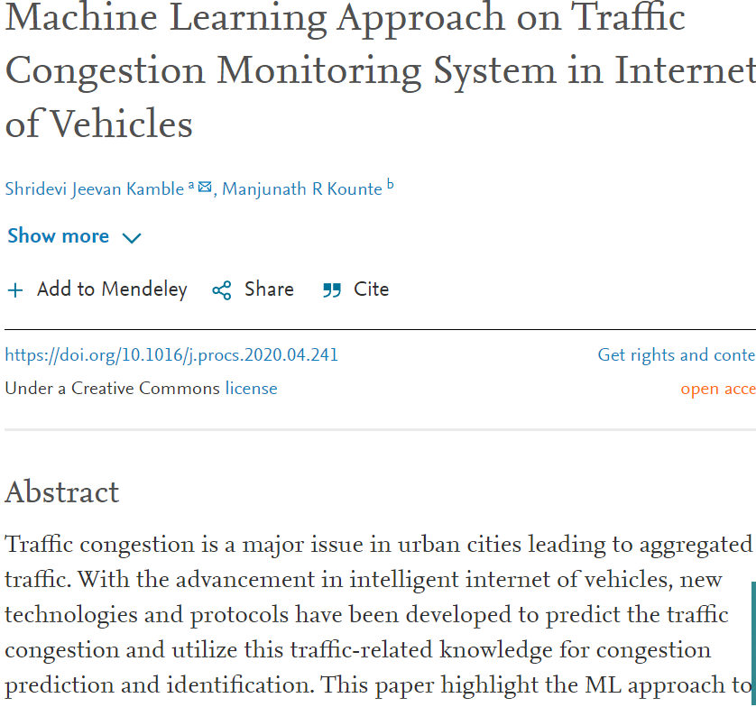
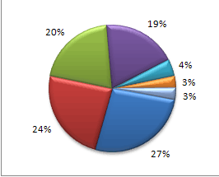
Problems faced by 2 wheeler riders : Our Customer Survey
1. Accidents due to POTHOLES
2.Long hours of TRAFFIC Congestion
3. Immediate BREAKING
4.Varying TYRE AIR PRESSURE LEVELS
5.BATTERY WASTAGE due to AHO guidelines
by Ministry.
6.BURN Accidents due to muffler/exhaust pipes
7.Immediate LEG Exposure on fall.

Slide 4
Introduction
A Realtime Pothole Detection Mechanism to avoid loss of lives due to Potholes in roads.
The idea is to divide the Problem in different uses cases and create custom navigation program according to the client requirement.
With Vehicle information gaining high importance within the domain of automotive technologies there are considerable efforts in developing systems & solutions for a holistic human machine interface (HMI), through our approach of the Pothole detection Mechanism.
For enhancing rider safety, comfort and user experience we’ve built a system using Machine Learning CNN Algorithm, and Kaggle Notebook, and dataset for Code implementation.

Slide 5
Program Functioning
1.Google Cloud Platform : Geo Data Upload Tool
2.Algorithm: Convolutional Neural Network
3.Dataset: Kaggle Pothole detection images,548 images
4. Backend Implementation: pot_hole_detection/pothole-detection-cnn.ipynb at main · Prannov/pot_hole_detection (github.com)
5. The Story Behind the Idea: VID-20211205-WA0011.mp4 - Google Drive

Slide 6
ALGORITHM DESCRIPTION
A Convolutional Neural Network (ConvNet/CNN) is a Deep Learning system that can take an input image, assign relevance (learnable weights and biases) to various aspects/objects in the image, and distinguish between them. When compared to other classification methods, the amount of pre-processing required by a ConvNet is significantly less.
A ConvNet is able to successfully capture the Spatial and Temporal dependencies in an image through the application of relevant filters. The architecture performs a better fitting to the image dataset due to the reduction in the number of parameters involved and reusability of weights

Slide 7
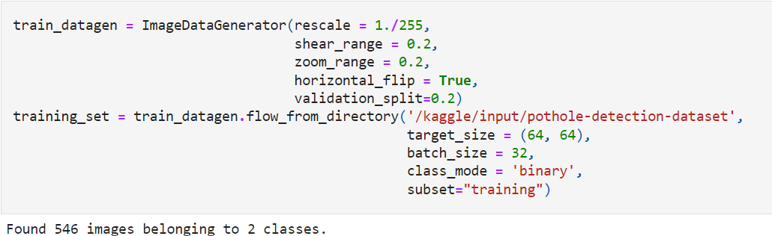
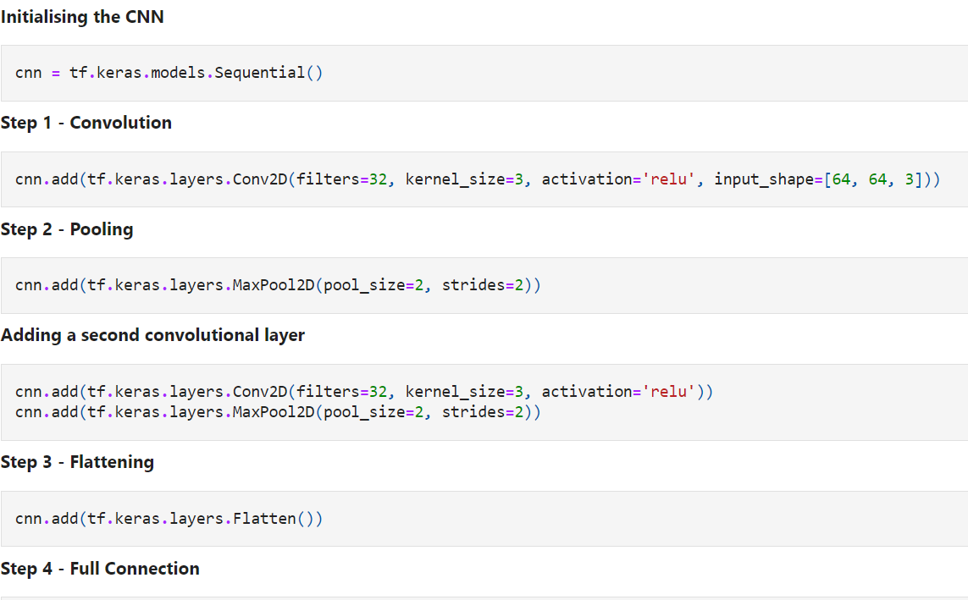
Training Dataset User Input , Building CNN

Slide 8
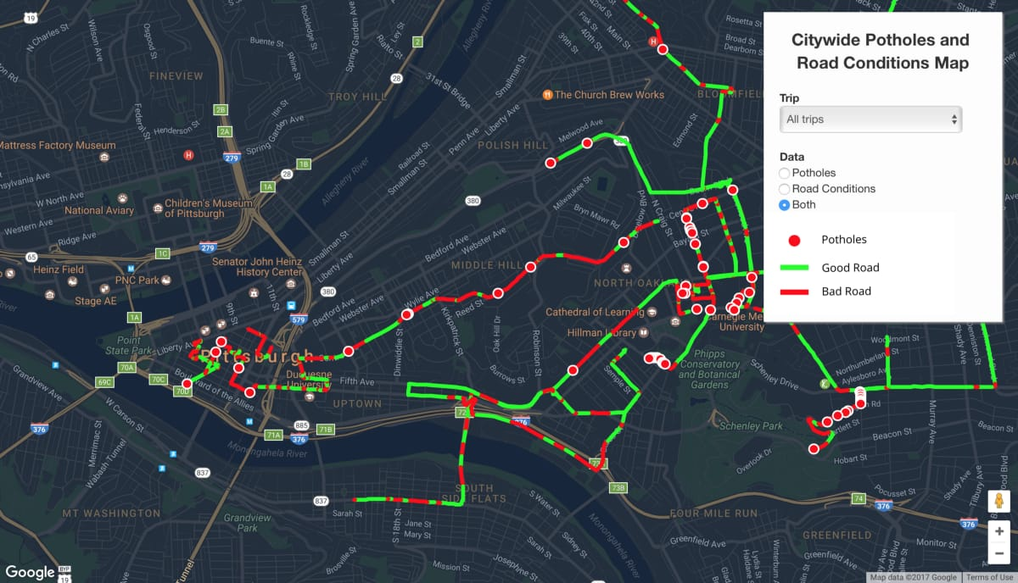
PROPOSED OUTPUT

Slide 9
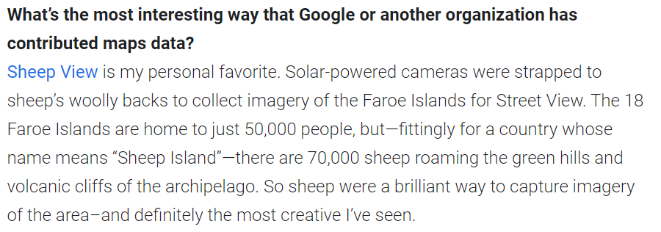
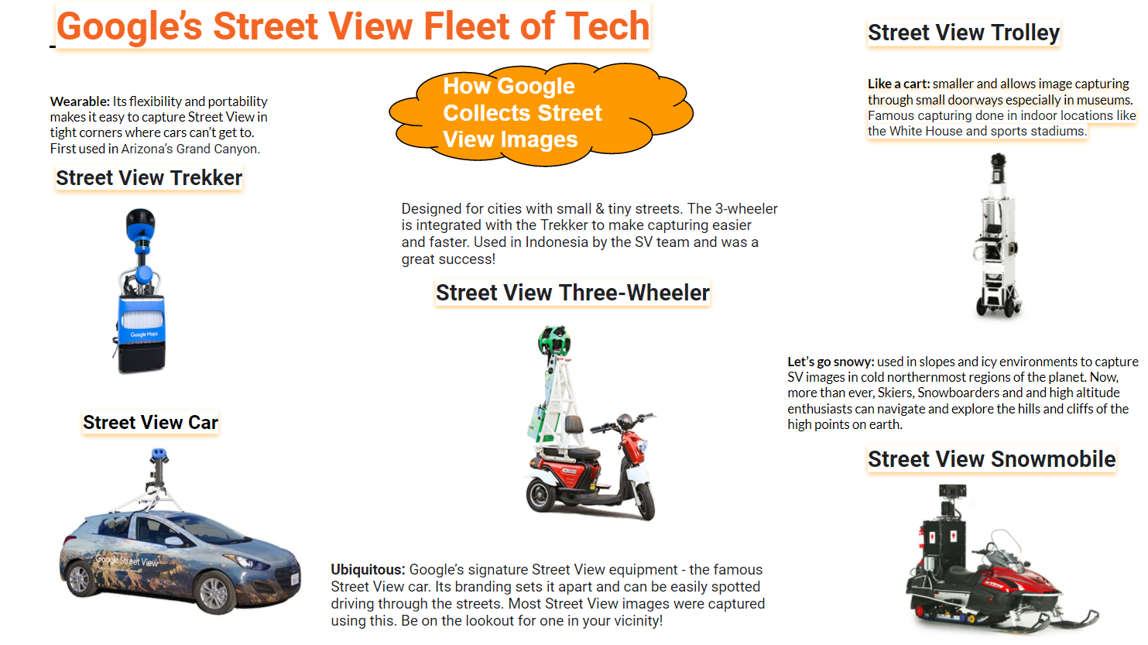
Accuracy of Data? Terrain? Language? Deriving Inspiration from Google Maps
Creepy images on Maps—and why they’re actually not that creepy (blog.google)
Beyond the Map: How we build the maps that power your apps and business | Google Cloud Blog
Overcoming mapping challenges to help power businesses with location-based data and insights | Google Cloud Blog
9 things to know about Google's maps data: Beyond the Map | Google Cloud Blog

Slide 10
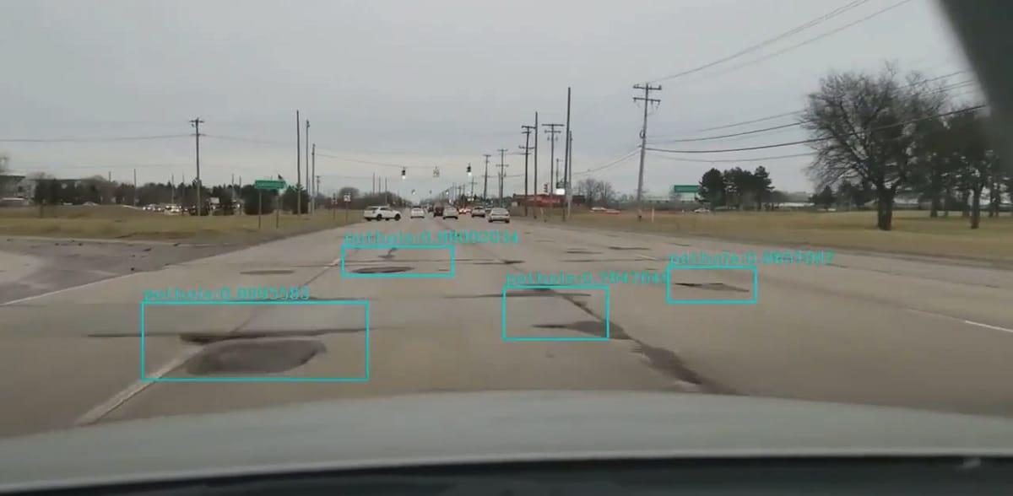
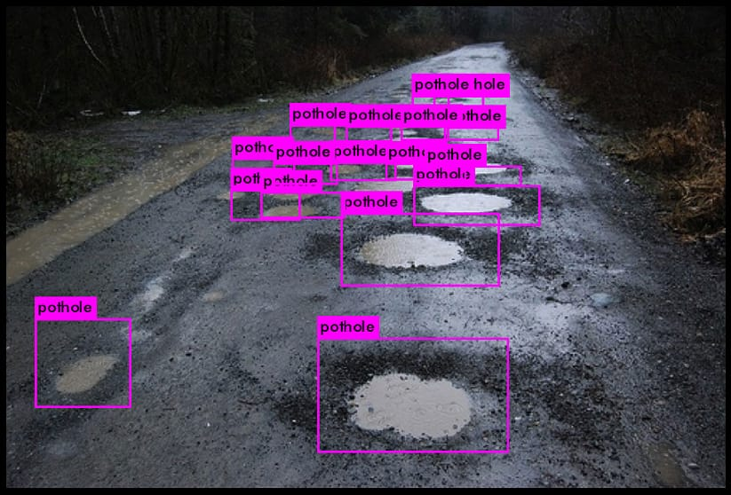

Slide 11




How is our Solution different from others?
Availability of the application in Offline mode.
Dynamic Realtime Video Extraction
Realtime data extraction from end user input :available in different languages
Non connected architecture enables easy integration across platforms

Slide 12
FUTURE SCOPE AND GROWTH STRATEGY
01
Traffic Monitoring :Using the Gaussian process in ML for prediction of traffic speed
Temperature Monitor Sensor:by incorporating in the design of motorcycles external thermo resistant shields
02
03
Tyre Pressure Monitoring:Using ML Logistic Model Tree(LMT)
Multilingual Support through BERT hugging Face Transformers
04

Slide 13




SWOT Analysis
STRENGTHS
WEAKNESSES
Introduction of new roads
Dynamic video may increase latency
Change in company policies
Availability in Offline mode
Ease of integration
Platform Independency
Realtime Functionality
S
W
OPPORTUNITIES
THREATS
Huge Market area
Seamless Automation resulting in better consumer service
Change in technology.
Risk of acceptance.
Entry of new innovators.
O
T

Slide 14
THANKYOU

