Slide 1
Quick-Commerce Expansion and
FMCG Financial Performance
A Comparative Descriptive Analysis of Marico, Dabur, and Hindustan Unilever · FY2020–FY2025
Geetika Kapoor · Youth Economy Lab — Computation / Financial Modeling Track · Capstone Project
Consolidated annual-report data · every observation source-verified (315/315 matched)

Slide 2
Research Question & Design
Descriptive and associative — explicitly not causal
Has the rapid expansion of quick commerce (Blinkit, Zepto, Swiggy Instamart) coincided with measurable changes in profitability and working-capital efficiency at major Indian FMCG companies?
Pre-period
Transition
Post-period
FY2020–22
FY2023
FY2024–25
Quick commerce not yet material; COVID disruption + pantry-loading inside this window
Blinkit acquired by Zomato (Jun 2022); Zepto scales; peak input-cost inflation. Held out of both averages
QC ≈ two-thirds of e-grocery orders by CY2024 (Bain/Flipkart); urban demand softness
Metrics: DIO · DSO · DPO · CCC (average-balance) · gross/EBITDA/net margins · ROCE · ROA · revenue growth — identical definitions across all three companies; EBITDA built from PBEIT so exceptional items never leak in; net profit = owners’ share only.
Quick-Commerce & FMCG Financial Performance · Geetika Kapoor | 2

Slide 3
Dataset: Verified to Zero Mismatches
Consolidated statements only, FY2019–FY2025 (FY19 = opening balances)
315 / 315
data points matched against scanned Consolidated statement pages
684
workbook formulas — zero evaluation errors
294
derived values independently recomputed in Python, zero diffs
0
Standalone or unlabeled pages — every source page headed "Consolidated"
Deliberate definition checks: PBEIT vs reported PBT separated wherever exceptional items intervene (Marico FY20/21, Dabur FY22, HUL FY19/25); owners’ profit vs total incl. NCI; trade payables = MSME + other dues; Dabur’s FY19–21 excise duty excluded from COGS by fixed definition.
Quick-Commerce & FMCG Financial Performance · Geetika Kapoor | 3

Slide 4
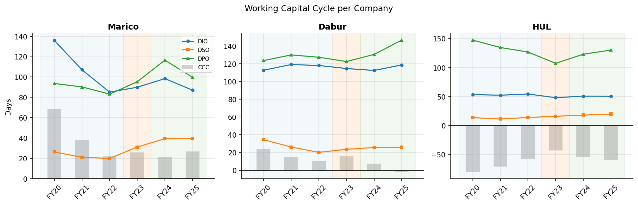
Working Capital: Three Different Stories
DIO / DSO / DPO (lines) and CCC (bars), FY2020–FY2025
Marico: CCC −18.8d — leaner inventory, longer payables, but DSO nearly doubled. Dabur: CCC −13.8d, predominantly payables-financed — DIO/DSO near-flat, DPO → 146.5d (first negative CCC in FY25). HUL: negative CCC shortened +12.7d; DSO climbed every year from FY22 on — the cleanest channel-mix fingerprint in the data.
Quick-Commerce & FMCG Financial Performance · Geetika Kapoor | 4

Slide 5
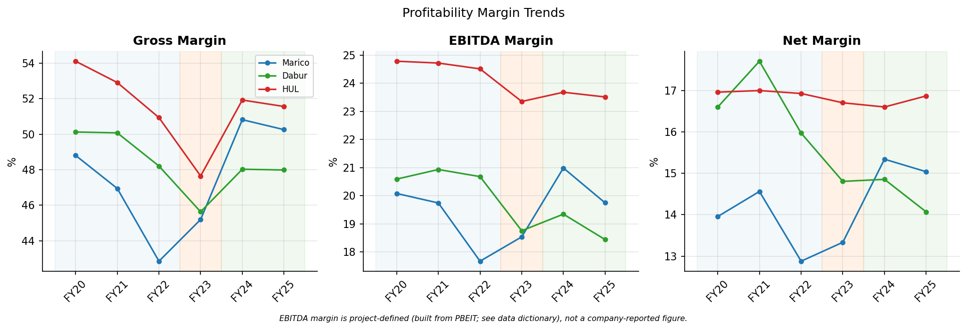
Margins: Marico Expands, Dabur Compresses, HUL Holds
Pre (FY20–22 avg.) → Post (FY24–25 avg.)
Marico +4.3pp gross / +1.2pp EBITDA / +1.4pp net — flattered by FY24 soft inputs, dented again by FY25 copra (+48%). Dabur −1.5 / −1.8 / −2.3pp — net margin slid from a 17.7% FY21 peak to 14.1% by FY25 (marginal FY24 uptick to 14.9%). HUL held: −1.1pp EBITDA off a 24.7% base, net margin flat.
Quick-Commerce & FMCG Financial Performance · Geetika Kapoor | 5

Slide 6
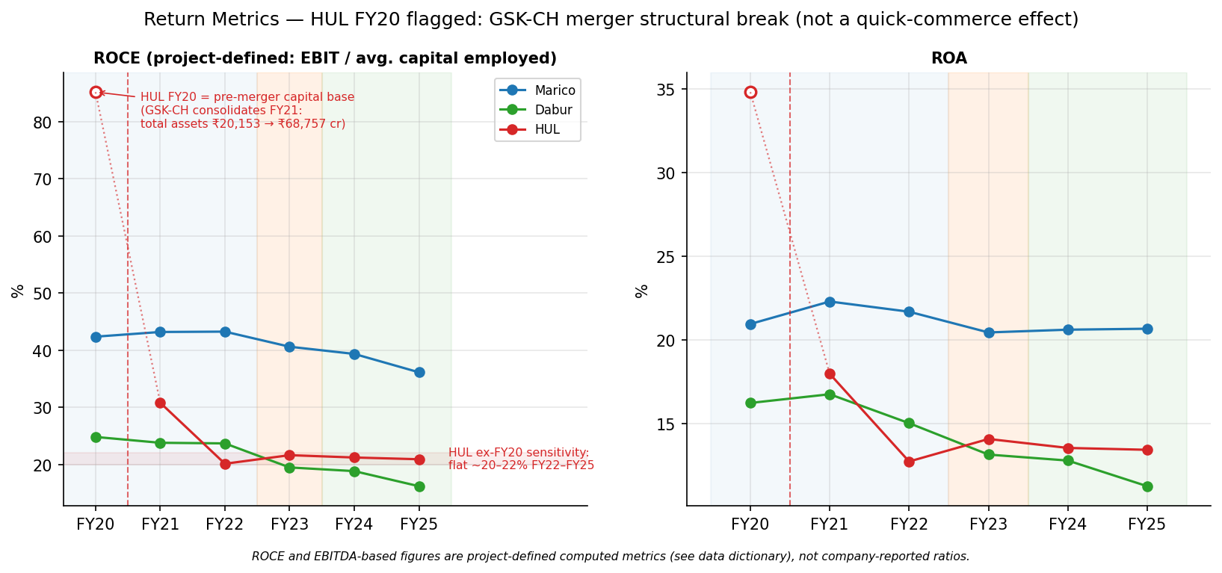
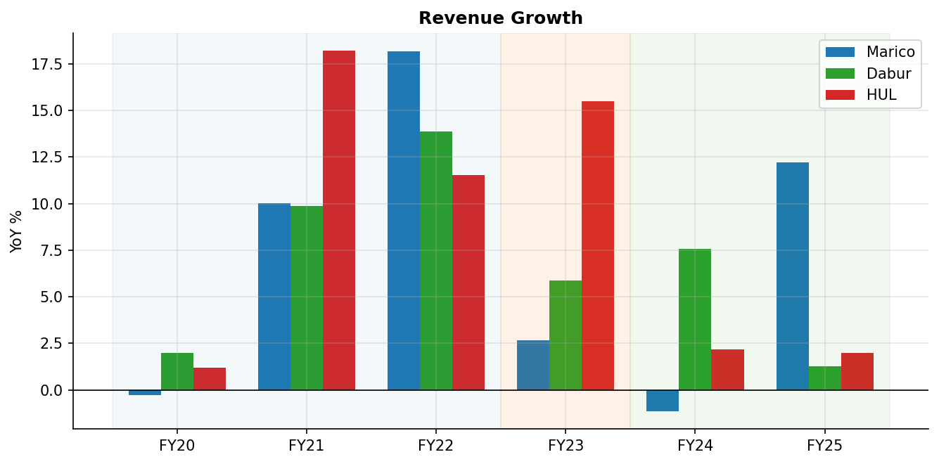
Returns Fell — With One Big Accounting Confounder
ROCE / ROA and revenue growth
HUL’s reported ROCE (project-defined) −24.3pp is a structural-break artefact — flagged on the chart: the FY2021 GSK-CH merger added ₹17,316 cr goodwill + ₹27,930 cr intangibles (total assets ₹20,153 → ₹68,757 cr). Excluding the pre-merger FY20 base (open point + sensitivity band on chart), HUL ROCE is flat at 20–22% from FY22 on. Genuine deterioration sits at Dabur (ROCE −6.6pp: capital employed +45.8% vs. EBIT +8.9%; capital-employed figures are period averages of closing balances — the ROCE denominator itself uses average balances). Revenue growth decelerated at all three — steepest at HUL (10.3% → 2.1%) — against a pandemic-rebound pre-period base and FY24–25 urban softness; a geometric (CAGR) recomputation preserves every deceleration (max gap vs arithmetic: 0.3pp).
Quick-Commerce & FMCG Financial Performance · Geetika Kapoor | 6

Slide 7
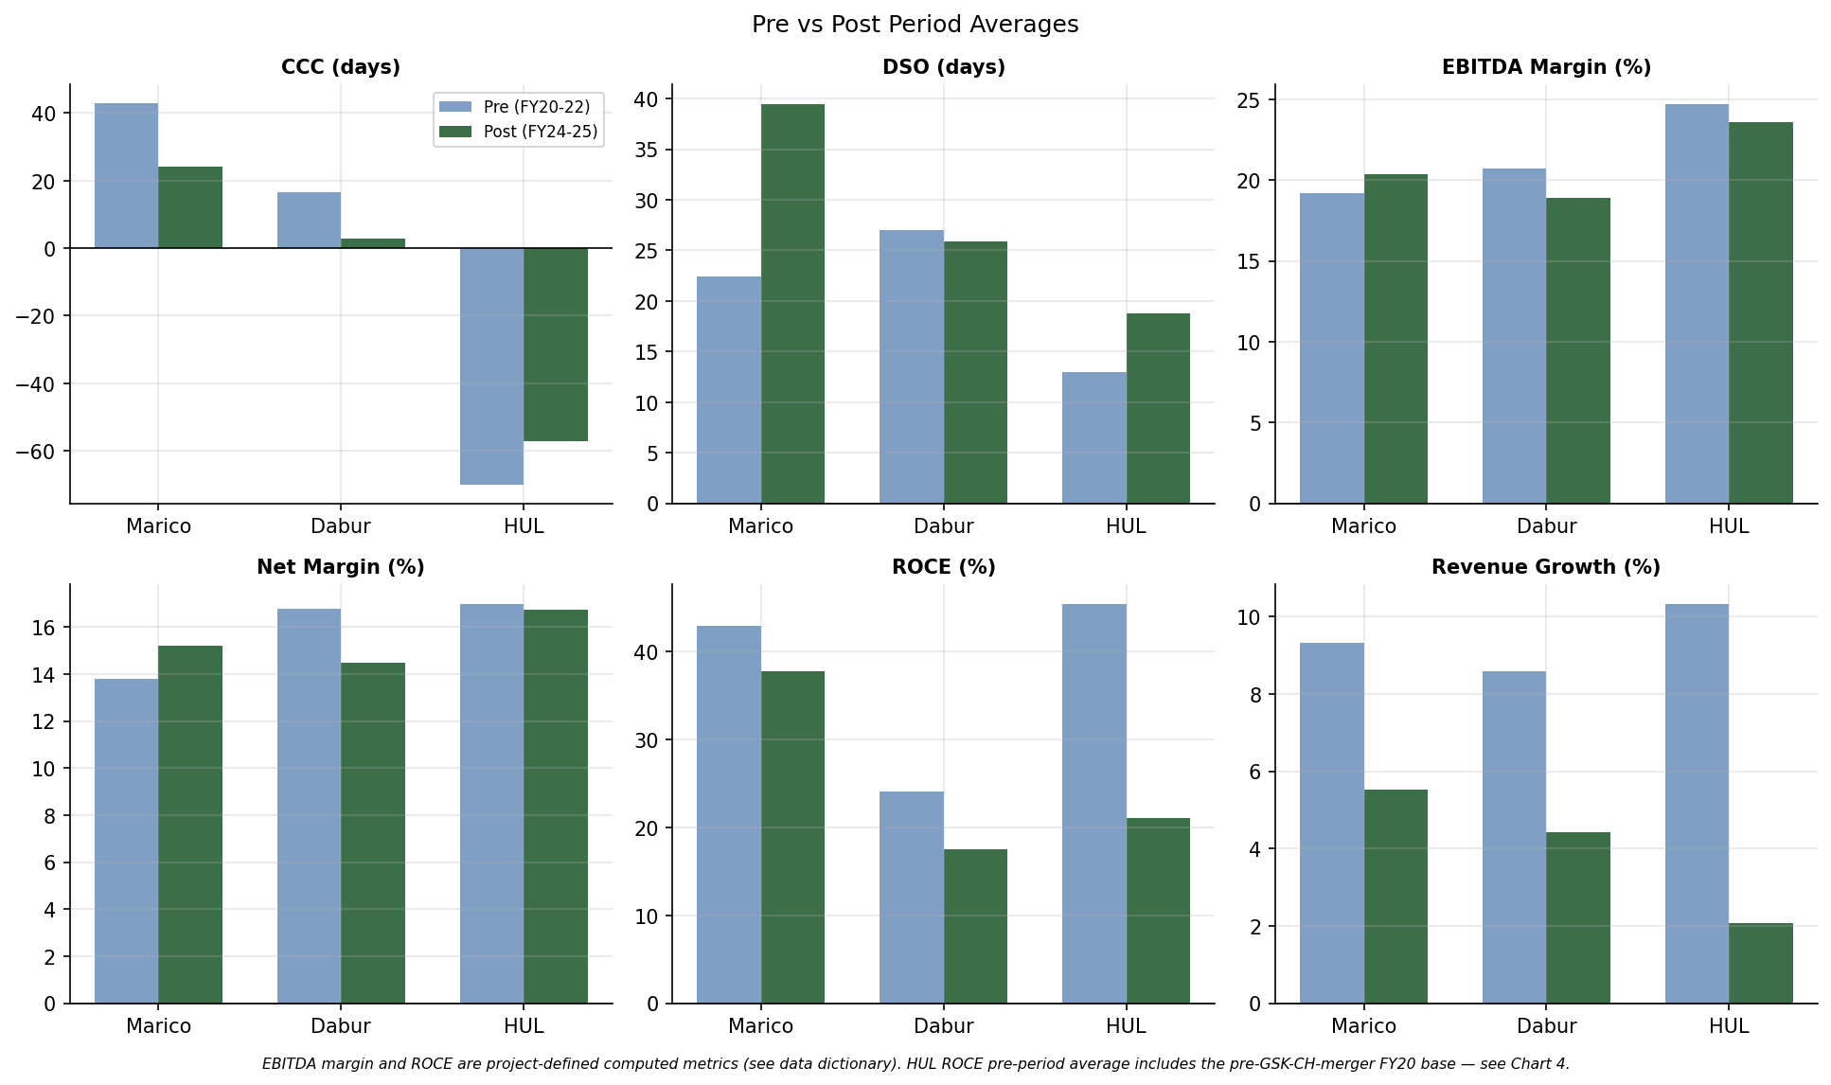
Pre vs Post: Divergence, Not Convergence
FY23 excluded from both averages
Quick-Commerce & FMCG Financial Performance · Geetika Kapoor | 7

Slide 8
FY2023 Sensitivity: Direction Never Flips
Alternative framing: FY2020–22 vs FY2023–25
Metric shift
Primary (FY24–25)
Sensitivity (FY23–25)
Reading
Marico gross margin
+4.3pp
+2.6pp
Gain nearly halves — FY23 carries the inflation trough
Marico DSO
+17.0 days
+14.2 days
Moderates, still the largest DSO move in the panel
Dabur CCC
−13.8 days
−9.5 days
Compression one-third smaller — FY25 DPO stretch diluted
HUL CCC
+12.7 days
+17.4 days
Widens — FY23 is HUL’s least-negative CCC year
HUL revenue growth
−8.2pp
−3.8pp
More than halves — FY23’s 15.5% growth joins the post-period
All 30 metric-company cells keep their sign under reclassification, and a geometric (CAGR) recomputation of revenue growth preserves every sign and ordering (largest gap vs arithmetic: 0.3pp). The conclusion is framing-robust in direction, framing-sensitive in emphasis — exactly what the transition-year design anticipated.
Quick-Commerce & FMCG Financial Performance · Geetika Kapoor | 8

Slide 9
What the Companies Themselves Said
Investor materials & earnings commentary, FY2024–FY2026 — plausible, never causal
Marico
Channel-specific price-pack architecture for QC to limit cannibalisation; digital-first ARR ₹750 cr exiting FY25; Project SETU direct-reach expansion with deliberate wholesale destocking. Matches: DIO −16.7d, DSO +17d. Margin swings attributed to copra (+48% FY25), A&P +18%.
Dabur
QC salience within e-commerce rose from ~50% toward ~75%; alternative channels growing while general trade stayed under pressure; explicit GT distributor-inventory correction (Q2 FY25); urban slowdown cited repeatedly. Matches: strain visible in margins; cash cycle defended via payables (DPO 146.5d FY25).
HUL
E-commerce ≈ 7–8% of sales with QC its fastest-growing slice (~1/6 of e-comm in 2024, +77% in 2023); assortment investment doubled; "structurally attractive", growing 40–50%; ₹2,706 cr Minimalist acquisition. Matches: DSO rising every year while consolidated margins barely moved.
Quick-Commerce & FMCG Financial Performance · Geetika Kapoor | 9

Slide 10
The Cost of the Channel Shift
Putting a rupee figure on the DSO increase — Marico and HUL, FY25 revenue basis
Marico — +17.0 extra collection days
HUL — +5.9 extra collection days
₹504 cr
cash tied up in receivables · ~₹55 cr/yr carrying cost @11%
₹1,018 cr
cash tied up in receivables · ~₹112 cr/yr carrying cost @11%
How this is calculated: Cash tied up = (extra DSO days ÷ 365) × FY25 revenue. Marico: (16.974 ÷ 365) × ₹10,831 cr ≈ ₹504 cr. HUL: (5.884 ÷ 365) × ₹63,121 cr ≈ ₹1,018 cr — computed on the unrounded DSO shifts; the headline day figures round to 17.0 and 5.9. Annual carrying cost applies an illustrative 11% cost of capital, typical for Indian FMCG — this is a modelling assumption, not a disclosed figure, and is meant to size the effect, not state it precisely.
Why this matters: the DSO shift isn’t just a days-count abstraction — it converts directly into cash the company can’t deploy elsewhere. It reframes the working-capital finding as a financing cost, not only an operating ratio.
Quick-Commerce & FMCG Financial Performance · Geetika Kapoor | 10

Slide 11
Conclusion
Measurable shifts coincided with the quick-commerce acceleration window — but the three companies diverged.
Marico improved margins and compressed its cycle while its receivables lengthened; Dabur compressed its cycle through supplier financing while every margin line fell; HUL held margins while its famously negative cycle shortened.
The shifts that survive the Section 2.5 confounder screen are the working-capital ones: the sustained DSO rise at HUL and Marico, and Dabur’s payables-financed compression — the fingerprints organised-channel growth would leave.
Margins, returns and growth are over-determined by input costs, the demand cycle and M&A (above all HUL’s GSK-CH merger); the data cannot attribute them to any single channel.
Findings are robust to FY2023 reclassification in direction, moderated in magnitude — a mixed, company-specific outcome, which is itself the study’s expected contribution.
This study identifies a consistent financial signature that coincides with the rise of quick commerce, while acknowledging the limits of attribution.
In this dataset, quick commerce is not associated with faster revenue growth — it is associated with a shift in who holds the cash, and each company appears to handle that shift differently.
Quick-Commerce & FMCG Financial Performance · Geetika Kapoor | 11

