Slide 1
GEOSPATIAL VISION AND VISUALIZATION
ASSIGNMENT-2
PROBE DATA ANALYSIS AND ROAD SLOPE

Slide 2
TEAM
SANATH REDDY LEBURU
SRIRAKSHITH BETAGIRI
GEETHANJALI VIVEKANANDAN

Slide 3
Problem Statement
Analyze the given set of probe data and link data in order to
1.Map match the probe points to the road links.
2. Derive the slope for each road link.
3.Evaluate the derived road slope with the surveyed road slope in the link data file.

Slide 4
Given,
The raw probe points in Germany collected in 9 months
The link data for the links that probe can be matched to.

Slide 5
Map Matching Probe data and road links
Determine the perpendicular distance from the link to the reference point,
Using a minimum initial threshold value for perpendicular distance we will be able to locate the closest probe point that matches the link edge.
Map Match the probe points to the Link data.

Slide 6
Derive the Slope of the road link
From the previous step, we get the map-matched result of probe and link data.
Using this we determine the slope for each link.
To determine the slope first we need to calculate the distance between the probe points (current and previous). We only have the latitude and longitude information of the probes.
We use the Haversine formula to determine the points and then calculate the distance between them.

Slide 7
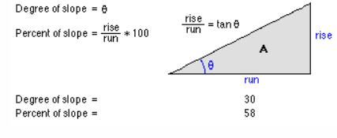
We have been given the altitude of the probe points, using these we can use heights and distance concept to determine the slope.
Distance as the run, altitude as rise, we derive the right angled triangle.
Angle θ represents the degree of the slope given by;
Tan θ = rise/run

Slide 8
Evaluate the derived slope value and the given slope information
First we will derive the slope value using the existing link data using the previously defined method.
We will then calculate the mean values for both the slope data.
Compare the results.

Slide 9
Output
Partition6467MatchedPoints.csv - The subset of probe points in partition 6467 that were successfully map-matched to a link.
SlopeData.csv – The calculated slope details from Matched Points file.

