Slide 1


Slide 2
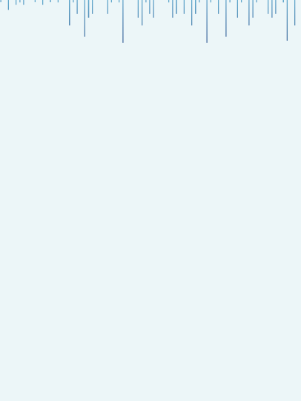


Bank Customer Churn Prediction
Leveraging Machine Learning for
Enhanced Customer Retention
Presented by : Tanmay Badgujar

Slide 3

Introduction
The Banking sector is evolving rapidly and is very well influenced by technological advancements, changing consumer preferences, and a competitive market.
Customer churn, which is the phenomenon of customers discontinuing their relationship with a bank, poses unique challenges and opportunities. When a bank loses customers, it can seriously affect how much money it makes and its market standing.
Machine learning, with its predictive capabilities, offers a transformative approach to understanding and mitigating the challenges posed by customer churn.
Through data-driven insights and predictive modeling, this presentation aims to showcase my Machine Learning Capstone Project focused on predicting customer churn in the Banking Sector.

Slide 4
Why BFSI Domain?
The Banking, Financial Services, and Insurance sector is a unique blend of Money, Technology and Rules and it's not shy to present its own set of distinct challenges and opportunities.
I chose BFSI Domain for my Capstone Project because :
Money Matters: BFSI handles tricky money stuff, so understanding how people use their money and predicting their actions is like solving a puzzle. BFSI handles tricky money stuff, so understanding how people use their money and predicting their actions is like solving a puzzle.
Rules Everywhere: There are lots of rules in BFSI. We have to play by these rules, and they keep changing. It's a challenge, but it also keeps things interesting.
Security: People's money info is super secret. We need to figure out how to analyze it without spilling the beans, making it a tricky but fascinating task.
Customers are unique: Everyone's money needs are different. Managing relationships with all kinds of customers adds another layer of complexity.
Tech is always changing: New tech stuff is always popping up, especially in finance. Figuring out how to use these tech innovations to help customers is part of the adventure.

Slide 5
Project’s Significance and
its Benefits to Banks
Enhanced Customer Satisfaction: Anticipating churn allows personalized strategies, building stronger relationships and boosting customer satisfaction.
Revenue optimization: Predicting and mitigating churn is cost-effective, preserving the customer base and optimizing revenue.
Risk Mitigation: Identifying potential churners mitigates risks, enabling preventive measures and strategic interventions.
Market Competitiveness: Predictive churn management positions banks as customer-centric institutions and offers a competitive edge by providing tailored services and experiences.
Long-Term Business Sustainability: By predicting and addressing churn, our project contributes not only to customer retention but also to the broader objectives of the BFSI sector, fostering customer-centric practices and ensuring long-term business sustainability.

Slide 6
Dataset Information
Here are the key details about the dataset used in this project:
Number of records: Our dataset comprises a robust collection of data, consisting of 10,000 records. Each record represents a unique entry, contributing to the richness and depth of our analysis.
Features/Columns: The dataset is characterized by a diverse set of features, each providing valuable insights into customer behavior, preferences, and interactions. In total, there are 14 features/columns that form the basis of our predictive modeling.
Source of the Data: The dataset is sourced from Kaggle, ensuring reliability and relevance. The data's origin plays a crucial role in shaping the context and ensuring that our analysis is grounded in real-world scenarios and industry dynamics.
Column Names
Row Number
Customer ID
Surname
Credit Score
Geography
Gender
Age
Tenure
Balance
Number of Products
Has Credit Card
Is Active Member
Estimated Salary
Churned

Slide 7

Exploratory Data Analysis (EDA)
Exploring the data allowed us to gain a comprehensive overview of the data's structure. It uncovered potential patterns, helped us identify key trends and get essential insights from the dataset.
Throughout the EDA process, we analyzed the distribution of individual features, investigated correlations, and explored any inherent relationships between variables.
Visualizations also played a crucial role in providing a clear representation of the data, offering insights into customer behavior and identifying the factors that may contribute to customer churn.

Slide 8
Exploratory Data Analysis (EDA)
First, we made sure there were no Null values and Duplicates in the dataset. And luckily, there weren't any. Our dataset was clean to begin with.
Then, we checked our columns to see if they were providing any useful information for us to work with. We found out that columns like “RowNumber”, “CustomerID” and “Surname” weren't contributing much to the predictions. Hence, we decided to drop them during preprocessing.
The "Geography" and "Gender" columns in our dataset were categorical variables. For them to work with our model, it was necessary to convert these categorical features into a numerical format.
To ensure consistent scales for numerical features, we decided to employ Standard Scaler during preprocessing.

Slide 9
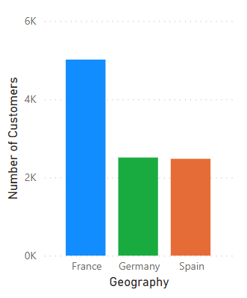
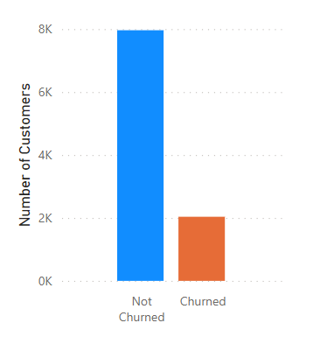
Visualizations
Our target variable 'Churned' exhibits class imbalance, with one class dominating the other.
This issue of data imbalance needs to be addressed.
The above plot reveals a substantial customer presence in France, surpassing other regions by a significant margin.

Slide 10
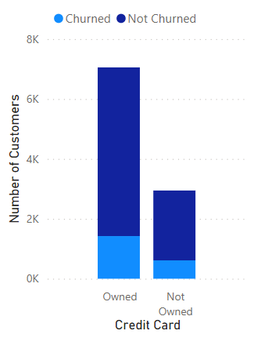
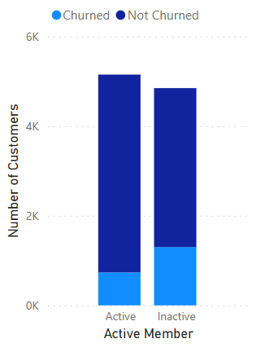
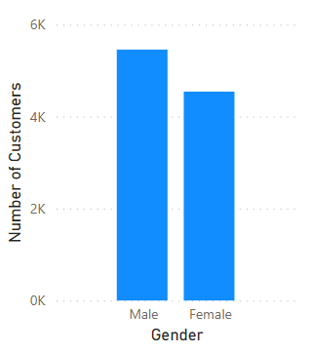
The dataset contains more Male entries than Female entries.
The number of credit card owners is significantly higher than those who don’t own a credit card.
Credit Card owners have a higher Churn Rate than Non-Credit Card owners.
The distribution of Active and Inactive members is almost the same.
Inactive members have a higher Churn Rate than Active members.

Slide 11
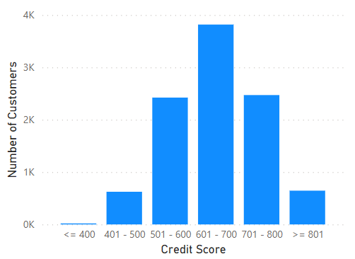
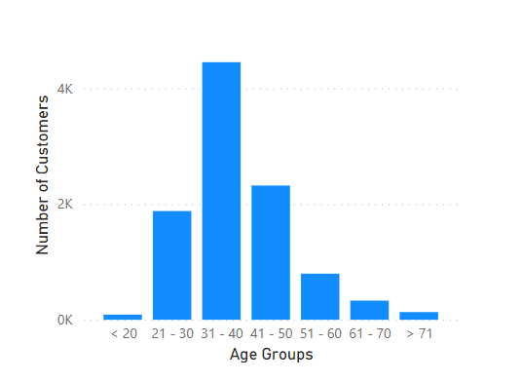
The distribution of people with Credit Score ranging from 601 to 700 is higher than any other group.
The distribution of people with Age ranging from 31 to 40 is higher than any other Age Group.

Slide 12
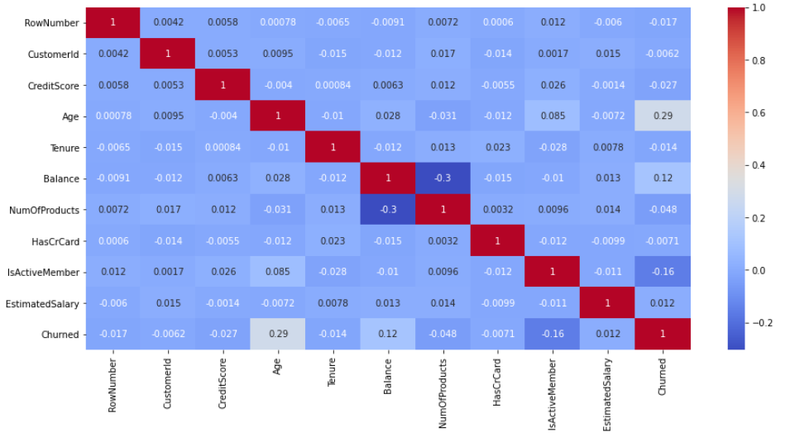
Upon inspecting the heatmap, we can see that there is no significant correlation observed among the columns. As a result, no columns will be dropped solely based on correlation.

Slide 13
Preprocessing
First, “RowNumber” , “CustomerID” and “Surname” columns were dropped as they didn’t provide any useful information for our predictions.
Then, we encoded the Categorical data into Numerical data with the help of One-Hot Encoding Technique. It assigns binary numeric values to each unique class present in columns with categorical data.
Splitting the data into X and y
In this step, we partitioned the dataset into two components: X and y.
The variable X encompasses all independent variables, representing the features that contribute to our predictions.
On the other hand, y encapsulates the dependent variable or target variable, serving as the outcome we aim to predict.

Slide 14
Train-Test Split
We then split the dataset into training data and testing data.
We did an 80:20 split, meaning 80% of our data is Training Data and 20% of our data is Testing Data. So, our test size was set to 0.2.
We took Random State as 123. This guaranteed the reproducibility of our results across different runs.
We also used Stratify = y to ensure that our Target Variable (y) is distributed proportionally.
Standard Scaler
We used Standard Scaler to standardize the features of the dataset.
This ensured that the consistency between the features of the dataset was maintained.
Standardization is crucial for certain machine learning algorithms, promoting optimal model performance by mitigating the influence of varying magnitudes among features

Slide 15
Over-Sampling with SMOTE
We had data imbalance within our target variable. Initially, we evaluated our model's accuracy in the presence of this imbalance.
Then, to rectify the issue of imbalance, we implemented the Synthetic Minority Over-Sampling Technique (SMOTE) as an oversampling method.
We then compared the model accuracies before and after addressing the data imbalance using SMOTE, providing valuable insights into the impact of this preprocessing technique.
Distribution of our y_train before oversampling :
Distribution of our y_train after oversampling:
Not Churned | Churned
6370 | 1630
Not Churned | Churned
6370 | 6370

Slide 16
Applying Machine
Learning Algorithms
This Bank Customer Churn problem we have here is a Binary Classification problem.
Models used:
Logistic Regression : Logistic Regression is a powerful tool in binary classification. Its very good at modeling the probability of an event occurring, making it suitable for scenarios where understanding the likelihood of customers churning is essential.
Support Vector Machine (SVC) : Support Vector Classification is a robust algorithm employed for classification tasks, especially when there's a need for clear separation between classes. In the context of customer churn prediction, it draws distinct decision boundaries between loyal and potential churned customers.
K Nearest Neighbour : The K-NN algorithm works by finding the K nearest neighbors to a given data point based on a distance metric. KNN considers the behaviors of neighboring customers to make predictions.
Naive Bayes : Naive Bayes is a probabilistic classification algorithm known for its simplicity and efficiency. It assumes that features are independent, making calculations easier. Its often used when simplicity and speed are crucial.

Slide 17
Evaluation Metrics
Without Oversampling (SMOTE)
With Oversampling (SMOTE)
Model | Accuracy | Precision | Recall | F1-Score
LOGI | 81.2 | 59.62 | 23.58 | 33.80
SVC | 86.5 | 80.44 | 44.47 | 57.27
KNN | 84.0 | 65.81 | 44.47 | 53.07
NB | 82.1 | 59.53 | 37.59 | 46.08
Model | Accuracy | Precision | Recall | F1-Score
LOGI_OS | 70.75 | 37.42 | 65.11 | 47.53
SVC_OS | 80.75 | 51.88 | 74.44 | 61.15
KNN_OS | 74.55 | 42.24 | 68.30 | 52.20
NB_OS | 71.70 | 38.91 | 68.55 | 49.64
We can see that Oversampling makes a huge difference.
After Oversampling, the accuracy and precision of our models have decreased a bit but Recall and F1-Score have increased.

Slide 18
Model Selection and Considerations
SVC outperforms Logistic Regression, KNN and Naive Bayes in all metrics, demonstrating higher Accuracy, Precision, Recall, and F1-Score. It seems to be a promising model for our task.
Based on the provided metrics, SVC stands out as the best-performing model overall. It achieves a good balance between precision and recall, making it suitable for our customer churn prediction task.
While metrics like Accuracy and Precision are essential, Recall is particularly crucial in Customer Churn Prediction, as it indicates the ability to identify customers who are likely to Churn. And Support Vector Classification provided us the best Recall value.
Hence, we will go with Support Vector Classification as our final model as it is quite evident that it performs best for our Bank Customer Churn problem.

Slide 19
Conclusion
With the help of several insights, patterns and trends in our data, we’ve used Machine Learning to address the intricate challenge of predicting Customer Churn.
This project offers significant benefits to banks:
By predicting potential churners, banks can adopt proactive strategies to retain valuable customers. This involves personalized interventions, loyalty programs, and targeted communication to address customer concerns and enhance satisfaction.
By focusing efforts on customers at a higher risk of churn, banks can streamline operations, reduce marketing costs, and improve overall efficiency.
Anticipating and mitigating customer churn contributes directly to revenue optimization.
Understanding the factors influencing customer churn enables banks to tailor their services to meet individual needs. This level of personalization fosters stronger customer relationships, increases loyalty, and enhances the overall banking experience.

Slide 20

Thank You !

