Slide 1


Slide 2



Bank Marketing
Campaign
Analysis using Machine Learning
Exploring strategies to strengthen long-term deposits and drive revenue growth in the Portuguese Bank.
- By Tanmay Badgujar

Slide 3
INTRODUCTION
Welcome everyone to our presentation on "Bank Marketing Campaign Analysis using Machine Learning”
In this project, our main objective is to leverage data-driven insights to optimize marketing efforts for a Portuguese banking institution.
The data set encompasses direct marketing campaigns involving phone calls, with the goal of predicting whether a client will subscribe to a term deposit. This prediction is crucial for the bank to efficiently allocate resources and tailor its approach to potential customers.
Over the course of the presentation, we will delve into the key steps taken to analyse the data, extract meaningful patterns, and build predictive models. By the end, you'll gain insights into the factors influencing customer responses and how these insights can shape targeted marketing strategies.
Let's dive into the world of predictive analysis and discover how it can revolutionize our approach to term deposit campaigns.

Slide 4
Understanding the Data
In this dataset, we have information on 32,950 existing customers contacted by a Portuguese banking institution for a term deposit campaign. The dataset includes 16 columns, each representing different aspects of the customer and the marketing campaign.
Basic Statistics:
Rows: 32,950
Columns: 16
Key Input Variables:
Age: Numeric variable representing the age of the customer.
Job: Categorical variable indicating the type of job.
Marital: Categorical variable representing the marital status.
Education: Categorical variable indicating the customer's education level.
Default: Categorical variable indicating whether the customer has credit in default.
Housing: Categorical variable indicating whether the customer has a housing loan.
Loan: Categorical variable indicating whether the customer has a personal loan.
Campaign Details:
Contact: Categorical variable indicating the communication type (e.g., cellular, telephone).
Month: Categorical variable representing the last contact month of the year.
Day_of_week: Categorical variable representing the last contact day of the week.
Duration: Numeric variable representing the last contact duration in seconds. Note: This variable strongly influences the outcome.
Previous Campaign Information:
Campaign: Numeric variable representing the number of contacts performed during this campaign for each client.
Pdays: Numeric variable representing the number of days passed since the client was last contacted from a previous campaign (999 means not previously contacted).
Previous: Numeric variable representing the number of contacts performed before this campaign for each client.
Poutcome: Categorical variable representing the outcome of the previous marketing campaign.
Outcome Variable:
y: Binary variable indicating whether the client subscribed to a term deposit ("yes" or "no").

Slide 5


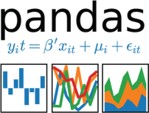




Tools Used
Jupyter Notebook, Python Libraries such as Pandas, Numpy, Matplotlib, seaborn, Sklearn and
Business Intelligence such as Power Bi.

Slide 6
Ensuring Data Quality
Handling Missing Values:
Identified and handled values like "unknown" as equivalent to missing values.
Chose not to discard rows with missing values but considered replacing them with mode values.
Filtering Data:
Filtered the dataset to keep only the rows where the 'duration' is greater than or equal to 5 seconds.
Column Renaming:
Renamed the 'y' column to 'response' for better clarity.
Feature Engineering:
Changed the unit of 'duration' from seconds to minutes.
Created an 'age_group' column to group ages into categories.

Slide 7
DISTRIBUTION OF Response
From above pie chart we can see that our target variable distribution is highly imbalanced.
Majority of the customers have negative response (89%)
Only (11%) customers have a positive response.

Slide 8
EXPLORATORY DATA ANALYSIS
Age 60+ & 20 have relatively Higher Positive Response than other Age Groups.
Customer’ with Marital Status is Single Have High Proportion to Positive response then others.

Slide 9
Retired and Students Seems to Be More Interested In Campaign.

Slide 10
The University Degree Holders had the highest number of contacts made to them, with around 9500 contacts each. They also had the highest proportion of positive responses, with about 15% of them saying yes.

Slide 11
The fewest contacts had a previous outcome of success, with around 1000 contacts in this category. However, they had the highest proportion of positive responses.
Cellular contact has lead to maximum conversions than the telephonic point of contact.

Slide 12
Highest subscription rate was in March, and all subscription rates in September, October, and December were over 40%.

Slide 13
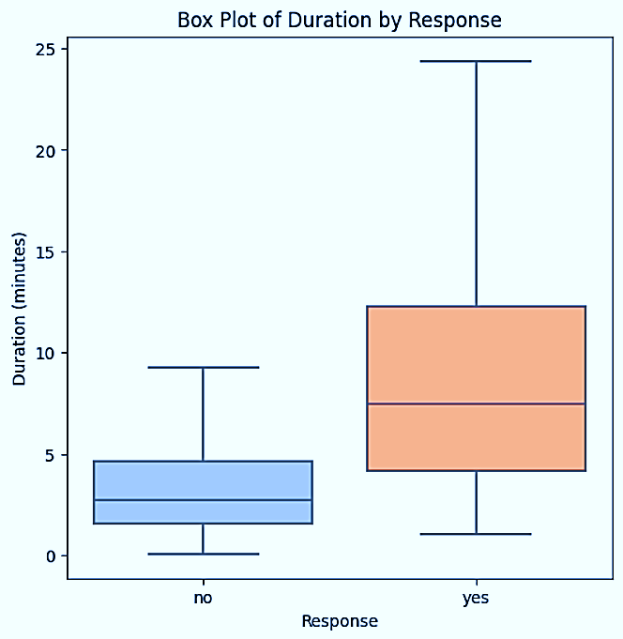
The range of duration for contacts who responded with 'yes' was larger than for contacts who responded with 'no'. This means that the contacts who said yes had more variation in their conversation length than the contacts who said no.
The outliers in the graph indicate that there were some contacts who had very long or very short conversations, regardless of their response. These outliers may have some special characteristics or circumstances that affected their duration.

Slide 14
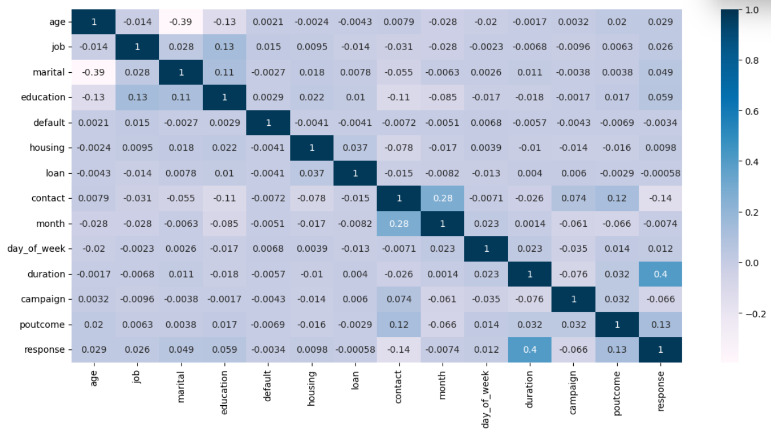
A correlation of 0.4 between Response and duration of calls means that there is a moderate positive relationship between these two variables. which means clients are more likely to accept the term deposit when duration of calls is high
A correlation of 0.28 between month and contact means that there is a weak positive relationship between these two variables. This means the campaign was more active or effective in the later months of the year.

Slide 15
Optimizing Features for Model Training
(1) Label Encoding:
Applied Label Encoding to convert categorical variables such as job, marital status, education, etc., into numerical values.
This transformation ensures that machine learning algorithms can effectively interpret and learn from these features.
(2) Age Group Removal:
Introduced an 'age_group' column during exploratory data analysis to visualize age patterns.
However, for the actual model training, 'age_group' was excluded to maintain simplicity and focus on more relevant features.
(3) Feature Drop:
Removed ‘duration’ to prevent data leakage and biased predictions.
‘Duration’ provides post-call information, risking model overfitting.
Ensuring fairness and unbiased results in predictive modelling.
These feature engineering steps contribute to the preparation of a well-structured dataset, enhancing the efficiency of the machine learning models in the subsequent steps.

Slide 16
Preparing for Model Training
(1) Dividing into Independent and Dependent Variables:
Segregated the dataset into independent variables (X) and the dependent variable (y).
The independent variables (features) include customer statistics, while the dependent variable is the target variable ('response') indicating subscription to a term deposit.
(2) Train-Test Split:
Split the data into training and testing sets using the train_test_split function from Scikit-Learn.
The training set (X_train and y_train) constitutes 80% of the data, while the testing set (X_test and y_test) holds the remaining 20%.
Applied the random_state parameter with a value of 123 to ensure reproducibility.
Stratified the split using stratify=y to maintain the distribution of the target variable in both training and testing sets.
By splitting the data in this manner, we create distinct sets for training our model and evaluating its performance on unseen data. The stratification ensures that the class distribution in the target variable is preserved in both training and testing datasets, improving the model's ability to generalize.

Slide 17
Ensuring Balanced Training
(1) Recognition of Class Imbalance:
Identified class imbalance in the target variable ('response') where one class significantly outweighs the other.
The initial distribution was imbalanced, with the majority class dominating and the minority class having fewer instances.
(2) Application of SMOTE:
Implemented the Synthetic Minority Over-sampling Technique (SMOTE) to address class imbalance.
SMOTE helps in generating synthetic samples for the minority class, balancing the distribution.
Post-SMOTE application, both classes in the training set are now more evenly represented.
Ensuring balanced classes is crucial for training a robust machine learning model, especially in scenarios where the target variable has disparate class frequencies. The use of SMOTE helps create a more representative and unbiased training dataset.

Slide 18
Choosing the Right Model
Logistic Regression:
Brief Info: Well-suited for binary classification, providing a straightforward approach to modelling relationships.
Reason to Choose: Our problem involves predicting binary outcomes, making logistic regression a natural choice for its simplicity and efficiency.
Decision Tree Classifier:
Brief Info: Effective for both classification and regression tasks, excelling at capturing non-linear relationships in data.
Reason to Choose: Our dataset exhibits complex patterns, and decision trees are adept at handling such intricacies.
Random Forest Classifier:
Brief Info: An ensemble of decision trees that enhances predictive power and robustness.
Reason to Choose: The random forest's ability to handle various data types and improve generalization makes it a strong candidate.
XGBoost Classifier:
Brief Info: A gradient boosting algorithm known for high predictive accuracy and handling complex relationships.
Reason to Choose: XGBoost's capability to handle missing data and capture non-linear patterns aligns well with our dataset's characteristics.

Slide 19
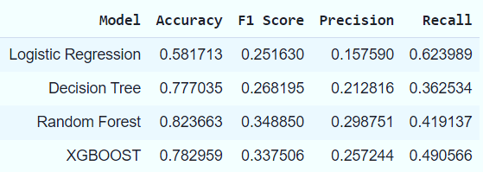
Optimal Model Choice
After comprehensive evaluation of various models, the Random Forest Classifier emerged as the top-performing algorithm for our Term Deposit Prediction.
Evaluation Metrics:
Achieved the highest accuracy among the models.
Demonstrated superior precision, recall, and F1-score.
Advantages of Random Forest:
Ensemble learning technique.
Robust against overfitting.
Handles various data types and interactions.
Conclusion:
The Random Forest Classifier stands out as the best choice for our predictive modeling, delivering high accuracy, robustness, and effectiveness in handling the complexities of our dataset. Its ensemble learning approach ensures reliable predictions for the term deposit subscription.

Slide 20
Deeper Insights into Random Forest Model
Classification Report:
Precision (Class 0): 92%
The model correctly identifies 92% of clients who actually decline the term deposit among all instances predicted as "no subscription.“
Recall (Class 0): 88%
Demonstrates an 88% accuracy in predicting clients who actually say "no" out of all clients who declined the offer.
Overall Model Performance:
The Random Forest model showcases exceptional predictive power, particularly in identifying customers who are unlikely to subscribe to the term deposit. Its precision, recall, and F1-score metrics contribute to its robustness and reliability in making accurate predictions.

Slide 21
CONCLUSION
In conclusion, our analysis of the term deposit subscription dataset has provided valuable insights into customer behaviour and preferences. Key findings include:
The dataset exhibits class imbalance, with a majority of clients (89%) not subscribing to the term deposit.
Customers with a university degree have the highest subscription rate, while those with basic education levels have lower subscription rates.
Marital status and loan status also impact subscription rates, with single clients showing higher subscription rates, and those with no housing or personal loans being more likely to subscribe.
The month of contact and the day of the week do not appear to strongly influence subscription rates.
Previous campaign outcomes play a role, with clients who had a successful outcome in the previous campaign showing higher subscription rates.

Slide 22
To address the class imbalance, the SMOTE technique was applied during preprocessing. The dataset was then split into training and testing sets, and various classification models were trained and evaluated. The Random Forest classifier emerged as the best-performing model, demonstrating high accuracy, precision, recall, and F1 score.
This suggests that the Random Forest model is well-suited for predicting customer responses to the term deposit campaign, providing a reliable tool for optimizing marketing efforts and targeting the most responsive clients.

Slide 23
Recommendations
The analysis yields several recommendations for the company to enhance the effectiveness of its term deposit campaign:
Target Marketing Efforts: Focus marketing efforts on specific customer segments that show a higher likelihood of subscribing to the term deposit. This includes customers with a university degree, single individuals, and those without existing housing or personal loans.
Optimize Contact Strategy: The analysis of previous campaign outcomes indicates that success in past interactions positively influences subscription rates. The company should consider tailoring its contact strategy based on the success of previous campaigns, potentially re-engaging clients with successful outcomes.
Seasonal Campaign Timing: While the analysis suggests higher contact rates during certain months, the subscription rates do not always align. Consider adjusting the timing of the telemarketing campaign to coincide with periods when subscription rates tend to be higher, such as in March and during the fall.
Utilize Predictive Modeling: Leverage the Random Forest classification model to predict customer responses before initiating the campaign. This can help identify the most responsive clients and allocate marketing resources more efficiently.

Slide 24
5. Customer Engagement Channels: Given that cellular contacts showed higher conversion rates, consider prioritizing cellular communication over telephonic channels. This aligns with the trend observed in the dataset and may lead to more positive responses.
6. Continuous Monitoring: Periodically reevaluate and update the predictive model as customer behaviours and preferences may change over time. Continuous monitoring and adaptation will ensure the model remains effective in predicting subscription outcomes.
By incorporating these recommendations, the company can optimize its marketing strategy, increase the efficiency of its telemarketing campaigns, and ultimately enhance the success rate of term deposit subscriptions.

Slide 25



