Slide 1
My Assignment Presentation
Task week 4 – Zwallet Back-End

Slide 2
Hello!
I am Gefy Aqiilah Aqshal
My Nickname is Gefy
From Fullstack Website - 5
You can find me at my github account @Gefyaqiilah

Slide 3




Let me explain a little bit about :

Slide 4
?

Slide 5
“API (Application Programming Interface)
sekumpulan perintah, fungsi, serta protokol yang dapat digunakan oleh programmer saat membangun perangkat lunak. ”
https://en.wikipedia.org/wiki/API

Slide 6
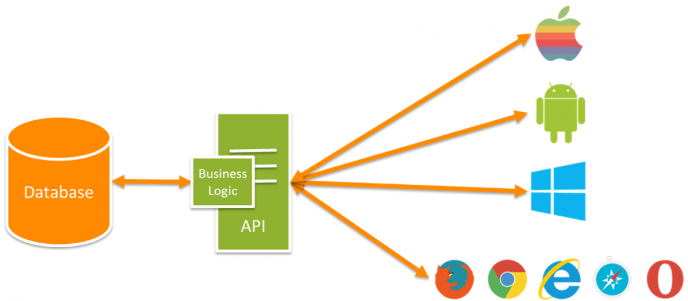

Slide 7
?

Slide 8

What is Nodejs
Front-end (Browser)
Back-end (Server)

Slide 9


Javascript in browser
V8 engine compiles java into machine code
C++

Slide 10
Machine Code

Slide 11
Read and write files on a computer
Connect to database
Act as a server for content

Slide 12
?

Slide 13
“Express JS
is a back end web application framework for Node.js, released as free and open-source software under the MIT License. It is designed for building web applications and APIs.”
https://en.wikipedia.org/wiki/Express.js

Slide 14
Features of Express Js
Faster Server side development
Middleware
Routing
Templating
Debugging

Slide 15
?

Slide 16
“MYSQL (Structured Query Languange)
MySQL is a open-source relational database management system (RDBMS), using the basic command of SQL (Structured Query Language)

Slide 17
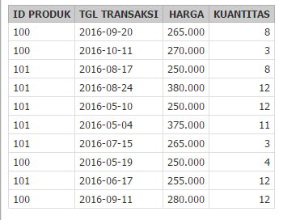
RDBMS

Slide 18
-+ 6.000.000 users around the world

Slide 19
DEMO

Slide 20
Thanks!
Any questions?

