Slide 1
Data mining and machine learning project
DEVELOPMENT OF AN APPLICATION TO ANALIZE REAL-TIME TWEETS ABOUT EARTHQUAKES
Giacomo Mantovani
Stefano Poleggi
Artificial Intelligence and Machine Learning
2019/2020

Slide 2
Motivation
Social network have entered our lives massively. The idea behind our work is to analyze tweets and to use them as a sort of sensor to detect study and detect their usage in case of natural disaster like earthquakes.
We developed an application for real-time monitoring of earthquake event detection. To do that, we analyzed tweets related to that topic using text analysis techniques; at the end we created a model able to classify tweets.

Slide 3
Dataset (I)
In order to build our classifier raw tweets have been scraped using a twitter scraping tool called Twint written in Python. Given location, tags to search for and a timestamp (or a date interval), returns the informations about the tweets matching those parameters.
To build the training set, two different queries have been used:
The first query selects tweets in Italy matching the tag #terremoto
The second query selects the tweets in Italy without tags
Another database was created by collecting (in the same way) tweets between the dates 2017-06-30 and 2016-06-01.

Slide 4
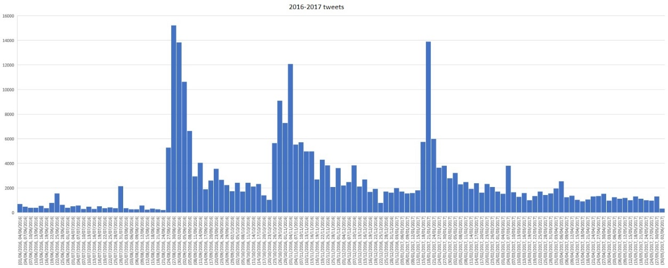
Dataset (II)
Once the database about tweets of 2016-2017 were created, we realized an histogram to check if there are spikes of tweets corresponding to catastrophic earthquakes in order to perform an analysis.
As we can see, there 3 major spikes relative to the 24-08-206, 30-10-2016 and 28-01-2017 huge earthquakes.

Slide 5
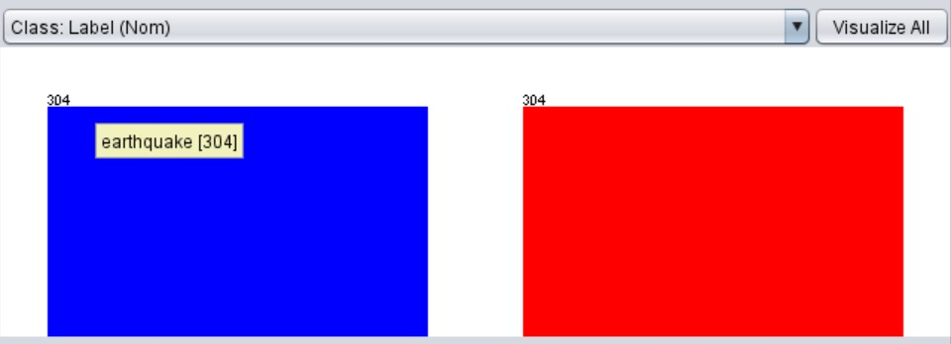
Training set
All labels (earthquakes, non-earthquakes) on tweets have been added manually. We ended up having a balanced data set of circa 300 tweets per class, 600 tweets in total.

Slide 6
Pre-processing
All the preprocessing steps were performed using Weka API and java.
After the tweets have been fetched, all of them have been pre-processed to extract only the raw text and remove all meta-information associated. All useless information have been discarded, like hashtags, mentions, links etc.
Finally, all character have been converted to lower case.

Slide 7
Classification model
Once the raw tweets have been elaborated during the pre-processing steps, we managed to try different classification models to find the one that provides the best results. Different classifiers have been applied to our training set, in particular we focused on SMO (Sequential Minimal Optimization), J48 (weka’s implementation of the C4.5 algorithm), kNN (k-Nearest Neighbors, we focused on two kNN models, with k equal to 1 and 3) an the NB (the naïve Bayesian classifier, based on the Bayes’ s theorem).

Slide 8
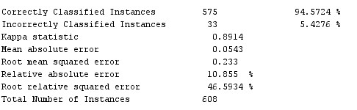
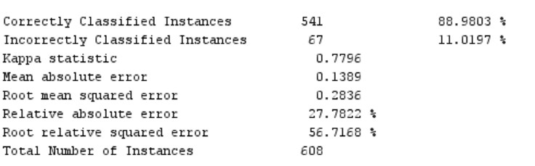
Classification model (II)
SMO
J48

Slide 9
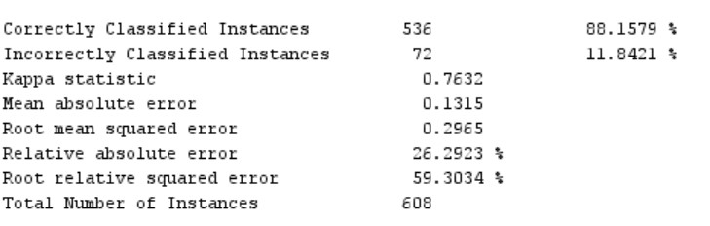
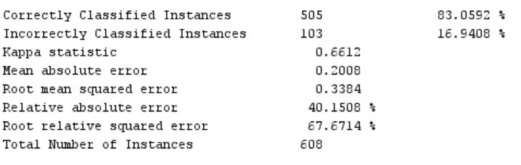
Classification model (III)
1NN
3NN

Slide 10
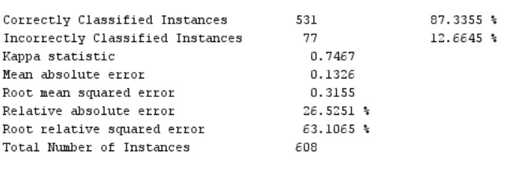
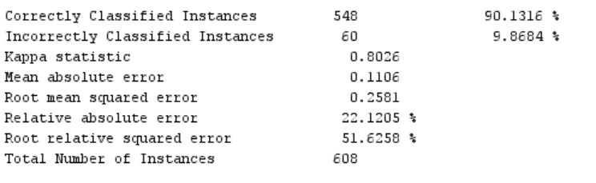
Classification model (IV)
NB
NB Multinomial

Slide 11
Classification model (V)
To evaluate each classification model, we used an n-fold cross-validation (with n = 10). The results obtained about accuracy for each classifier are summarized here:
Classifier | Accuracy (%)
SMO | 96.22%
J48 | 88.98%
1NN | 88.16%
3NN | 83.06%
NB | 87.33%
NB Multinomial | 90.13%

Slide 12
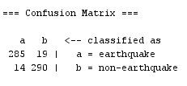
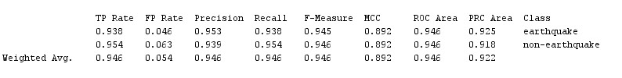
SMO Classifier
To have a better view about the classifier we studied their confusion matrix and other measures. Here, we showed those results for the SMO classifier.

Slide 13
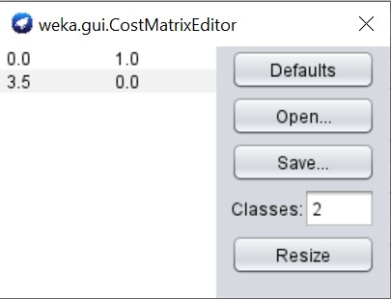
Note about classifier
We performed a cost sensitive classification schema, because we wanted to give an higher weight to the “earthquake” class than to “non-earthquake” class.

Slide 14
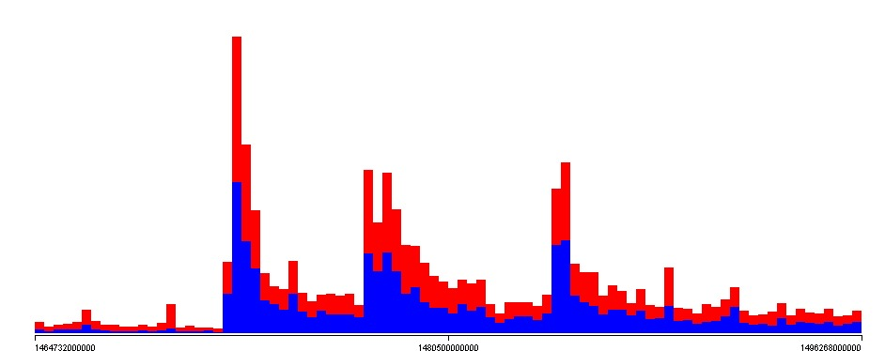
Using the classifier on the database
Since the SMO classifier provided us the best results, we used it in the application. To exploit a further test, we applied the model build on the database containing the 2016-2017 tweets, containing the “terremoto” hashtag.
We can see that the classifier has labeled a good amount of tweets as “earthquake” at the peaks seen previously.

Slide 15
Toward the application
Once we found the right classifier, we started implementing the application using java language. The application fetches real-time tweets containing the keyword “terremoto”, performs a real_time classification of each fetched tweet; if a positive tweet is found, the information about the tweet are stored in a mysql database. At the end of the fetch step, the user can visualize the results in a dedicated are of the application.

