Slide 1
Data mining and machine learning project
DEVELOPMENT OF AN APPLICATION TO ANALIZE REAL-TIME TWEETS ABOUT EARTHQUAKES
Giacomo Mantovani
Stefano Poleggi
Artificial Intelligence and Machine Learning
2019/2020

Slide 2
Motivation
Social network have entered our lives massively. The idea behind our work is to analyze tweets and to use them as a sort of sensor to detect study and detect their usage in case of natural disaster like earthquakes.
We developed an application for real-time monitoring of serious earthquake event detection. To do that, we analyzed tweets related to that topic using text analysis techniques; at the end we created a model able to classify tweets.

Slide 3
Dataset (I)
In order to build our classifier, raw tweets have been scraped using a twitter scraping tool called Twint written in Python. Given location, tags to search for and a timestamp (or a date interval), returns the informations about the tweets matching those parameters.
To build the training set, two different queries have been used:
The first query selects tweets in Italy matching the keyword “terremoto”.
The second query selects the tweets in Italy without tags.
Another database was created by collecting tweets between the dates 2017-06-30 and 2016-06-01.

Slide 4
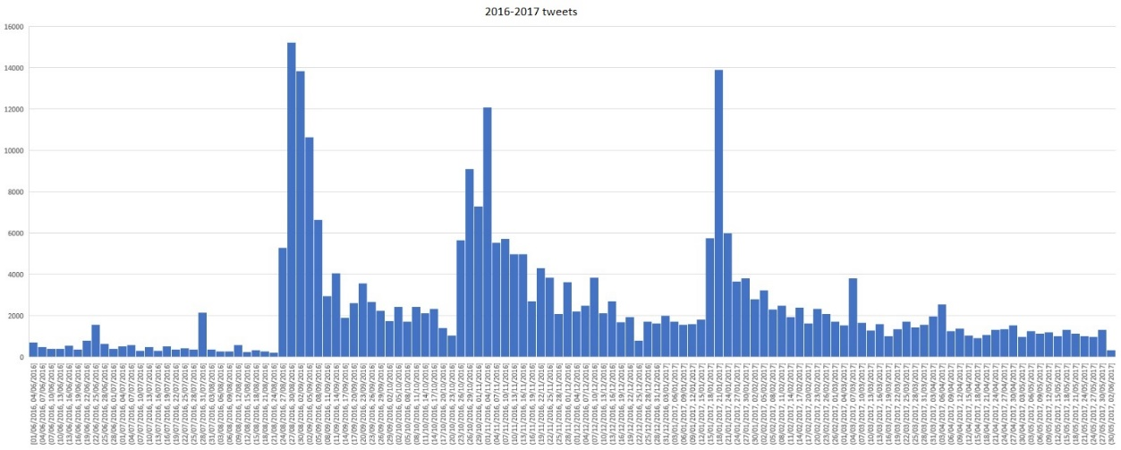
Dataset (II)
Once the database about tweets of 2016-2017 were created, we realized an histogram to check if there are spikes of tweets corresponding to catastrophic earthquakes in order to perform an analysis.
As we can see, there 3 major spikes relative to the 24-08-2016, 30-10-2016 and 18-01-2017 huge earthquakes.

Slide 5
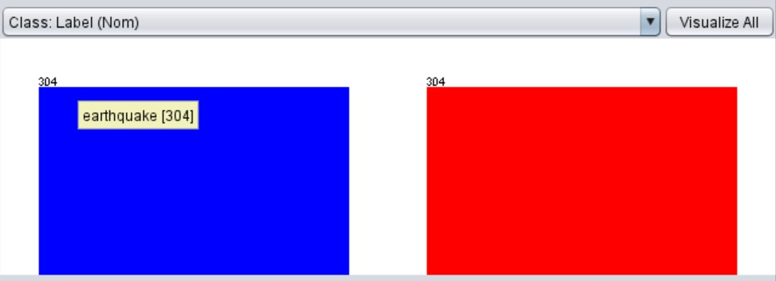
Training set (I)
All labels (earthquakes, non-earthquakes) on tweets have been added manually. We ended up having a balanced data set of 608 tweets (304 per class).
Earthquake class: tweets relative to a serious earthquake.
Non-earthquake class: tweets NOT relative to serious earthquakes (minor earthquakes are labeled as non-earthquake too)

Slide 6
Training set (II)
An example of the manual classification exploited is shown below, we choosed to label “earthquake” all those tweets about serious earthquake, while we labeled “non-eartqhake” all the tweets about mild earthquake, with no damage, or out of context.

Slide 7
Pre-processing
After the tweets have been fetched, all of them have been pre-processed in order to extract only the raw text and remove all meta-information associated. All useless information have been discarded, like user id, retweet flag etc. After that a regular expression filter to the text of the tweet is applied and all the characters have been converted to lower case.

Slide 8
Text mining process
Before creating the model we needed to apply a text mining process in order to obtain, from a set of strings, a set of numeric vectors that will be elaborated in the classification step.
Text mining steps:
Tokenization
Stop-word filtering
Stemming
Stem-filtering
Feature representation

Slide 9
Classification
Once the raw tweets have been elaborated during text mining steps, we used a classification model
to obtain a label for each tweet. Different classifiers have been compared, in particular we focused on SMO (Sequential Minimal Optimization), J48 (weka’s implementation of the C4.5 algorithm), kNN (k-Nearest Neighbors, we focused on two kNN models, with k equal to 1 and 3) an the NB (the naïve Bayesian classifier, based on the Bayes’ s theorem).

Slide 10
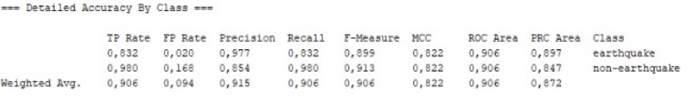
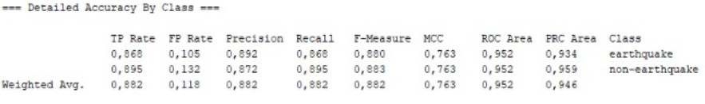
Classification model (I)
SMO
J48

Slide 11
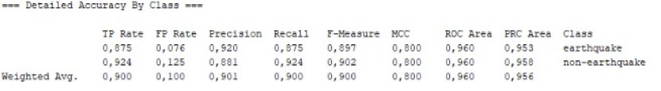
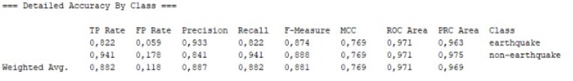
Classification model (II)
1NN
2NN

Slide 12
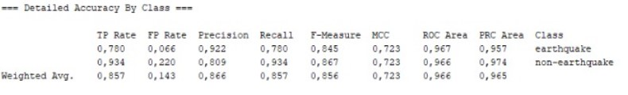

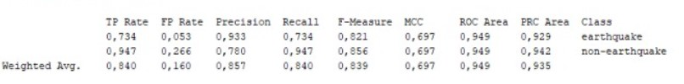
Classification model (III)
3NN
NB

Slide 13
Classification model (IV)
To evaluate each classification model, we used an n-fold cross-validation (with n = 10). The results obtained about accuracy for each classifier are summarized here:
Classifier | Accuracy (%)
SMO | 90.62%
J48 | 88.16%
1NN | 89.97%
2NN | 88.16%
3NN | 85.70%
NB | 84.05%

Slide 14
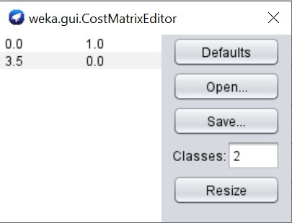
Note about classifier
We performed a cost sensitive classification schema, because we wanted to give an higher
misclassification error cost for the “earthquake” class rather than “non-earthquake” class.

Slide 15

Classifier choice
We ended up choosing the SMO classifier since it has the higher accuracy and his false negative
rate is fairly low, which is good in our case since we don’t want to classify non-earthquake tweets
as earthquake, but it is acceptable to have a slightly higher number of false positive (this is the
reason for applying the cost sensitive classifier to our model).

Slide 16
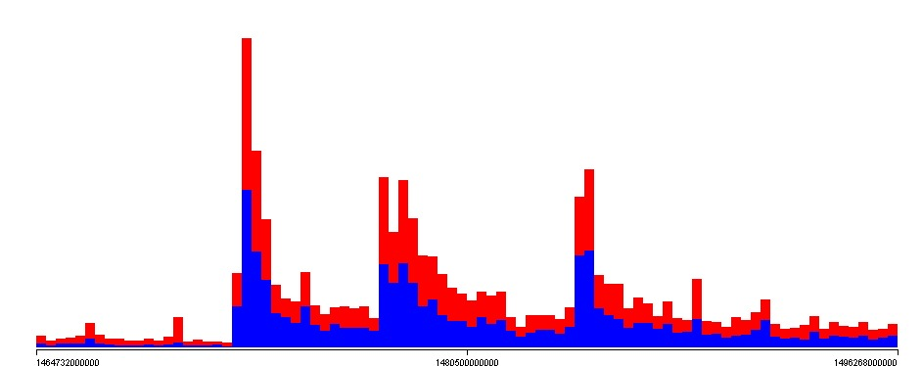
Using the classifier on the database
To exploit a further test, we applied the model on the database containing the 2016-2017 tweets.
We can see that the classifier has labeled a good amount of tweets as “earthquake” at the peaks seen previously.

Slide 17
Toward the application
Once we found the right classifier, we started implementing the application using java language. The application fetches the last 10 minutes tweets containing the keyword “terremoto” and performs
a real-time classification of each fetched tweet.
Two thresholds are set: warningThreshold and emergencyThreshold.
If N tweets (of the last 10 minutes) are classified as “earthquake”:
If N > warningThreshold: then a warning message is shown.
If N > emergencyThreshold: then an emergency message is shown (earthquake recognized).

Slide 18
Threshold values
To choose the threshold values we counted how many tweets are labeled as positive (in a 10
minute span) in three different cases and compared those values:
tweets relative to a catastrophic earthquake.
tweets relative to a non-catastrophic earthquake.
tweets relative to a date without earthquake.
Considering those thresholds, if an earthquake has been recognized, its informations
are stored into a sql database and showed on the application.

Slide 19
Test (I)
To test the application, we retrieved tweets collected within 10 minutes after an earthquake on three different days. In particular, we collected tweets about earthquake on the dates of 2016-10-30 (magnitude 6,5), of 2017-01-18 (over magnitude 5) and of 2019-08-27 (less than magnitude 3). Those tweets are stored in ARFF files. For the first two dates’ tweets, our application should classify an high number of earthquake-labeled, so it should display an emergency message, while for the third date’s tweet should classify a low number of earthquake-labeled and no emergency message should be displayed.

Slide 20
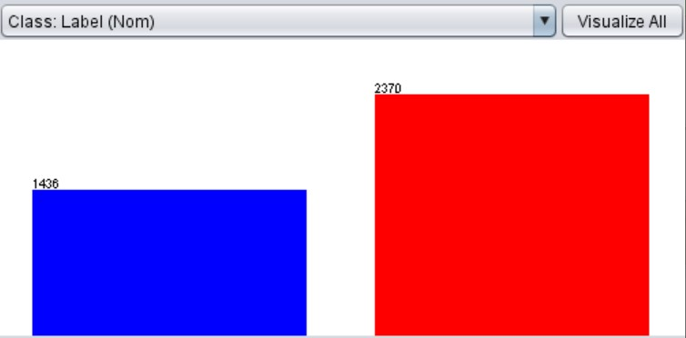
Test (II)
2016-10-30: we have obtained a good ratio between positive and negative tuples, with 1436 positive tuples and 2370 negative tuples.

Slide 21
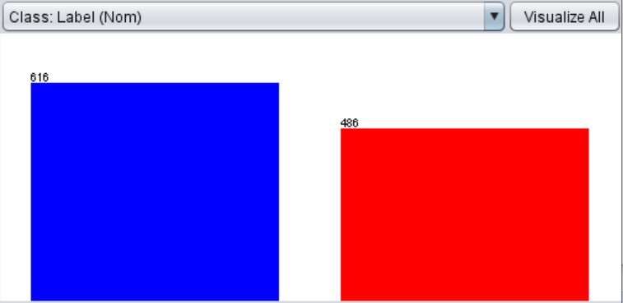
Test (III)
2017-01-18: in that test we obtained 616 positive tuples and 486 negative tuples.

Slide 22
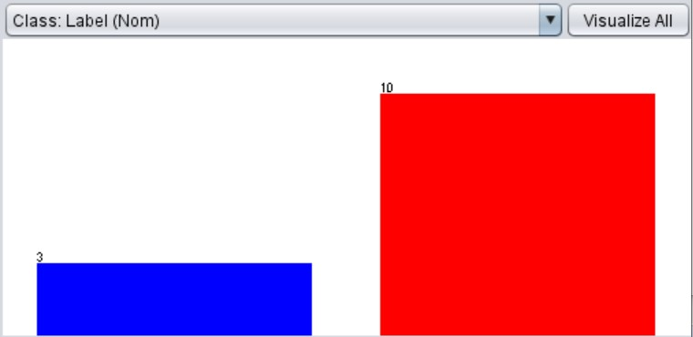
Test (IV)
2019-08-27: as expected, for that test we a low number (3) of positive tuples and just few more negative tuples (10).

