Slide 1


AI-Powered Intelligent Talent Acquisition System

Slide 2



INTRODUCTION TO THE PROBLEM
Recruitment problem | Large number of applicants | Manual interview (Resume) | Subjective decisions
  Job–candidate matching fails to explain why a candidate is recommended, reducing recruiter trust.
  Resume parsing only extracts keywords and ignores actual skill depth.
  Existing systems cannot predict early employee attrition before hiring.
  Interview evaluation remains subjective and inconsistent, with no structured analysis of communication quality
Affected Groups
  Recruiters and HR Managers
  Job Candidates
  Organizations
  Recruitment Agencies
Our Goal
  Develop an AI-Powered Intelligent Talent Acquisition System that improves the recruitment process by automatically analyzing resumes, evaluating interview responses, predict early employee attrition assessing candidate soft skills and Job–Candidate Matching.

Slide 3

Impact of the problem to User and Society
  Recruiters may spend large amounts of time manually screening applications.
  Hiring decisions may become biased or inconsistent.
  Poor soft skill assessment
  Organizations may experience reduced productivity due to poor hiring decisions.
  Qualified candidates may miss opportunities due to subjective evaluation.
  Talent mismatch

Slide 4
Existing Solutions
  Talent Acquisition System for resume filtering
  Online interview platforms for conducting remote interviews
  Basic AI tools for keyword-based resume screening
Their Limitations
  Most systems rely mainly on keyword-based resume filtering, which may overlook qualified candidates.
  Limited capability to analyze soft skills and communication patterns during interviews.
  Lack of explainable AI insights for recruiters when making hiring decisions.
  No reliable mechanisms to verify the authenticity of submitted certificates.

Slide 5

IT22248796 - Fonseka W.G.K
Hiring Risk & Early Attrition Prediction
Contribution
Novelty
  Predicts probability of early employee resignation
  Analyzes candidate employment history and job patterns
  Detects job-role mismatch and unstable career paths
  Generates attrition risk scores for recruiters
  Supports data-driven hiring decisions
  Predicts attrition risk before hiring decisions
  Uses pre-hire candidate data instead of post-hire HR data
  Combines multiple ML models for better prediction accuracy
  Provides Explainable AI insights for recruiter trust
IT22248794 | Gehan Fonseka | R26-IT-082

Slide 6
Hiring Risk & Early Attrition Prediction
Problem Definition
Sub-Objectives
  Existing recruitment systems mainly evaluate skills and qualifications
  They rarely predict whether a candidate will remain in the organization long-term
  This leads to high early employee turnover and increased recruitment costs
  Extract candidate attributes from resumes and applications
  Identify employment patterns and job-tenure indicators
  Train machine learning models for attrition prediction
Research Objective
  Develop an AI-driven attrition risk prediction system that analyzes candidate data during recruitment to estimate the probability of early employee resignation and provide explainable insights for recruiters.
IT22248794 | Gehan Fonseka | R26-IT-082

Slide 7
Hiring Risk & Early Attrition Prediction
Domain Knowledge Area
Technologies
  Human Resource Analytics
  Artificial Intelligence for Recruitment
  Machine Learning for Predictive Modeling
  Explainable Artificial Intelligence
  Python – Machine learning development
  Scikit-learn – Random Forest implementation
  XGBoost – Gradient boosting prediction model
  SHAP & LIME – Explainable AI interpretation
  Pandas / NumPy – Data preprocessing and analysis
IT22248796 | Gehan Fonseka | R26-IT-082
IT22248794 | Gehan Fonseka | R26-IT-082

Slide 8
Hiring Risk & Early Attrition Prediction
Validate & Evaluate
  Accuracy, Precision, Recall, F1-Score
  Model comparison across algorithms
Security
  Secure storage of candidate information
  Role-based access control for recruitment data
  Protection of sensitive candidate and HR data
Data Availability
  IBM HR Analytics Attrition Dataset
  Public HR analytics and workforce datasets
  Synthetic candidate data generation for training
Ethical Clearance
  Use of datasets only for research purposes
  Compliance with ethical AI and data protection guidelines
IT22248794 | Gehan Fonseka | R26-IT-082

Slide 9
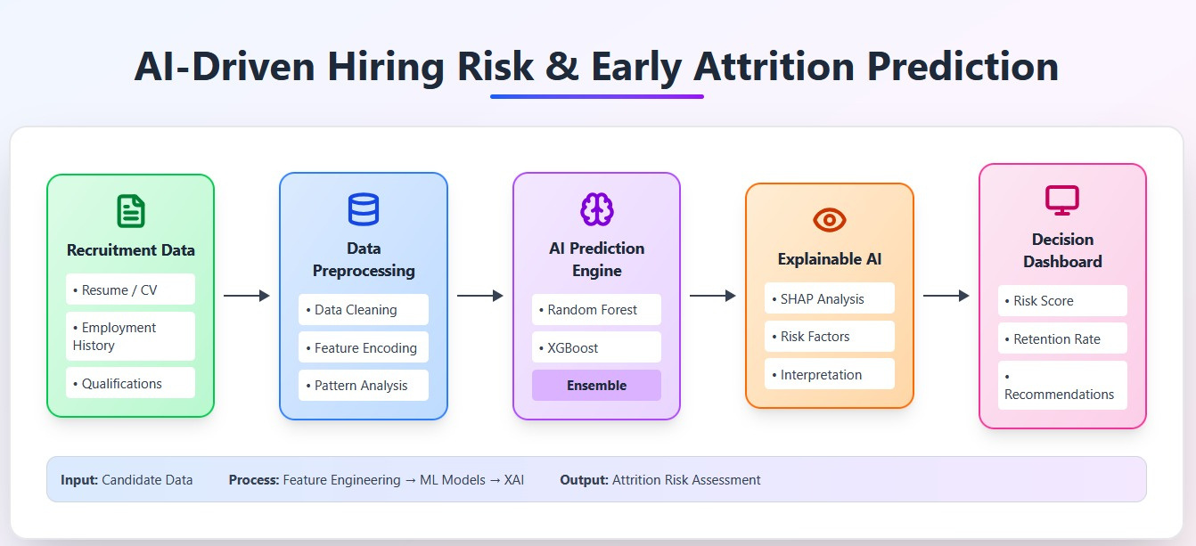
Hiring Risk & Early Attrition Prediction
System Overview
IT22248794 | Gehan Fonseka | R26-IT-082

Slide 10
Hiring Risk & Early Attrition Prediction
Dependencies
Common Components
  Candidate data from Resume Parsing Module
  Job-candidate similarity scores from Matching Engine
  Interview insights from AI Interview Evaluation Module
  Candidate Profile Database
  Authentication & User Management
  Resume Repository
  API Communication Layer
  AI Model Management
  Recruiter Dashboard
  Security & Data Protection Layer
IT22248794 | Gehan Fonseka | R26-IT-082

Slide 11

IT22226914 - Jayantha C H
Intelligent Resume Parsing & Skill Proficiency Analysis
Novelty
Contribution
Novelty
  Converts resumes into structured candidate data
  Extracts skills, education, and experience
  Generates candidate skill profiles
  Provides data for other AI modules
  Context-aware skill proficiency estimation
  Moves beyond keyword-based resume screening
  Evaluates experience duration and project context
  Improves the accuracy of candidate evaluation
IT22226914 | Chamudi Jayantha | R26-IT-082

Slide 12
Intelligent Resume Parsing & Skill Proficiency Analysis
Problem Definition
Sub-Objectives
  Existing ATS rely on keyword-based resume screening
  Skill presence detected but proficiency not evaluated
  Contextual factors like experience and projects ignored
  Leads to inaccurate candidate evaluation
  Apply NLP techniques for resume text processing
  Use NER to extract skills, education, experience
  Analyze experience duration and project relevance
  Generate structured candidate skill profiles
Research Objective
  To develop an NLP-based intelligent resume parsing system that extracts candidate information and estimates skill proficiency using contextual factors such as experience duration and project relevance.
IT22226914 | Chamudi Jayantha | R26-IT-082

Slide 13
Intelligent Resume Parsing & Skill Proficiency Analysis
Domain Knowledge Area
Technologies
  Artificial Intelligence for recruitment automation
  Natural Language Processing for resume analysis
  Machine Learning for information extraction
  Information Retrieval for skill identification
  SpaCy – NLP preprocessing and linguistic analysis
  CRF-based NER – entity extraction
  pdfplumber / PyMuPDF – resume text extraction
IT22226914 | Chamudi Jayantha | R26-IT-082

Slide 14
Intelligent Resume Parsing & Skill Proficiency Analysis
Validate & Evaluate
  Extraction Accuracy
  Skill relevance evaluation accuracy
  System processing efficiency
Security
  Secure storage of candidate information
  Access control for recruitment data
  Protection of sensitive candidate data
Data Availability
  Public resume datasets
  Job description datasets
  IBM HR Analytics Attrition Dataset
Ethical Clearance
  Personal data anonymization
  Use of data only for research purposes
  Compliance with ethical data handling guidelines
IT22226914 | Chamudi Jayantha | R26-IT-082

Slide 15
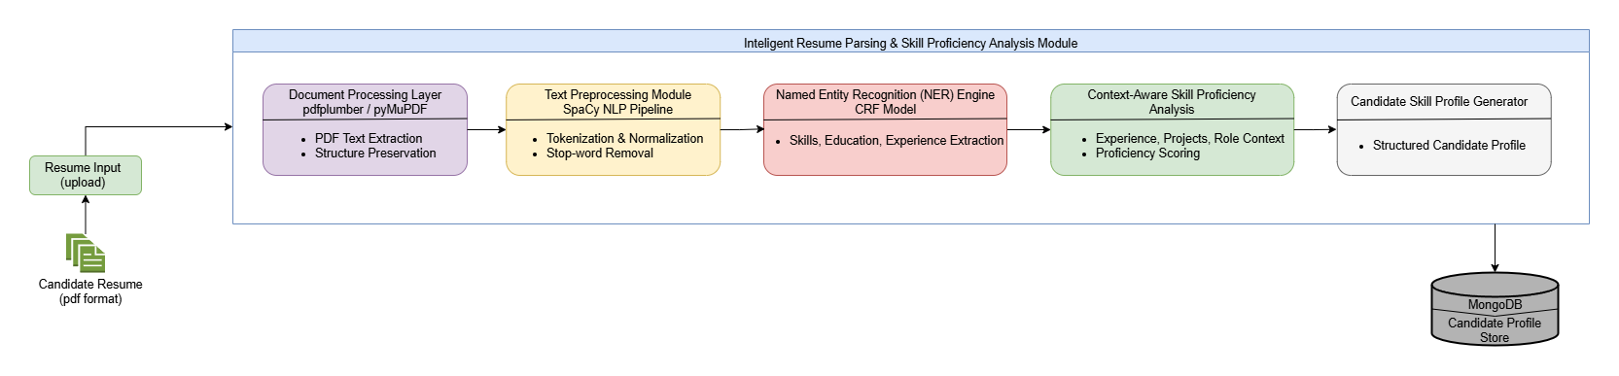
Intelligent Resume Parsing & Skill Proficiency Analysis
System Overview
IT22226914 | Chamudi Jayantha | R26-IT-082

Slide 16
Intelligent Resume Parsing & Skill Proficiency Analysis
Dependencies
Common Components
  Resume Text Extraction Tools
Extract text from PDF resumes using pdfplumber / PyMuPDF
Convert resume documents into machine-readable format
  NLP Processing Library:
SpaCy performs tokenization and text preprocessing
Generates linguistic features for resume analysis
  Named Entity Recognition Model:
CRF (sklearn-crfsuite) used for entity extraction
Identifies skills, education, and work experience
  Candidate Profile Database
  Authentication & User Management
  Resume Repository
  API Communication Layer
  AI Model Management
  Recruiter Dashboard
  Security & Data Protection Layer
IT22226914 | Chamudi Jayantha | R26-IT-082

Slide 17

IT22195616 - Deshan M A K
Job–Candidate Matching & Explainable AI Engine
Semantic Job–Candidate Matching | Skill Alignment Scoring | Explainable AI Decision
  Semantic Candidate Matching
  Context-Aware Skill Alignment
  Embedding-Based Similarity Analysis
  Explainable AI (XAI) Insights
  AI-Assisted Recruitment Decisions
Novelty
IT22195616 | Deshan M A K | R26-IT-082

Slide 18
Job–Candidate Matching & Explainable AI Engine
Problem Definition
Sub-Objectives
  Apply NLP embeddings for semantic representation
  Implement machine learning similarity scoring
  Generate ranked candidate recommendation lists
  Produce explainable matching insights
  Traditional ATS rely on keyword-based matching
  Candidate suitability evaluated only by skill presence
  Contextual factors like experience relevance ignored
  Results in inaccurate job–candidate matching
Research Objective
  Develop an AI-based job–candidate matching engine
  Compute semantic similarity between candidates and jobs
  Provide transparent explanations for AI recommendations
IT22195616 | Deshan M A K | R26-IT-082

Slide 19
Job–Candidate Matching & Explainable AI Engine
Domain Knowledge Area
Technologies
  Artificial Intelligence for recruitment automation
  Natural Language Processing for text understanding
  Machine Learning for candidate ranking models
• Explainable AI for transparent decision
making
  Sentence-BERT / embeddings for semantic similarity
  Scikit-learn for similarity scoring models
  SHAP / feature importance for explainable insights
• MongoDB for candidate data storage
IT22195616 | Deshan M A K | R26-IT-082

Slide 20
Job–Candidate Matching & Explainable AI Engine
Validate & Evaluate
  Matching accuracy evaluation
  Precision, Recall, and F1-Score
  Ranking quality for candidate recommendations
  System processing efficiency
Security
  Candidate data anonymization
  Access control for recruitment information
  Ethical use of recruitment data
Data Availability
  Public resume datasets
  Job description datasets
  Synthetic recruitment data generation
Ethical Clearance
  Personal Data Anonymization
  Use of Data for Research Purposes
  Compliance with Ethical Data Guidelines
IT22195616 | Deshan M A K | R26-IT-082

Slide 21
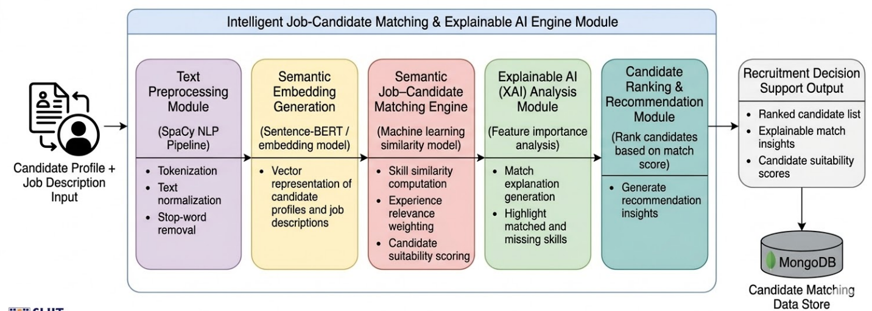
Job–Candidate Matching & Explainable AI Engine
System Overview
IT22195616 | Deshan M A K | R26-IT-082

Slide 22
Job–Candidate Matching & Explainable AI Engine
Dependencies
Common Components
  Candidate & Job Data Input:
The matching process depends on structured candidate profiles and job descriptions generated from the resume parsing module.
  Semantic Similarity Processing:
The matching engine relies on NLP embeddings and similarity models to analyze relationships between candidate skills and job requirements.
  Explainable AI Analysis:
The final candidate recommendation score depends on explainable AI techniques that identify key factors influencing the matching decision.
  Candidate Profile Database
  Job Description Repository
  API Communication Layer
  AI Model Management
  Recruiter Dashboard
  Security & Data Protection Layer
IT22195616 | Deshan M A K | R26-IT-082

Slide 23

IT22197832 - Tennakoon T.M.S.S
AI-Based Interview Evaluation, Soft Skill Analysis & Certificate Validation
Active interview phase | Soft-Skill Quantification | Enhanced Decision Support
  Multimodal Soft-Skill Evaluation
  Context-Aware Skill Assessment
  Behavioral & Emotional Cue Analysis
  Explainable AI (XAI) Scoring
  Advanced Transcription Integration
Novelty
IT22197832 | Sajani Tennakoon | R26-IT-082

Slide 24
AI-Based Interview Evaluation, Soft Skill Analysis & Certificate Validation
Problem Definition
Sub-Objectives
  Inefficiency of Traditional Systems
  Limited Evaluation of Soft Skills
  Objective Decision Support
  Reduced Time-to-Hire
  Generate AI-based soft skill evaluation scores.
  Design a Communication and Behavioral Cue Analysis Module
  Integrate Automated Certificate Validation
Research Objective
  To develop an AI-driven system that analyzes candidate interview responses and evaluates communication skills, behavioral cues, and emotional tone to generate objective soft-skill scores.
IT22197832 | Sajani Tennakoon | R26-IT-082

Slide 25
AI-Based Interview Evaluation, Soft Skill Analysis & Certificate Validation
Domain Knowledge Area
Methodology
Technologies
  Natural Language Processing (NLP)
  Artificial Intelligence
  Software Engineering
  Research Approach
  Data Collection
  Speech-to-Text Conversion
  Natural Language Processing
  Communication Pattern Analysis
  Soft Skill Scoring
  OpenAI Whisper
Transcription of interview audio.
  SpaCy
NLP-based text analysis
  VADER / TextBlob
Integrated for sentiment analysis
  Python
Model development
IT22197832 | Sajani Tennakoon | R26-IT-082

Slide 26
AI-Based Interview Evaluation, Soft Skill Analysis & Certificate Validation
Validate & Evaluate
  Compare AI-generated soft skill scores with human HR expert evaluations.
  Use sample interview datasets to test the system performance.
  Conduct pilot testing with mock interview recordings.
  Verify accuracy of speech-to-text transcription.
  Validate sentiment detection results using labeled datasets.
Security
  Data anonymization
  Secure storage
  Encrypted interview recordings
  Ethical approval for human data
Ethical Clearance
  Ethical Considerations - Ensure fair AI decisions.
  Data Privacy & Security - secure and encrypted
  The system will follow data protection guidelines and ethical research standards.
Data Availability
  Public interview datasets
  Simulated interview recordings
  Candidate response datasets
  collect through IBM HR data set
IT22197832 | Sajani Tennakoon | R26-IT-082

Slide 27
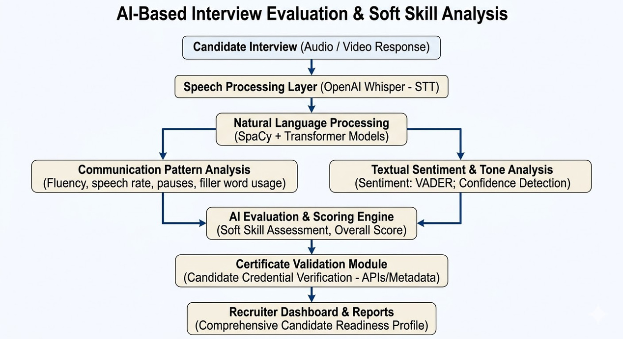
AI-Based Interview Evaluation, Soft Skill Analysis & Certificate Validation
System Overview
IT22197832 | Sajani Tennakoon | R26-IT-082

Slide 28
AI-Based Interview Evaluation, Soft Skill Analysis & Certificate Validation
Dependencies
Common Components
  Audio Input to Transcription:
The analysis cannot begin until the raw interview audio is successfully captured and fed into the OpenAI Whisper engine.
  Text to NLP Processing:
The SpaCy and Transformer models for response evaluation and behavioral analysis depend entirely on the text transcripts generated by the transcription module.
  Feature Extraction to Scoring:
The final "Candidate Readiness Score" depends on the aggregated outputs from the sentiment analysis, fluency detection, and relevance scoring sub-modules
  Candidate Profile Database
  Authentication & User Management
  Resume Repository
  API Communication Layer
  AI Model Management
  Recruiter Dashboard
  Security & Data Protection Layer
IT22197832 | Sajani Tennakoon | R26-IT-082

Slide 29
AI-Powered Intelligent Talent Acquisition System
Cost & Pricing
Target Market
  Cloud infrastructure and database hosting
  System maintenance and updates
  Corporate HR departments
  Recruitment agencies and HR consultancies
  Technology companies with high hiring volumes
Cost Recovery (Pricing)
Customer Profile
  Software-as-a-Service (SaaS) subscription model
  Tier-based pricing depending on resume processing volume
  Enterprise licensing for large organizations
  HR managers,
  recruiters
  talent acquisition specialists

Slide 30
AI-Powered Intelligent Talent Acquisition System
Value Proposition
Intellectual Property Rights
  Context-aware AI recruitment analysis
  More accurate candidate evaluation than traditional ATS
  Transparent and explainable hiring insights
  AI algorithms and system architecture protected by software copyright
  Potential patent for context-aware skill proficiency model
  Organizational recruitment data remains privately owned

Slide 31
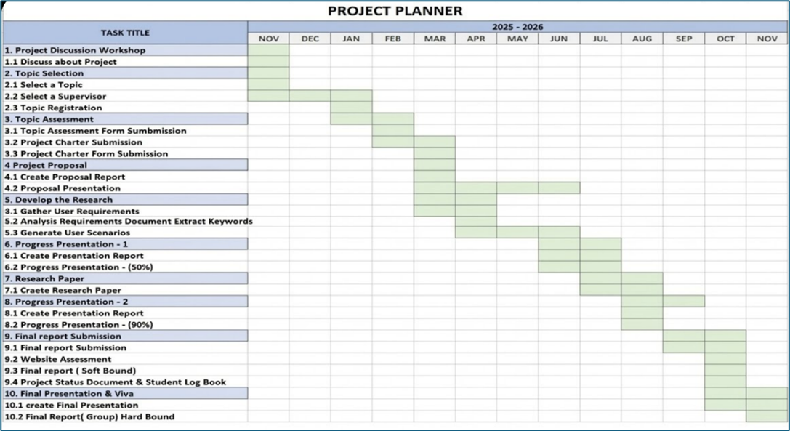
AI-Powered Intelligent Talent Acquisition System
Gantt Chart

Slide 32
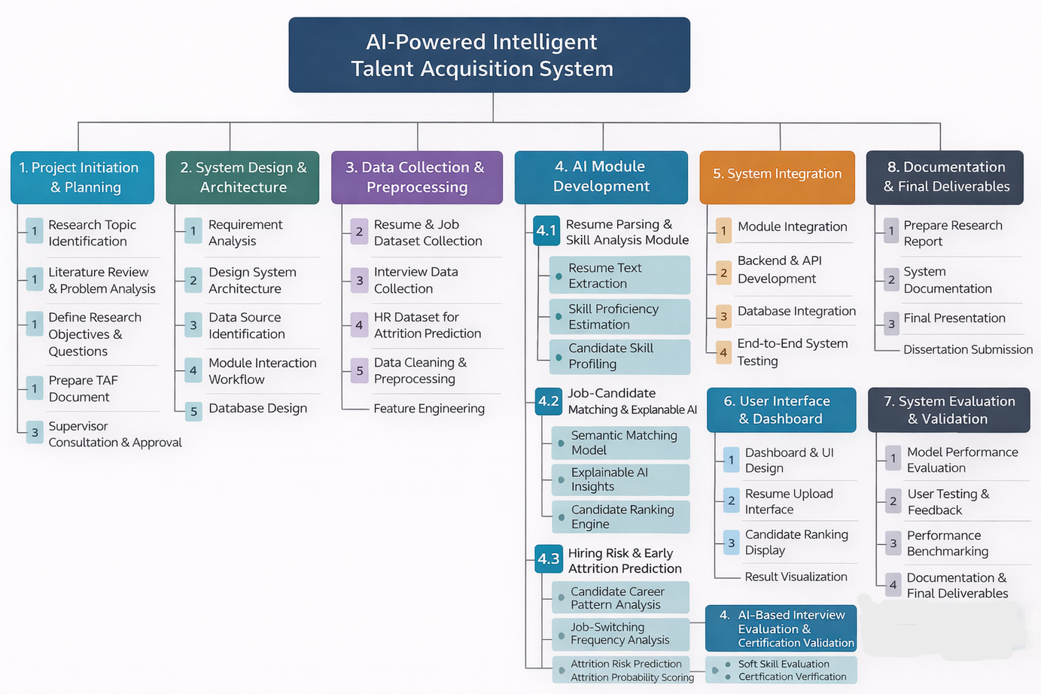

AI-Powered Intelligent Talent Acquisition System
Work Breakdown Chart

Slide 33
Thank You

