Slide 1


AI-Powered Intelligent Talent Acquisition System
R26-IT-082

Slide 2

AI-POWERED INTELLIGENT TALENT ACQUISITION SYSTEM
Traditional recruitment processes involve time-consuming manual CV screening, inconsistent candidate evaluation, and limited assessment of skills, job suitability, interview performance, and employee retention risks. Existing systems often lack integrated AI-driven analysis, making large-scale recruitment inefficient and hiring decisions less informed.
Problem in Brief
Our AI-Powered Intelligent Talent Acquisition System integrates four AI modules: Intelligent Resume Parsing & Skill Proficiency Analysis, Job–Candidate Matching, AI Interview Evaluation, and Hiring Attrition Prediction. It provides automated screening, explainable candidate insights, proficiency assessment, interview scoring, and retention-risk analysis through a unified platform, enabling efficient, consistent, and data-driven recruitment while keeping final hiring decisions with recruiters.
Design Excellence

Slide 3


IT22248796 - Fonseka W.G.K
Hiring Risk & Early Attrition Prediction
Brief Description:
This component predicts the risk of newly hired employees leaving an organization early. It identifies important factors that may influence employee retention and provides clear explanations to help recruiters understand potential hiring risks.
How It Fits the Whole Solution:
This component supports better long-term hiring decisions by helping organizations identify potential retention risks and improve workforce planning.
IT22248794 | Gehan Fonseka | R26-IT-082
20/10/2026

Slide 4



IT22226914 - Jayantha C H
Intelligent Resume Parsing & Skill Proficiency Analysis
Brief Description:
This component automatically reads resumes, identifies candidates’ skills, and evaluates their proficiency as Beginner, Intermediate, or Advanced based on work experience, projects, and qualifications. It also provides clear explanations for each assessment.
How It Fits the Whole Solution:
As the first stage of the Talent AI system, this component creates detailed candidate profiles that support job matching, interview evaluation, and hiring risk analysis, helping recruiters make faster, fairer, and more informed hiring decisions.
IT22226914 | Chamudi Jayantha | R26-IT-082
20/10/2026

Slide 5

IT22195616 - Deshan M A K
Job–Candidate Matching & Explainable AI Engine
Brief Description:
This component compares candidates’ skills, qualifications, and experience with job requirements to identify the most suitable candidates. It provides matching scores and clear explanations to help recruiters understand candidate suitability.
How It Fits the Whole Solution:
Using the candidate profiles generated through resume analysis, this component recommends suitable jobs to candidates and helps recruiters shortlist applicants more efficiently and accurately.
IT22195616 | Deshan M A K | R26-IT-082
20/10/2026

Slide 6

IT22197832 - Tennakoon T.M.S.S
AI-Based Interview Evaluation & Certificate Validation
Brief Description:
This component evaluates candidates’ interview answers, assesses communication and other soft skills, and checks submitted certificates to support a more complete candidate evaluation.
How It Fits the Whole Solution:
After candidate shortlisting, this component provides additional insights into interview performance, soft skills, and qualifications, helping recruiters make more confident and informed hiring decisions.
IT22197832 | Sajani Tennakoon | R26-IT-082
20/10/2026

Slide 7
Results & Testimonials
  Resume Strength Model: ~95% accuracy and macro F1 ~0.87 on validation (DeBERTa V5).
  Interview Answer Scoring: ~73.5% test accuracy and macro F1 ~0.69 (ROC-AUC ~0.92).
  End-to-end platform: Core recruitment flow (CV → match → interview → attrition) verified with automated service tests.
  User feedback (UAT/demo): Recruiters found AI scores useful for faster shortlisting with human review.
  Product value: The system acts as decision support clearer candidate insights, not automatic hiring.
Limitations of the System
  AI scores help recruiters, not automatic hiring
  Scores depend on model quality and available evidence
  Interview scoring works best with a reference answer and one mic per physical device limitation.
  Certificate checks verify content, not full issuer authenticity
  Attrition / match scores are estimates
  Supports text-based CVs only (PDF, DOCX, TXT).
  Skill proficiency accuracy depends on CV clarity and completeness.
Future Improvements
  Improve interview scorer accuracy / multilingual support
  Publish matching & attrition benchmark metrics
  Faster certificate checks (GPU / better infra)

Slide 8

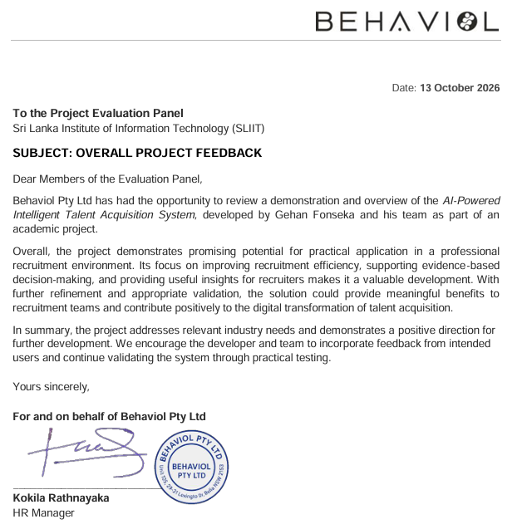
User Acceptance / Feedback

Slide 9
THANK YOU

