Slide 1

AI-POWERED INTELLIGENT TALENT ACQUISITION SYSTEM
R26-IT-082

Slide 2
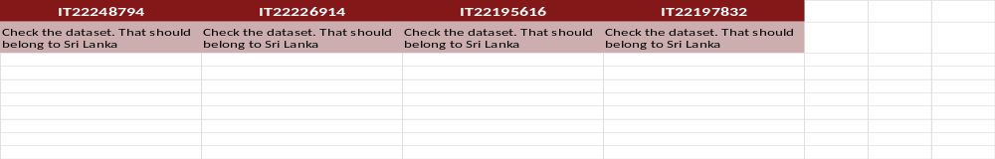
AI-POWERED INTELLIGENT TALENT ACQUISITION SYSTEM
Comments for the Proposal Presentation
How we addressed them
  Conducted extensive searches for Sri Lankan recruitment datasets.
  However, publicly available Sri Lankan datasets were difficult to obtain due to privacy and confidentiality concerns.
  Survey-based data collection was also attempted, but the response rate was limited.
  Therefore, the IBM HR dataset is currently being used for prototype development and model training.

Slide 3
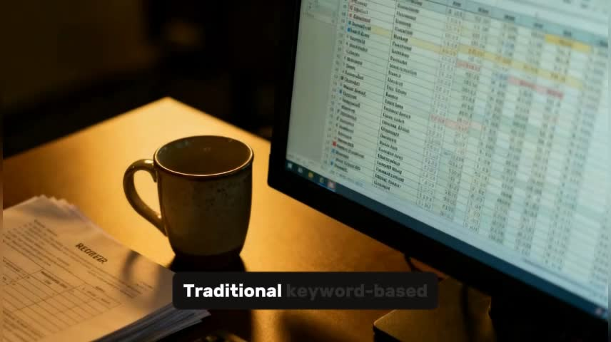
AI-POWERED INTELLIGENT TALENT ACQUISITION SYSTEM
Introduction
Develops an AI-Powered Intelligent Talent Acquisition System to improve recruitment efficiency and accuracy
  Talent acquisition is a critical process, but it is often time-consuming, subjective, and inefficient
  Traditional systems rely on manual resume screening and human judgment, leading to bias and inconsistency
  Existing ATS systems focus on keyword-based filtering, failing to understand context and candidate potential
  Interview evaluations are subjective with limited analysis of communication skills, behavior, and emotional intelligence
  Organizations struggle with accurate job-candidate matching and predicting long-term employee retention
Target Users:
  Provides a fully automated, intelligent recruitment pipeline
  Reduces human bias and manual workload
  Improves accuracy, transparency, and efficiency in hiring
  Supports data-driven decision making in talent acquisition

Slide 4
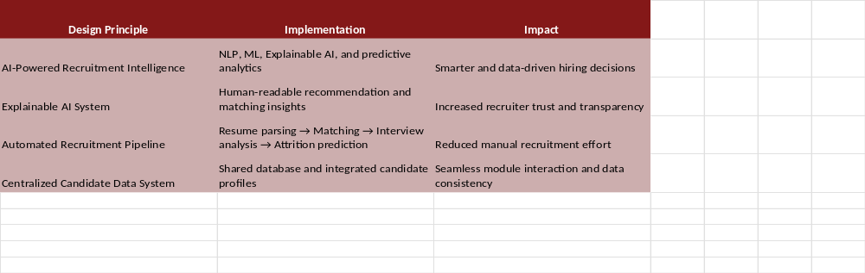
AI-POWERED INTELLIGENT TALENT ACQUISITION SYSTEM
Design Excellence of the Overall Solution

Slide 5
AI-POWERED INTELLIGENT TALENT ACQUISITION SYSTEM
Problem,
Traditional recruitment systems mainly rely on keyword matching and manual decision-making. These systems cannot accurately evaluate candidate skills, explain hiring decisions, assess interview performance, or predict early employee attrition. This leads to inefficient and inaccurate hiring processes.
Impact of Our Solution:
Recruitment Impact:
Faster and more accurate candidate screening and hiring decisions
Organizational Impact:
Reduces recruitment costs and early employee turnover
Recruiter Impact:
Provides explainable and data-driven candidate evaluation insights
Research Impact:
Advances AI-driven recruitment using NLP, Explainable AI, and predictive analytics

Slide 6


HIRING RISK & EARLY ATTRITION PREDICTION
IT22248796 - FONSEKA W.G.K
SPECIALIZATION : INFORMATION TECHNOLOGY
IT22248794 | Gehan Fonseka | R26-IT-082
05/12/2026

Slide 7
HIRING RISK & EARLY ATTRITION PREDICTION
HOW THE SOLUTION WILL ADDRESS THE SUB-PROBLEM
Sub-Problem Addressed
Proposed Solution
  Organizations cannot identify high-risk hires early
  Traditional ATS cannot analyze employee retention patterns
  Poor role alignment leads to early resignation
  Recruiters lack hiring risk insights
  Manual risk evaluation is difficult
  AI model predicts early attrition risk before hiring
  System analyzes career history and job-switching behavior
  Evaluates skill-role and expectation-role mismatch
  Generates attrition risk scores and retention indicators
  Provide skill proficiency levels and candidate dashboards
IT22248794 | Gehan Fonseka | R26-IT-082
05/12/2026

Slide 8
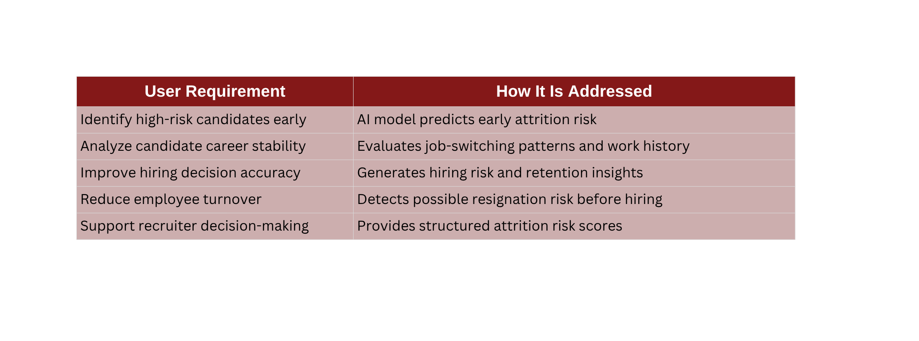
HIRING RISK & EARLY ATTRITION PREDICTION
USER REQUIREMENTS ADDRESSED BY THE SOLUTION
DESIGN EXCELLENCE / CONTRIBUTION
USER FEEDBACK ON PROTOTYPE
  AI-based attrition prediction
  Career pattern analysis
  Role mismatch detection
  Risk score generation
  Data-driven hiring insights
  Easy risk identification
  Useful recruitment insights
  Clear attrition risk scores
  Helpful for hiring decisions
  Suggested dashboard improvements
IT22248794 | Gehan Fonseka | R26-IT-082
05/12/2026

Slide 9

INTELLIGENT RESUME PARSING & SKILL PROFICIENCY ANALYSIS
IT22226914 - JAYANTHA C H
SPECIALIZATION : INFORMATION TECHNOLOGY
IT22226914 | Chamudi Jayantha | R26-IT-082
05/12/2026

Slide 10
INTELLIGENT RESUME PARSING & SKILL PROFICIENCY ANALYSIS
HOW THE SOLUTION WILL ADDRESS THE SUB-PROBLEM
Sub-Problem Addressed
Proposed Solution
  Traditional ATS only checks keywords in resumes
  Cannot understand actual skill proficiency
  Difficulty identifying relevant candidate skills
  Manual resume screening takes time
  Recruiters lack clear candidate insights
  Use NLP-based intelligent resume parsing
  Analyze experience duration and project context
  Extract skills, education, and experience using NER
  Automatically generate structured candidate profiles
  Provide skill proficiency levels and candidate dashboards
IT22226914 | Chamudi Jayantha | R26-IT-082
05/12/2026

Slide 11
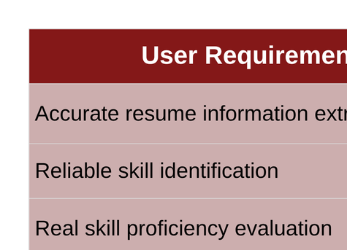
INTELLIGENT RESUME PARSING & SKILL PROFICIENCY ANALYSIS
USER REQUIREMENTS ADDRESSED BY THE SOLUTION
USER FEEDBACK ON
PROTOTYPE
DESIGN EXCELLENCE / CONTRIBUTION
  NLP-based Resume Parsing: Extracts skills and experience automatically
  Context-Aware Analysis: Evaluates real skill proficiency
  NER-based Skill Detection: Identifies candidate information accurately
  Structured Skill Profiles: Generates recruiter-friendly outputs
  Beyond Keyword Matching: Understands skill depth and relevance
  User-friendly interface
  Fast resume processing
  Clear skill proficiency insights
  Helpful candidate profiles
IT22226914 | Chamudi Jayantha | R26-IT-082
05/12/2026

Slide 12

JOB–CANDIDATE MATCHING & EXPLAINABLE AI ENGINE
IT22195616 - DESHAN MAK
SPECIALIZATION : INFORMATION TECHNOLOGY
IT22195616 | Deshan M A K | R26-IT-082
05/12/2026

Slide 13
JOB–CANDIDATE MATCHING & EXPLAINABLE AI ENGINE
HOW THE SOLUTION WILL ADDRESS THE SUB-PROBLEM
Sub-Problem Addressed
Proposed Solution
  ATS systems fail to understand candidate context
  Hiring decisions are difficult to justify
  Recruiters spend too much time filtering resumes
  Candidate ranking lacks fairness and accuracy
  Candidate evaluation is often inconsistent
  Apply semantic AI matching to understand skill meaning and relevance
  Generate explainable recommendation reports using XAI recommendations
  Perform standardized AI-driven profile analysis
IT22195616 | Deshan M A K | R26-IT-082
05/12/2026

Slide 14
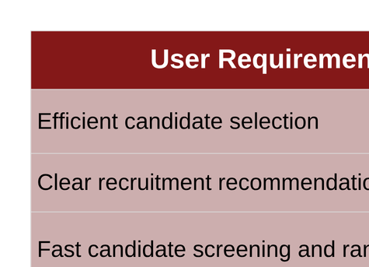
JOB–CANDIDATE MATCHING & EXPLAINABLE AI ENGINE
USER REQUIREMENTS ADDRESSED BY THE SOLUTION
DESIGN EXCELLENCE / CONTRIBUTION
USER FEEDBACK ON
PROTOTYPE
  Semantic AI-based recruitment matching
  Transparent and interpretable AI outputs
  Context-aware skill and experience analysis
  Automated candidate recommendation system
  Human-readable matching insights
  Simple and easy recruitment interface
  Easy-to-understand AI explanations
  Clear AI recommendation explanations
  Better confidence in AI recommendations
  Improved trust in AI decisions
IT22195616 | Deshan M A K | R26-IT-082
05/12/2026

Slide 15

AI-BASED INTERVIEW EVALUATION, SOFT SKILL ANALYSIS & CERTIFICATE VALIDATION
IT22197832 - TENNAKOON T.M.S.S
SPECIALIZATION : INFORMATION TECHNOLOGY
06
IT22197832 | Sajani Tennakoon | R26-IT-082
05/12/2026

Slide 16
AI-BASED INTERVIEW EVALUATION, SOFT SKILL ANALYSIS & CERTIFICATE VALIDATION
HOW THE SOLUTION WILL ADDRESS THE SUB-PROBLEM
Sub-Problem Addressed
Proposed Solution
  Subjective interview evaluation
  No soft skill assessment
  Lack of communication analysis
  No emotional intelligence evaluation
  Recruiters lack clear candidate insights
  AI-based scoring using NLP + communication analysis
  Analyze fluency, tone, sentiment, and behavior patterns
  Detect filler words, pauses, response structure
  Sentiment analysis (confidence, positivity, tone)
  Provide skill proficiency levels and candidate dashboards
IT22197832 | Sajani Tennakoon | R26-IT-082
05/12/2026

Slide 17
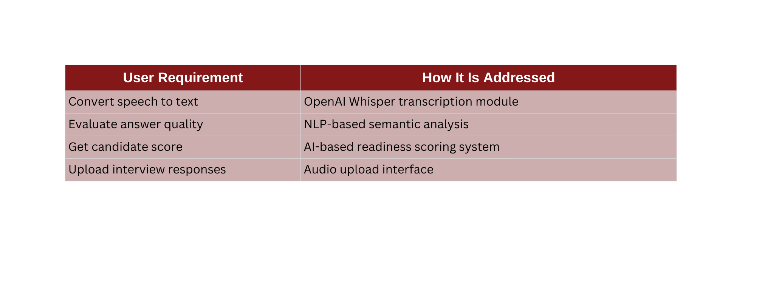
AI-BASED INTERVIEW EVALUATION, SOFT SKILL ANALYSIS & CERTIFICATE VALIDATION
USER REQUIREMENTS ADDRESSED BY THE SOLUTION
DESIGN EXCELLENCE / CONTRIBUTION
USER FEEDBACK ON PROTOTYPE
  Integration of NLP and speech processing
  Explainable AI scoring
  Real-time automated evaluation
  Score generation
  Clear and understandable scoring reports
  Useful recruitment insights
  Helpful for hiring decisions
  Suggested dashboard improvements
IT22197832 | Sajani Tennakoon | R26-IT-082
05/12/2026

Slide 18

AI-POWERED INTELLIGENT TALENT ACQUISITION SYSTEM
Commercialization & Sustainability
  AI-powered recruitment platform for companies and recruitment agencies.
  Integration with existing ATS and HR management systems.
  Subscription-based and enterprise licensing business model.
  Cloud-based scalable deployment with low operational cost.
  Continuous AI model improvement using recruitment data and recruiter feedback.

Slide 19
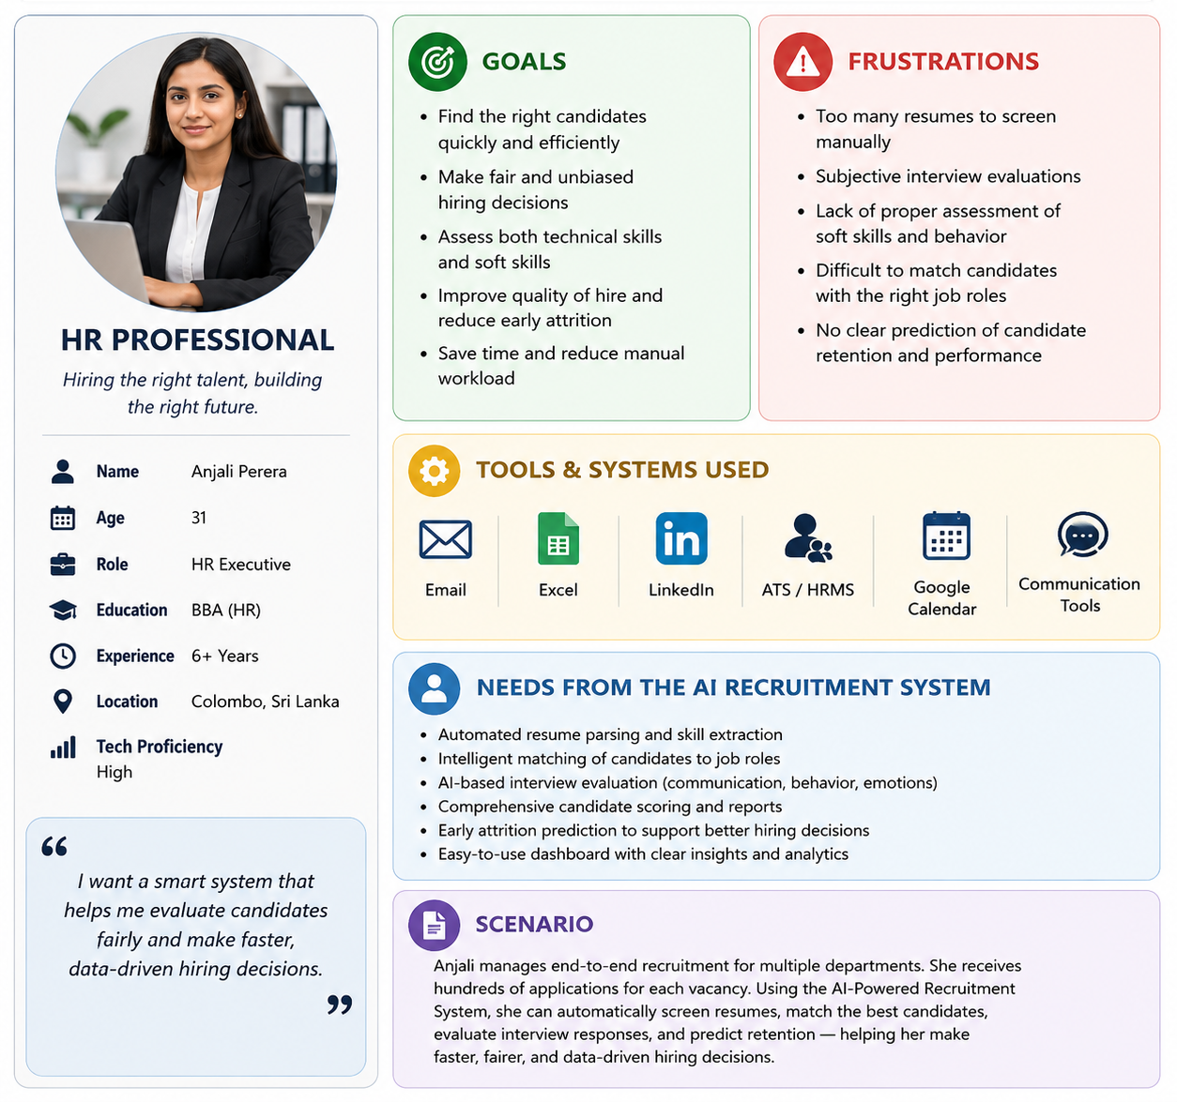

AI-POWERED INTELLIGENT TALENT ACQUISITION SYSTEM
Customer Persona

Slide 20

AI-POWERED INTELLIGENT TALENT ACQUISITION SYSTEM
Market Size,
  The market for AI-based recruitment and talent acquisition systems is rapidly growing.
  Global Perspective:
    Increasing use of AI in recruitment and HR automation
    Rising demand for faster and smarter hiring processes
    Growing need for explainable and data-driven recruitment systems
  Regional Context (Sri Lanka & South Asia):
    High volume of job applications creates manual screening challenges
    Increasing adoption of digital recruitment platforms
    Growing demand for cost-effective AI recruitment solutions
  Target Market Includes:
    Corporate HR departments
    Recruitment agencies
    IT companies and startups
    Large-scale enterprises
    Online recruitment platforms

Slide 21

AI-POWERED INTELLIGENT TALENT ACQUISITION SYSTEM
What is Unique in the Solution
  Integrated AI recruitment platform combining multiple hiring modules
  Multi-task AI pipeline for:
    Resume Parsing
    Job Matching
    Interview Evaluation
    Attrition Prediction
  Context-aware skill analysis beyond keyword matching
  Explainable AI insights for transparent hiring decisions
  Predictive hiring intelligence to identify attrition risks early

Slide 22

AI-POWERED INTELLIGENT TALENT ACQUISITION SYSTEM
How will the cost be recovered?
  The cost recovery model is designed to be scalable and sustainable.
  Possible Revenue Models:
    Subscription Model
    Enterprise Licensing
    Recruitment Platform Integration
  Cost Structure:
    Initial AI model development and training
    Cloud hosting and database maintenance
    Minimal ongoing system update costs

Slide 23

THANK YOU

