Slide 1



AI-POWERED INTELLIGENT TALENT ACQUISITION SYSTEM
R26-IT-082

Slide 2
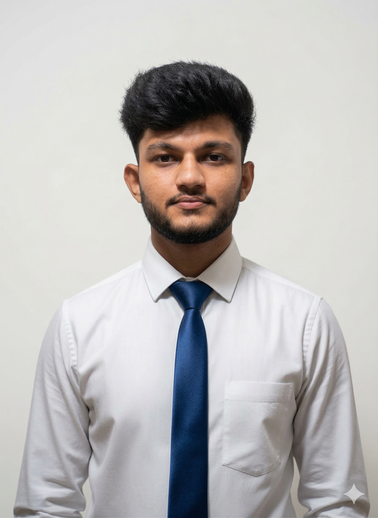


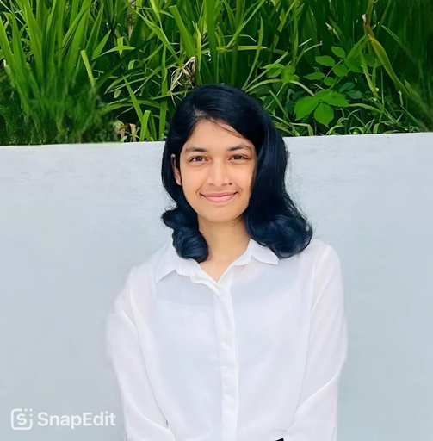

Our Team
IT22248796
FONSEKA W.G.K
IT22226914 JAYANTHA C H
IT22195616
DESHAN MAK
IT22197832 TENNAKOON T.M.S.S
SPECIALIZATION : INFORMATION TECHNOLOGY
31/08/2026

Slide 3
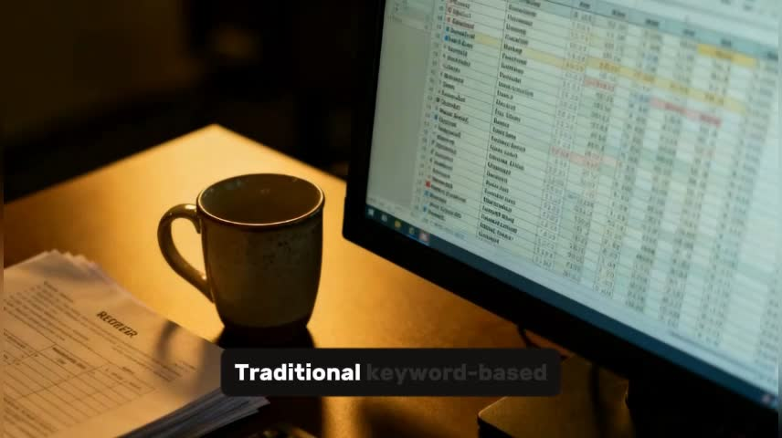
AI-POWERED INTELLIGENT TALENT ACQUISITION SYSTEM
Introduction
Develops an AI-Powered Intelligent Talent Acquisition System to improve recruitment efficiency and accuracy
  Talent acquisition is a critical process, but it is often time-consuming, subjective, and inefficient
  Traditional systems rely on manual resume screening and human judgment, leading to bias and inconsistency
  Existing ATS systems focus on keyword-based filtering, failing to understand context and candidate potential
  Interview evaluations are subjective with limited analysis of communication skills, behavior, and emotional intelligence
  Organizations struggle with accurate job-candidate matching and predicting long-term employee retention
Target Users:
  HR Managers and Recruiters
  Recruitment Agencies
  Organizations and Hiring Teams
  Job Candidates

Slide 4
AI-POWERED INTELLIGENT TALENT ACQUISITION SYSTEM
Problem,
Traditional recruitment systems mainly rely on keyword matching and manual decision-making. These systems cannot accurately evaluate candidate skills, explain hiring decisions, assess interview performance, or predict early employee attrition. This leads to inefficient, inconsistent, and less data-driven hiring decisions.
Impact of Our Solution:
Recruitment Impact:
Faster and more accurate candidate screening and hiring decisions
Organizational Impact:
Reduces recruitment costs and early employee turnover
Recruiter Impact:
Provides explainable and data-driven candidate evaluation insights
Research Impact:
Advances AI-driven recruitment using NLP, Explainable AI, and predictive analytics

Slide 5


AI-POWERED INTELLIGENT TALENT ACQUISITION SYSTEM
Research GAP
Research Gap – Existing recruitment systems usually:
  Focus on individual recruitment tasks rather than an integrated end-to-end process.
  Provide limited integration of resume analysis, job matching, interview evaluation and attrition prediction.
  Provide limited explainability for AI-generated recruitment scores and predictions.
  Mainly focus on candidate selection, with limited support for predicting early attrition risk before hiring.
  Have limited validation and adaptation for the Sri Lankan recruitment context.
Objective – Develop an AI-powered intelligent talent acquisition system that can:
  Perform intelligent resume and skill proficiency analysis.
  Provide job–candidate matching with explainable AI.
  Support AI-assisted interview evaluation.
  Predict hiring attrition risk using machine learning.
  Provide explainable risk factors and what-if retention simulations to support recruiter decision-making.

Slide 6

AI-POWERED INTELLIGENT TALENT ACQUISITION SYSTEM
Solution Overview
Solution Summary
  An AI-powered intelligent talent acquisition system that integrates resume intelligence, job matching, interview evaluation, and hiring attrition prediction to provide explainable, data-driven recruitment decision support.
Key Features
  Intelligent CV parsing & skill proficiency analysis
  Job–candidate matching with explainable insights
  AI-assisted live interview and candidate evaluation
  Hiring attrition risk prediction
  SHAP-based risk explanation & AI recommendations
  What-If retention simulation for proactive decision support

Slide 7
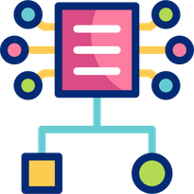
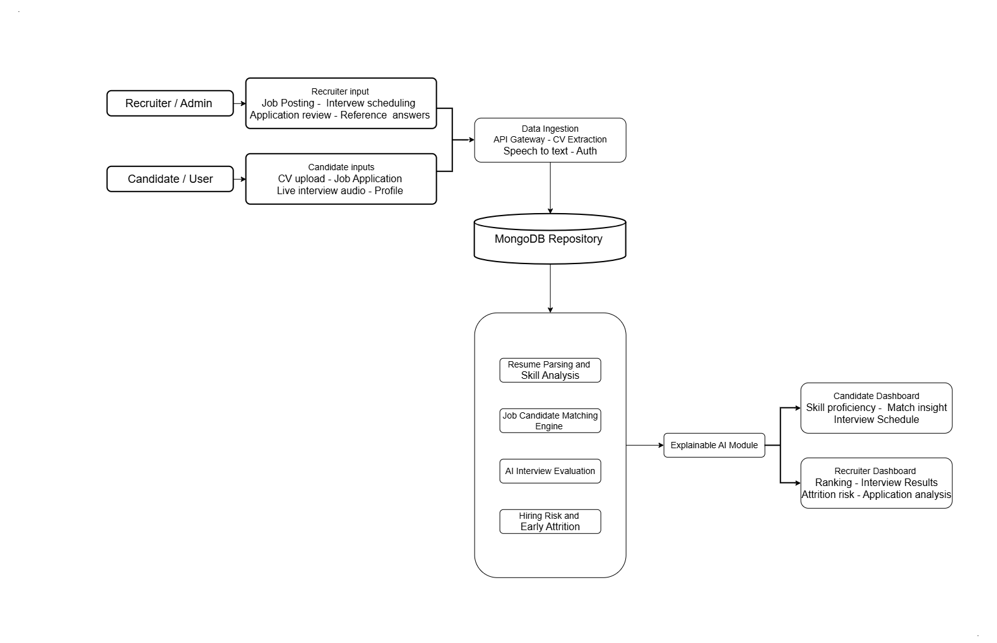
AI-POWERED INTELLIGENT TALENT ACQUISITION SYSTEM
System Architecture

Slide 8

AI-POWERED INTELLIGENT TALENT ACQUISITION SYSTEM
Commercialization
  AI-powered recruitment platform for companies and recruitment agencies.
  Integration with existing ATS and HR management systems.
  Subscription-based and enterprise licensing business model.
  Cloud-based scalable deployment with low operational cost.
  Continuous AI model improvement using recruitment data and recruiter feedback.
  Target Market Includes:
⚬ Corporate HR departments
⚬ Recruitment agencies
⚬ IT companies and startups
⚬ Large-scale enterprises
⚬ Online recruitment platforms

Slide 9

THANK YOU

