Slide 1


CHRONOS Meeting
Julian Geiger
jgeiger@iciq.es
THEOS@EPFL
11/04/2023

Slide 2
Structural overview
System | Unit formula | Cell formula | # Atoms | # Conf. | U_{init} / eV
Mn-olivine | LiMnPO₄ | Mn₄O₁₆P₄Li₄ | 28 | 7 (1), 249 (2) | ~5.5 (4.6-6.3)
Fe-olivine | LiFePO₄ | Fe₄O₁₆P₄Li₄ | 28 | 10 (1), 462 (2) | ~5.3 (5.3-5.4)
Mn/Fe-olivine | LiMn_{0.5}Fe_{0.5}PO₄ | Mn₂Fe₂O₁₆P₄Li₄ | 28 | 16 (1), 840 (2) | as above
Mn-spinel | LiMn₂O₄ | Mn₁₆O₃₂Li₈ | 56 | 76 (1) | ~6.6 (6.2-6.8)
Mn/Ni-spinel | LiMn_{1.5}Ni_{0.5}0₄ | Mn₁₂Ni₄O₃₂Li₈ | 56 | 22 (1), 5858 (2) | Mn: ~6.6 (6.6-7.0) Ni: ~8.1 (6.8-9.4)
Julian Geiger
CHRONOS Meeting, 11/04/2023

Slide 3
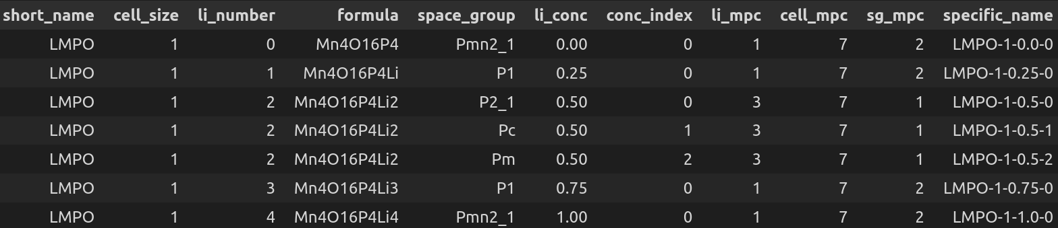
Structural overview
Example for Mn-olivine:
Julian Geiger
CHRONOS Meeting, 11/04/2023

Slide 4
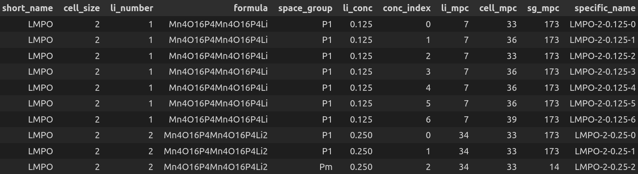
Structural overview
Example for Mn-olivine:
Julian Geiger
CHRONOS Meeting, 11/04/2023

Slide 5
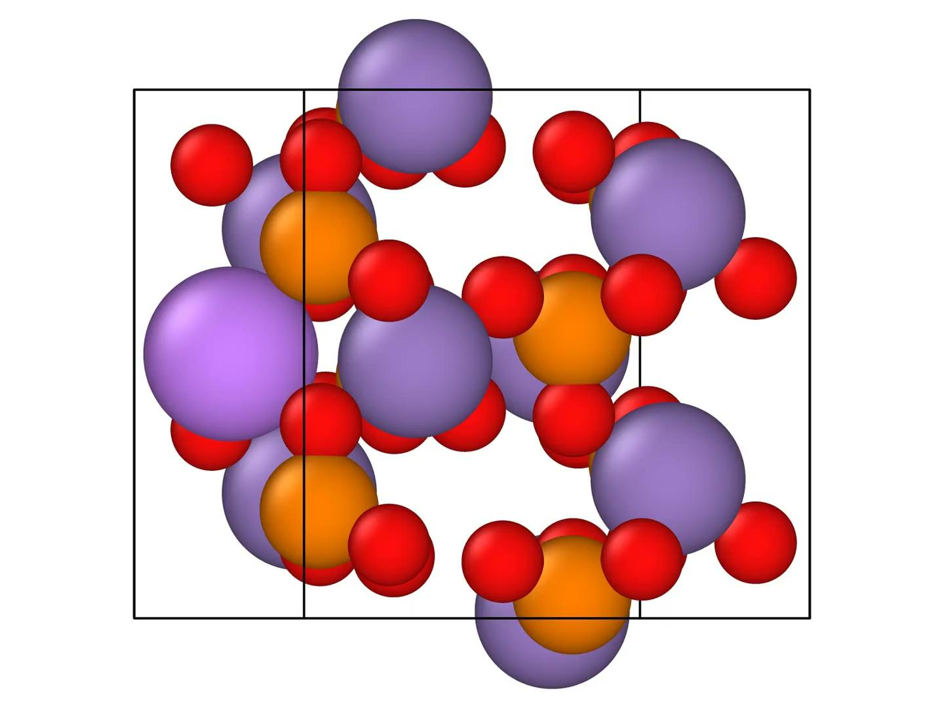
Structural overview
Example for Mn-olivine:
Julian Geiger
CHRONOS Meeting, 11/04/2023

Slide 6
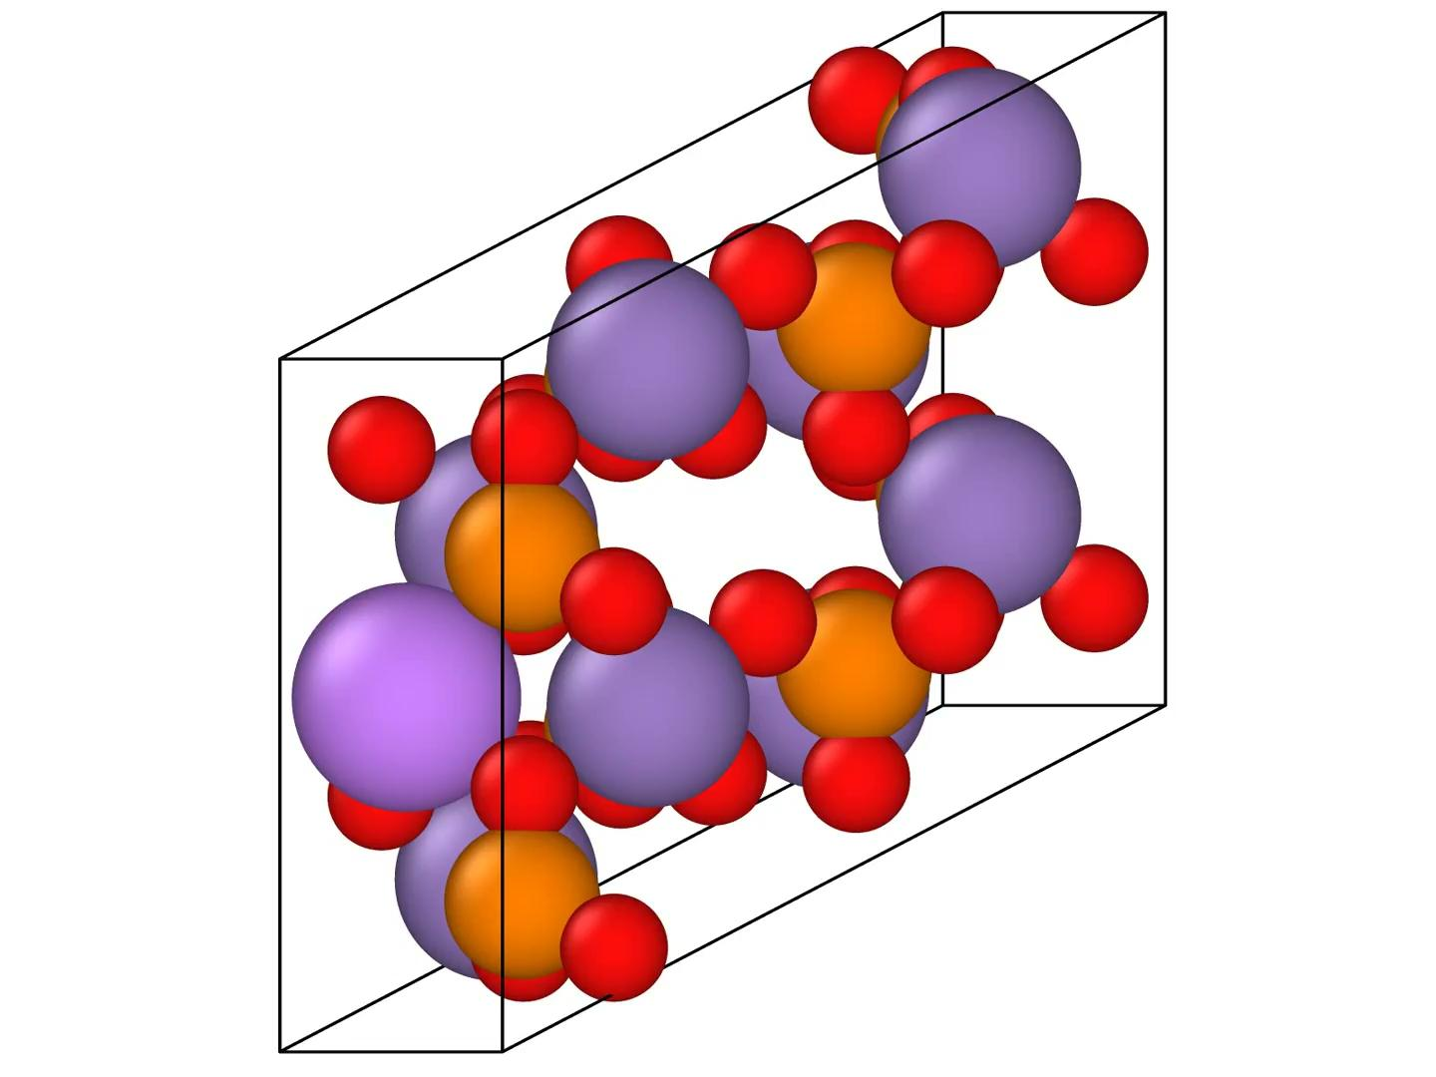
Structural overview
Example for Mn-olivine:
Julian Geiger
CHRONOS Meeting, 11/04/2023

Slide 7
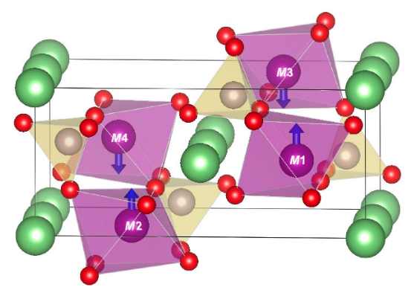
Using the workchain
Thus far
Resolved issue with atom ordering
Custom magnetic ordering (e.g. AFM)
Going forward
Full infrastructure available to create HTP data for ML
Influence of Li distribution on intercalation voltages
Influence of magnetic ordering on U+V values
Julian Geiger
CHRONOS Meeting, 11/04/2023

