Slide 1
Big Mountain Resort

Slide 2
Question
How can Big Mountain Resort increase revenue by decreasing operations costs or justifying ticket prices based on amenities and market average.
Suggestion, close less used runs.

Slide 3
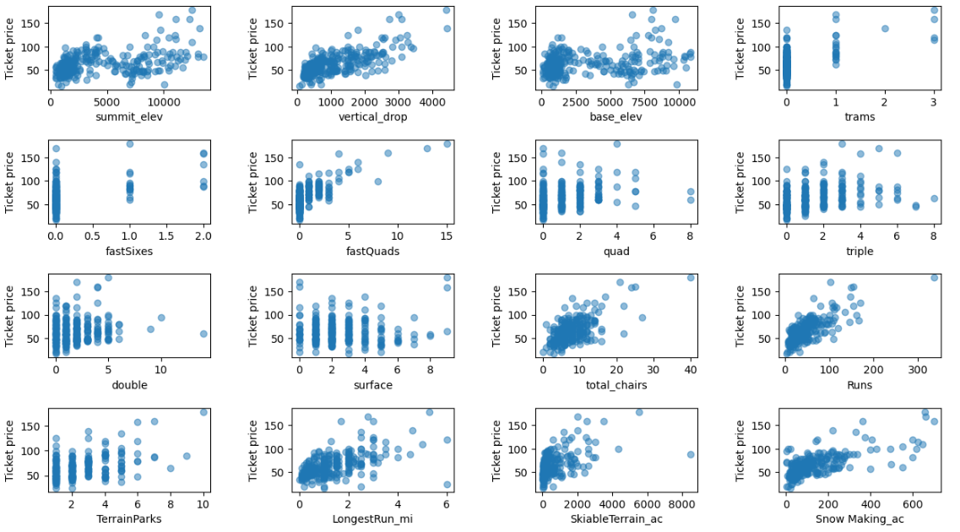
Correlations
The red boxes show what correlated the most to ticket sales:
Vertical drop
Fast Quads
Total runs/chairs
Snow making
Longest run

Slide 4
Solutions
Permanently closing down up to 10 of the least used runs. This doesn't impact any other resort statistics.
Increase the vertical drop by adding a run to a point 150 feet lower down but requiring the installation of an additional chair lift to bring skiers back up, without additional snow making coverage

Slide 5
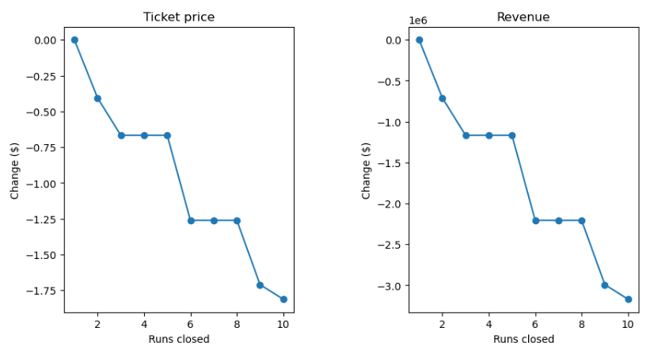
Runs closures
Closing up to 5 runs increases revenue without decreasing ticket value significantly.
Closing runs in a low risk choice because they can be reopened and there is no capital expense.

Slide 6
Increasing vertical drop by 150 ft
This scenario increases support for ticket price by
$8.61
Over the season, this could be expected to amount to $15065471

Slide 7
Conclusion
Closing runs is the easiest way to lower expenses and increase revenue.
Increasing the vertical height by 150 ft would allow an increase in ticket price of $8.61. However it would include capital expenses.
Ticket prices could also be raised by $15 without making any changes based on the model with an STD of $10.

