Slide 1
WBC Image Recognition
Data Science Capstone Project October 2025
By Jeremy Jex

Slide 2
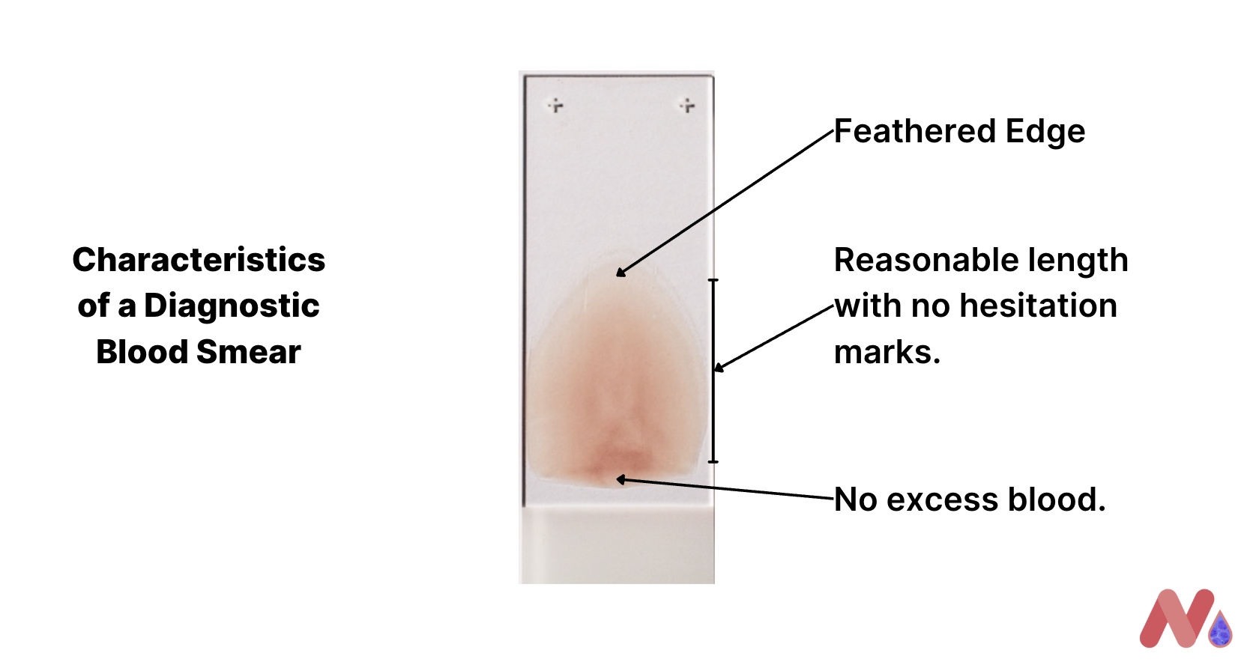
WBCs Imaging Medical Importance
In Medical laboratory science white blood cells (WBCs) are used to diagnose medical conditions.
A blood smear is prepared on a glass slide and then analyzed under a microscope.
The laboratory professional then counts at least 100 WBCs to create a percentage that is multiplied by the total number of WBCs per volume of blood.
This creates WBC absolute counts that are sent to the doctor to create a diagnosis. This process is called a manual (WBC) differential.

Slide 3
Importance of Automated WBC Image Recognition
Medical laboratories are short staffed
Automation allows lab staff to run testing simultaneously
Faster turn around times
More specimens processed with limited staff
Faster patient diagnosis times

Slide 4
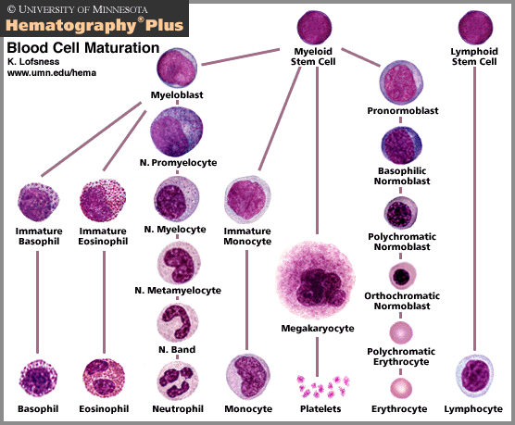
WBC Types in Data Set
This project looks at six types of WBCs:
Immature Granules- These are precursors to mature white blood cells, and their presence indicates infection or cancer.
Basophil- These are associated with allergies.
Eosinophils- These are associated with allergies.
Lymphocytes- These create a specific immune response by creating antibodies. They are also known as B cells, T cells, and Plasma cells.
Neutrophils- These respond to general bacterial infections and nonspecific immune reactions.
Monocytes- These WBCs phagocytize pathogens. They are also known as mast cells when found in tissues.

Slide 5
Data Set
Kaggle Data Set
17,092 CellaVision DM96 Images
Erythroblasts and platelet images were not included in EDA or modeling
224 x 224 color pixel images

Slide 6
Data Wrangling
Cell types were confirmed to be labeled correctly
RBG Images were resized to 100 x 100 pixels
Images were made into arrays, flattened and scaled by dividing by 255
Pandas data frames were created using scaled arrays

Slide 7
Modeling
The following models were created.
K Nearest Neighbor
Random Forest
Convolutional Neural Network (CNN)

Slide 8
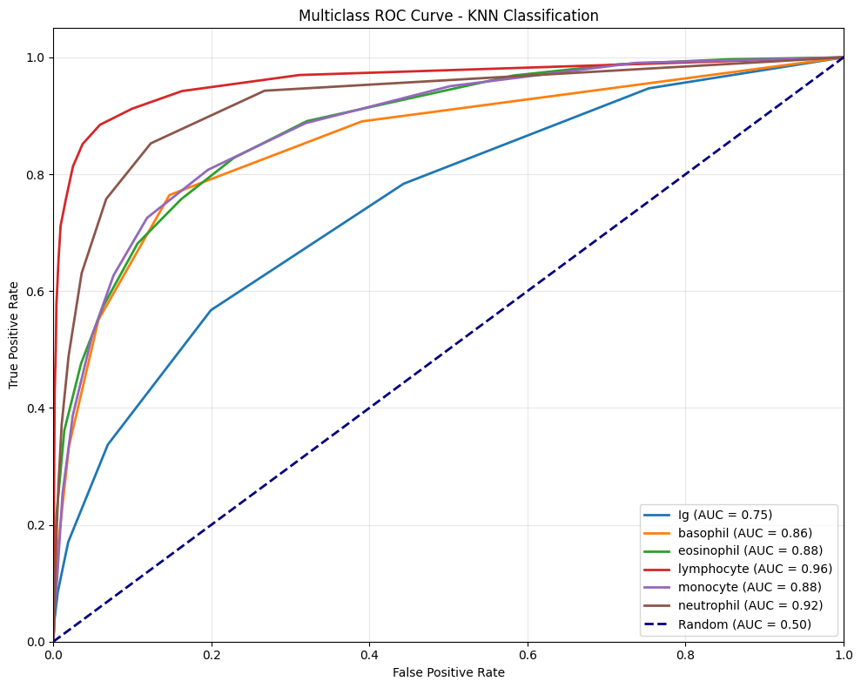
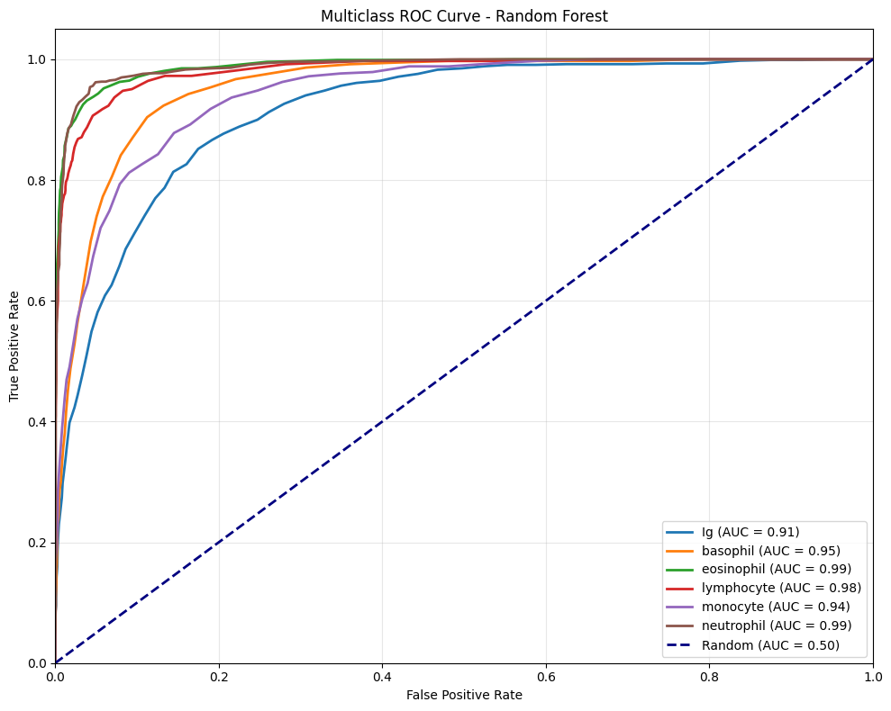
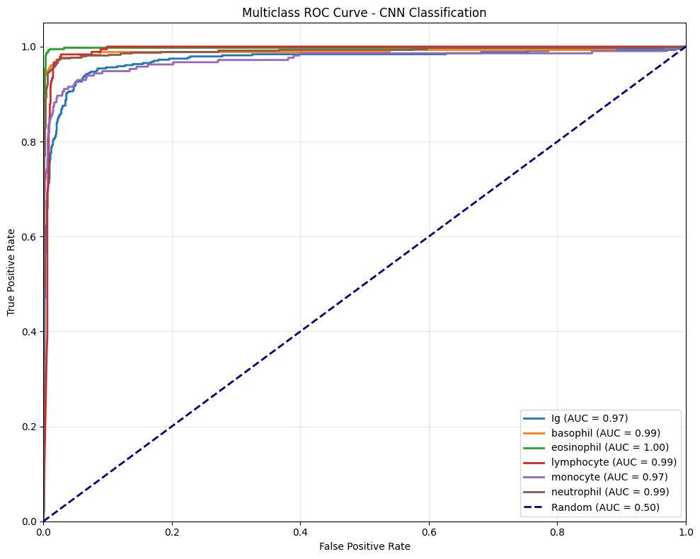
ROC AUC Curves KNN, Random Forest, and CNN
Notes:
ROC AUC curves for KNN, RF and CNN

Slide 9
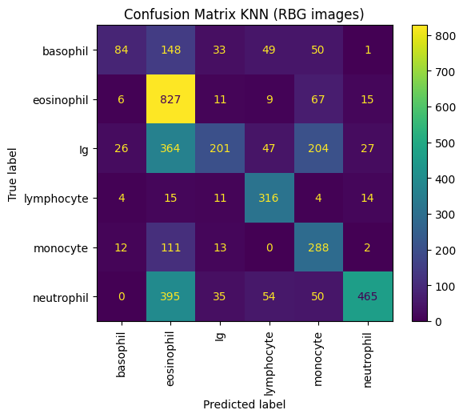
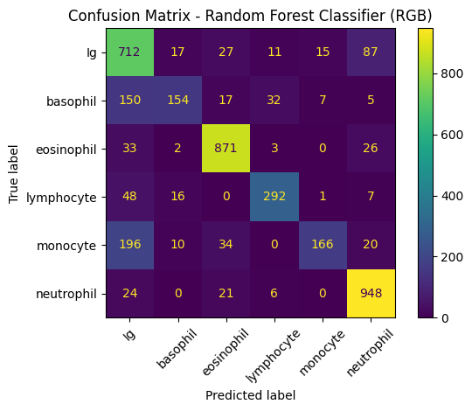
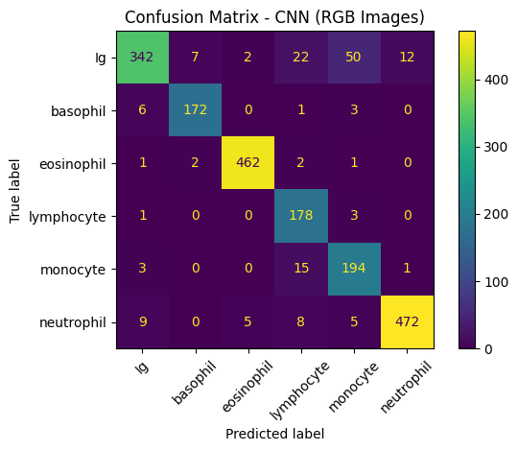
Confusion Matrix KNN, Random Forest, and CNN
Notes:
Confusion Matrix for KNN, Random Forest, and CNN

Slide 10
Model Metrics
CNN | Precision | Recall | f1-score | AUC
basophil | 0.94 | 0.79 | 0.86 | 0.97
eosinophil | 0.95 | 0.95 | 0.95 | 0.99
lymphocyte | 0.99 | 0.99 | 0.99 | 1
monocyte | 0.79 | 0.98 | 0.87 | 0.99
neutrophil | 0.76 | 0.91 | 0.83 | 0.97
accuracy | 0.97 | 0.95 | 0.96 | 0.99
macro avg |  |  | 0.92
weighted avg | 0.9 | 0.93 | 0.91
 | 0.93 | 0.92 | 0.92
RBG KNN | Precision | Recall | f1-score | AUC
Ig | 0.66 | 0.23 | 0.34 | 0.75
basophil | 0.64 | 0.23 | 0.34 | 0.86
eosinophil | 0.44 | 0.88 | 0.59 | 0.88
lymphocyte | 0.67 | 0.87 | 0.75 | 0.96
monocyte | 0.43 | 0.68 | 0.53 | 0.88
neutrophil | 0.89 | 0.47 | 0.61 | 0.92
accuracy |  |  | 0.55
macro avg | 0.62 | 0.56 | 0.53
weighted avg | 0.64 | 0.55 | 0.53
RBG Random Forest | Precision | Recall | f1-score | AUC
Ig | 0.61 | 0.82 | 0.7 | 0.91
basophil | 0.77 | 0.42 | 0.55 | 0.95
eosinophil | 0.9 | 0.93 | 0.91 | 0.99
lymphocyte | 0.85 | 0.8 | 0.82 | 0.98
monocyte | 0.88 | 0.39 | 0.54 | 0.94
neutrophil | 0.87 | 0.95 | 0.91 | 0.99
accuracy |  |  | 0.79
macro avg | 0.81 | 0.72 | 0.74
weighted avg | 0.81 | 0.79 | 0.78
Notes:
KNN preformed poorly
Random forest preformed significantly better than KNN but had low AUC scores
CNN model preforms very well
Any results under 0.9 are highlighted in red

Slide 11
Conclusion
CNN model was chosen for the final model.
It had the highest AUC for the cell types
It has the best overall metrics
Notes:
The final model created from this analysis performs very well. It has high AUC scores across the six chosen cell types, and an overall accuracy around 0.92. Looking at the confusion matrix, we can see that the most misclassified images are immature granules. This makes sense because Ig cells are precursors to the other white blood cells and resemble their mature forms. Professional instrumentation also runs into similar classification issues and flags them for manual review. Current instrumentation has trouble recognizing the difference between Igs and mature cells. It is a cause for manual differentials.

Slide 12
Further Study
Use original full-sized images
Use transformed images
Use images from other microscope types and stains
Notes:
The main suggestions for further research are to use the full-sized images (224 x 224) instead of scaling them down. Due to memory constraints this was not an option when performing data analysis. Using full size images may remove the discrepancies between Ig cells and other types. Also transforming the images in various ways to create a more robust data set could improve modeling.
Image sources could influence modeling too. Using images sourced from the same microscope camera, slides, and stain decrease sample variation. If this model was to be used for diagnosis it would have to specify the microscope, stain and slide types it is compatible with. The model could be more marketable if it can show accurate results when testing cellular data from other microscope types, not just the CellaVision.

