Slide 1
Deep Learning

Slide 2
A Little Bit About Deep Learning History

Slide 3
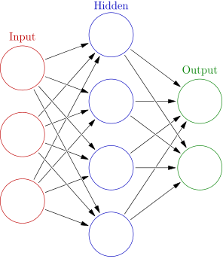

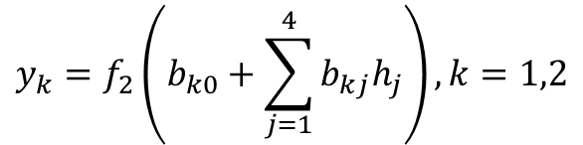


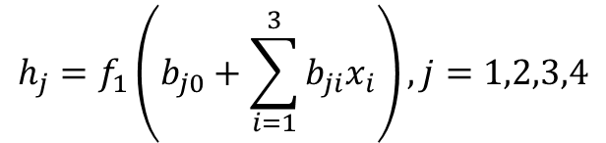











Simple Feed Forward Neural Network (FFNN)
Concepts stated as early as 1940s!
$$h_{1}$$
$$h_{j}=f_{1}\left(b_{j0}+\sum_{i=1}^{3}{b_{ji}x_{i}}\right), j=1,2,3,4$$
$$x_{1}$$
$$h_{2}$$
$$y_{1}$$
$$x_{2}$$
$$y_{k}=f_{2}\left(b_{k0}+\sum_{j=1}^{4}{b_{kj}h_{j}}\right), k=1,2$$
$$h_{3}$$
$$y_{2}$$
$$x_{3}$$
$$h_{4}$$
$$y=f_{1}\left(f_{2}\left(x,b\right),b\right)$$
$$\left[x_{1},x_{2},x_{3}\right]:$$
Input features vector for one observation
$$\left[y,y_{2} \right]:$$
Actual output outcome for one observation
$$f_{1}\left(∙\right),f_{2}\left(∙\right):$$
Activation functions, usually non-linear
$$L\left(b,y,\hat{y} \right):$$
Loss function where $\hat{y}$ the model forecast response
Total number of parameters (i.e. size of a NN): (3+1)*4 + (4+1)*2 = 26

Slide 4
From Slow Progress to Wide Adoption
1940s – 1980s, very slow progress due to:
Computation hardware capacity limitation
Number of observations with labeled results in the dataset
Lack efficient algorithm to estimate the parameters in the model
1980s – 2010, a few applications in real word due to:
Moore’s Law + GPU
Internet generated large labeled dataset
Efficient algorithm for optimization and better activation functions
2010-Now, very broad application in various areas:
Near-human-level image classification
Near-human-level handwriting transcription
Much improved speech recognition
Much improved machine translation
Now we know working neural network models usually contains many layers (i.e. the depth of the network is deep), and to achieve near-human-level accuracy the deep neural network need huge training dataset (for example millions of labeled pictures for image classification problem).

Slide 5
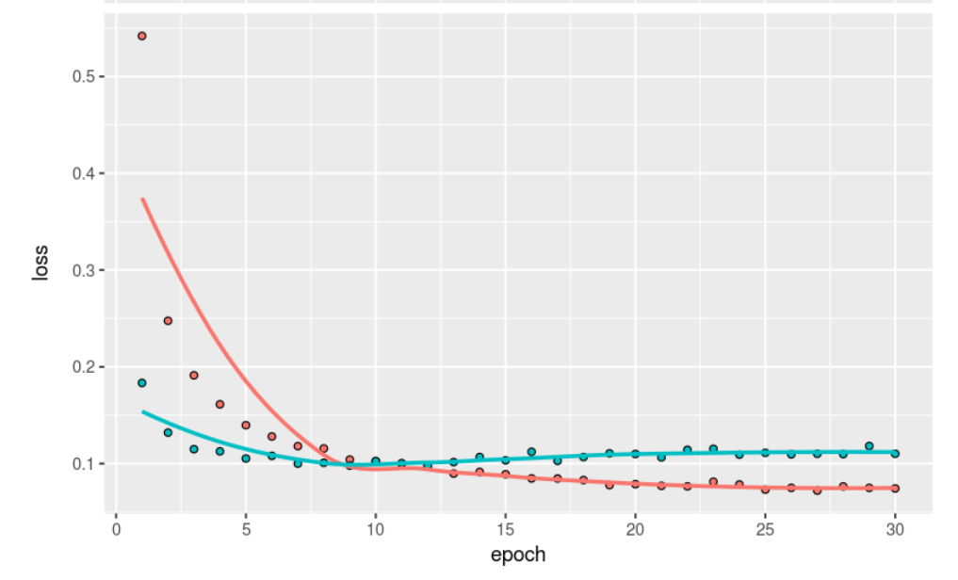
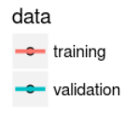
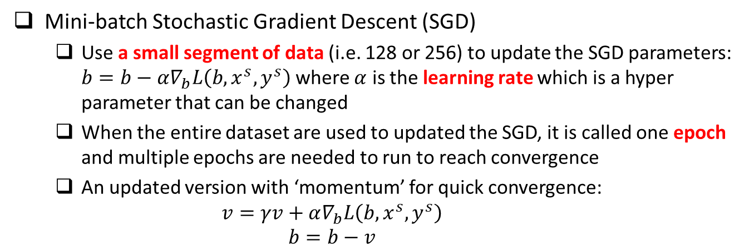
Optimization Methods
Mini-batch Stochastic Gradient Descent (SGD)
Use a small segment of data (i.e. 128 or 256) to update the SGD parameters: $b=b−α∇_{b}L\left(b,x^{s},y^{s}\right)$ where $α$ is the learning rate which is a hyper parameter that can be changed
When the entire dataset are used to updated the SGD, it is called one epoch and multiple epochs are needed to run to reach convergence
An updated version with ‘momentum’ for quick convergence:
$$v=γv+α∇_{b}L\left(b,x^{s},y^{s}\right)$$
$$b=b−v$$

Slide 6


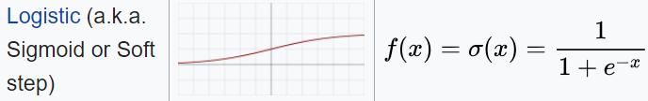
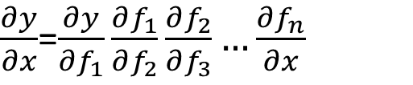

Activation Functions
$\frac{∂y}{∂x}$=$\frac{∂y}{∂f_{1}}\frac{∂f_{1}}{∂f_{2}}\frac{∂f_{2}}{∂f_{3}}…\frac{∂f_{n}}{∂x}$
$$y=f_{1}\left(f_{2}\left(f_{3}\left(…f_{n}\left(x,b\right),b\right),b\right),b\right)$$
Intermediate layers
Relu (i.e. rectified linear unit) is usually a good choice which has the following good properties: (1) fast computation; (2) non-linear; (3) reduced likelihood of the gradient to vanish; (4) Unconstrained response
Sigmoid, studied in the past, not as good as Relu in deep learning
Last layer which connects to the output
Binary classification: sigmoid with binary cross entropy as loss function
Multiple class, single-label classification: Softmax with categorical cross entropy for loss function

Slide 7
Deal With Overfitting
Huge number of parameters, even with large amount of training data, there is a potential of overfitting
Overfitting due to size of the NN (i.e. total number of parameters)
Overfitting due to using the training data for too many epochs
Solution for overfitting due to NN size
Dropout: randomly dropout some proportion (such as 0.3 or 0.5) of nodes at each layer, which is similar to random forest concept
Using L1 or L2 regularization in the activation function at each layer
Solution for overfitting due to using too many epochs
Run NN with large number of epochs to reach overfitting region through cross validation from training/validation vs. epoch curve
Choose the model with number of epochs that have the minimum validation accuracy as the final NN model

Slide 8
Recap of A Few Key Concepts
Data: Require large well labeled dataset
Computation: intensive matrix-matrix operation
Structure of fully connected feedforward NN
Size of the NN: total number of parameters
Depth: total number of layers (this is where deep learning comes from)
Width of a particular layer: number of nodes (i.e. neurons) in that layer
Activation function
Intermediate layers
Last layer connecting to outputs
Loss function
Classification (i.e. categorical response)
Regression (i.e. continuous response)
Optimization methods (SGD)
Batch size
Learning rate
Epoch
Deal with overfitting
Dropout
Regularization (L1 or L2)

Slide 9
Deep Learning Models Across Platforms

Slide 10
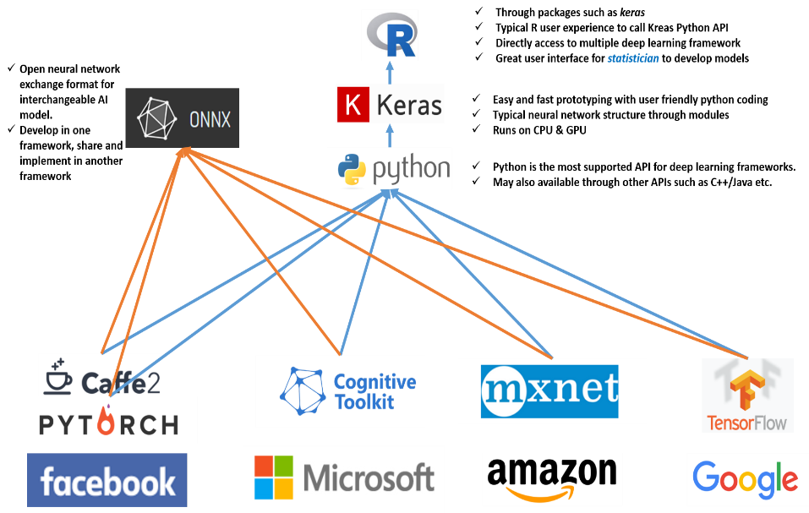
Open NN Exchange Format (ONNX)

Slide 11
The MNIST Dataset

Slide 12
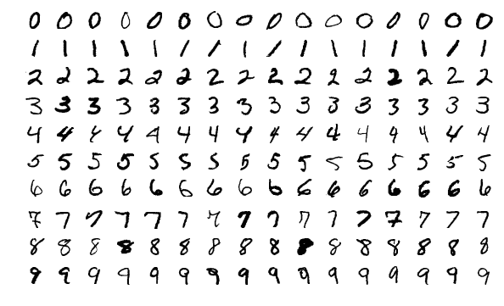
MNIST Dataset
Originally created by NIST, then modified for machine leaning training purpose
Contains 70000 handwritten digit images and the label of the digit in the image where 60000 images are the training dataset and the rest 10000 images are the testing dataset.
Census Bureau employees and American high school students wrote these digits
Each image is 28x28 pixel in greyscale
Yann LeCun used convolutional network LeNet to achieve < 1% error rate at 1990s

Slide 13
Using Keras R Package To Build Deep Neural Network Model

Slide 14
Procedures
Data preprocessing (from image to list of input features)
One image of 28x28 grey scale value matrix → 784 column of features
Scale the value to between 0 and 1, by divide each value by 255
Make response categorical (i.e. 10 columns with the corresponding digit column 1 and rest columns zero.
Load keras package and build a neural network with a few layers
Define a placeholder object for the NN structure
1st layer using 256 nodes, fully connected, using ‘relu’ activation function and connect from the input 784 features
2nd layer using 128 nodes, fully connected, using ‘relu’ activation function
3rd layer using 64 nodes, fully connected, using ‘relu’ activation function
4th layer using 10 nodes, fully connected, using ‘softmax’ activation function and connect to the output 10 columns
Add drop out to the first three layers to prevent overfitting
Compile the NN model, define loss function, optimizer, and metrics to follow
Fit the NN model using the training dataset, define epoch, mini batch size, and validation size used in the training where the metrics will be checked
Predict using the fitted NN model using the testing dataset

Slide 15
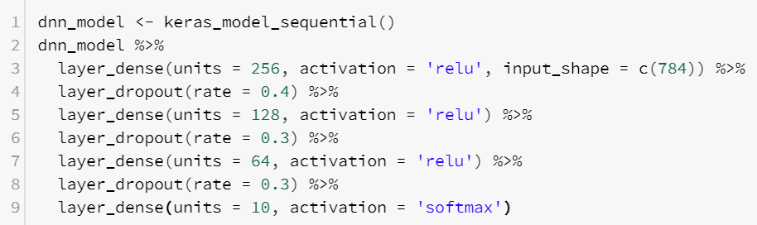
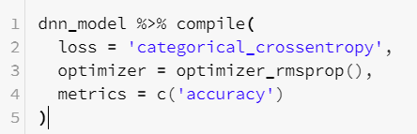
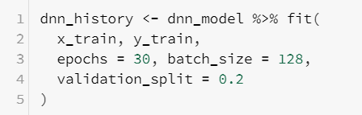

R Scripts
Define NN Structure
Compile and define loss function, optimizer and metrics to monitor during the training
Fit the model using training dataset and define epochs, batch size and validation data
Predict new outcomes using the trained model

Slide 16
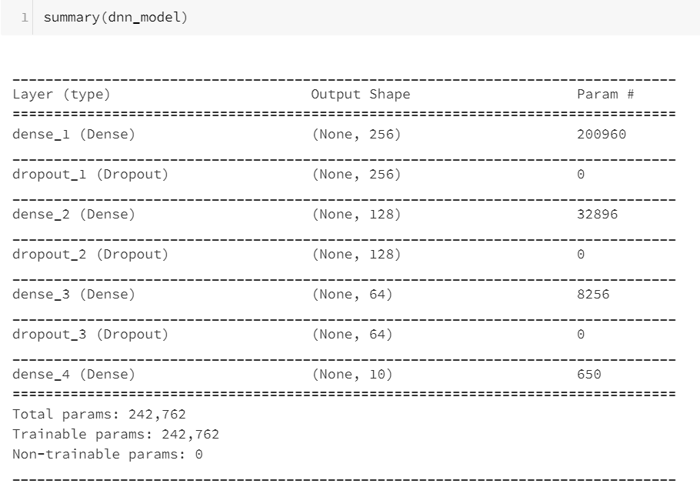
Size of the Model

Slide 17
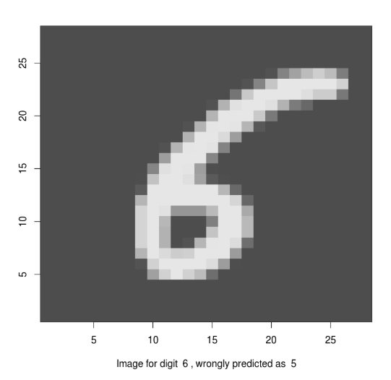
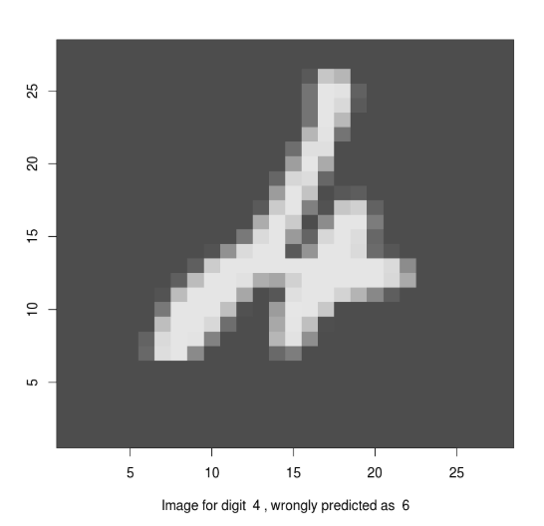
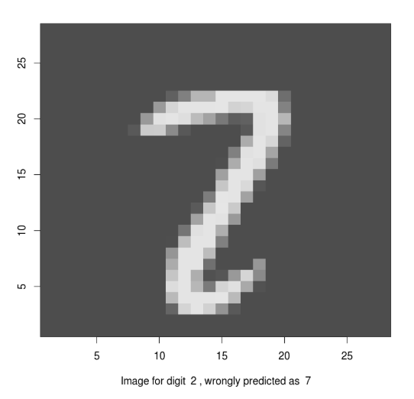
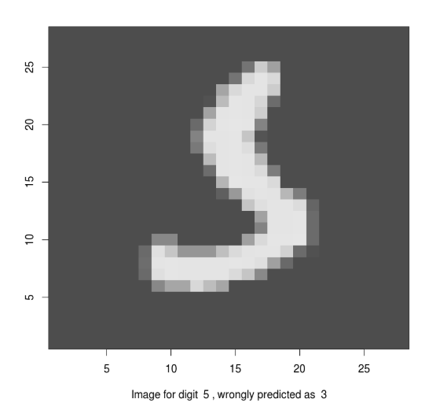
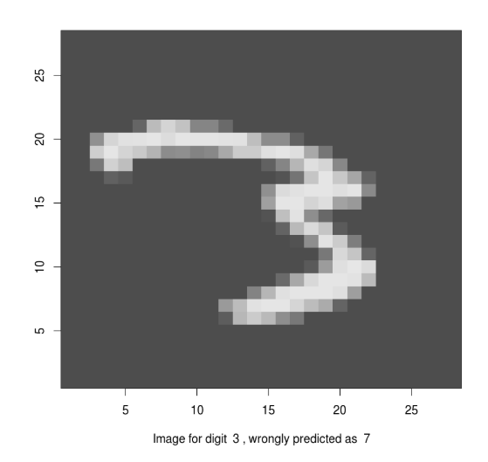
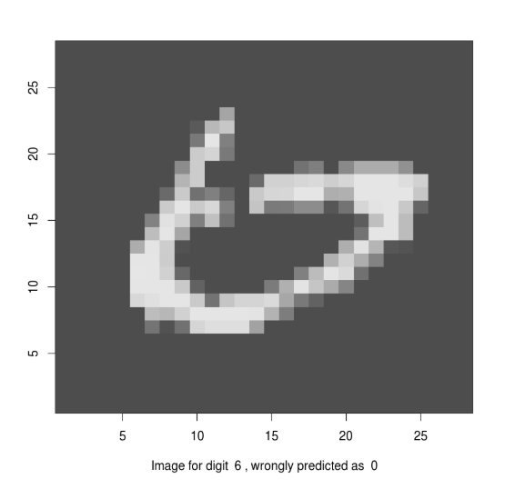
Performance
Accuracy: 97.99% without much fine tuning
A few misclassified images:

Slide 18
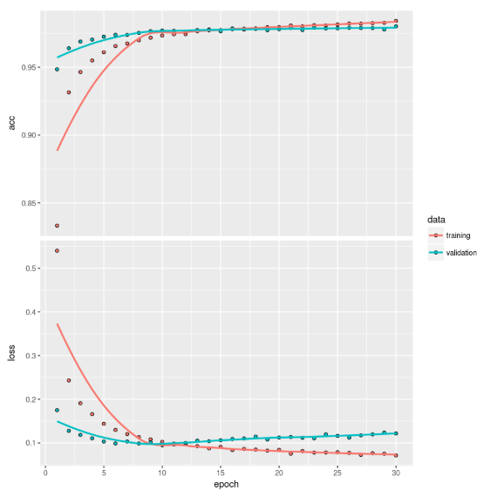
Cross-Validation Curve

Slide 19
Using Keras R Package To Build Convolutional Neural Network Model

Slide 20
Introduction
If we use FFNN for image analysis
Input pixels dimension can be large such as 1920x1080
Usually multiple channels such as RGB format has three channels or red, green, blue
Number of input features using FFNN will be 1920x1080x3 = 6.2M
Become infeasible to fit multiple-layer FFNN even with super computers
FFNN will remove any location dependencies among pixels
In images we know
Localized features are important (such as edge, cat’s eye, dog’s ear etc)

Slide 21
Procedures

Slide 22
R Scripts

Slide 23
Size of the Model

Slide 24
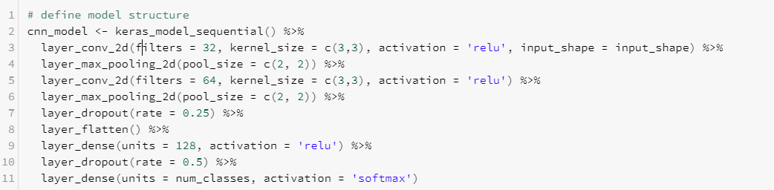
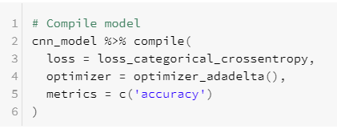
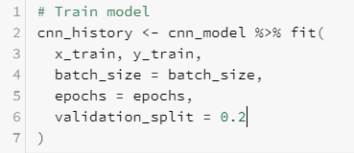

R Scripts

Slide 25
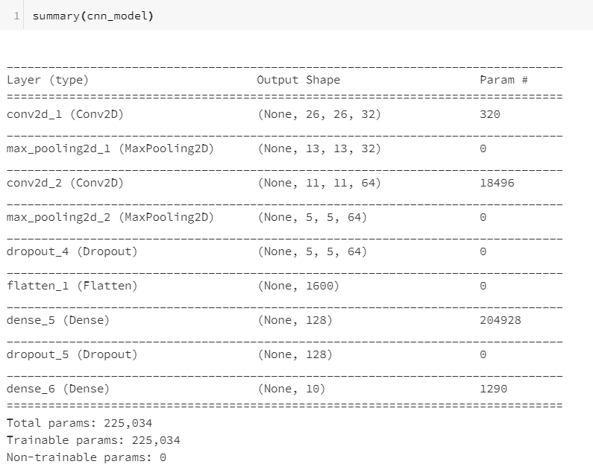
Size of the Model

Slide 26
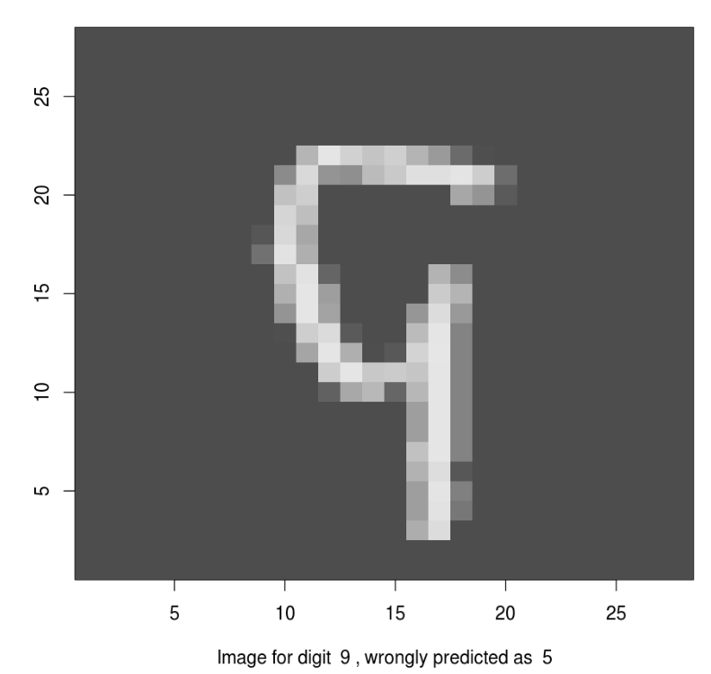
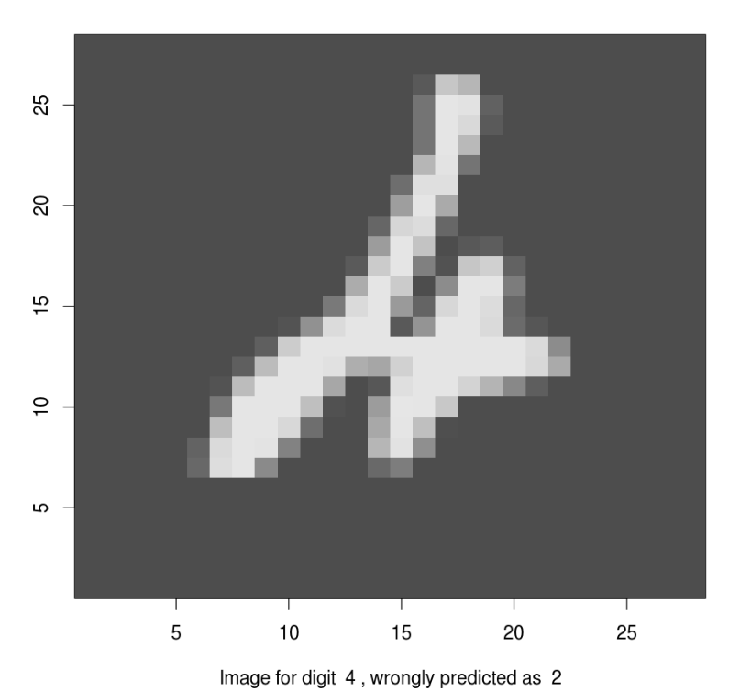
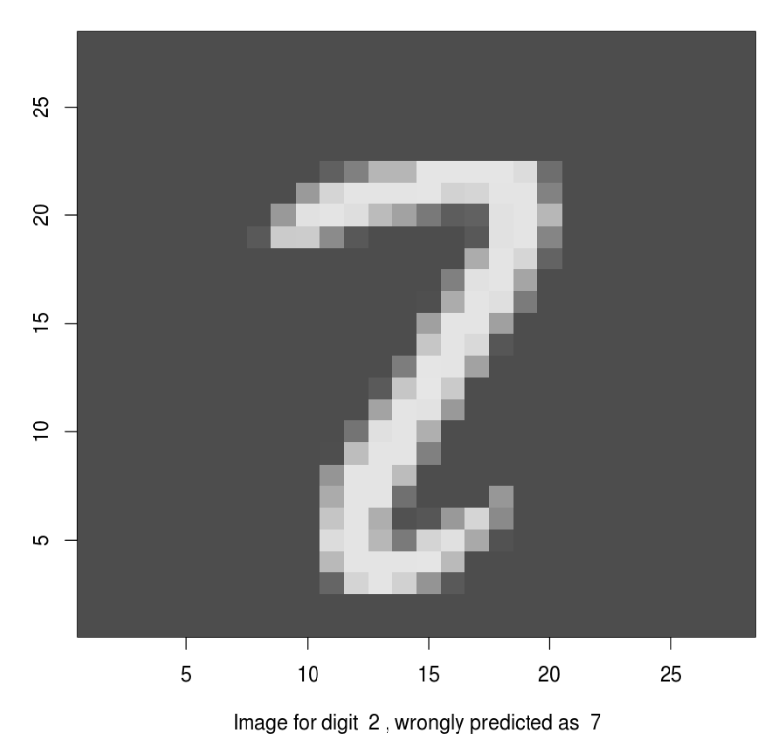
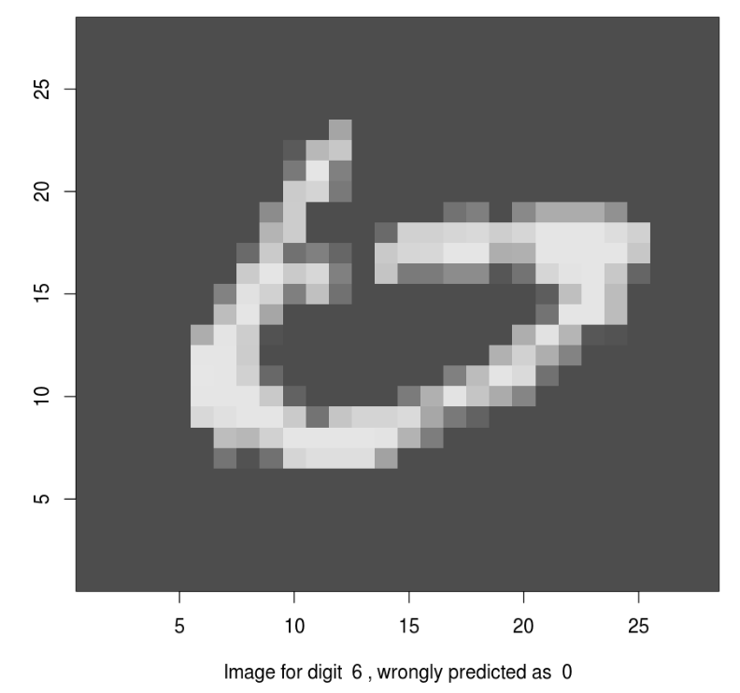
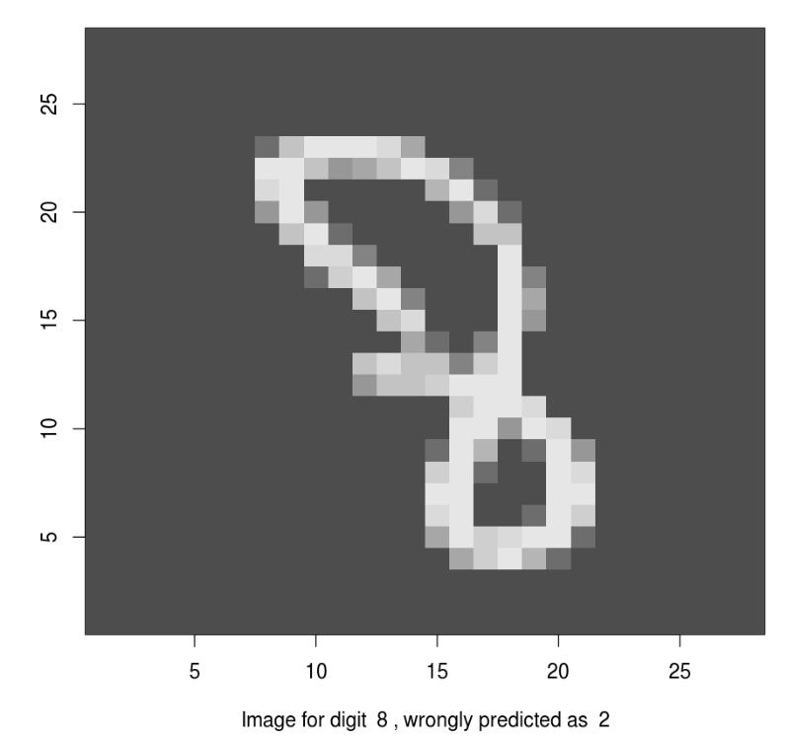
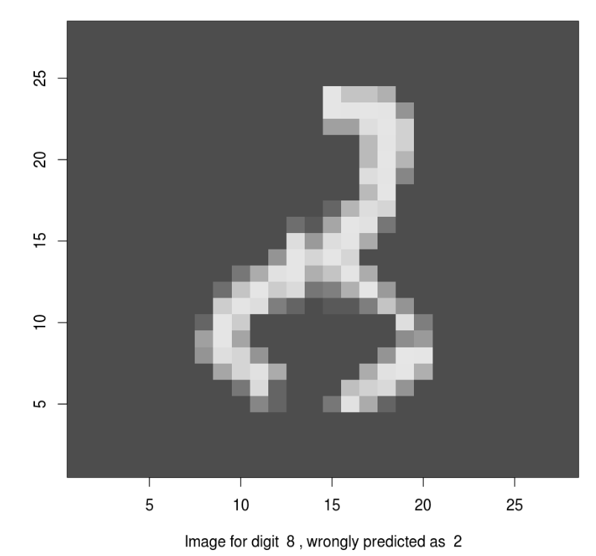
Performance
Accuracy: 99.31% without much fine tuning
A few misclassified images:

Slide 27
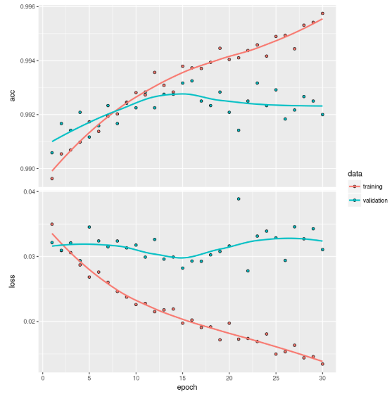
Cross-Validation Curve

Slide 28
Now Let’s Do It In The Cloud!
Databrick free community edition account open: https://accounts.cloud.databricks.com/registration.html#signup/community
Notebook contains all the material for this section:
https://databricks-prod-cloudfront.cloud.databricks.com/public/4027ec902e239c93eaaa8714f173bcfc/2961012104553482/1430974153588517/1806228006848429/latest.html

