Slide 1
Big Data Cloud Platform

Slide 2
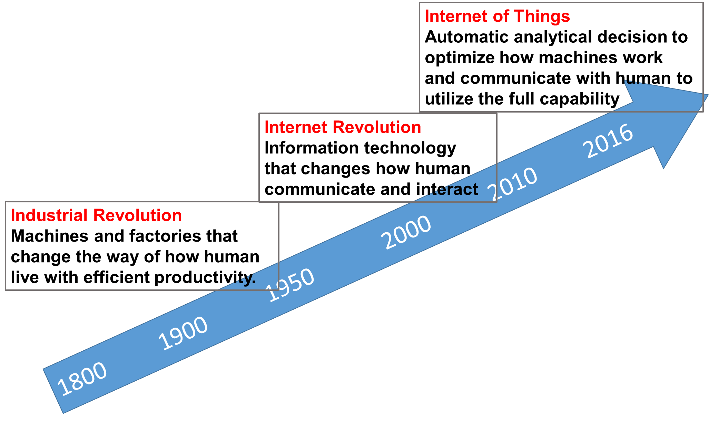
New Wave of Industrial Revolution
PB
TB
KB

Slide 3
History of Statistician in the America
Data in the cloud
Data in one computer’s disk
or memory
Data in
tapes or punch cards
American Statistical Association
1839
First Statistical Laboratory in US Universities
1934
Data Science Revolution
2001
Now
2017
Data in
pieces of
paper
Easy access to data
become universal in all areas
Iowa State University
with study of Agriculture
2nd oldest continuously operating professional society in the US

Slide 4
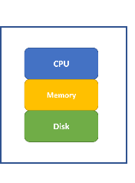
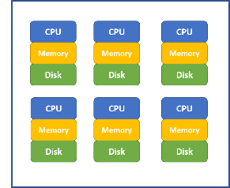
Big Data Cloud Framework
Cluster of Computers
(Cloud)
Single Computer
(Local)
Shared disk
Shared memory
Parallel computation
Data redundancy
Low coast hardware
Professionally managed
Scalability to process large dataset
Centralized data source for easy retrieval
Robust and reliable for data safety
Worry-free behind sense maintenance
Production ready for easy implementation
Automatic refresh and scheduled update

Slide 5
Hadoop / MapReduce / Spark
Hadoop build on Commodity Hardware
Low cost and scalable by simply added more hardware
Low reliability (such as regular hard disk failures) for each individual computation node
Need robust file system to ensure data safety and integrity
HDFS (Hadoop Distributed File System)
Cut data into small segments (i.e. 64MB) as blocks
Duplicate each data block N times (i.e. N=3) and save them across computation nodes in the cluster
Master node saves all the data mapping information (i.e. meta data)
Data nodes save actual data blocks
When a few data nodes are down, data is still safe
MapReduce Operation (Demo)
Hive and Pig: application software for easy access the data stored in HDFS and apply analytics
Spark
Build on top of HDFS and other cluster file systems
Provide in-memory computation for faster speed
Provide parallel algorithm for many machine learning methods through MLib
Provide easy to use interface for data scientist
Users do not need to know the details of how data and algorithm are paralleled

Slide 6
Cloud Environments Providers
Amazon AWS cloud environment
Microsoft Azure cloud environment
Google cloud platform
Databricks Community Edition
For beginners, Databricks provides an easy to use cloud system for learning purpose
It provides a user-friendly web-based notebook environment that can create Hadoop/Spark/GPU cluster on the fly to run R/Python/Scala/SQL
Some reference:
https://docs.databricks.com/user-guide/faq/sparklyr.html
http://spark.rstudio.com/index.html

Slide 7
Databricks Big Data Platform
Two short videos for how to create a free account and use Databricks community edition which can run R / Python / SQL / Scala:
https://youtu.be/vx-3-htFvrg
https://youtu.be/0HFujX3t6TU
Databrick free community edition account open: https://accounts.cloud.databricks.com/registration.html#signup/community
Notebook that contains all the steps in this section can be imported from:
https://databricks-prod-cloudfront.cloud.databricks.com/public/4027ec902e239c93eaaa8714f173bcfc/2961012104553482/3725396058299890/1806228006848429/latest.html

Slide 8
Library Installation
First, we need to install sparklyr package which enables the connection between master or local node to Spark cluster environments.
As it will install more than 10 dependencies, it may take more than 5 minutes to finish. Be patient while it is installing!
Once the installation finishes, load the sparklyr package as illustrated by the following code:
if (!require("sparklyr")) { install.packages("sparklyr") }
library(sparklyr)

Slide 9
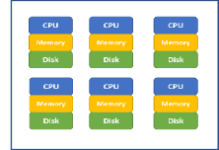

Create Connection
we need to create a Spark Connection to link the local node running the R notebook to the Spark environment. The options for different environments are different, here we set “method” option to “databricks”:
The created Spark Connection (i.e. sc) will be the pipe that connects R notebook to the Spark Cluster.
sc <- spark_connect(method = "databricks")
Spark Cluster
R Notebook
Spark Connection
sc

Slide 10
Establish Connection to Spark DataFrame
For illustration purpose, we will use the iris dataset which is part of the dplyr package:
library(dplyr) head(iris)
Copy local R data frame: iris to Spark DataFrame iris and we can refer Spark DataFrame iris through iris_tbl:
iris_tbl <- sdf_copy_to(sc = sc, x = iris, overwrite = T)
Spark Cluster
R Notebook
Spark Connection
sc
iris_tbl
iris
We can also establish connection between local R object my_df_tbl to existing Spark DataFrame my_df: my_df_tbl <- tbl(sc, my_df)

Slide 11
Manipulate Spark DataFrame Through R
Once connection is established, we can always refer iris_tbl in R notebook to operate on Spark DataFrame iris using the scalable computation power of Spark cluster
iris_tbl %>% mutate(Sepal_Width = ROUND(Sepal_Width * 2) / 2) %>% group_by(Species, Sepal_Width) %>% summarize(count = n(), Sepal_Length = mean(Sepal_Length),
stdev = sd(Sepal_Length))
With the sparklyr packages, we can use many functions in dplyr to Spark DataFrame directly to iris_tbl, same as we are applying dplyr functions to a local R data frame.
The advantage is more significant when the Spark DataFrame is huge (such as the data take 20GB+ of memory to store)

Slide 12
Collect Result Back to R Notebook
Even though we can run many of the dplyr functions on Spark DataFrame, we cannot apply functions from other packages to Spark DataFrame direction (such as ggplot()).
To use functions from other packages, we need to bring data (usually aggregated and much smaller in size) back to R Notebook using collect() function.
Once the data is brought back to R Notebook, we can use any library. With code below, iris_summary is a local R object
iris_summary <- iris_tbl %>% mutate(Sepal_Width = ROUND(Sepal_Width * 2) / 2) %>% group_by(Species, Sepal_Width) %>% summarize(count = n(), Sepal_Length = mean(Sepal_Length),
stdev = sd(Sepal_Length)) %>% collect

Slide 13
Apply Statistical and Machine Learning Models to Spark DataFrame Through R
One of the BIGGEST advantage is that there are many popular statistical and machine learning models developed in Spark system (i.e. MLlib) for Spark DataFrame to leverage the scalable computation power of Spark Cluster.
These models include: linear regression, logistic regression, Survival Regression, Generalized Linear Regression, Decision Trees, Random Forests, Gradient-Boosted Trees, Principal Components Analysis, Naive-Bayes, K-Means Clustering.
Conveniently, we can use R notebook to call functions to apply these machine learning algorithms to Spark DataFrame which enable minimum effort for statistician to leverage the Spark environment.

Slide 14
Fit Regression to Spark DataFrame
We can call ml_linear_regression to fit a linear regression model to Spark DataFrame iris by referring to iris_tbl
The response variable is "Sepal_Length“
The explanatory variables are "Sepal_Width", "Petal_Length", "Petal_Width"
The fitted results are stored in fit1
fit1 <- ml_linear_regression(x = iris_tbl, response = "Sepal_Length", features = c("Sepal_Width", "Petal_Length", "Petal_Width"))
summary(fit1)

Slide 15
Fit K-means Cluster to Spark DataFrame
We can call ml_kmeans() to fit a k-mean clustermodel to Spark DataFrame iris by referring to iris_tbl
The variables are "Petal_Length", "Petal_Width"
The fitted results are stored in fit2
We can then apply the model to a specific dataset (in this case the original dataset) using sdf_predict() function
Finally we can use collect() function to bring results back to R Notebook for further analysis
fit2 <- ml_kmeans(x = iris_tbl, centers = 3, features = c("Petal_Length", "Petal_Width"))
print(fit2)
prediction = collect(sdf_predict(fit2, iris_tbl))

Slide 16
Quick Summary
In the above a few sub-sections, we illustrated:
The relationship between local node (i.e. where R notebook is running) and Spark Clusters (i..e where massive data are stored and computation are done in parallel)
Sparklyr library to established the connection between local node and Spark Cluster
How to copy a local data frame to a Spark DataFrames (please note if your data is already in Spark environment, there is no need to copy).
Establish connection between local R object my_df_tbl to existing Spark DataFrame my_df: my_df_tbl <- tbl(sc, my_df)
How to manipulate Spark DataFrames for data cleaning and preprocessing through dplyr functions
How to fit statistical and machine learning models using R notebook to Spark DataFrame in a truly parallel manner
How to collect information from Spark DataFrames back to a local R object (i.e. local R data frame) for future analysis
List of functions in Sparklyr: http://spark.rstudio.com/reference/index.html

