Slide 1

Final year Project Presentation on Eco-Fertilization
Presented by :
Gaurav Sharma (1AT18CS128)
Ishita Katiyar (1AT18CS044)
Arpit Chakraborty (1AT18CS020)
Sumukha Hegde (1AT18CS129)
Under the Guidance
Dr. Manash Sarkar
Associate Professor

Slide 2
Content
Abstract
Introduction/motivation
Literature review (+10)
Objective
Proposed Methodology (algo)
Block Diagram of the model (*)
Proposed algorithms (*)
Data Description (*)
Implementation

Slide 3
Abstract
Agriculture plays an important role in national economic growth. Agriculture contributes 17-18% to India's GDP and ranks second worldwide in farm outputs. Plants requires fertilizers and fertilizers replace the nutrients that crops remove from the soil. Without the addition of fertilizers, crop yields and agricultural productivity would be significantly reduced. That's why mineral fertilizers are used to supplement the soil's nutrient stocks with minerals that can be quickly absorbed and used by crops. The farmers usually have little control over the usage of fertilizers. There is need for proper guidance for optimal usage of these fertilizers and is required by farmers in order to get more yields and prevent wastage.
There is a relationship between rainfall intensity and nutrient loss for different fertilizer treatments following each rainfall event. Timely and moderate rainfall can be beneficial to dissolve dry fertilizer and move nutrients into the soil rooting zone, but excessive rain can increase runoff potential and leaching potential of nutrients such as nitrate, sulfate, chloride, and boron.
The prime objective of “Eco-Fertilization” is to provide useful insight for fertilizer usage by considering short- and long-term weather forecast and reduce environmental pollution by deaccelerating the process of leaching. The application takes multiple input from the user such as crop, location etc. and apply machine learning algorithms to predict the amount and usage of fertilizers.
The Implement Phase is most important phase of the project cycle. It commences after the completion of preparation and planning phase. It is a phase where the execution of the project is carried out. In this project, the tools and technologies required for execution are Python, Matplotlib, Random Forest algorithm and Neural Networks.

Slide 4
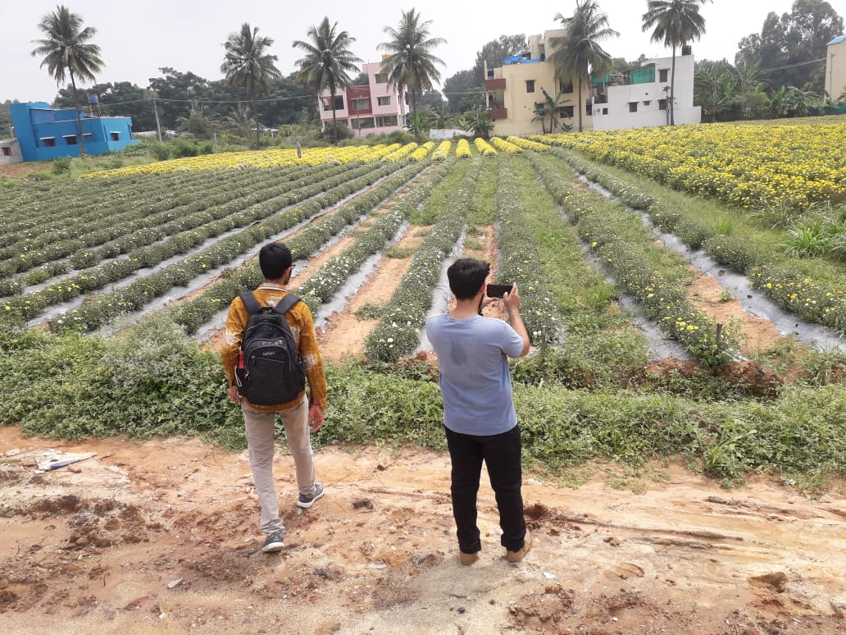
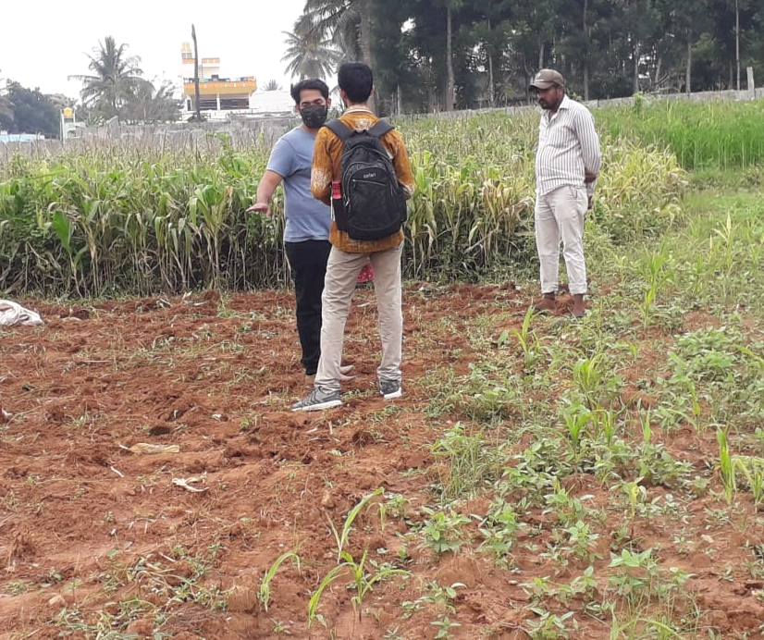
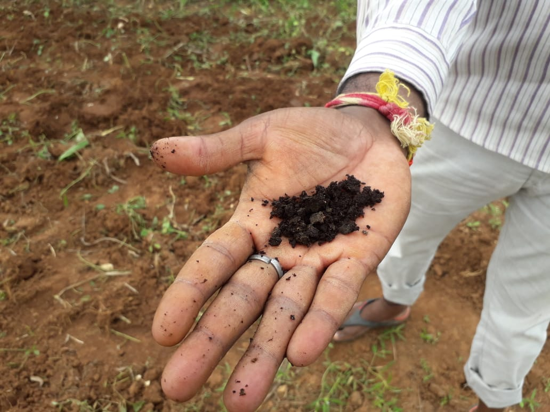

Introduction / Motivation
1
Unbalanced progress in rural and urban areas.
2
Analysis of farmers' problems at the ground level.
3
The problem statements are analyzed and determined based on what is in our study area.

Slide 5
Literature Review
Sl. No. | Year | Title | Author’s Name | Journal | Description
1. | 2018 | Prediction of Crop Fertilizer Consumption | Krutika Hampannavar, Vijay Bhajantri Shashikumar G. Totad | IEEE, DOI:10.1109/ICCUBEA.2018.8697827 | Prediction of fertilizer consumption can prevent the toxicity and deficiency in plants to certain extent and this can help farmers to get proper yield without much wastage.
2. | 2018 | Phosphorus losses via surface runoff in rice-wheat cropping systems as impacted by rainfall regimes and fertilizer applications | LIU Jian, ZUO Qiang ZHAI Li-mei,LUO Chun-yan LIU Hong-bin, WANG Hong-yuan ZOU Guo-yuan,REN Tian-zhi | Integrative Agriculture, ISSN: 2095-3119 (Elsevier) | Phosphorus losses from rice-wheat cropping systems can be affected by rainfall regimes, P application rates and soil P content, as well as field management practices such as construction of field bund and open ditches.
3. | 2018 | Data Mining Techniques for Crop Yield Prediction | Shital Bhojani Nirav Bhatt | Computers and Electronics in Agriculture, ISSN: 0168-1699 (Elsevier) | It's a difﬁcult task to predict crop yield due to stochastic rain fall pattern and also variation in temperature. So we can apply different data mining techniques for crop yield predication and can produce an efﬁcient algorithm for crop classiﬁcation for better.

Slide 6
Literature Review
Sl. No. | Year | Title | Author’s Name | Journal | Description
4. | 2019 | Estimation of NPK requirements for rice production in diverse Chinese environments under optimal fertilization rates | Yulong Yin, Hao Ying Huifang Zheng ,Qingsong Zhang ,Yanfang Xue, Zhenling Cui | Agricultural and Forest Meteorology, ISSN : 0168-1923 (Elsevier) | Objectives of this study were to evaluate the relationship between nutrient requirements and climates or soil chemical properties.
5. | 2020 | Rainfall intensification increases nitrate leaching from tilled but not no-till cropping systems in the U.S. Midwest | Laura J.T. Hess Eve-Lyn S. Hinckley G. Philip Robertson Pamela A. Matson | Agriculture, Ecosystems & Environment, ISSN : 0167-8809 (Elsevier) | Rainfall intensification may exacerbate leaching losses of reactive N from cropping systems, and that no-till management may buffer against these losses.
6. | 2020 | Crop Yield Prediction Based on Indian Agriculture using Machine Learning | Potnuru Sai Nishant Pinapa Sai Venkat Bollu Lakshmi Avinash B. Jabber | IEEE : DOI: 10.1109/INCET49848.2020.9154036 | This paper predicts the yield of almost all kinds of crops in India. This script makes novel by usage of simple parameters like state, district, season, area and the user can predict the yield of the crop in which year he or she wants to.

Slide 7
Literature Review
Sl. No. | Year | Title | Author’s Name | Journal | Description
7. | 2020 | Cropping systems in agriculture and their impact on soil health | TonyYang, Kadambot H.M. Siddique, Kui Liu | Global Ecology and Conservation, ISSN: 2351-9894 (Elsevier) | Significant achievements, including refine content of soil health and the development of new evaluation standards for ‘soil health and quality’.
8. | 2020 | Would fertilization history render the soil microbial communities and their activities more resistant to rainfall fluctuations? | János Kátai Ágnes Oláh Zsuposné Magdolna Tállai Tarek Alshaal | Ecotoxicology and Environmental Safety, ISSN: 0147-6513 (Elsevier) | This paper aims to study the intrinsic changes in the composition of soil populations and their functions due to the interaction between long-term fertilization and rainfall fluctuations, seeing whether fertilization history would render the soil microbial communities and their activities more resistant to water stress or not.
9. | 2021 | A nutrient recommendation system for soil fertilization based on Evolutionary Computation. | Usman Ahmed Jerry Chun-Wei Lin Gautam Srivastava Youcef Djenouri | Computers and Electronics in Agriculture, ISSN: 0168-1699 (Elsevier)) | This paper develops a model that enables efficient exploration of correct usage of nutrients (such as N, P and K) for developing a knowledge-based system for the ICT (Information and Communication Technology) environment.

Slide 8
Literature Review
Sl. No. | Year | Title | Author’s Name | Journal | Description
10. | 2021 | Controlled traffic farming effects on productivity of grain sorghum, rainfall and fertiliser nitrogen use efficiency | A.Hussein Diogenes L. Antille Shreevatsa Kodur GuangnanChen Jeff N.Tullberg | Global Ecology and Conservation, ISSN: 2351-9894 (Elsevier) | Enhanced efficiency fertilizers cannot compensate for other stresses caused by compaction.

Slide 9

Objective
1
To provide useful information for fertilizer use in terms of nutrients (NPK) by considering weather forecast.
2
To reduce water pollution by slowing down the process of leaching.
Source : Google

Slide 10
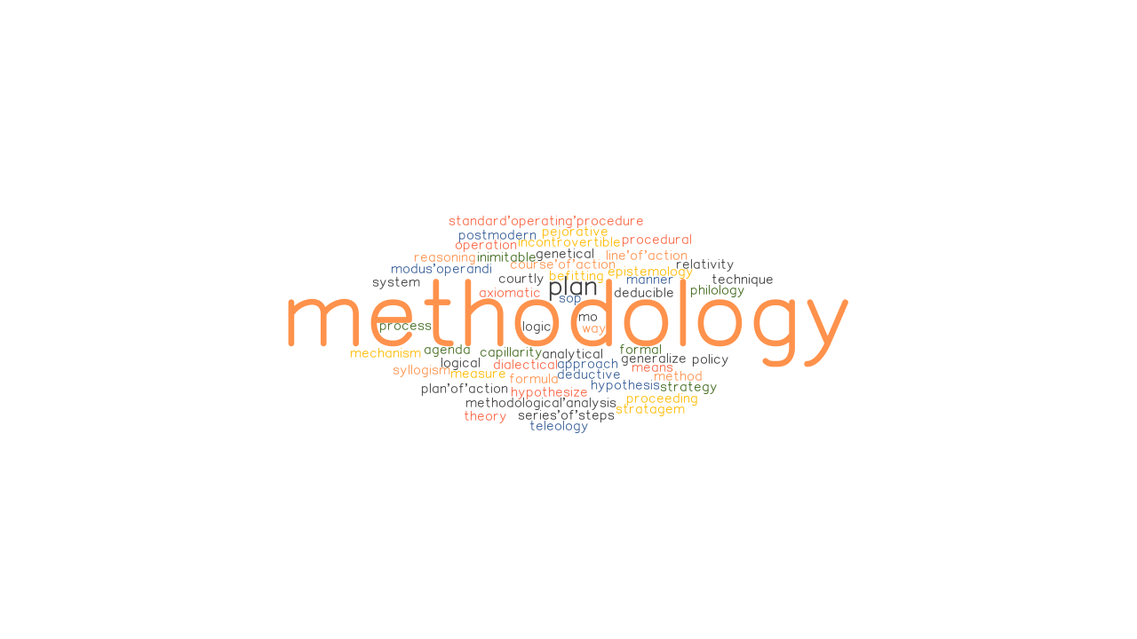
Proposed Methodology
Tools & Technologies :
Jupyter Notebook
Python
Matplotlib
HTML / CSS
Flutter
Image Source : Google

Slide 11
Proposed Methodology
Methodology :
In this study, a predictive model for the nutrients required for crops was obtained using random forest and artificial neural network algorithms. First, a variate of random forest, Multivariate Random Forest (MRF, when the number of output features is greater than One) presents a model. In the following, using the artificial neural network, a model is presented. Then, using a combination of two random forest algorithms and an artificial neural network, a model with acceptable accuracy for the prediction is presented. A total of 7 features have been used to evaluate the above algorithm.
The algorithm requires input from the user (such as location and cropping). The location is fed to the Weather API which will return certain characteristics (e.g. temperature, humidity, rainfall) and if there is a possibility of heavy rainfall, a precautionary message is displayed to the user, otherwise the proposed algorithm is followed.
Image Source : Google

Slide 12
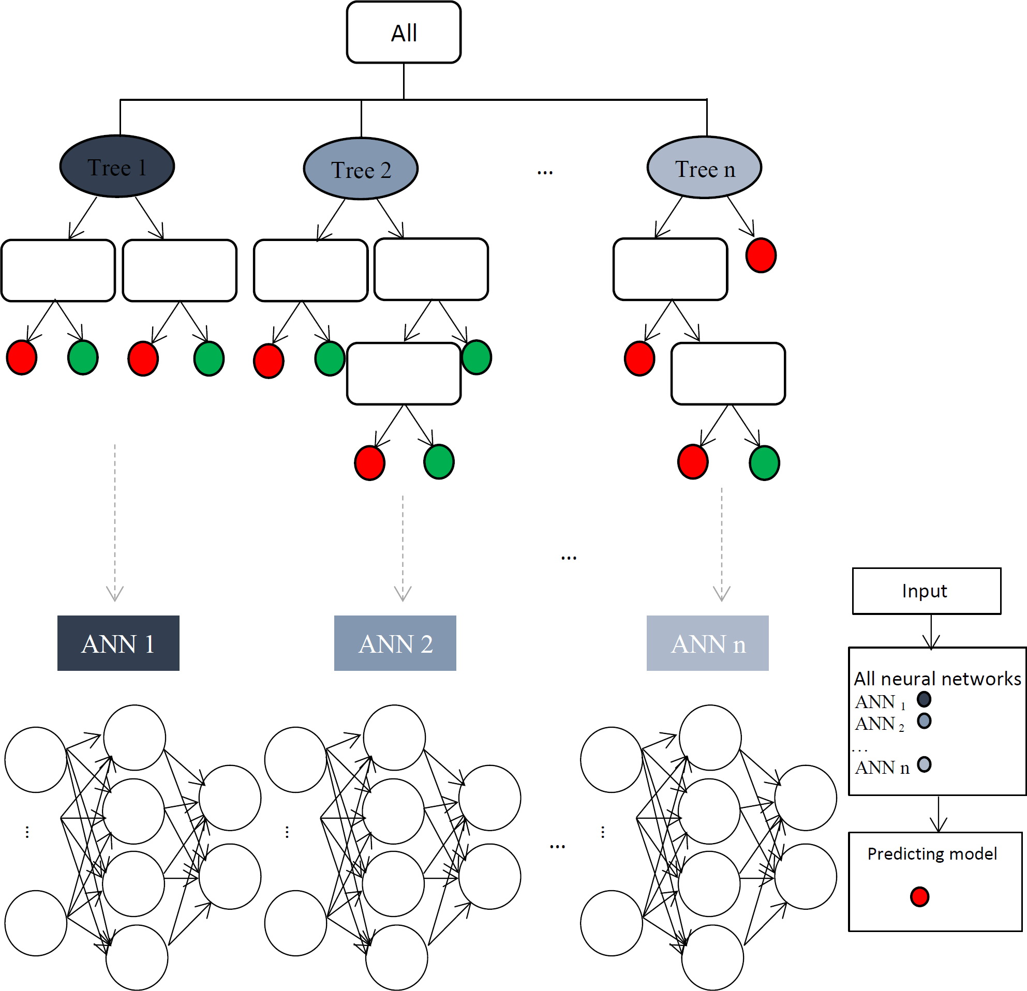
Proposed Model

Slide 13
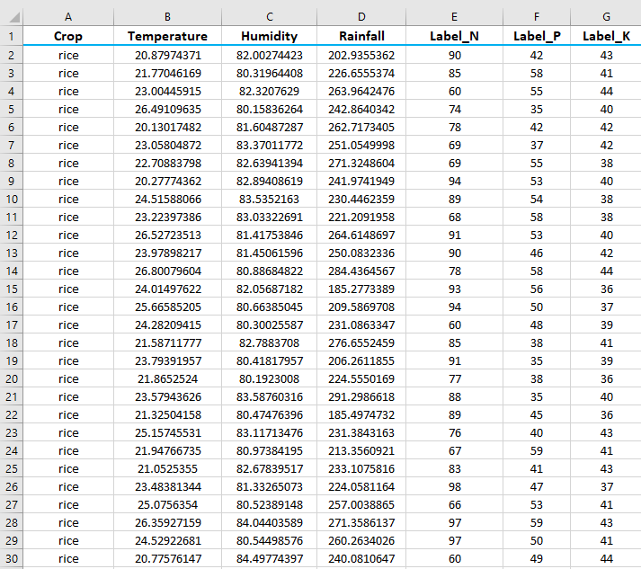
Dataset
Access Link: kaggle.com/datasets
Last access date : 16.11.2021

Slide 14
Data Description
Input Features :
Crop : rice, cotton, etc.
Temperature : temperature in degree Celsius
Humidity : relative humidity in %
Rainfall : rainfall in mm
Output Features :
Label_N : ratio of Nitrogen content in soil
Label_P : ratio of Phosphorous content in soil
Label_K : ratio of Potassium content in soil

Slide 15
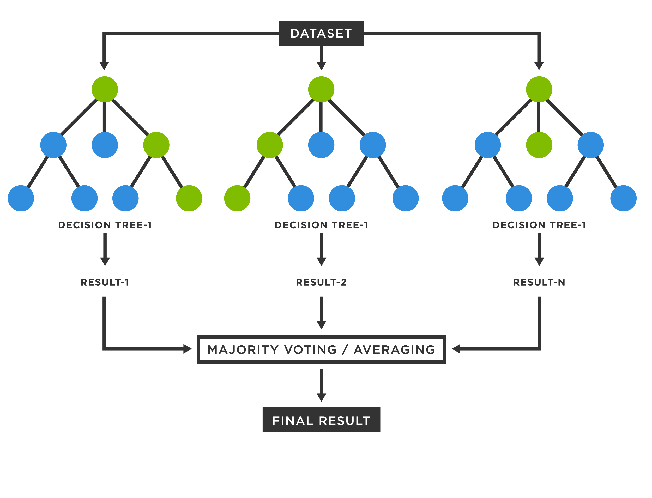
Proposed algorithm
Multivariate Random Forest :
Random Forest (RF) regression refers to ensembles of regression trees where a set of T un-pruned regression trees are generated based on bootstrap sampling from the original training data. For each node, the optimal feature for node splitting is selected from a random set of m features from the total N features. The selection of the feature for node splitting from a random set of features decreases the correlation between different trees and thus the average prediction of multiple regression trees is expected to have lower variance than individual regression trees. Larger m can improve the predictive capability of individual trees but can also increase the correlation between trees and void any gains from averaging multiple predictions. The bootstrap resampling of the data for training each tree also increases the variation between the trees. Multivariate Random Forest(MRF) calculates prediction of all output features using one model, which is generated using the training output features. While, if the output features are highly correlated then, the prediction using MRF is much improved then prediction using Random Forest.
Source : Google

Slide 16
Proposed algorithm
Multivariate Random Forest Algorithm :
Select random K data points from the training set.
Build the decision trees associated with the selected data points (Subsets).
Choose the number N for decision trees that you want to build.
Repeat Step 1 & 2.
For new data points, find the predictions of each decision tree, and assign the new data points to the category that wins the majority votes.
Source : Google

Slide 17
Proposed algorithm
Artificial Neural Network Algorithm :
Assign Random Weights to all the linkage to start the algorithm.
Using the inputs and the (Input->Hidden Node) linkage find the activation rate of hidden Nodes.
Using the activation rate of hidden nodes and linkages to output, find the activation rate of Output Nodes
Find the error rate at the output node and recalibrate all the linkage between Hidden Nodes and Output Nodes.
Using the weights and error found at Output node, cascade down the error to hidden Nodes
Recalibrate the weights between the hidden node and the input nodes
Repeat the process till the convergence criterion is met.
Using the final linkage weights score the activation rate of the output nodes.
Source : Google

Slide 18
Tasks Remaining
1. To Validate the proposed model, algorithms will be implemented by using python at jupyter notebook platform.
2.Feed the customized dataset into the python program and determine the errors.
3.Retified the errors
4. Performance analysis of the model will be determine using different performance matric .
5. Finalized the decision.

Slide 19
Proposed outcome
An Intelligent and optimistic decision will be generated for the agriculture system to enhanced the

Slide 20
THANK YOU

