Slide 1

Eco-Fertilization
Final Year Project presentation on
Presented by :
Gaurav Sharma (1AT18CS128)
Ishita Katiyar (1AT18CS044)
Arpit Chakraborty (1AT18CS020)
Sumukha Hegde (1AT18CS129)

Slide 2

Introduction
Agriculture plays a significant role in the economic sector. The automation in agriculture is the main concern and the emerging subject across the world.
The traditional methods which were used by the farmers, were not sufficient. Thus, new automated methods were introduced. These new methods provide sustainable development in agricultural practices. Artificial Intelligence in agriculture has brought an agriculture revolution.

Slide 3
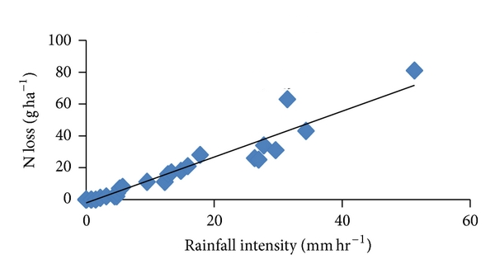
Description
There is a relationship between rainfall intensity and nutrient loss for different fertilizer treatments following each rainfall event.
Timely and moderate rainfall can be beneficial to dissolve dry fertilizer and move nutrients into the soil rooting zone, but excessive rain can increase runoff potential and leaching potential of nutrients such as nitrate, sulfate, chloride, and boron.

Slide 4
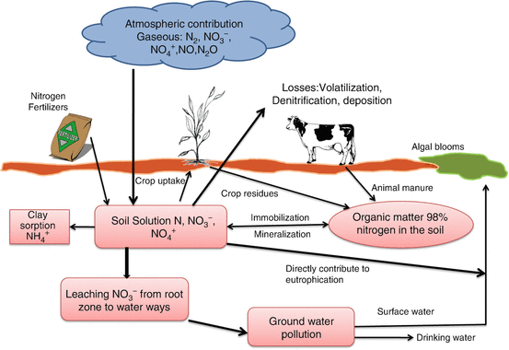

Leaching
In agriculture, leaching is the loss of water-soluble plant nutrients from the soil, due to rain and irrigation. Leaching is a natural environment concern when it contributes to groundwater contamination. As water from rain, flooding, or other sources seeps into the ground, it can dissolve chemicals and carry them into the underground water supply.

Slide 5
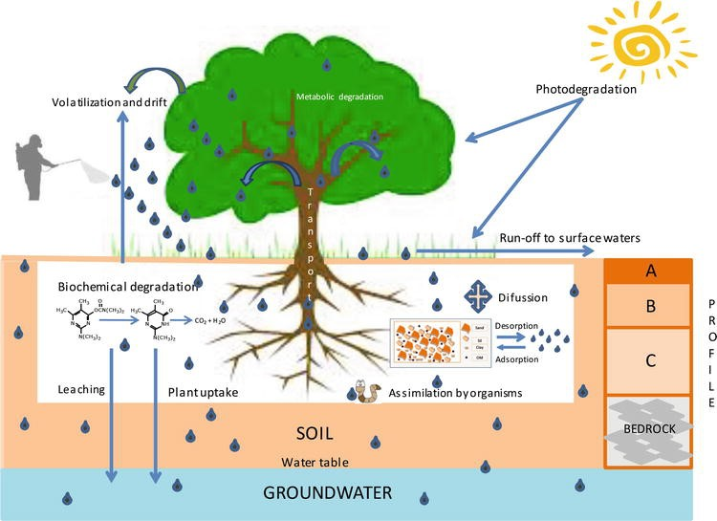
Objective
1
Provide useful insight for fertilizer usage by considering short- and long-term weather forecast.
2
Reduce environmental / water pollution by deaccelerating the process of leaching

Slide 6
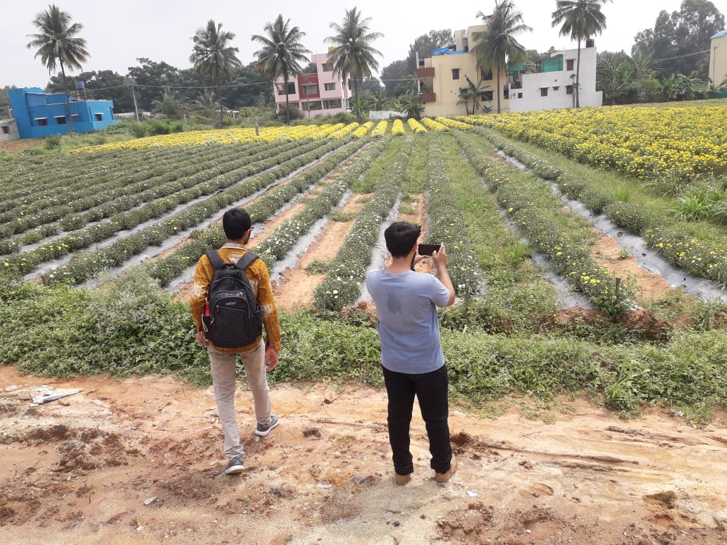
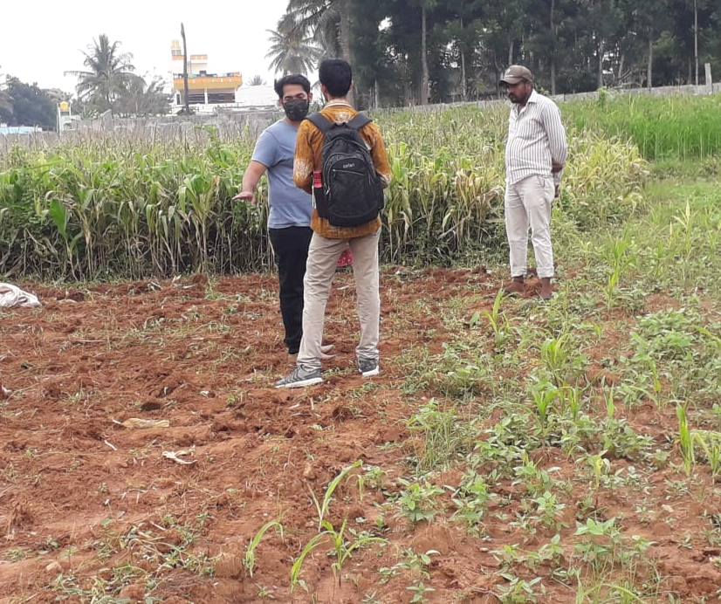
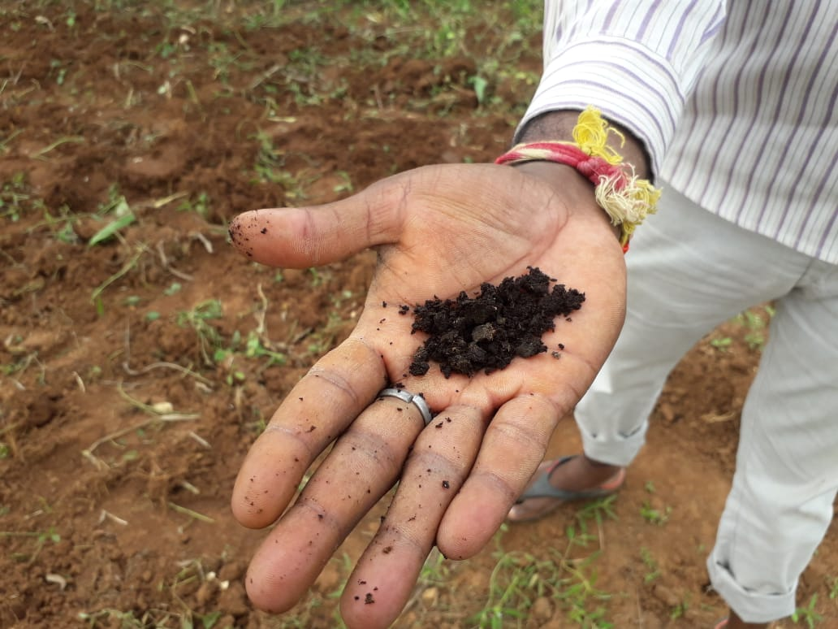
How did we approach ?
1
Unbalanced advancements in rural and urban areas.
2
On Ground Analysis
3
Problem statement analyzed and decided which lies in our domain.

Slide 7
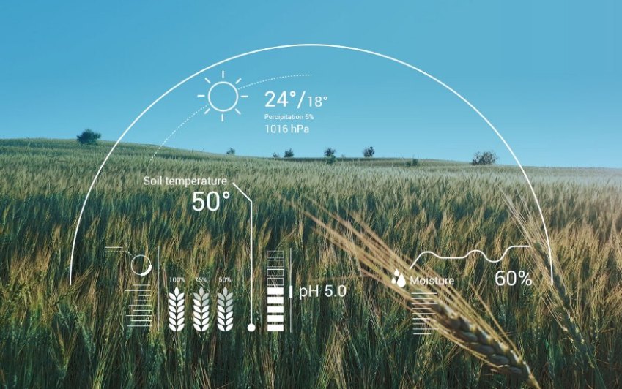
Domain & Tools
Machine Learning :
Machine learning (ML) is a type of artificial intelligence (AI) that allows software applications to become more accurate at predicting outcomes without being explicitly programmed to do so. Machine learning algorithms use historical data as input to predict new output values.
Tools & Technologies :
Jupyter Notebook
Python
Matplotlib
HTML / CSS

Slide 8
Output(Expected)
Inputs :
Output :
N : _____ kg/ha
P : _____ kg/ha
K : _____ kg/ha
Area : _____ ha
Crop : _____
Algorithm
Accuracy : %

Slide 9
THANK YOU

