Slide 1

Eco-Fertilization
Submitted as Final Year Project
towards completion of Bachelor of
Engineering
Presented by :
Gaurav Sharma (1AT18CS128)
Ishita Katiyar (1AT18CS044)
Arpit Chakraborty (1AT18CS020)
Sumukha Hegde (1AT18CS129)
Under the Guidance
Dr. Manash Sarkar
Associate Professor

Slide 2
Content
Abstract
Introduction/motivation
Literature review
Proposed Methodology
Dataset
Objective

Slide 3
Abstract
Agriculture plays an important role in national economic growth. Agriculture contributes 17-18% to India's GDP and ranks second worldwide in farm outputs. Plants requires fertilizers and fertilizers replace the nutrients that crops remove from the soil. Without the addition of fertilizers, crop yields and agricultural productivity would be significantly reduced. That's why mineral fertilizers are used to supplement the soil's nutrient stocks with minerals that can be quickly absorbed and used by crops. The farmers usually have little control over the usage of fertilizers. There is need for proper guidance for optimal usage of these fertilizers and is required by farmers in order to get more yields and prevent wastage.
There is a relationship between rainfall intensity and nutrient loss for different fertilizer treatments following each rainfall event. Timely and moderate rainfall can be beneficial to dissolve dry fertilizer and move nutrients into the soil rooting zone, but excessive rain can increase runoff potential and leaching potential of nutrients such as nitrate, sulfate, chloride, and boron.
The prime objective of “Eco-Fertilization” is to provide useful insight for fertilizer usage by considering short- and long-term weather forecast and reduce environmental pollution by deaccelerating the process of leaching. The application takes multiple input from the user such as crop, area etc. and apply machine learning algorithms to predict the amount and usage of fertilizers.
The Implement Phase is most important phase of the project cycle. It commences after the completion of preparation and planning phase. It is a phase where the execution of the project is carried out. In this Project, The tools and technologies required for execution are Python, Matplotlib, Random forest algorithm and Neural Networks.

Slide 4
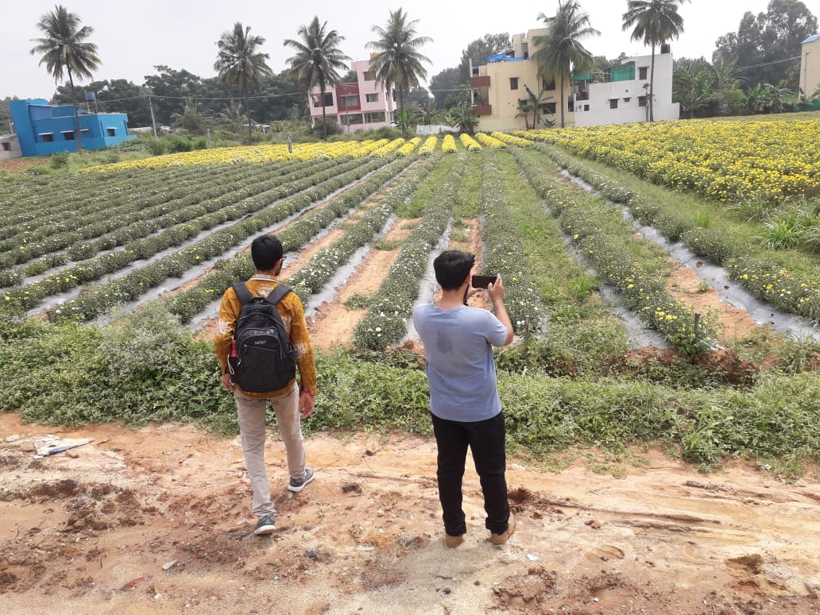
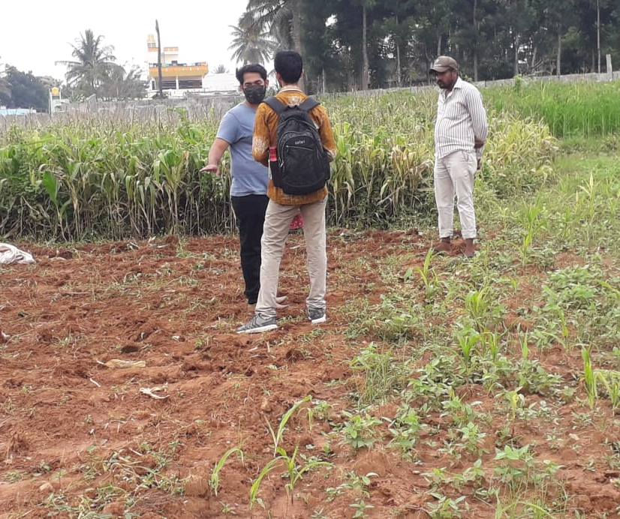
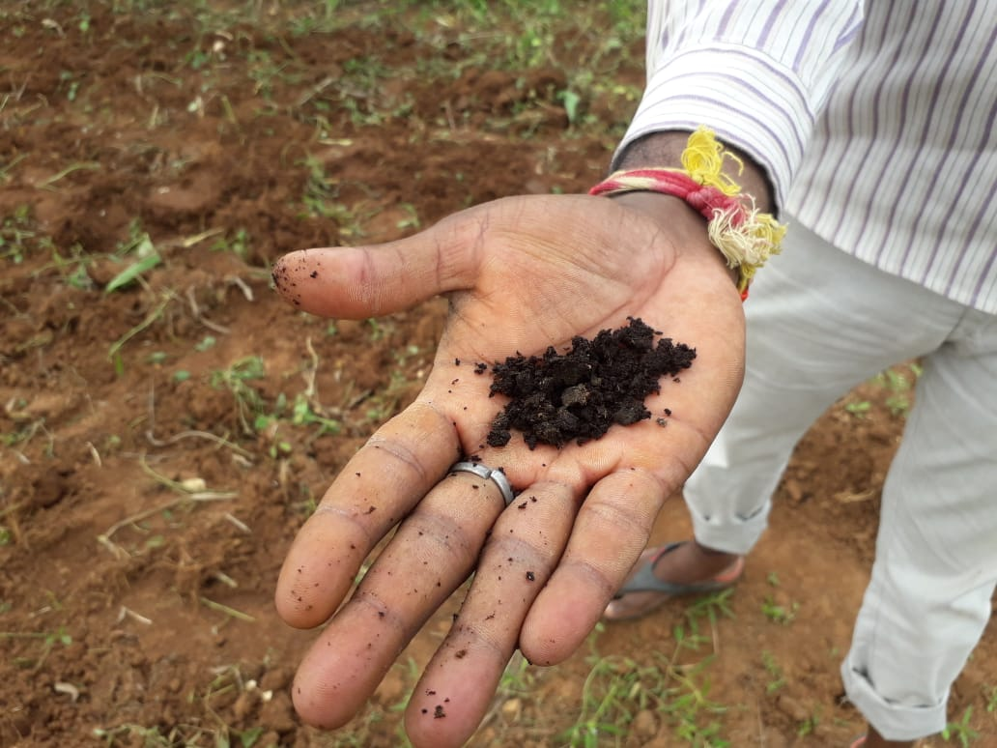
Introduction / Motivation
1
Unbalanced advancements in rural and urban areas.
2
On Ground Analysis
3
Problem statement analyzed and decided which lies in our domain.

Slide 5
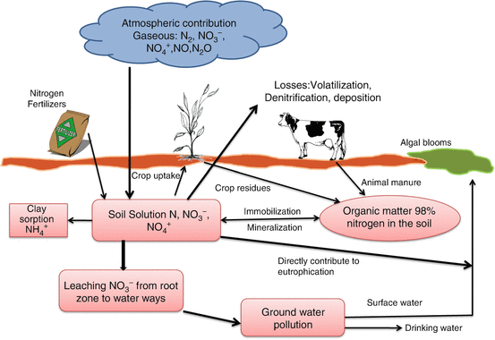

Leaching
In agriculture, leaching is the loss of water-soluble plant nutrients from the soil, due to rain and irrigation. Leaching is a natural environment concern when it contributes to groundwater contamination. As water from rain, flooding, or other sources seeps into the ground, it can dissolve chemicals and carry them into the underground water supply.
Video Source : Youtube
Image Source : Google

Slide 6
Literature Review
Sl. No. | Year | Title | Author’s Name | Journal | Description
1. | 2018 | Prediction of Crop Fertilizer Consumption | Krutika Hampannavar, Vijay Bhajantri Shashikumar G. Totad | IEEE, DOI:10.1109/ICCUBEA.2018.8697827 | Prediction of fertilizer consumption can prevent the toxicity and deficiency in plants to certain extent and this can help farmers to get proper yield without much wastage.
2. | 2018 | Phosphorus losses via surface runoff in rice-wheat cropping systems as impacted by rainfall regimes and fertilizer applications | LIU Jian, ZUO Qiang ZHAI Li-mei,LUO Chun-yan LIU Hong-bin, WANG Hong-yuan ZOU Guo-yuan,REN Tian-zhi | Integrative Agriculture, ISSN: 2095-3119 (Elsevier) | Phosphorus losses from rice-wheat cropping systems can be affected by rainfall regimes, P application rates and soil P content, as well as field management practices such as construction of field bund and open ditches.
3. | 2018 | Data Mining Techniques for Crop Yield Prediction | Shital Bhojani Nirav Bhatt | Computers and Electronics in Agriculture, ISSN: 0168-1699 (Elsevier) | It's a difﬁcult task to predict crop yield due to stochastic rain fall pattern and also variation in temperature. So we can apply different data mining techniques for crop yield predication and can produce an efﬁcient algorithm for crop classiﬁcation for better.

Slide 7
Literature Review
Sl. No. | Year | Title | Author’s Name | Journal | Description
4. | 2019 | Estimation of NPK requirements for rice production in diverse Chinese environments under optimal fertilization rates | Yulong Yin, Hao Ying Huifang Zheng ,Qingsong Zhang ,Yanfang Xue, Zhenling Cui | Agricultural and Forest Meteorology, ISSN : 0168-1923 (Elsevier) | Objectives of this study were to evaluate the relationship between nutrient requirements and climates or soil chemical properties.
5. | 2020 | Rainfall intensification increases nitrate leaching from tilled but not no-till cropping systems in the U.S. Midwest | Laura J.T. Hess Eve-Lyn S. Hinckley G. Philip Robertson Pamela A. Matson | Agriculture, Ecosystems & Environment, ISSN : 0167-8809 (Elsevier) | Rainfall intensification may exacerbate leaching losses of reactive N from cropping systems, and that no-till management may buffer against these losses.
6. | 2020 | Crop Yield Prediction Based on Indian Agriculture using Machine Learning | Potnuru Sai Nishant Pinapa Sai Venkat Bollu Lakshmi Avinash B. Jabber | IEEE : DOI: 10.1109/INCET49848.2020.9154036 | This paper predicts the yield of almost all kinds of crops in India. This script makes novel by usage of simple parameters like state, district, season, area and the user can predict the yield of the crop in which year he or she wants to.

Slide 8
Literature Review
Sl. No. | Year | Title | Author’s Name | Journal | Description
7. | 2020 | Cropping systems in agriculture and their impact on soil health | TonyYang, Kadambot H.M. Siddique, Kui Liu | Global Ecology and Conservation, ISSN: 2351-9894 (Elsevier) | Significant achievements, including refine content of soil health and the development of new evaluation standards for ‘soil health and quality’.
8. | 2020 | Would fertilization history render the soil microbial communities and their activities more resistant to rainfall fluctuations? | János Kátai Ágnes Oláh Zsuposné Magdolna Tállai Tarek Alshaal | Ecotoxicology and Environmental Safety, ISSN: 0147-6513 (Elsevier) | This paper aims to study the intrinsic changes in the composition of soil populations and their functions due to the interaction between long-term fertilization and rainfall fluctuations, seeing whether fertilization history would render the soil microbial communities and their activities more resistant to water stress or not.
9. | 2021 | A nutrient recommendation system for soil fertilization based on Evolutionary Computation. | Usman Ahmed Jerry Chun-Wei Lin Gautam Srivastava Youcef Djenouri | Computers and Electronics in Agriculture, ISSN: 0168-1699 (Elsevier)) | This paper develops a model that enables efficient exploration of correct usage of nutrients (such as N, P and K) for developing a knowledge-based system for the ICT (Information and Communication Technology) environment.

Slide 9
Literature Review
Sl. No. | Year | Title | Author’s Name | Journal | Description
10. | 2021 | Controlled traffic farming effects on productivity of grain sorghum, rainfall and fertiliser nitrogen use efficiency | A.Hussein Diogenes L. Antille ShreevatsaKodur GuangnanChen Jeff N.Tullberg | Global Ecology and Conservation, ISSN: 2351-9894 (Elsevier) | Enhanced efficiency fertilizers cannot compensate for other stresses caused by compaction.

Slide 10
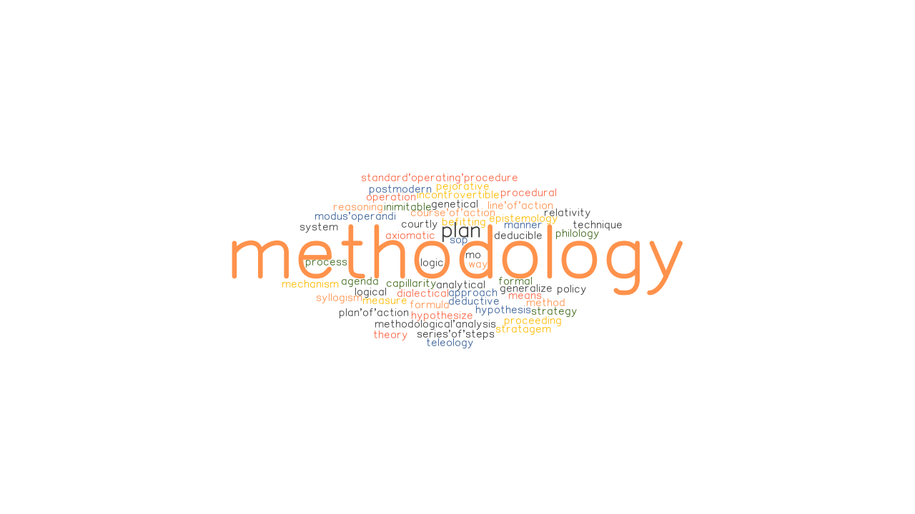
Proposed Methodology
Tools & Technologies :
Jupyter Notebook
Python
Matplotlib
HTML / CSS
Algorithm :
Random forest
Neural Networks
Image Source : Google

Slide 11
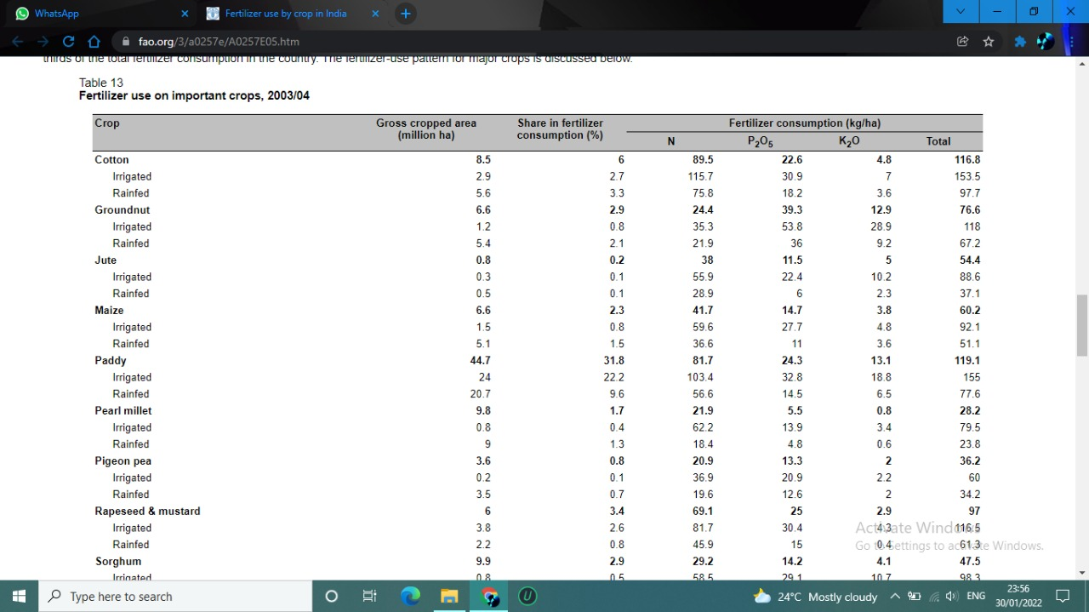
Dataset
Fertilizer Consumption :
Access Link: https://www.fao.org/3/a0257e/A0257E05.htm
Last access date : 16.11.2021

Slide 12
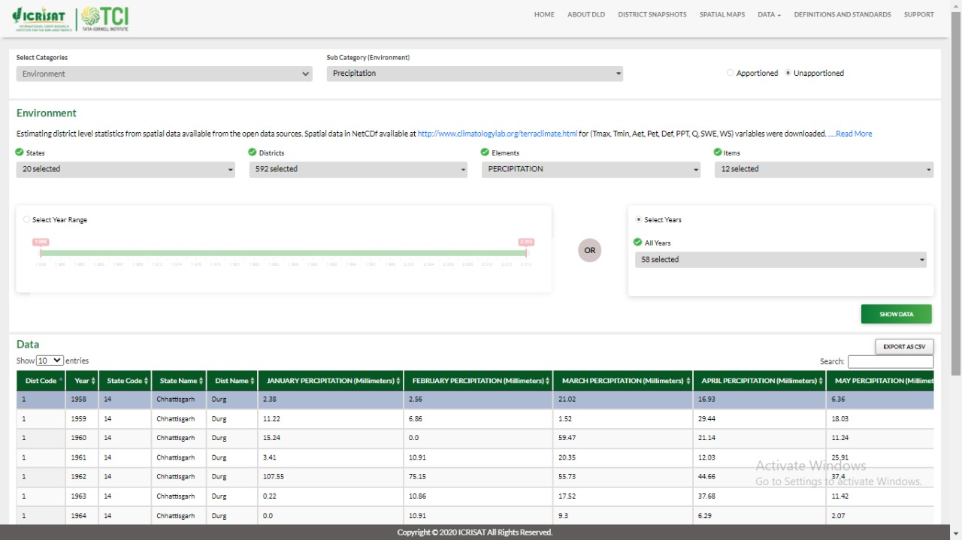
Dataset
Precipitation :
Access Link: http://data.icrisat.org/dld/src/crops.html
Last access date : 16.11.2021

Slide 13

Dataset
Soil Type :
Access Link: http://data.icrisat.org/dld/src/crops.html
Last access date : 16.11.2021

Slide 14

Objective
1
Provide useful insight for fertilizer usage by considering short- and long-term weather forecast.
2
Reduce environmental / water pollution by deaccelerating the process of leaching
Source : Google

Slide 15
THANK YOU

