Slide 1

Eco-Fertilization (Literature Review)
Final Year Project presentation on
Presented by :
Gaurav Sharma (1AT18CS128)
Ishita Katiyar (1AT18CS044)
Arpit Chakraborty (1AT18CS020)
Sumukha Hegde (1AT18CS129)

Slide 2

A nutrient recommendation system for soil fertilization based on Evolutionary Computation
Journal - Computers and Electronics in Agriculture, ISSN: 0168-1699 (Elsevier)
Date of Publication – Oct 2021
What is EC (Evolutionary Computation) ?
Evolutionary Computing is the study of computational systems which use ideas and get inspirations from natural evolution and other biological systems.

Slide 3
A nutrient recommendation system for soil fertilization based on Evolutionary Computation
Findings relate to project - This paper develops a model that enables efficient exploration of correct usage of nutrients (such as N, P and K) for developing a knowledge-based system for the ICT (Information and Communication Technology) environment. Develop knowledge is then applied directly to the environment, which recommends balancing soil fertility and crop production.
Summary - Each sensor in the remote area has its set of nutrient levels. The sensor values are stored locally and sent to the database based on intervals (weekly, monthly, yearly). All sensors for each nutrient are collected and merged through the Internet to log the extensive data set of the remote area. The designed algorithm is then applied and optimize for sequence nutrients for decision-making. The objective of the developed model is to maintain soil fertility (maintaining nutrient levels) and increase crop production (yield) simultaneously.

Slide 4
A nutrient recommendation system for soil fertilization based on Evolutionary Computation
Similarities – This model used the series of data of the same cultivated area and then recommended the nutrient level before the crop. Compared to the traditional approach that only utilities the previous or current state of the soil, the developed model can recommend a set of nutrient levels and maximize the yield production.
Differences - This model doesn't account for rainfall patterns and eventually fails to prevent the leaching of soil.
Algorithm - This paper proposes nutrient recommendations through an improved genetic algorithm (GA) that uses time-series sensor data.

Slide 5

A nutrient recommendation system for soil fertilization based on Evolutionary Computation
What is Genetic Algorithm ?
A genetic algorithm is a search heuristic that is inspired by Charles Darwin’s theory of natural evolution.
This algorithm reflects the process of natural selection where the fittest individuals are selected for reproduction in order to produce offspring of the next generation.
The algorithm terminates if the population has converged (does not produce offspring which are significantly different from the previous generation). Then it is said that the genetic algorithm has provided a set of solutions to our problem.
The population has a fixed size. As new generations are formed, individuals with least fitness die, providing space for new offspring.

Slide 6
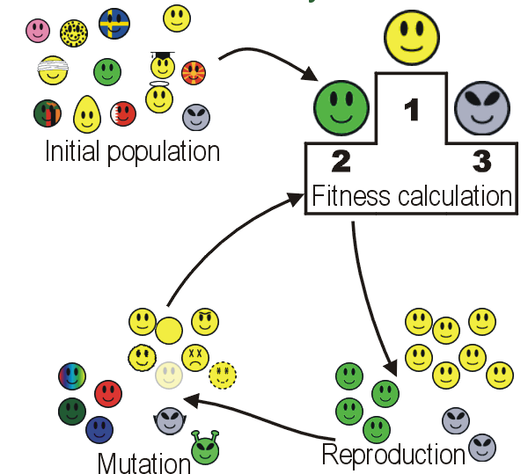
A nutrient recommendation system for soil fertilization based on Evolutionary Computation
Phases in GA :
Initial population - The process begins with a set of individuals which is called a Population. Each individual is a solution to the problem you want to solve.
Fitness function - The fitness function determines how fit an individual is (the ability of an individual to compete with other individuals). It gives fitness score to each and every individual.
Selection - The idea of selection phase is to select the fittest individuals and let them pass their genes to the next generation.
Crossover - The new offspring are added to the population.
Mutation - In certain new offspring formed, some of their genes can be subjected to a mutation with a low random probability.

Slide 7
Cropping systems in agriculture and their impact on soil health
Journal - Global Ecology and Conservation, ISSN: 2351-9894 (Elsevier)
Date of Publication – Sep 2020
Findings relate to project - Significant achievements, including refine content of soil health and the development of new evaluation standards for ‘soil health and quality’ by combining various soil health indicators (such as soil physicochemical properties, soil microorganisms status, and cropping practices) into indices in agroecosystems, can be used to evaluate and guide soil and crop management decisions

Slide 8
Cropping systems in agriculture and their impact on soil health
Algorithm –
Classiﬁcation algorithms can follow three different learning approaches: supervised learning, unsupervised learning, or semi-supervised learning. The different classiﬁcation techniques for discovering knowledge are Rule Based Classiﬁers, Bayesian Networks (BN), Artiﬁcial Neural Network (ANN)

Slide 9
Crop Yield Prediction
Journal - Computers and Electronics in Agriculture, ISSN: 0168-1699 (Elsevier)
Date of Publication – Dec 2018
Findings relate to project - This paper presents a brief study of various data mining techniques used for crop yield prediction by different researchers. Various researches have been done exploring the connections between large-scale climatologically phenomena and crop productivity. Crop prediction methodology is used to predict the suitable crop by sensing various parameters of soil and environment.

Slide 10
Crop Yield Prediction
Summary – There are a growing number of applications of data mining techniques in agriculture and a growing amount of data that are currently available from many resources. It's a difﬁcult task to predict crop yield due to stochastic rain fall pattern and also variation in temperature. So we can apply different data mining techniques for crop yield predication and can produce an efﬁcient algorithm for crop classiﬁcation for better decision making for the beneﬁt of mankind.
Algorithm – Clustering [Density-Based Methods(DBM)], Regression [Linear Regression (LR)]

Slide 11
Rainfall intensification increases nitrate leaching from tilled but not no-till cropping systems in the U.S. Midwest
Journal - Agriculture, Ecosystems & Environment, ISSN : 0167-8809 (Elsevier)
Date of Publication – Mar 2020
Findings relate to project - Rainfall intensification may exacerbate leaching losses of reactive N from cropping systems, and that no-till management may buffer against these losses. Variation in soil type and structure, climate, and agronomic practices across larger spatial scales may influence the way that cropping systems respond to rainfall intensification

Slide 12
Rainfall intensification increases nitrate leaching from tilled but not no-till cropping systems in the U.S. Midwest
Summary :
The Main Cropping System Experiment (MCSE) is made up of plots approximately one hectare in size (81 x 105 m) assigned to different cropping system types in a complete randomized block design. The intensity of rainfall is simulated at different blocks and the water percolation is measured. Then, the amount of nitrates lost in each given block is calculated.
Statistical analyses were performed using R 3.0.2. Linear mixed models with a nested design were used to determine the effects of rainfall intensification and tillage on soil water N concentrations, percent change in soil water N concentrations, cumulative N leached, soil inorganic N, net N mineralization and nitrification, and crop tissue N.

Slide 13
Rainfall intensification increases nitrate leaching from tilled but not no-till cropping systems in the U.S. Midwest
Similarities – Accounts for nitrate leaching in soil, due to rainfall, when considering the appropriate amount of nitrate needed for the ideal growth of the crop.
Differences - Does not use historical data based on the given region to estimate nitrate leaching.
Algorithm - Linear mixed models with a nested design.

Slide 14
Estimation of NPK requirements for rice production in diverse Chinese environments under optimal fertilization rates
Journal – Agricultural and Forest Meteorology, ISSN : 0168-1923 (Elsevier)
Date of Publication – Dec 2019
Findings relate to project - Objectives of this study were to :
evaluate the relationship between nutrient requirements and climates or soil chemical properties
determine the N, P, and K requirements in northern and southern China to support optimal regional nutrient management.

Slide 15
Estimation of NPK requirements for rice production in diverse Chinese environments under optimal fertilization rates
Summary :
The Angstrom-Prescott equation (Li et al., 2004) is used to compute the daily solar radiation based on daily sunshine hours. The daily maximum and minimum temperatures were used to calculate the daily average temperature, while temperature, relative humidity, and wind speed were used to calculate the potential evapotranspiration.
Associations between variables were evaluated using nonlinear correlation analysis. Statistical analyses were carried-out in R (version 3.5.1) through the Remdr package.
Descriptive statistical analysis was performed to evaluate the average, variability, and standard deviation of each parameter measured. The means were compared using the t-test at a 0.05 significance level, using SPSS version 17.0.

Slide 16
Estimation of NPK requirements for rice production in diverse Chinese environments under optimal fertilization rates
Similarities – Accounts for the nitrogen disparity caused by solar radiation and calculates the total need of N,P,K based on local conditions.
Differences - Paper is not applicable to any other crop other than rice and does not use any machine learning algorithms to enhance the realistic estimations.
Algorithm - Uses Angstrom-Prescott equation for estimation of solar radiation. Associations between variables were evaluated using nonlinear correlation analysis. Associations between variables were evaluated using nonlinear correlation analysis.

Slide 17
Would fertilization history render the soil microbial communities and their activities more resistant to rainfall fluctuations?
Journal - Ecotoxicology and Environmental Safety, ISSN: 0147-6513 (Elsevier)
Date of Publication – Sep 2020
Findings relate to project - This paper aims to study the intrinsic changes in the composition of soil populations and their functions due to the interaction between long-term fertilization and rainfall fluctuations, seeing whether fertilization history would render the soil microbial communities and their activities more resistant to water stress or not.

Slide 18
Would fertilization history render the soil microbial communities and their activities more resistant to rainfall fluctuations?
Summary :
A maize monoculture field is cultivated by a rain-fed and fertilized continuously at different doses of NPK, i.e., control. The experiment is carried out for 21-23 years and soil samples were collected from control and five fertilized plots in the 21st, 22nd and 23rd years of the experiment. It is observed that addition of continuous NPK fertilization : 1. reduced soil pH values (i.e. soil become more acidic in nature) 2. increase the soil orgainic carbon (SOC) [6] content, significantly 3. increased the humus content 4. increased microbial biomass carbon (MBC) [7] 5. CO2 production increased linearly with increasing NPK doses 6. favorable effect on the activity of four soil enzymes, i.e., phosphatase, saccharase, urease and dehydrogenase. Also, high rates of NPK resulted in higher soil NO3− (Nitrate) content; and it thus could be recommended that in years with expected high rainfall the applied amount of N should be decreased in order to avoid the excess leaching of soil NO3− which possibly can contaminate the groundwater and consequently threatens human health.

Slide 19
Would fertilization history render the soil microbial communities and their activities more resistant to rainfall fluctuations?
Similarities – This model gives good insight about the dynamics of soil such as pH, texture, porosity, water holding capacity, organic carbon, and humus content, in relation to rainfall and fertilizer (NPK) usage.
Differences - Unable to make predictions for future usage of fertilizers in accordance with rainfall patterns.
Algorithm - Soil moisture content was measured gravimetrically [4] by drying the soil at 105 °C for 24 h and expressed as m/m% (dry basis) of absolute mass of dry soil. Soil pH was measured in 1:2.5 (w/w) soil: distilled water suspension. Absorbance was measured with a spectro-photometer [5] (UV-403). The total number of bacteria and microscopic fungi was determined using plate dilution technique on bouillon and peptone-glucose agar medium, respectively.

Slide 20
Crop Yield Prediction Based on Indian Agriculture using Machine Learning
Journal - IEEE ; DOI: 10.1109/INCET49848.2020.9154036
Date of Publication – Jun 2020
Findings relate to project - This paper predicts the yield of almost all kinds of crops in India. This script makes novel by usage of simple parameters like state, district, season, area and the user can predict the yield of the crop in which year he or she wants to.

Slide 21
Crop Yield Prediction Based on Indian Agriculture using Machine Learning
Summary :
This paper uses stacked regression which in which initially the total training set is divided into two different sets. Then, the selected base models with first part (train). Then, test them with second part (holdout). Now, the prediction obtained from test part are inputs to the train higher level learner called meta model. The average of the predictions is taken for predictive portion and used them as meta-features on which the meta-model is finally predicted. Here the meta model is Lasso Regressor.

Slide 22
Crop Yield Prediction Based on Indian Agriculture using Machine Learning
Similarities – Uses historical data from different states and regions to determine the crop yield in the given region.
Differences - Paper does not account for local real-time weather conditions and other parameters which are contingent on the local area
Algorithm - Uses advanced regression techniques like Kernel Ridge. Lasso and ENet algorithms to predict yield and uses the concept of stacking regression for enhancing the algorithms to give a better prediction.

Slide 23
Phosphorus losses via surface runoff in rice-wheat cropping systems as impacted by rainfall regimes and fertilizer applications
Journal - Journal of Integrative Agriculture, ISSN: 2095-3119 (Elsevier)
Date of Publication – Mar 2018
Findings relate to project - Phosphorus (P) losses from agricultural soils contribute to eutrophication of surface waters. This field plot study investigated effects of rainfall regimes and P applications on P loss by surface runoff from rice and wheat cropping systems.

Slide 24
Phosphorus losses via surface runoff in rice-wheat cropping systems as impacted by rainfall regimes and fertilizer applications
Summary :
Phosphorus losses from rice-wheat cropping systems can be affected by rainfall regimes, P application rates and soil P content, as well as field management practices such as construction of field bund and open ditches. In particular, great P loss results from heavy rainfalls shortly after P applications, and P loss increases with increasing P application rates and soil P content. Phosphorus concentrations in surface runoff are regulated by P concentrations in field ponding water during rice growing season. Phosphorus loss during winter wheat growing season can be enhanced by constructing open ditches.

Slide 25

Phosphorus losses via surface runoff in rice-wheat cropping systems as impacted by rainfall regimes and fertilizer applications
Methodology :
The SAS software (Version 9.2) was used for statistical analysis. A mixed model was used to analyze differences in P losses between years, crop seasons, P treatments and soils. Pairwise comparisons of means were adjusted using the Tukey-Kramer multiple comparisons test. The general linear model was used for analysis of regressions of runoff P concentration and P concentration in the field ponding water during rice growing seasons. A significance level of α=0.05 was used throughout this study unless otherwise stated.

Slide 26
Prediction of Crop Fertilizer Consumption
Journal – IEEE, DOI: 10.1109/ICCUBEA.2018.8697827
Date of Publication – Aug 2018
Findings relate to project - The proposed work identifies the nitrogen deficiency in chilly, determines the area of region of deficient region and predicts the amount of fertilizer consumption by these deficient plants.

Slide 27
Prediction of Crop Fertilizer Consumption
Summary :
There is need for proper guidance for optimal usage of these fertilizers and is required by farmers in order to get more yields and prevent wastage. The factors affecting the fertilizer consumption are: extent of available land, cultivated land, rainfall, cropping pattern, soil characteristics. The various nitrogen fertilizers that are supplied to plant, when it is deficient are ammonium nitrate, urea, ammonium sulphate, and anhydrous ammonia. Prediction of fertilizer consumption can prevent the toxicity and deficiency in plants to certain extent and this can help farmers to get proper yield without much wastage.

Slide 28
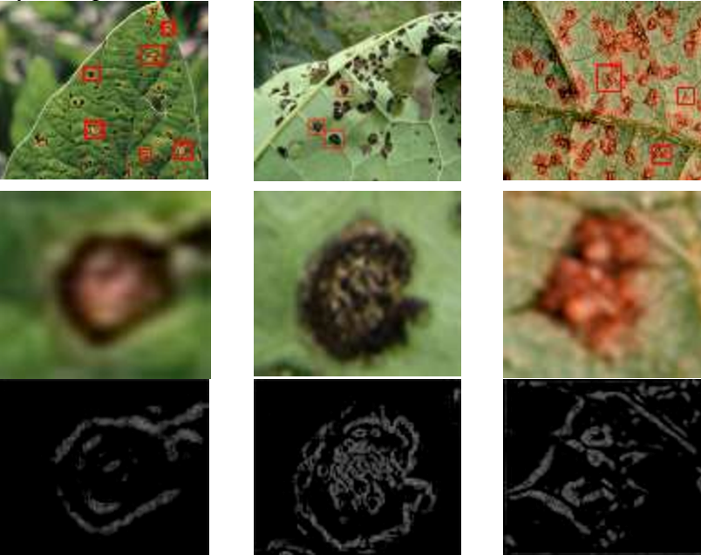
Prediction of Crop Fertilizer Consumption
Methodology :
This system consists of phases such as: Image acquisition, converting of input image to gray scale image, plotting of histogram, segregating plants into healthy and nitrogen deficient plants determining the affected region and fertilizer consumption (akin of Digital Image Processing).

Slide 29
Thank You

