Slide 1
PICO: Privacy-Preserving Access Control in IoT Scenarios through Incomplete Information
Dr. Savio Sciancalepore
Dr. Nicola Zannone
Presented by : Gelareh Hasel Mehri
May 2022

Slide 2
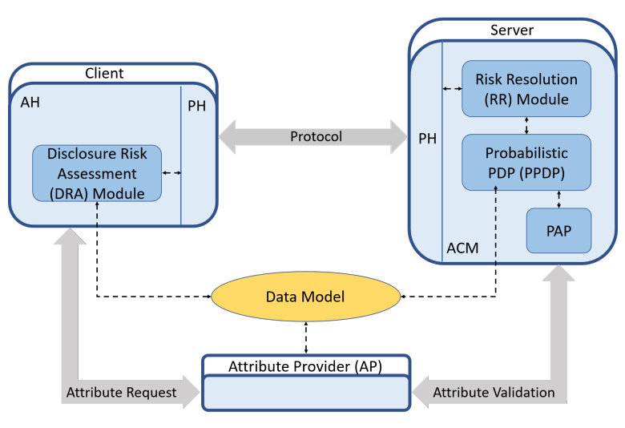
Problem Statement
Fine-grained info are required for services and resources to be granted in IoT
The user might have privacy preserving concerns regarding the granularity of sensitive information disclosure
PICO
Provides an evaluation platform for users to assess its disclosure risk and to act based on privacy exchange and energy consumption tradeoff
Attribute Provider (AP)
Collects and certifies the client’s attribute values
Provides cryptography materials for server's attribute validation
Client
Attribute Handler (AH)
Local storage and management of attributes
Decision Risk Assessment (DRA)
Protocol Handler (PH)
Supports interactions with the server
Server
Access Control Manager (ACM)
Protection of sensitive resources and services
Probabilistic Policy Decision Point (PPDP)
Policy Administration Point (PAP)
Risk Resolution (RR)
Protocol Handler (PH)
Supports interactions with the server
Data Model
Shared
Tree-based structure
Clients use it to determine the level of granularity
Servers use it for incorrect risk assessment
PICO Architecture

Slide 3
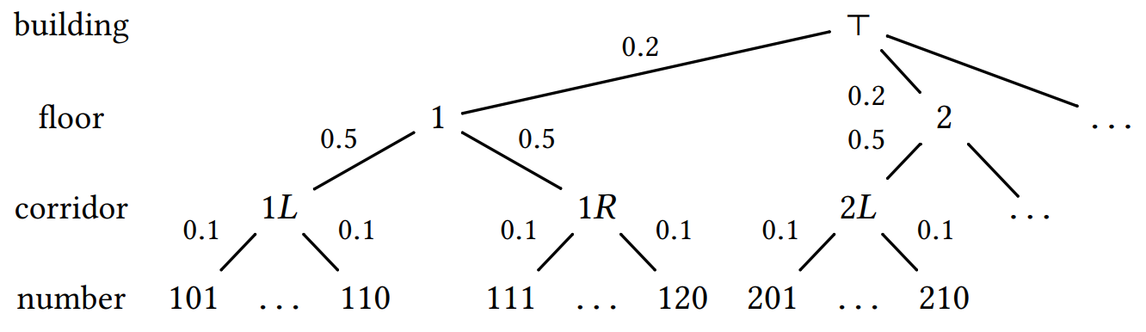
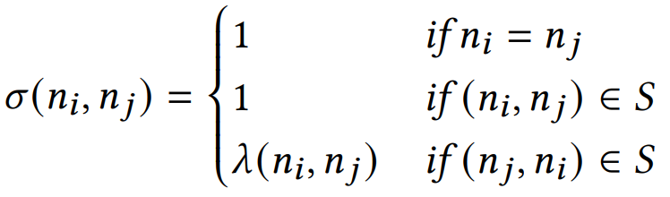
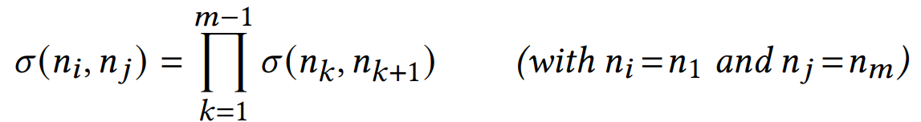
Notation
Hierarchy Tree
A = {a₁, …, a_{n}} , a_{i} : attribute i
V_{ai} : set of possible values for a_{i}
H_{a} = (N, S, λ) : attribute hierarchy
N : set of nodes
S ⊆ N×N : specialization relation on N
(n_{i} , n_{j}) : path from i to j
λ : S → [0,1] : labeling function, shows closeness between two attribute values
(a , v_{i}) ⊆ (a , v_{j}) : In attribute a, v_{i} is a specialization of v_{j}
Specialization is:
Reflexive
Antisymmetric
transitive
Degree of Similarity
Base case: for adjacent n_{i} and n_{j}
Path: for a path from n_{i} to n_{j}
Probability of inferring j when we know i

Slide 4




Disclosure Risk Assessment (DRA) - Client Side
Assesses the risk associated to the disclosure of attribute values and decides at which level of granularity information can be disclosed
For an attribute value, the disclosure risk is the probability of inferring the most specialized value of a user
n : exact attribute value
n' : generalization of n
i.e. (a , n) ⊂ (a , n')
Attribute risk tolerance:
sensitive
non-sensitive
All generalizations of a non-sensitive value are also non-sensitive
Risk disclosure of a set of attribute values is equal to the highest disclosure risk.

Slide 5

Probabilistic PDP – Server Side
Represents the risks of incorrectly granting/denying access due to incomplete information
Query : a set of attribute name-value pairs (𝑎_{𝑖} , 𝑣_{𝑖})
Set of queries over A
Using XACML policy language syntax
t : policy targets
Atomic : (a ,v)
Composite : Boolean expression (¬, ∧, ∨) over atomic targets
p : policy
Atomic : singe decision, 1 or 0
Target policy : (t , p)
Composite : deny-override (△) or permit-override (▽) over {1 , 0, ⊥}
Deny-override algorithm (△) : Deny decision has priority over a permit decision
Permit-override algorithm (▽) : Permit decision has priority over a deny decision
Deny-override & Permit-override look-up tables
P₁ | P₂ | P₁△P₂
0 | 0 | 0
0 | 1 | 0
0 | ⊥ | 0
⊥ | 0 | 0
1 | 0 | 0
1 | 1 | 1
1 | ⊥ | 1
P₁ | P₂ | P₁▽P₂
1 | 1 | 1
1 | 0 | 1
1 | ⊥ | 1
⊥ | 1 | 1
0 | 1 | 1
0 | 0 | 0
0 | ⊥ | 0
⊥ | 1 | 1
⊥ | ⊥ | ⊥
⊥ | 0 | 0
⊥ | ⊥ | ⊥

Slide 6
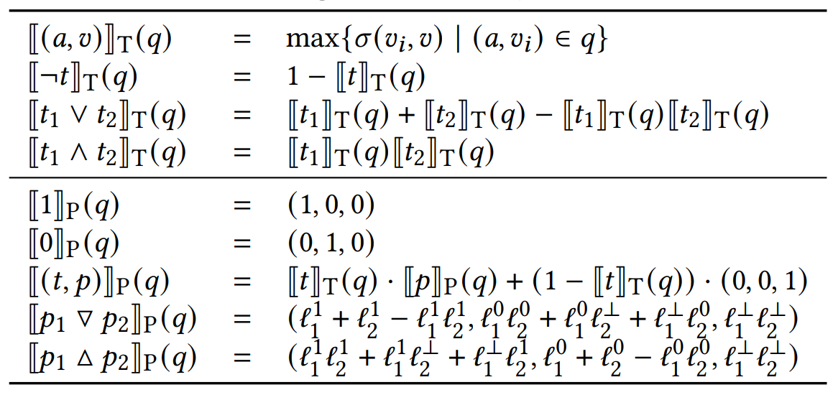
Probabilistic PDP – Server Side
Set of targets over A : T_{A}
Set of policies over A : P_{A}
Evaluation Function〚.〛_{T}
T_{A} × 𝑄_{A} → [0, 1]
〚t〛_{T}(q) : likelihood that 𝑞 matches 𝑡 based on the degree of similarity between the attribute values in t & q
1 : target certainly matches the query
0 : target certainly doesn't match the query
Evaluation Function〚.〛_{P}
P_{A} × 𝑄_{A} → [0, 1]³
〚p〛P(q) : likelihood that a certain decision is returned based on the degree of similarity between attributes
〚p〛_{P}(q) = (ℓ ¹ , ℓ⁰ , ℓ⊥)
ℓ¹ : likelihood that the decision is permit
ℓ⁰ : likelihood that the decision is deny
ℓ¹ : likelihood that the decision is NA
ℓ¹ + ℓ⁰ + ℓ⊥ = 1

Slide 7
Risk Resolution – Server side
Responsible for policy enforcement, similar to the Policy Enforcement Point (PEP) in the XACML
Decision needs to be made conclusively and not by likelihood
The uncertainty in likelihood estimations needs to be quantified
"Not-applicable" decisions need to be translated into either "permit" or "deny"
Conservatively deciding, NAs are considered "deny"
Risk Tolerance
ℓ¹ ≥ 𝛼 (ℓ⁰ + ℓ⊥)
𝛼 : risk factor (showing criticality of resources)
𝛼 (ℓ⁰ + ℓ⊥) : permission lower band

Slide 8
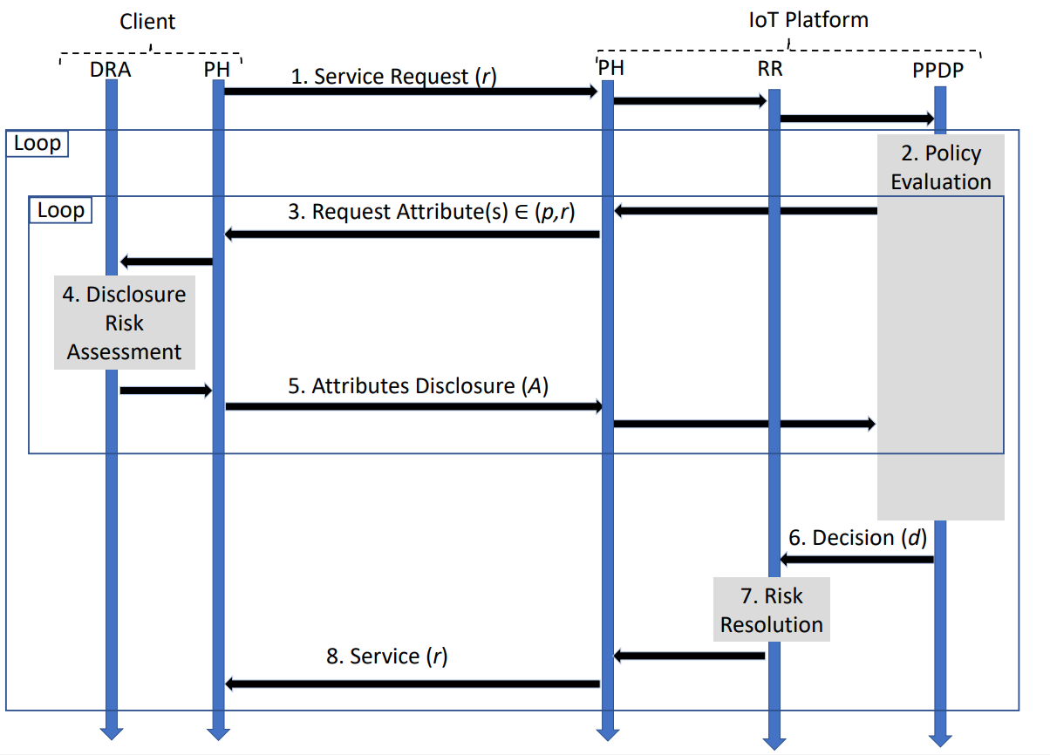
Protocol
Sequence diagram of the protocol used by the client to access services provided by the server IoT platform
Notes
Client can decide to disclose her attributes in different levels of granularity.
The protocol can be continued until:
The resource is granted
The client refuses to reveal more info
Information disclosure increases the disclosure risk, and refusal to expose coarse-grained information is time and energy consuming
A trade-off between disclosure risk and time/energy consumption is applied in client's behavior.

Slide 9
Implementation
Each disclosed attribute value is embedded into a CWT
CWT
CBOR Web Token
A compact means of representing claims to be transferred between two parties
Optimized for IoT use-cases
Consisting of 3 parts:
Header (for correct decoding)
Claims (standardized or private)
Signature (for integrity and authenticity verification)
Claims
A piece of information asserted about a subject
represented as a name/value pair consisting of a Claim Name and a Claim Value
Claims in a CWT are encoded using CBOR
Standardized claims are used for the: issuer (iss), unique identifier (cti), subject (sub), and expiration date (exp)
Ad-hoc private claim is used for attribute values (atv)
HMAC-SHA-256 is used to generate CWT signature
A single CWT is 233 bytes
Delivering CWT over IoT wireless networks
CoAP message (adding 4 bytes header)
UDP (adding 8 bytes header)
6LoWPAN (adding 40 bytes header)
IEEE 802.15.4 (21 bytes header and 4 bytes trailer)
Sum: 76 bytes
MTU of IEEE 802.15.4 is 127 bytes
Available payload for application-layer information: 50 bytes
Number of MAC-layer messages needed to deliver a single CWT: five IEEE 802.15.4 messages
Energy Consumption Estimations
Openmote-b IoT device, same protocol stack, same MAC-layer message
802.65 mJ for a transmission slot
778.51 mJ for a reception slot

Slide 10
Experiment
Attribute disclosure approaches:
Direct disclosure of non-sensitive attribute values with the highest disclosure risk (A1)
Incremental disclosure of non-sensitive attribute values, from low risk to high (A2)
Attribute delivery modes:
All CWTs delivered together in a single stream (M1)
CWTs delivered one-by-one in different streams (M2)
Operational strategies:
(A1+M1), (A1+M2), (A2+M1), (A2+M2)
Considerations:
Number of attributes: 6 (fixed in first experiment, ranging from 1 to 10 in second experiment)
Attribute hierarchies: Static, Height-balanced binary trees, predefined depth (9, 10, or 11)
Random semantic closeness values (siblings' semantic closeness values with the parent node sum up to 1)
Random policies on the server side : Random combination of attributes (from 1 to 6) + Random risk factor

Slide 11
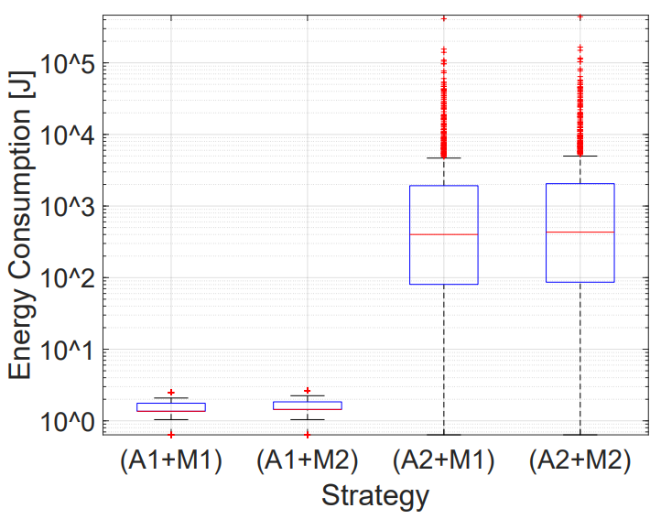
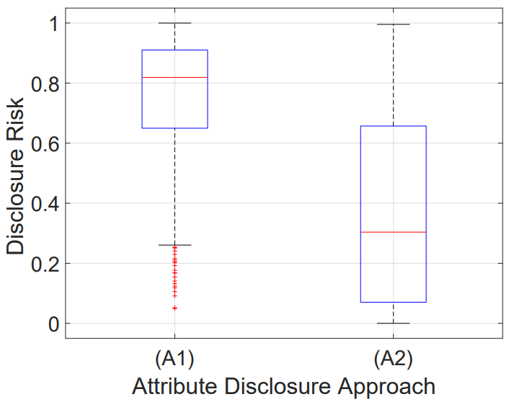
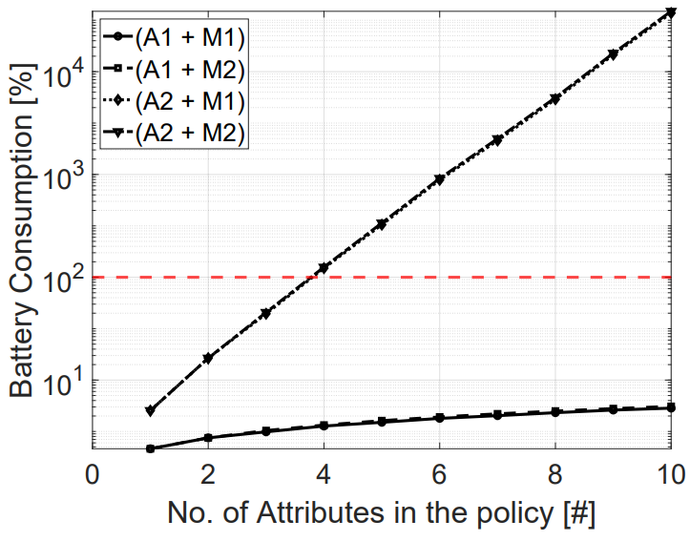
Results

Slide 12
Ref:
Sciancalepore, Savio & Zannone, Nicola. (2022). PICO: Privacy-Preserving Access Control in IoT Scenarios through Incomplete Information. 10.1145/3477314.3508379.

